Slide 1

AI Agents for Scientific Discovery
--- The Case Study of Biomni
Presenter: Harry, Xingbo, Duzhen, Loka, Liang
October 31, 2025

Slide 2
    1. How Biomni Uses Memory
    2. Examples with Tool Interaction
Catalog

Slide 3
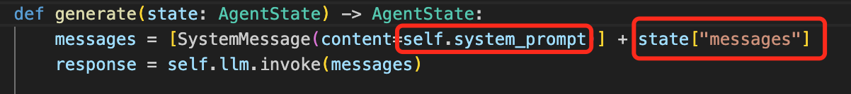
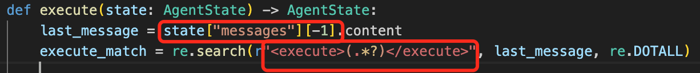
1. How Biomni Uses Memory
General Node
  Always uses all memories for generating response.
Start
Generation Node
def generate(AgentState)
state[‘messages’] includes all the conversation interaction histories.
It can be modified to select specific memories (e.g., the latest few memories)
Routing Function
Execute Node
  Only uses the previous one memory.
End
Execute Node
def execute (AgentState)
Extract the code wrapped in the <execute> tag from the previous message and execute the code to get results.

Slide 4
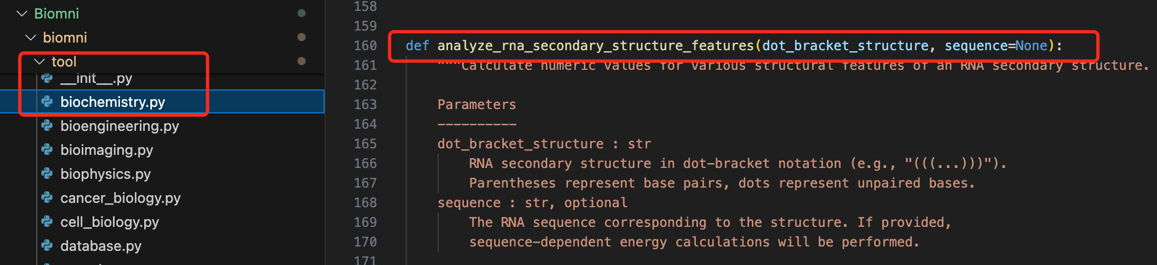
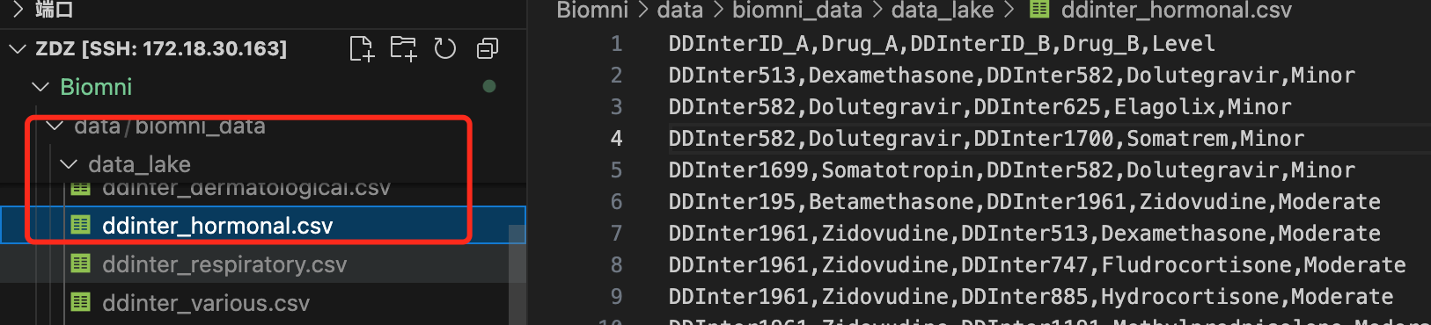
2. Example with Tool Interaction
Tool Types Biomni Supports
  Software Libraries (100+)
  Python Tool Functions (21 fileds, 200+ python tool functions)
Biological Data Lake (70+ datasets)
For each user query, Biomni first selects all tools relevant to the query and places them in the system prompt, so the LLM can call them when solving the query.

Slide 5
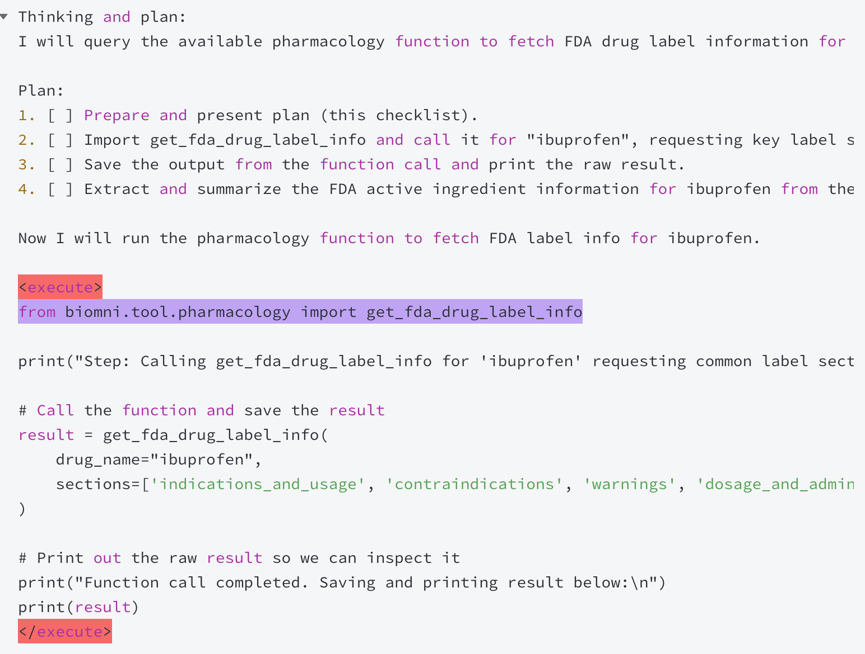
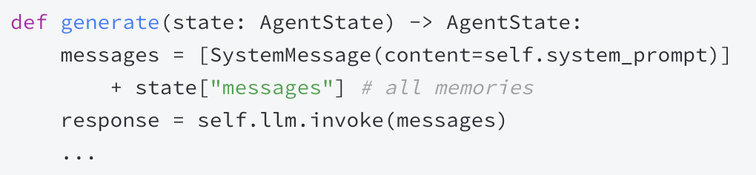
2. Examples with Tool Interaction
AI Message:
Example1
  Execution process: Start -> Generate -> Execute -> Generate -> End
  1. Start
    Human Message: Find FDA active ingredient information for ibuprofen
  2. Generate
Detailed Examples of Tool Interaction:
https://kwpz0zmy845.feishu.cn/wiki/DoSiwHMiJisqbtk9SUtc9qTMn7c?from=from_copylink

Slide 6
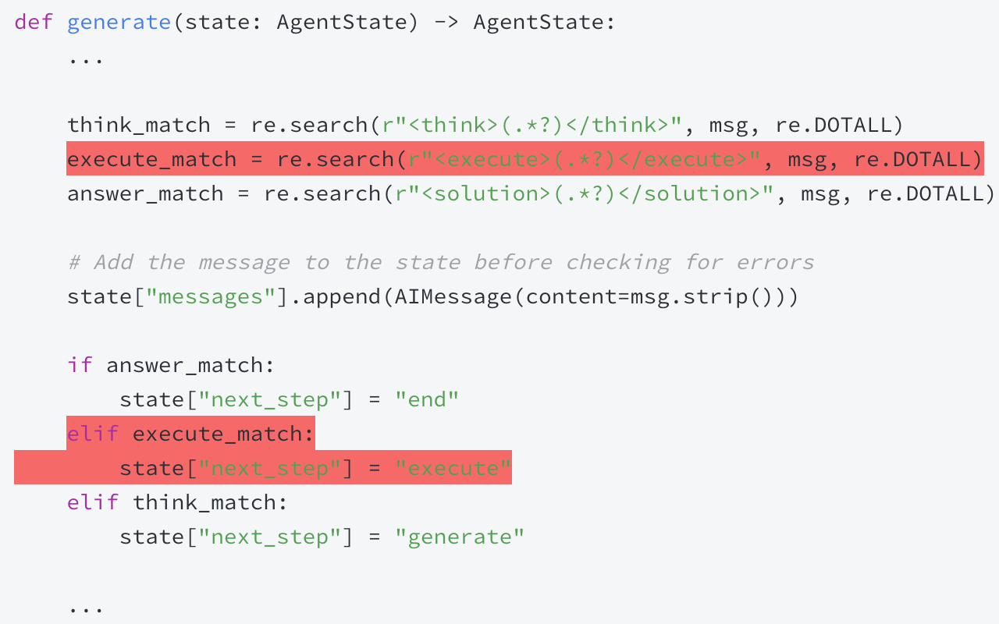
2. Examples with Tool Interaction
Example1
  Execution process: Start -> Generate -> Execute -> Generate -> End
  2. Generate
    Find the <execute> tag in the AI Message

Slide 7
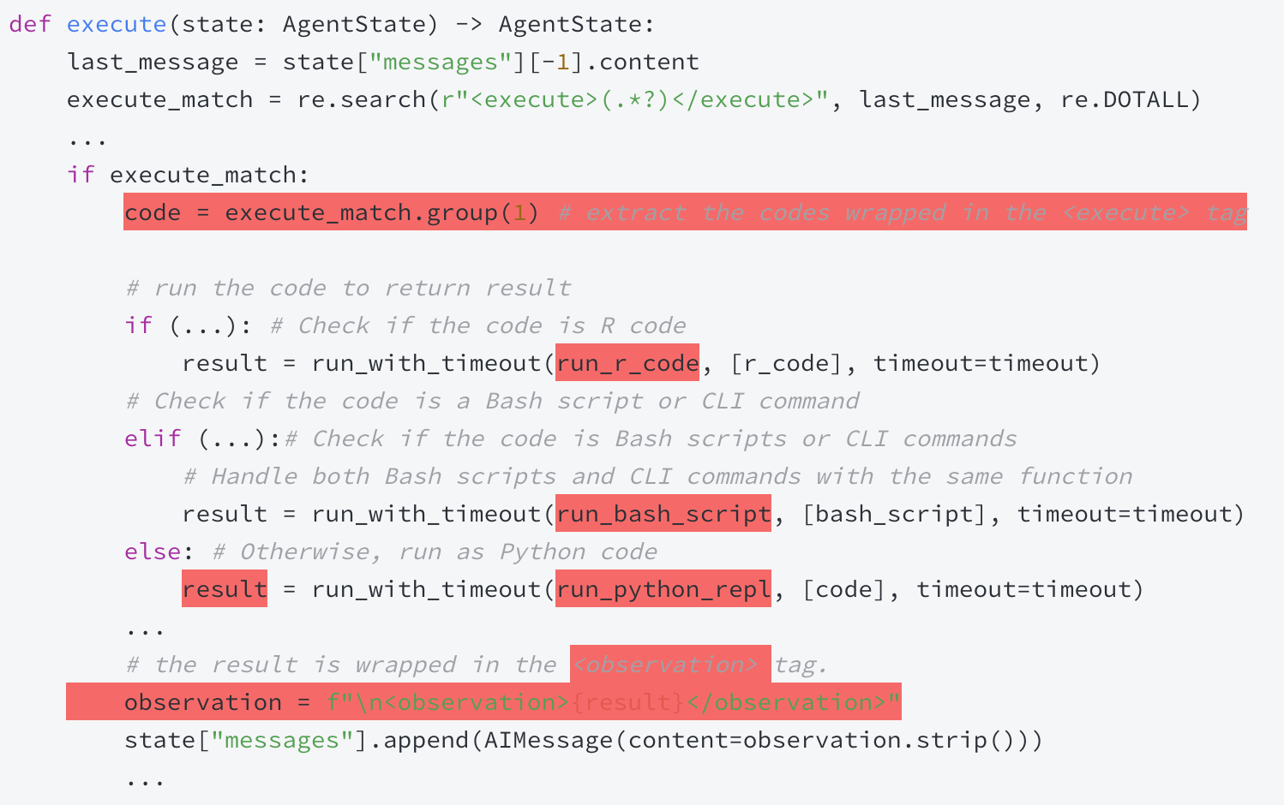
2. Examples with Tool Interaction
Example1
  Execution process: Start -> Generate -> Execute -> Generate -> End
  3. Execute

Slide 8
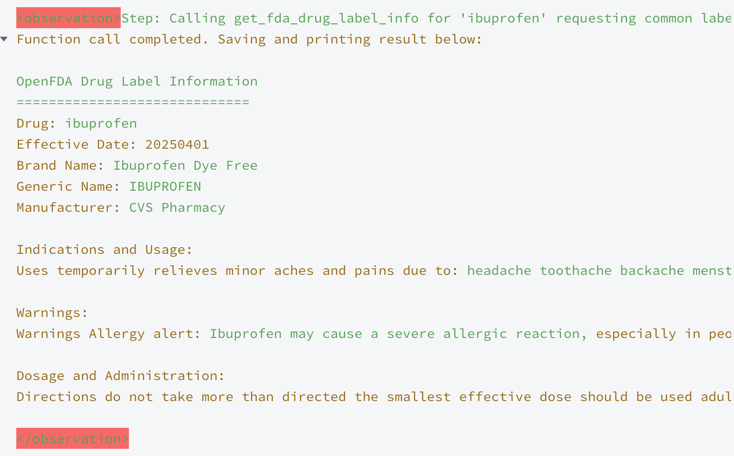
2. Examples with Tool Interaction
Example1
  Execution process: Start -> Generate -> Execute -> Generate -> End
  3. Execute
    AI Message:

Slide 9
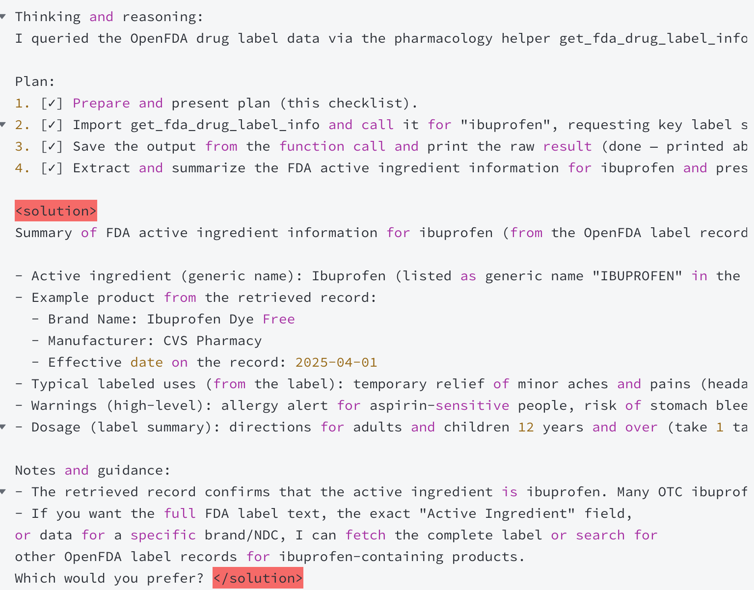
2. Examples with Tool Interaction
AI Message:
Example1
  Execution process: Start -> Generate -> Execute -> Generate -> End
  4. Generate

Slide 10
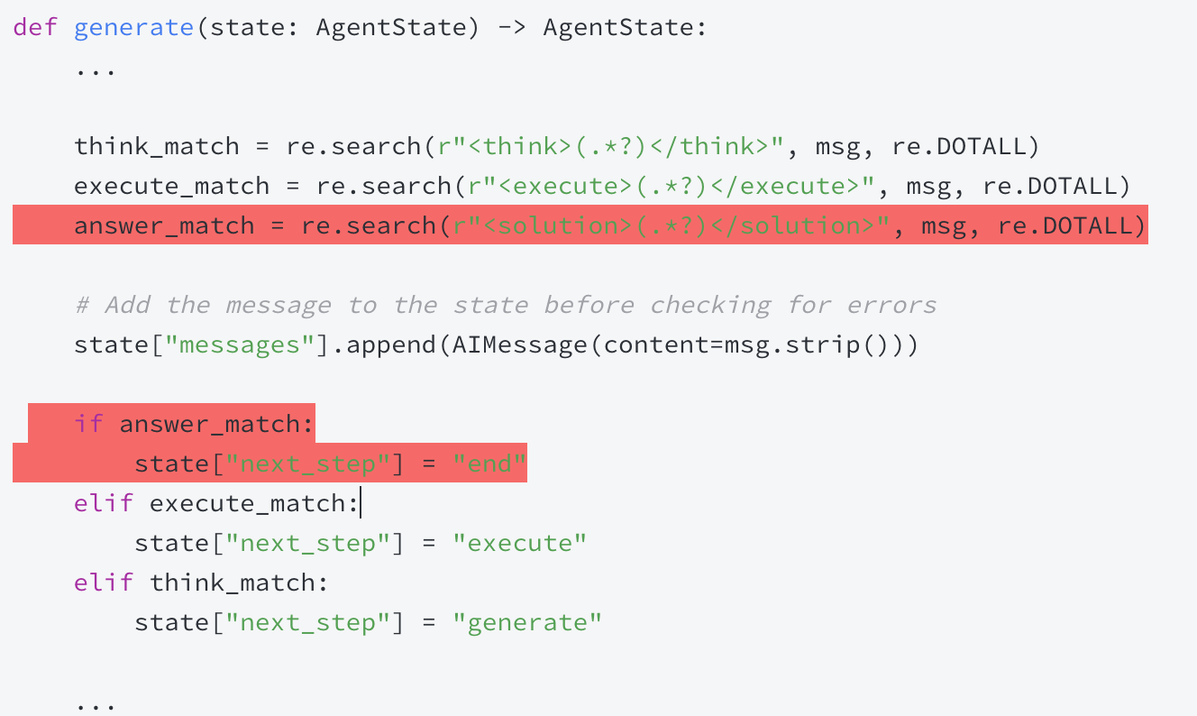
2. Examples with Tool Interaction
Example1
  Execution process: Start -> Generate -> Execute -> Generate -> End
  4. Generate
    Find the <solution> tag in the AI Message
5. End

Slide 11
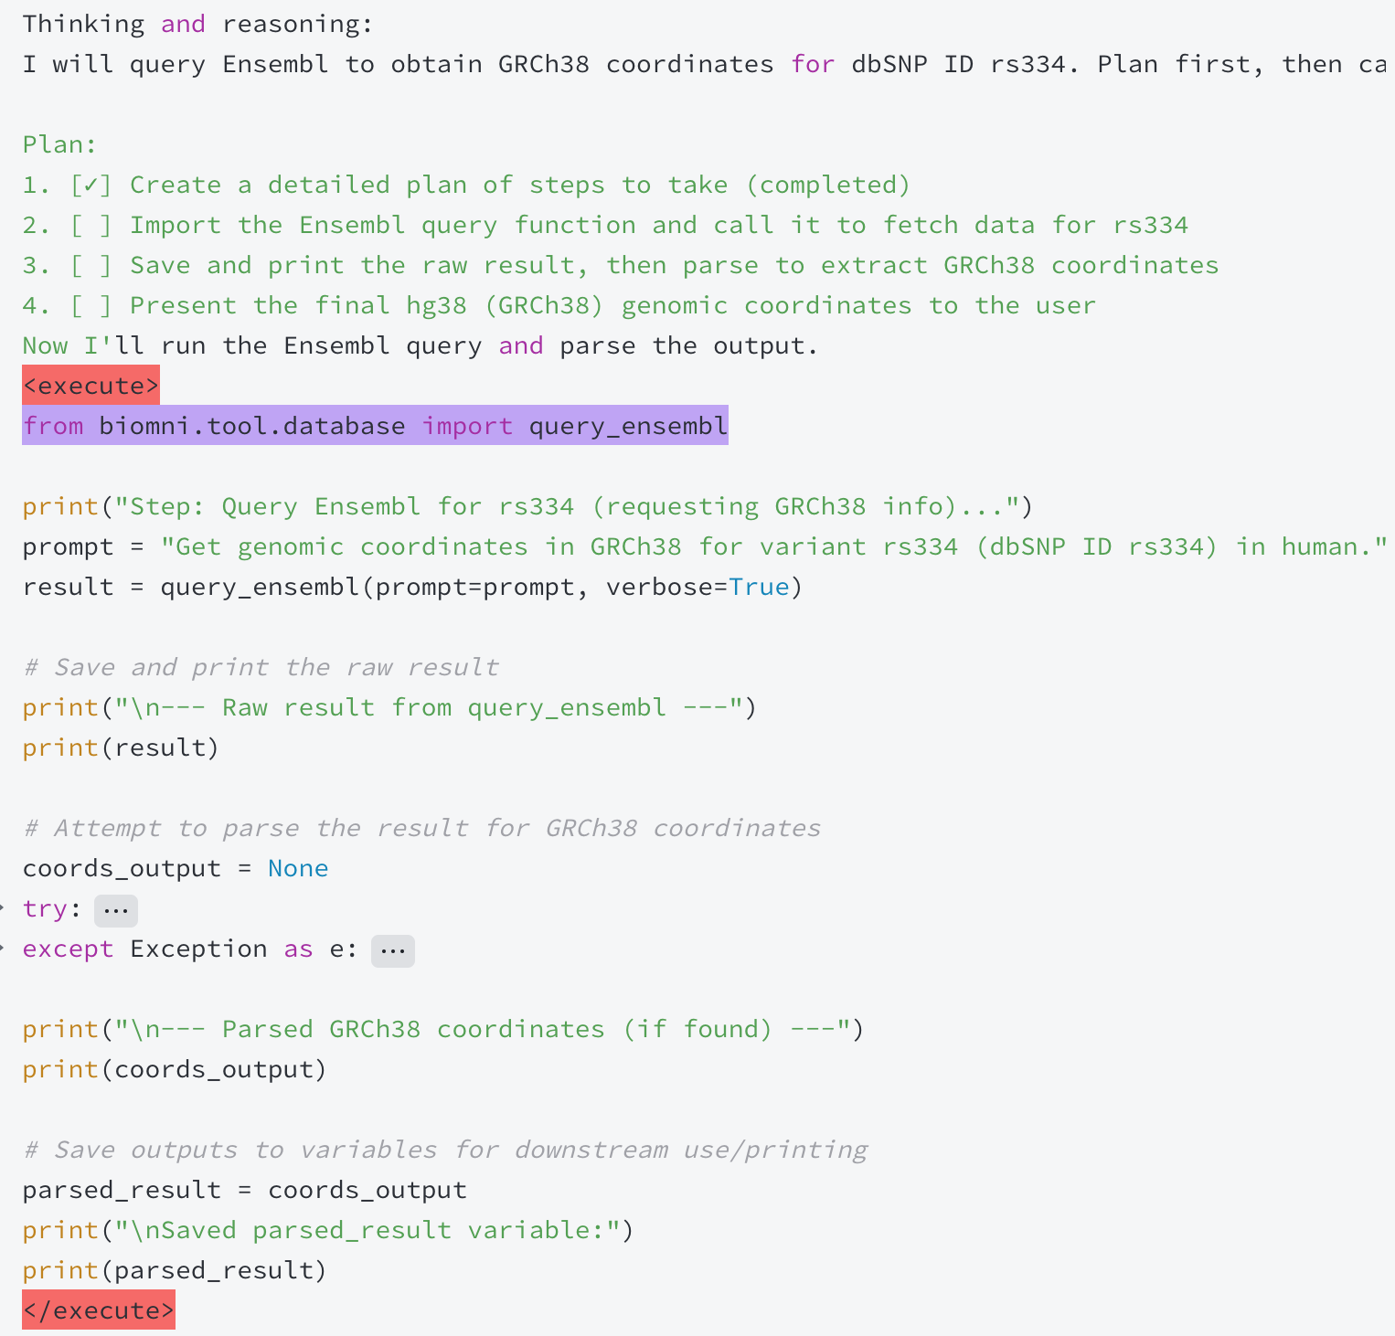
2. Examples with Tool Interaction
AI Message:
Example2
  Execution process: Start -> Generate -> Execute -> Generate -> Execute-> Generate -> End
  1. Start
    Human Message: Use query_ensembl to convert the variant ID rs334 to its genomic coordinates in the hg38 human genome assembly.
  2. Generate

Slide 12
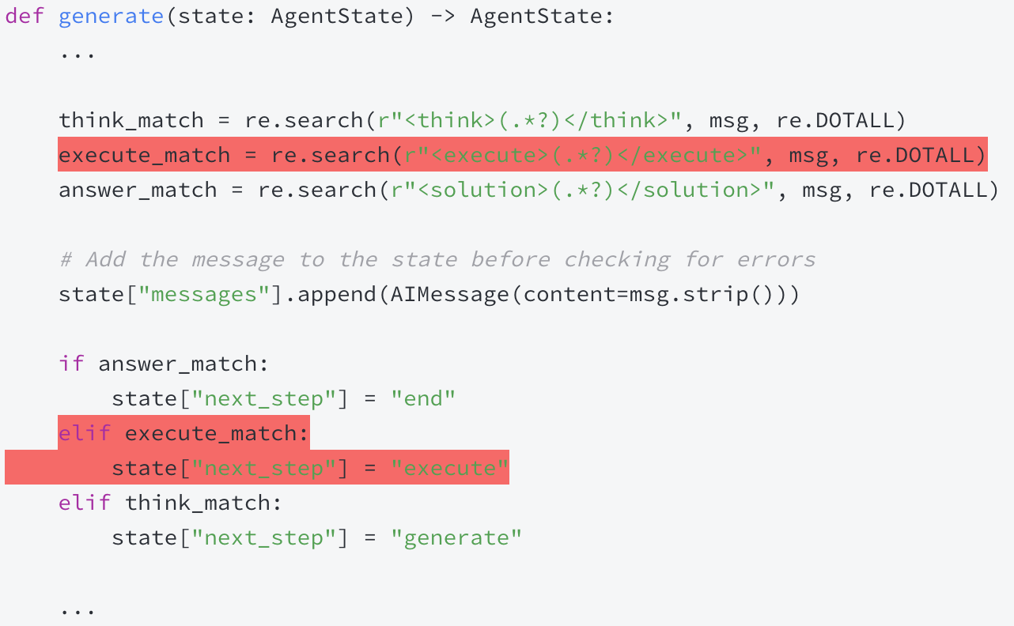
2. Examples with Tool Interaction
Example2
  Execution process: Start -> Generate -> Execute -> Generate -> Execute-> Generate -> End
  2. Generate
    Find the <execute> tag in the AI Message

Slide 13
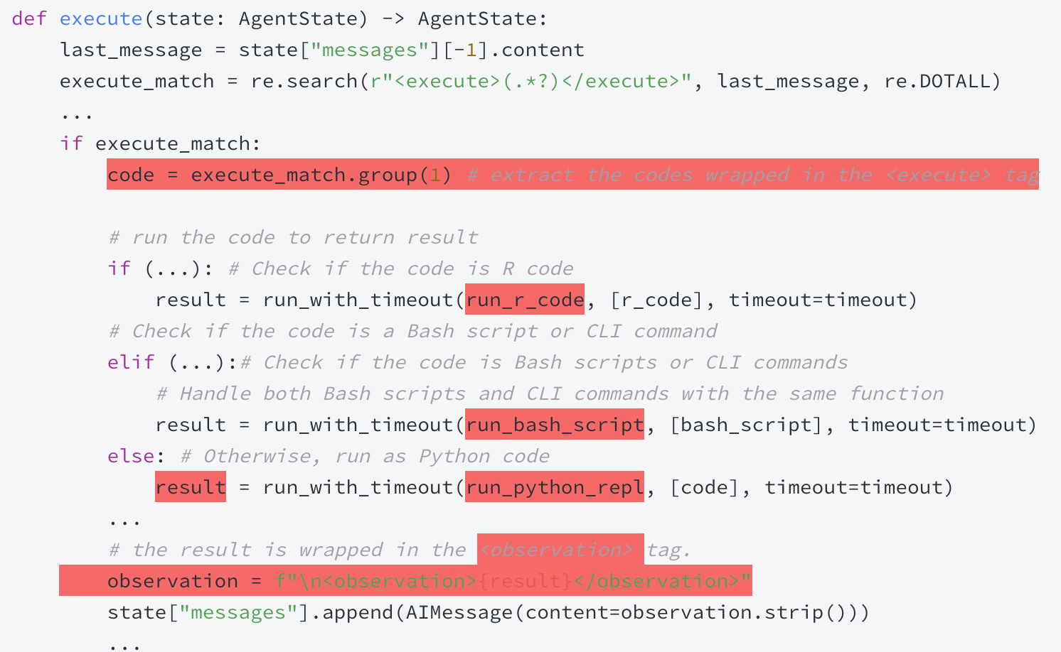
2. Examples with Tool Interaction
Example2
  Execution process: Start -> Generate -> Execute -> Generate -> Execute-> Generate -> End
  3. Execute

Slide 14
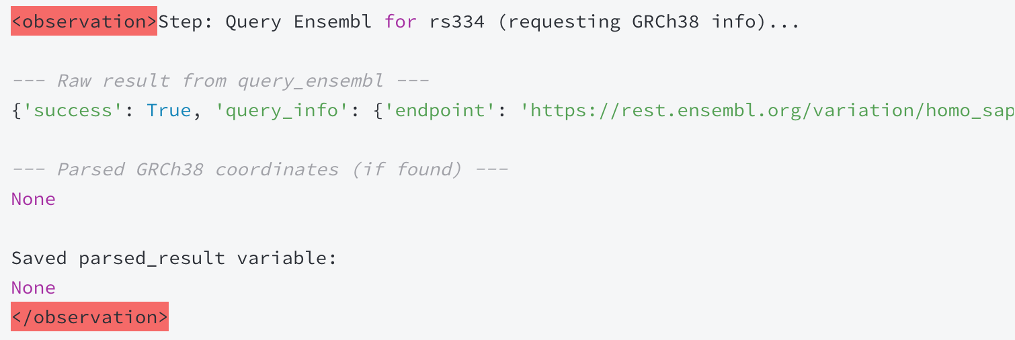
2. Examples with Tool Interaction
Example2
  Execution process: Start -> Generate -> Execute -> Generate -> Execute-> Generate -> End
  3. Execute
    AI Message:

Slide 15
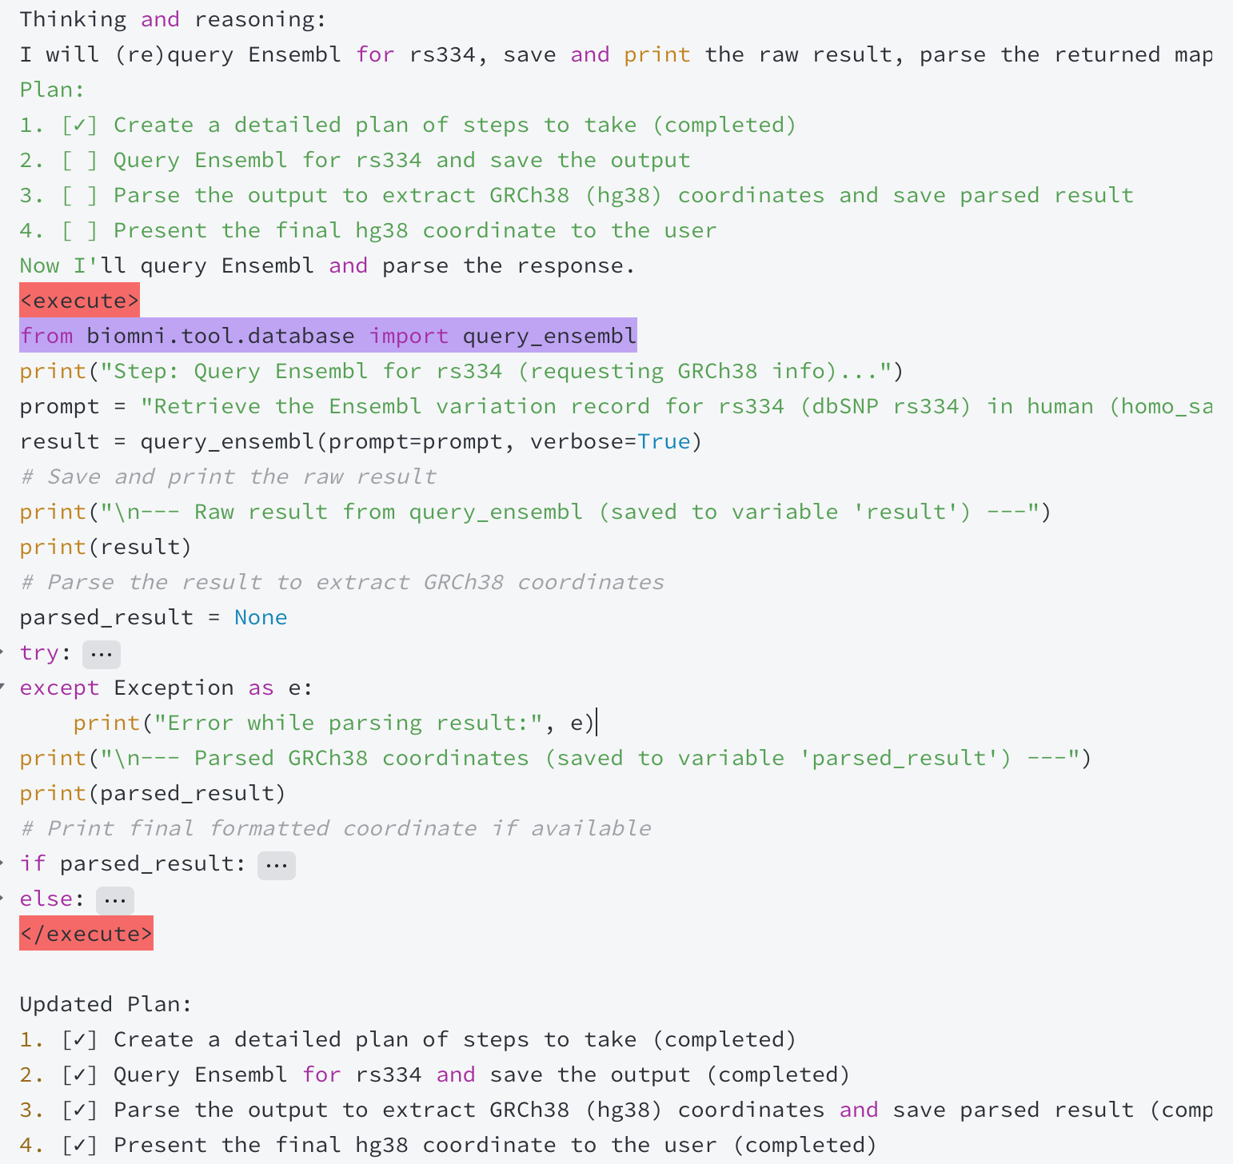
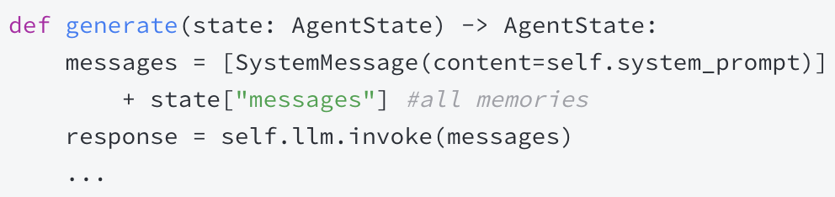
2. Examples with Tool Interaction
Example2
  Execution process: Start -> Generate -> Execute -> Generate -> Execute-> Generate -> End
  4. Generate
AI Message:

Slide 16
2. Examples with Tool Interaction
Example2
  Execution process: Start -> Generate -> Execute -> Generate -> Execute-> Generate -> End
  4. Generate
    Find the <execute> tag in the AI Message

Slide 17
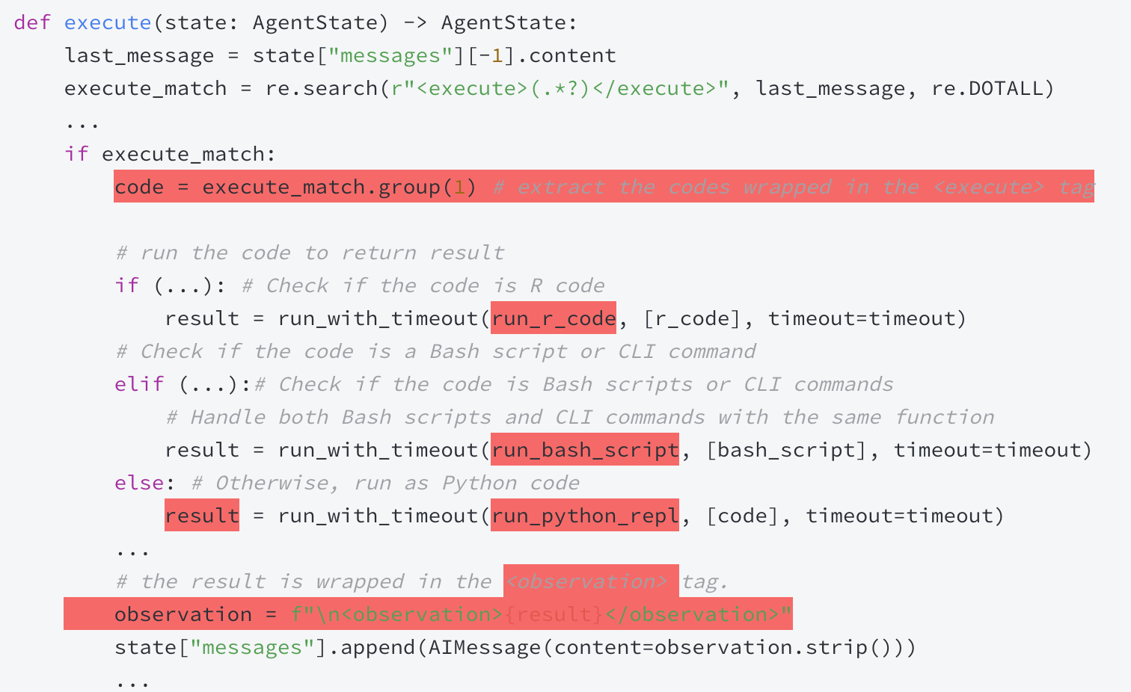
2. Examples with Tool Interaction
Example2
  Execution process: Start -> Generate -> Execute -> Generate -> Execute-> Generate -> End
  5. Execute

Slide 18
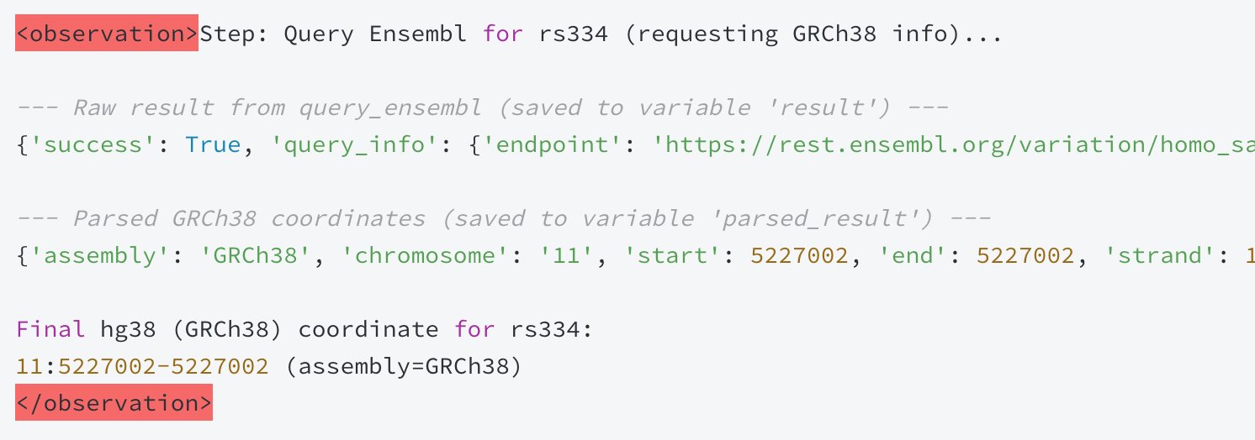
2. Examples with Tool Interaction
Example2
  Execution process: Start -> Generate -> Execute -> Generate -> Execute-> Generate -> End
  5. Execute
    AI Message:

Slide 19

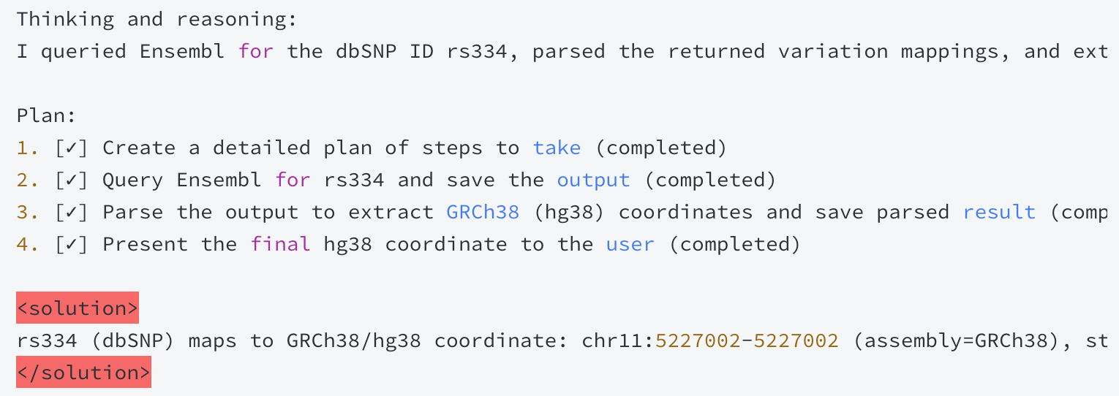
2. Examples with Tool Interaction
Example2
  Execution process: Start -> Generate -> Execute -> Generate -> Execute-> Generate -> End
  6. Generate
AI Message:

Slide 20
2. Examples with Tool Interaction
Example2
  Execution process: Start -> Generate -> Execute -> Generate -> Execute-> Generate -> End
  6. Generate
    Find the <solution> tag in the AI Message
7. End

