Slide 1

AI Agents for Scientific Discovery
--- LLM Agents for Automated Code
Presenter: Duzhen, Xingbo, Harry, Loka, Liang
November 07, 2025

Slide 2
    1. AlphaEvolve
    2. LLM+Tree Search System
    3. Design Our Own Model
Catalog

Slide 3
1. AlphaEvolve: Background & Motivation
Research Context
  LLM have shown strong capabilities in code generation. Yet, most systems are limited to evolving short code snippets, lack scalability, and cannot autonomously produce novel algorithms.
Key Challenge
  Enabling an AI system to autonomously design and improve algorithms, not just reproduce human-written ones, across complex tasks.
Motivation
  Automating scientific and algorithmic discovery could accelerate innovation in both science and computational infrastructure (e.g., optimization, scheduling, numerical methods).
Problem Statement
  How can we create an autonomous LLM-based coding agent that can iteratively modify, evaluate, and evolve code to generate new, provably correct, and efficient algorithms?
Novikov, Alexander, et al. "AlphaEvolve: A coding agent for scientific and algorithmic discovery." arXiv preprint arXiv:2506.13131 (2025).

Slide 4
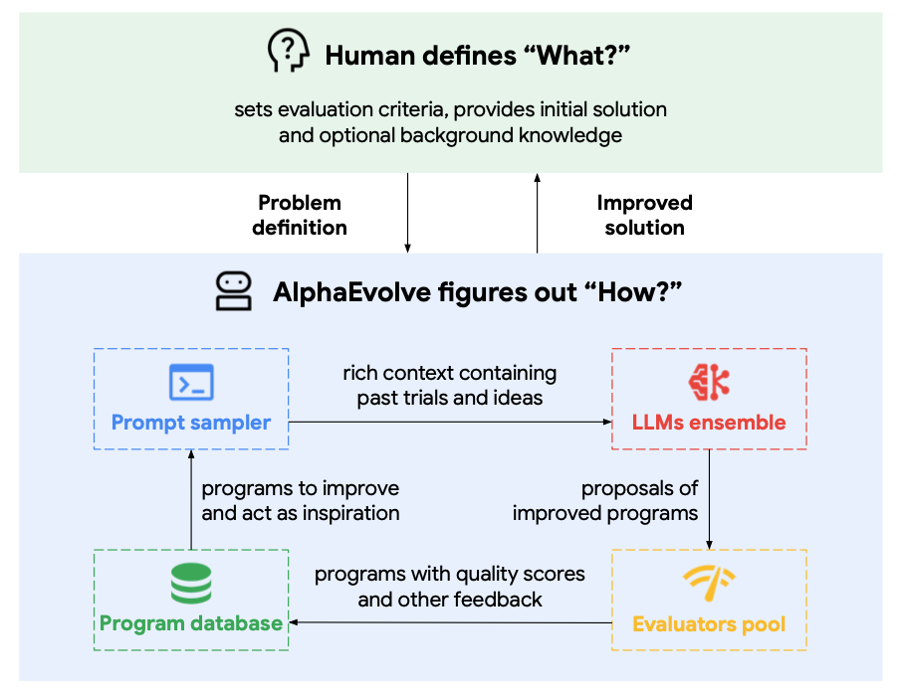
1. AlphaEvolve: Core Method
Overview
  AlphaEvolve is an LLM-guided evolutionary coding agent that autonomously writes and optimizes code. It evolves entire codebases (hundreds of lines) rather than isolated functions.
Human defines “What?”
  Start by describing what needs to be solved.
AlphaEvolve figures out “How?”
  Explore, modify, and evolve the code to make it perform better.
  Include several interconnected modules: Prompt Sampler, LLMs Ensemble, Evaluators Pool, and Program Databases.
Novikov, Alexander, et al. "AlphaEvolve: A coding agent for scientific and algorithmic discovery." arXiv preprint arXiv:2506.13131 (2025).

Slide 5
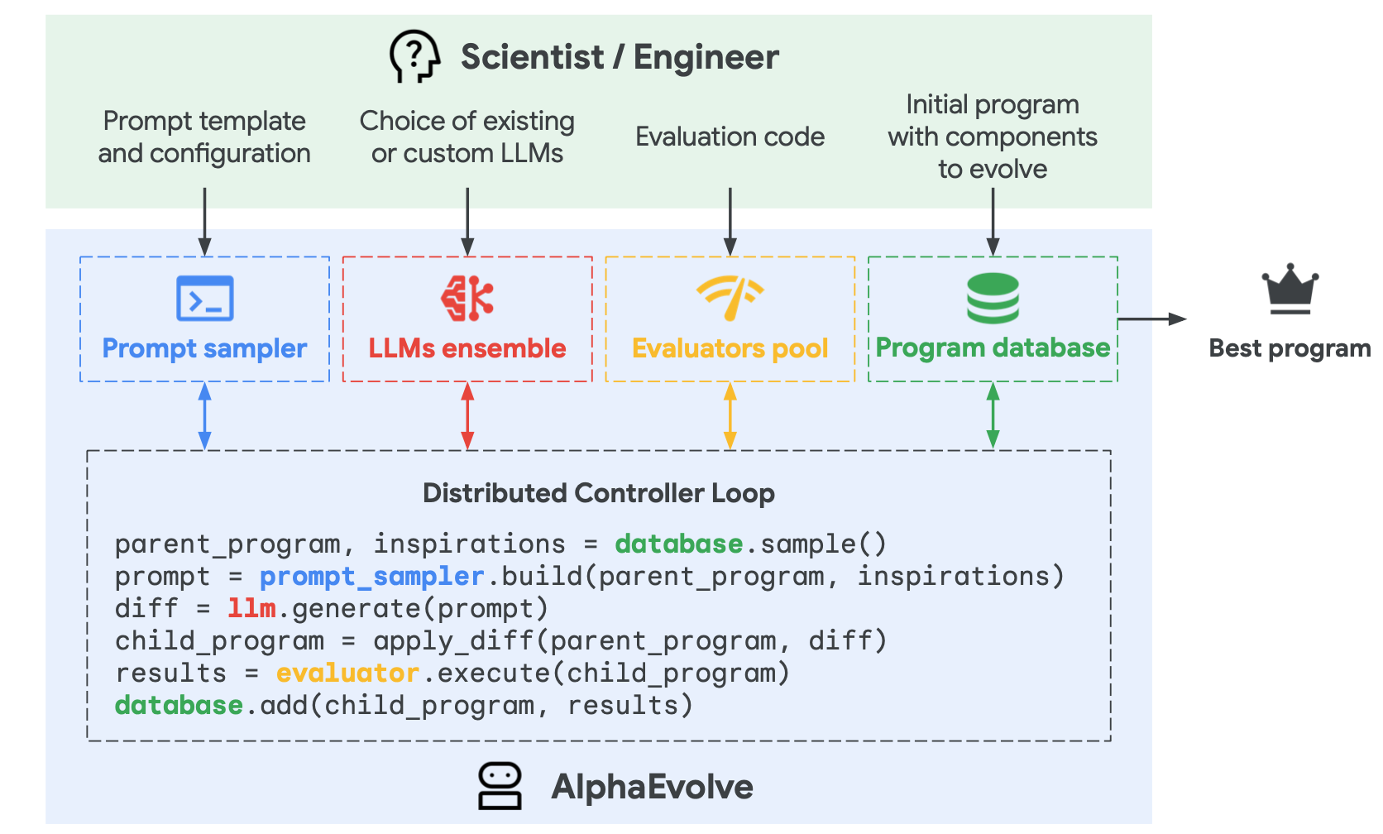
1. AlphaEvolve: Core Method
Workflow
Task Definition
Prompt Sampler
Code Generation
Select
Evaluation
Store
Program Database
Novikov, Alexander, et al. "AlphaEvolve: A coding agent for scientific and algorithmic discovery." arXiv preprint arXiv:2506.13131 (2025).

Slide 6
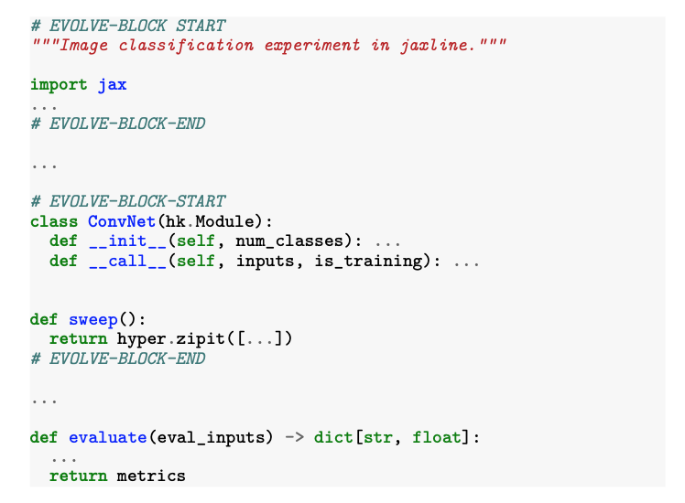
1. AlphaEvolve: Core Method
Example
  Human defines the task & eval
    An initial program with EVOLVE-BLOCK markers showing what the agent may rewrite.
    An evaluate() function that returns scalar metrics (the “score” AlphaEvolve must improve).
    In the right Figure, both appear inline: blocks marked #EVOLVE-BLOCK-START/END and an evaluate(...)->dict[str,float] function the evaluators call.
Novikov, Alexander, et al. "AlphaEvolve: A coding agent for scientific and algorithmic discovery." arXiv preprint arXiv:2506.13131 (2025).

Slide 7
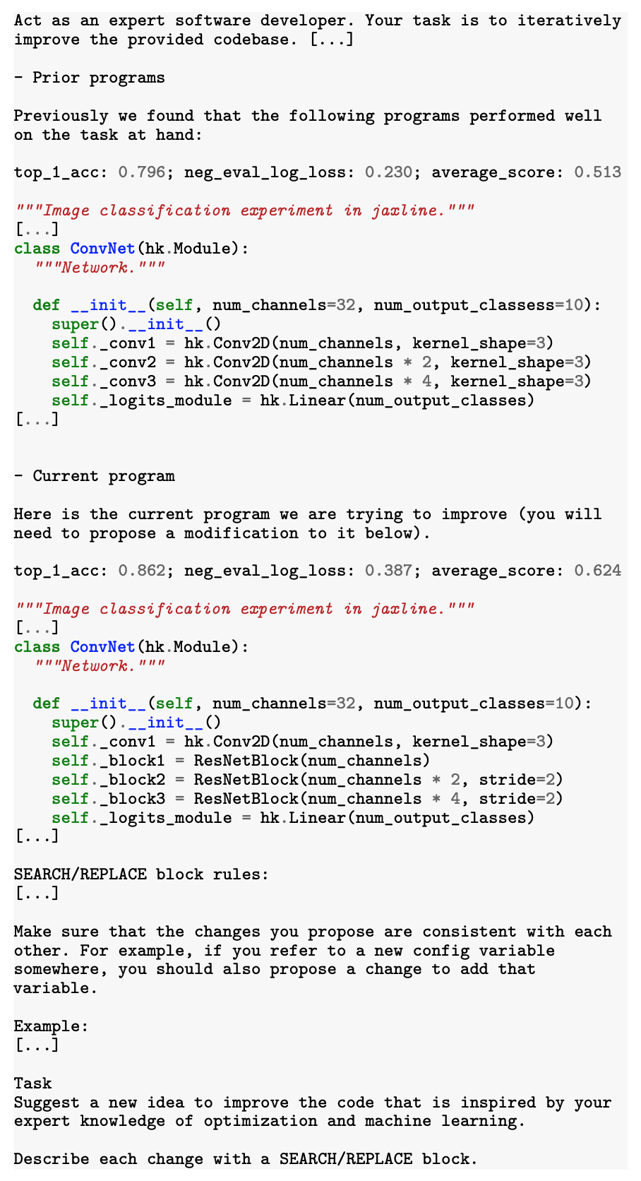
1. AlphaEvolve: Core Method
Example
  Prompt is assembled with rich context.
    Prior high-scoring programs and their metric lines.
    The current program to improve.
    Clear system instructions on how to output diffs (SEARCH/REPLACE format).
    This figure shows exactly that structure (prior programs + current program + task + rules).
Novikov, Alexander, et al. "AlphaEvolve: A coding agent for scientific and algorithmic discovery." arXiv preprint arXiv:2506.13131 (2025).

Slide 8
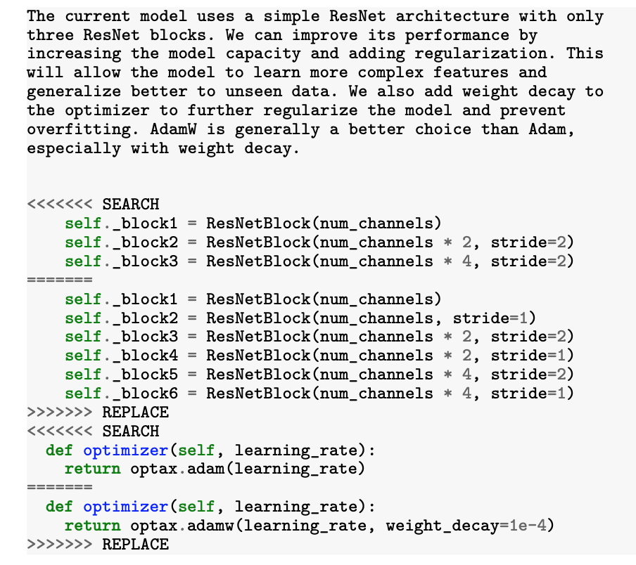
1. AlphaEvolve: Core Method
Example
  LLM ensemble proposes code diffs.
    Change optimizer (Adam → AdamW),
    Modify architecture (e.g., add blocks),
    Wire up new hyperparams consistently.
    …
  The right figure shows concrete SEARCH/REPLACE edits across optimizer and network blocks.
  Output format for diffs is specified (SEARCH/REPLACE) so code patches apply cleanly in large files.
Novikov, Alexander, et al. "AlphaEvolve: A coding agent for scientific and algorithmic discovery." arXiv preprint arXiv:2506.13131 (2025).

Slide 9
1. AlphaEvolve: Core Method
Example
  Automatic evaluation.
    Each child program is executed and scored by the evaluation function.
  Selection & Storage.
    AlphaEvolve stores scored solutions in a program database and resurfaces promising or diverse ones in future prompts.
    The archive follows Elites-style principles: one elite per niche to balance exploitation (refine the best) and exploration (preserve different strategies).
  Iterate asynchronously
    The distributed pipeline runs many proposals/evals concurrently, letting many generations accumulate improvements quickly.
Novikov, Alexander, et al. "AlphaEvolve: A coding agent for scientific and algorithmic discovery." arXiv preprint arXiv:2506.13131 (2025).

Slide 10
2. LLM+Tree Search System: Background & Motivation
Research Question
  How can we automate the creation of scientific software, code that implements empirical models or algorithms optimized for a measurable objective, using AI?
Why It Matters:
  Nearly every modern scientific field (physics, biology, epidemiology, neuroscience, geospatial analysis, etc.) depends on specialized empirical software.
  However, such code is slow and expensive to develop—it can take years of expert effort and iterative trial-and-error.
  As science advances faster than human coding capacity, automated software discovery could accelerate innovation across disciplines.
Aygün, Eser, et al. "An AI system to help scientists write expert-level empirical software." arXiv preprint arXiv:2509.06503 (2025).

Slide 11
2. LLM+Tree Search System: Background & Motivation
Existing Approaches
  Genetic Programming: evolves code but through random mutations, lacks semantic understanding.
  AutoML: automates ML pipeline tuning, but only within predefined templates.
  LLMs (e.g., Codex, AlphaCode): can write code but in one-shot, without iterative self-improvement.
Limitations
  No existing system combines deep contextual reasoning (LLM) with systematic search and evaluation (Tree Search).
  Existing LLMs generate runnable code but cannot autonomously optimize or discover algorithms that outperform human experts.
Core Idea
  The authors hypothesize that combining LLM-based code mutation with Tree Search (TS) guided by a quantitative evaluation metric can autonomously evolve expert-level scientific software across diverse domains.
Aygün, Eser, et al. "An AI system to help scientists write expert-level empirical software." arXiv preprint arXiv:2509.06503 (2025).

Slide 12
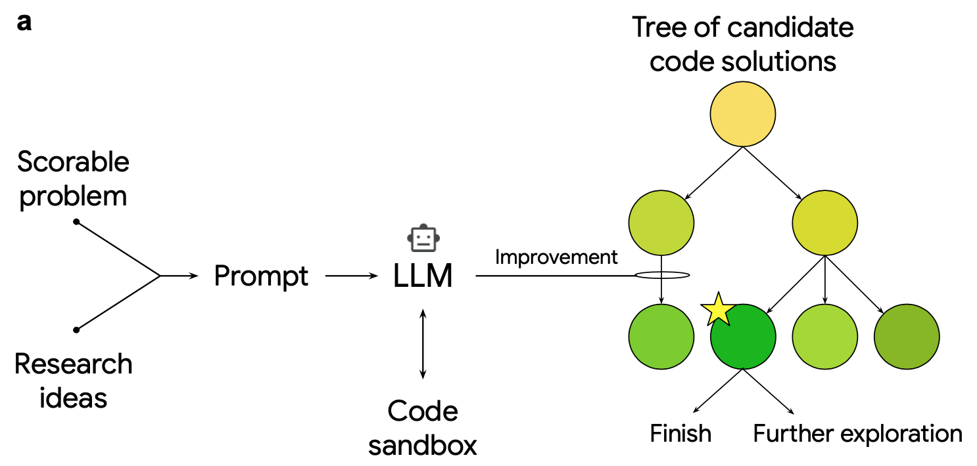
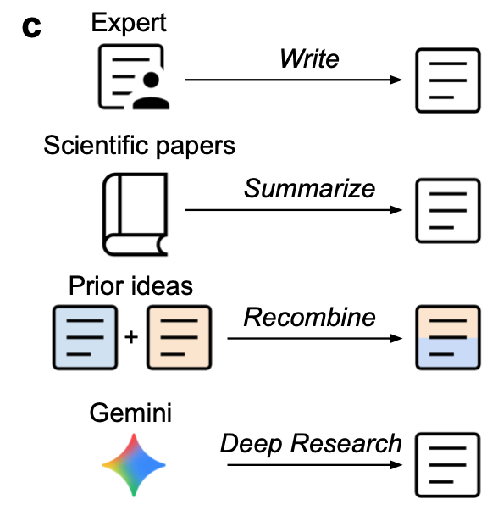
2. LLM+Tree Search System: Core Method
System Overview
Aygün, Eser, et al. "An AI system to help scientists write expert-level empirical software." arXiv preprint arXiv:2509.06503 (2025).

Slide 13
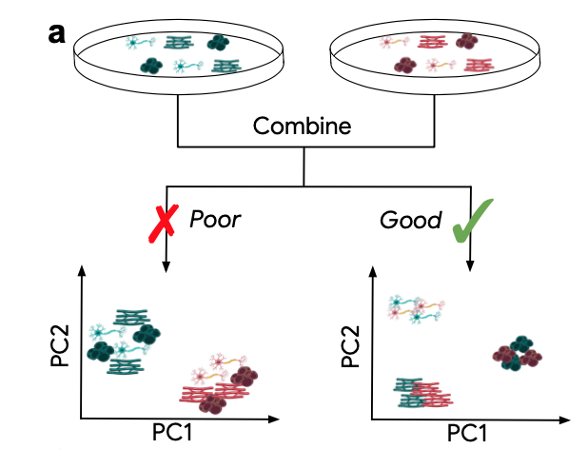
2. LLM+Tree Search System: Core Method
Example: scRNA-seq batch integration
  Step 1. Define a scorable problem
    A scorable task is formulated, in genomics, the batch integration of single-cell RNA-seq datasets, where the goal is to remove “batch effects” while preserving biological variation.
    The task comes with a quantitative metric that can be used to evaluate any piece of code written to solve it.
  Step2. Gather or inject research ideas
    The system collects relevant scientific ideas from literature, textbooks, or prior methods (for example, existing algorithms like ComBat or BBKNN for batch correction).
    These are summarized and injected into the LLM prompt to guide the model’s code generation.
Aygün, Eser, et al. "An AI system to help scientists write expert-level empirical software." arXiv preprint arXiv:2509.06503 (2025).

Slide 14
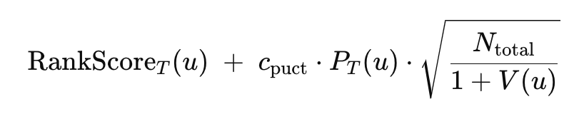
2. LLM+Tree Search System: Core Method
Example: scRNA-seq batch integration
  Step 3. LLM writes code (first generation)
    The LLM receives the task description, the evaluation metric, and the research ideas as a prompt.
    It outputs a Python code candidate, which is executed in a sandbox to compute its quality score (root node).
  Step4. Evaluate and expand via Tree Search
    4.1. Pick which code version (node) to try next
      At any moment you have a tree of code versions (each node = a runnable script + its score).
      The algorithm scores every node with a selection formula that balances Exploit (rank score) and Explore (visit count).
      Formally, we select the node u that maximizes:
Aygün, Eser, et al. "An AI system to help scientists write expert-level empirical software." arXiv preprint arXiv:2509.06503 (2025).

Slide 15
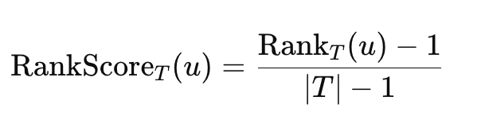
2. LLM+Tree Search System: Core Method
Example: scRNA-seq batch integration
  Step4. Evaluate and expand via Tree Search
    4.2. Expand the chosen node (have the LLM rewrite the code)
      Prompt the LLM to rewrite u’s code.
      Run the new code safely in a sandbox and get a TaskScore.
      Add the resulting child node u_c​ to the tree with its score and set V(u_c)=1.
    4.3 Score normalization
      Because different tasks/metrics have different scales, the raw TaskScore(u) is converted to a 0–1 rank inside the tree:
4.4 Back-propagate visits
  After adding u_c​, increment visit counts for all ancestors of u_c​.
  This raises the “confidence” on paths you’ve already tried, reducing over-exploration there in future selections.
Aygün, Eser, et al. "An AI system to help scientists write expert-level empirical software." arXiv preprint arXiv:2509.06503 (2025).

Slide 16
2. LLM+Tree Search System: Core Method
Example: scRNA-seq batch integration
  Step4. Evaluate and expand via Tree Search
    4.5. Repeat until budget is used, then return the best
      Keep looping: select → expand → score → back-prop.
      Stop at a node budget (e.g., 500 nodes ≈ 7 hours for scRNA-seq).
      Return the highest TaskScore code in the tree; then validate on holdouts.
Aygün, Eser, et al. "An AI system to help scientists write expert-level empirical software." arXiv preprint arXiv:2509.06503 (2025).

Slide 17
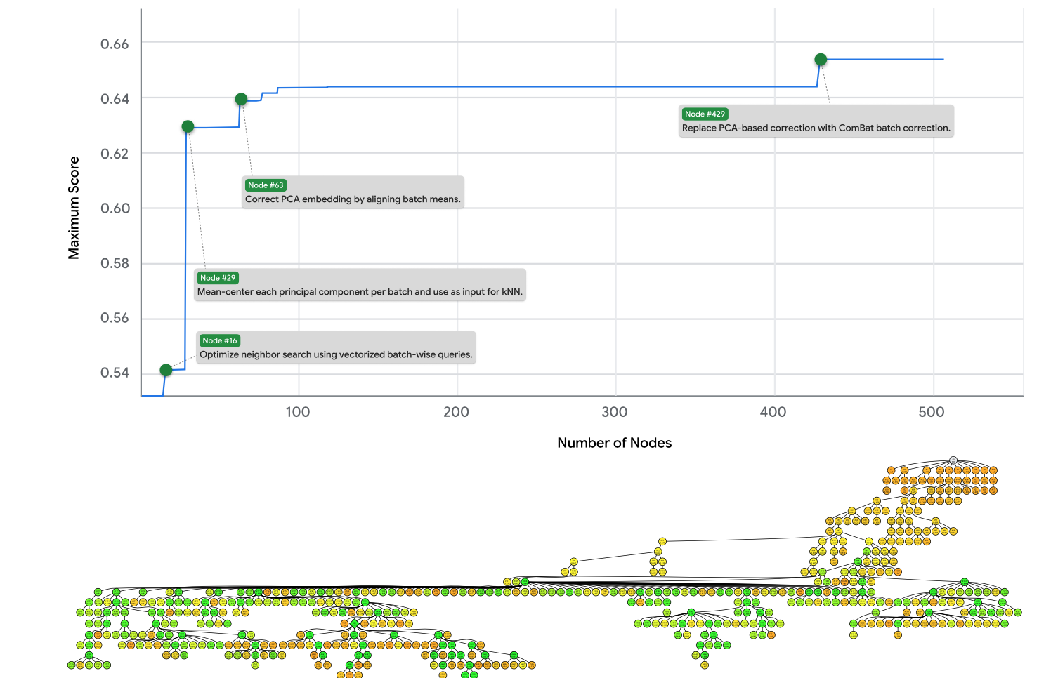
2. LLM+Tree Search System: Core Method
Example: scRNA-seq batch integration
Step5. Example outcome — scRNA-seq Batch Integration
  The system rediscovered and then improved on BBKNN, a leading human-made method.
  It combined BBKNN + ComBat to remove global and local batch effects, an idea not explicitly described in any single paper.
  Manual inspection confirmed that the code was scientifically valid and novel.
  In benchmarks, it outperformed all 15 published methods on 13 metrics across 6 datasets
Aygün, Eser, et al. "An AI system to help scientists write expert-level empirical software." arXiv preprint arXiv:2509.06503 (2025).

Slide 18
3. Design Our Own Model
Extending Capabilities: ML Model Building
  Previous Biomedical Agent (Biomni) focused on reasoning, calling existing software packages, Python functions, and datasets for RAG.
  Lacks ability to automatically generate and train ML / neural network models based on user tasks.
  Goal: enable the system to build, train, optimize, and validate ML models for given datasets.
  Plan:
    Collect biomedical benchmarks (e.g., common datasets).
    Evaluate the agent’s ability to build models that reach or surpass SOTA performance.
    Explore new research on LLM-based code generation for ML.
Organizing Agent Memory
  Design structured memory storage and compression mechanisms.
  Focus on extracting key information and managing long-term memory efficiently.
Multi-Source Integration
  When multiple data sources, tools, or LLMs are involved:
    Develop methods to assign confidence / uncertainty scores.
    Aggregate results from multiple sources reliably.

Slide 19
3. Design Our Own Model: Biomedical Benchmarks
Benchmarks of Molecule Tasks
  Molecular Property Prediction
    MoleculeNet:
      Website: https://moleculenet.org/
      Code: https://github.com/deepchem/deepchem
    Geom3D
      Code: https://github.com/chao1224/Geom3D
  Molecular Generation Benchmark
    CBGBench: The Benchmark of Structure-based Drug Design (SBDD) .
      Code: https://github.com/EDAPINENUT/CBGBench
Benchmarks of Protein Tasks
  Protein Property Prediction and Targeting Fitness Prediction
    TAPE
      Code: https://github.com/songlab-cal/tape
    Geom3D:
      Code: https://github.com/chao1224/Geom3D
  Protein Foundation Model Benchmark
    PFMBencn
      Code: https://github.com/biomap-research/PFMBench

Slide 20
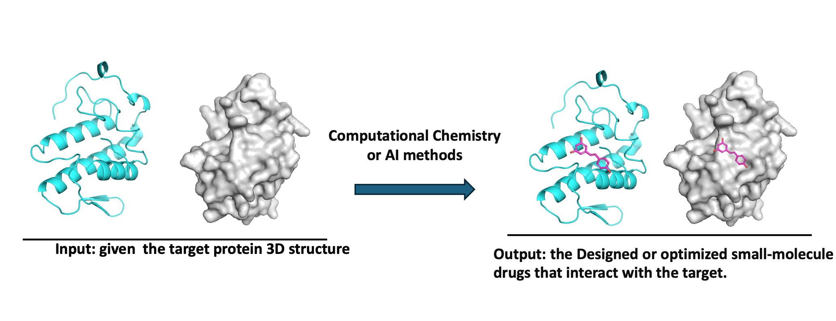
3. Design Our Own Model: Biomedical Benchmarks
Structure-based Drug Design (SBDD)

