Slide 1

Intro to GEOG 472/572: Geovisual Analytics
GEOG 472/572: Geovisual Analytics
TR 1100 -1150 @ WITH 205
Bo Zhao
Oregon State University

Slide 2
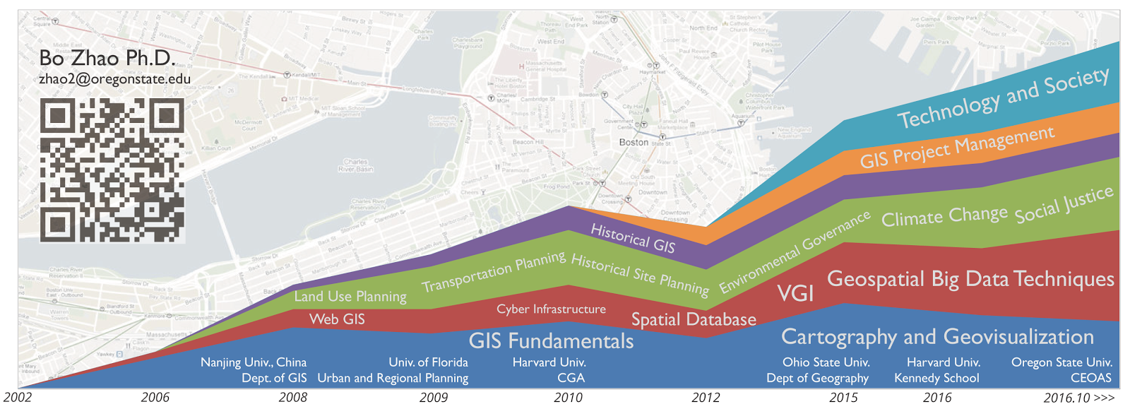

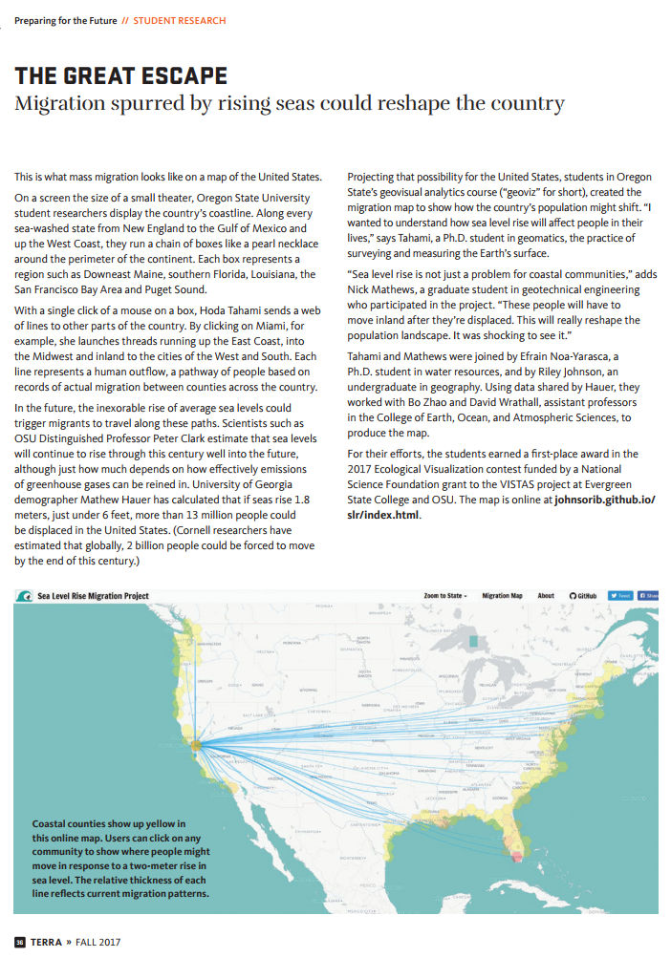
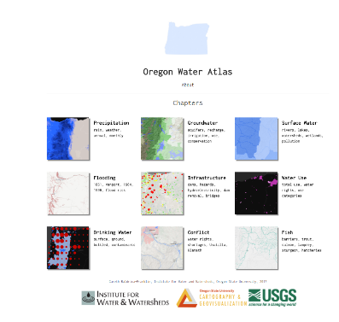
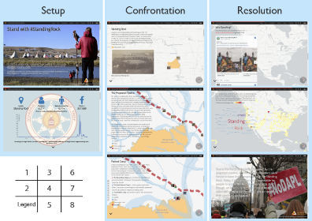

Teaching
GEOG 370 - WT: Cartography
GEOG 371 - FL: Web Mapping
GEOG 4/572 - SP: Geovisual Analytics
GEOG 571 - FL: Web Mapping
Research Triangle
Previous collaboration with students
Location based social media
Spatiality
Who speaks for Climate Change in China (Liu and Zhao, 2017)
Environment
Fake News, Food Desert, etc.
Representation
Storytelling with interactive map
Computation
Deep Learning

Slide 3
Now, why are you here …?
So, why study Cartography?
Notes:
Now is your turn.

Slide 4
Instructor: | Bo Zhao, zhao2@oregonstate.edu
 | Office Hours: 1500-1600 T or by appointment @ Strand 347A
TA: | Jared Ritchey, ritcheja@oregonstate.edu
 | Office Hours: TBD
Text: | No required text. Required papers and online materials is available on the course website, and recommended books are reserved at the Valley library.
Credits: | 3
Meeting: | Lecture: TR 1100 - 1150 @WITH 205; Lab: T 1800 - 1950 @Wilkinson 210
Prerequisites: | GEOG 370 or GEOG 371
Grades: | Letter grading (A to F)
Notes:
To be short,

Slide 5

Recommended Book
Slocum, T.A., McMaster, R.B., Kessler, F.C. and Howard, H.H., 2009. Thematic cartography and geovisualization.
Web Site: https://media.pearsoncmg.com/bc/abp/slocum3e/

Slide 6
Course Schedule
WK | LECTURE (T) | LAB (T) | LECTURE(R) | PROJECT
Wk 1 | Intro to this course | Lab1: Project Management for GeoViz | GeoViz Fundamentals | Introduction
Wk 2 | Brainstorms | GeoViz Programming Fundamentals Lab2: Web programming | Interactive Maps using Leaflet | Team-up
Wk 3 | Recap + D3 I | Lab3: Map Design | Spatial data Processing | Proposal
Wk 4 | D3 II | Lab3 cont’d Google Cloud Platform | D3 III | Proposal revision
Wk 5 | Layout Design using Bootstrap, GeoViz evaluation | Lab4: Geoviz Module | Color, Topography | Sketch, Interface Design
Wk 6 | SVG, Icons | Lab5: Geoviz Interaction, or Storymap | Word cloud | Design Scheme (Color, label, icon, and multimedia, etc.)
Wk 7 | Real-time mapping, Heatmap | Fieldwork for Drone Mapping | GeoViz Critique | Coding
Wk 8 | Geoviz of Structure-from-motion | Lab6: Point-cloud GeoViz | Hexagonal Geoviz | Coding
Wk 9 | Network | Lab6: cont’d | Flow maps, Sankeys | Fine-tuning
Wk 10 | Course Summary | Project Q&A | Final Presentation | Presentation

Slide 7
Grading
Item | Description | % of Final Grade
 |  | GEOG 472 | GEOG 572
Participation | Most classes have time allotted for discussions, in-class work and other activities. | 5 | 5
Quizzes | 8 in-class or take-home quizzes covering topics from lecture and reading assignments. | 25 | 20
Labs | 2 lab assignments (15% each). We understand that many of the programming techniques discussed early in the course will be relatively new. Recognizing this, the first few assignments will contain more detailed instructions. | 35 | 30
Project Development | Each student is expected to make concrete contribute to one major component of the final project. It could be the proposal, the about page, icon, color scheme, font scheme, sketch or etc. | 20 | 20
Project | Each student is required to collaboratively develop a final project using geovisual analytics. Each project should be no more than three members. Graduate students are encouraged to be the group leader or the project coordinator, and undergraduate students are encouraged to be a principle group member. Each group will make a presentation to demonstrate their work. This final project is mainly evaluated by both the presentation and the quality of the geovisual application. | 15 | 25
TOTAL |  | 100

Slide 8
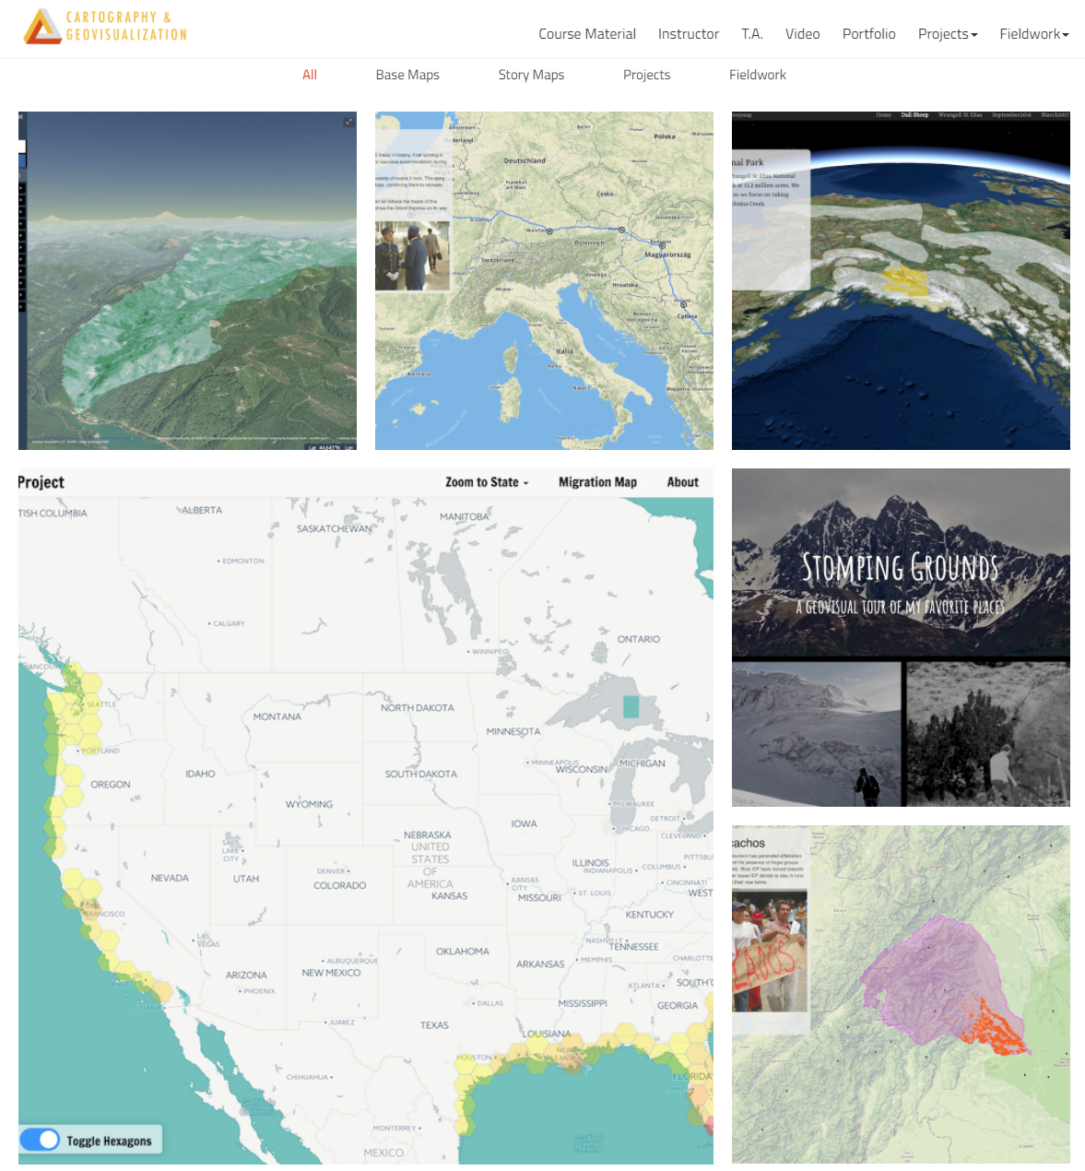
Previous Year

Slide 9
You need to
Read the text required for the week
Come to lecture
Must attend the labs
Submit assignments on time
Follow the academic honest policy
Ask questions
Happy mapping + coding!

Slide 10
Any questions?

