Slide 1
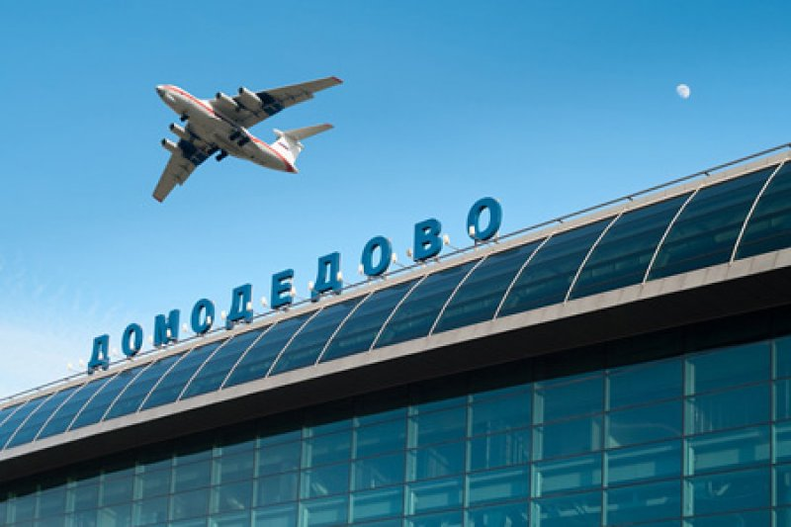
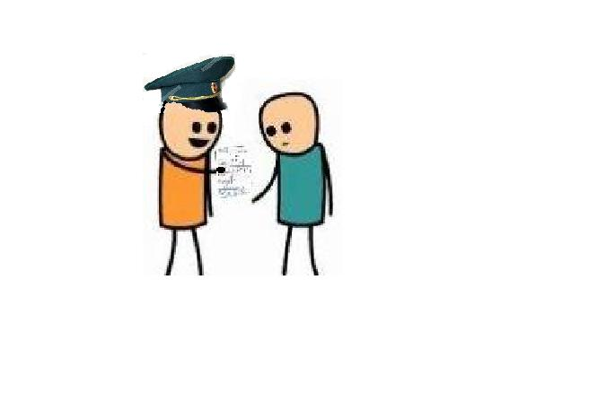
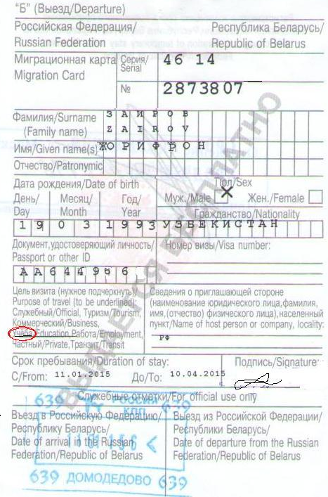

Rules of migration card
Arrival
Passport control
Migration card
Welcome to Russia
Purpose of travel -
Учеба/Education

Slide 2
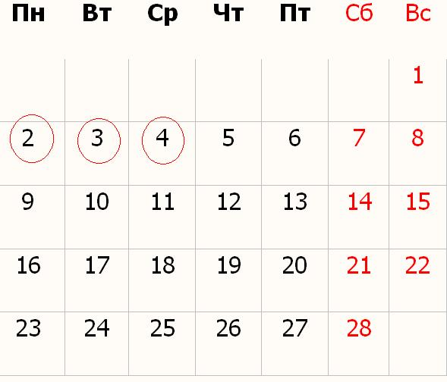

registration for international students
Office Hours for Students to Drop Off or
Collect Documents
Monday 11:00 – 17:00
Tuesday 11:00 – 17:00
Wednesday – no office hours
Thursday 11:00 – 17:00
Friday – no office hours
Lunch 13:00 – 14:00
3 working days

Slide 3

List of documents:
1. Copy of passport
2. Copy of migration card
3. Confirmation (order) of admission to university
4. Copy of enrollment agreement

Slide 4



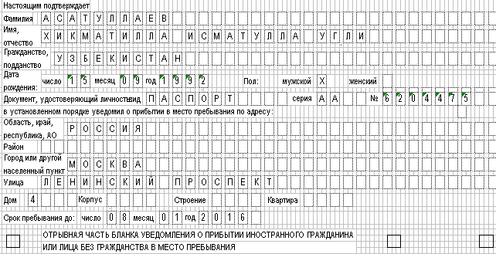


"NUST"
"MISiS"
УМАМ
Г-370
Wait
Documents ready to pick up

