Slide 1
Smart Tool Wear and Breakage Detection via Servo Load Monitoring
Jisu Hong, Leah Lee, Nawaf Rasheed

Slide 2
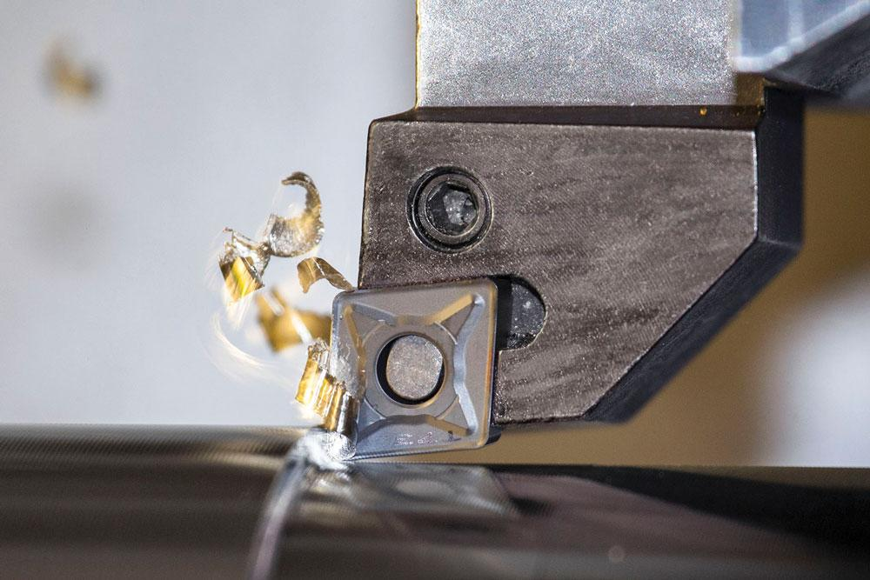

Motivation
Machining tools are often replaced on a fixed schedule
Early replacement wastes usable tool life
Late replacement can cause poor surface finish, scrap parts, or tool breakage
A low-cost monitoring method can help detect wear before failure
ME 452
Wu et al. (2020) The International Journal of Advanced Manufacturing Technology 106 (2020) 4391-4399

Slide 3
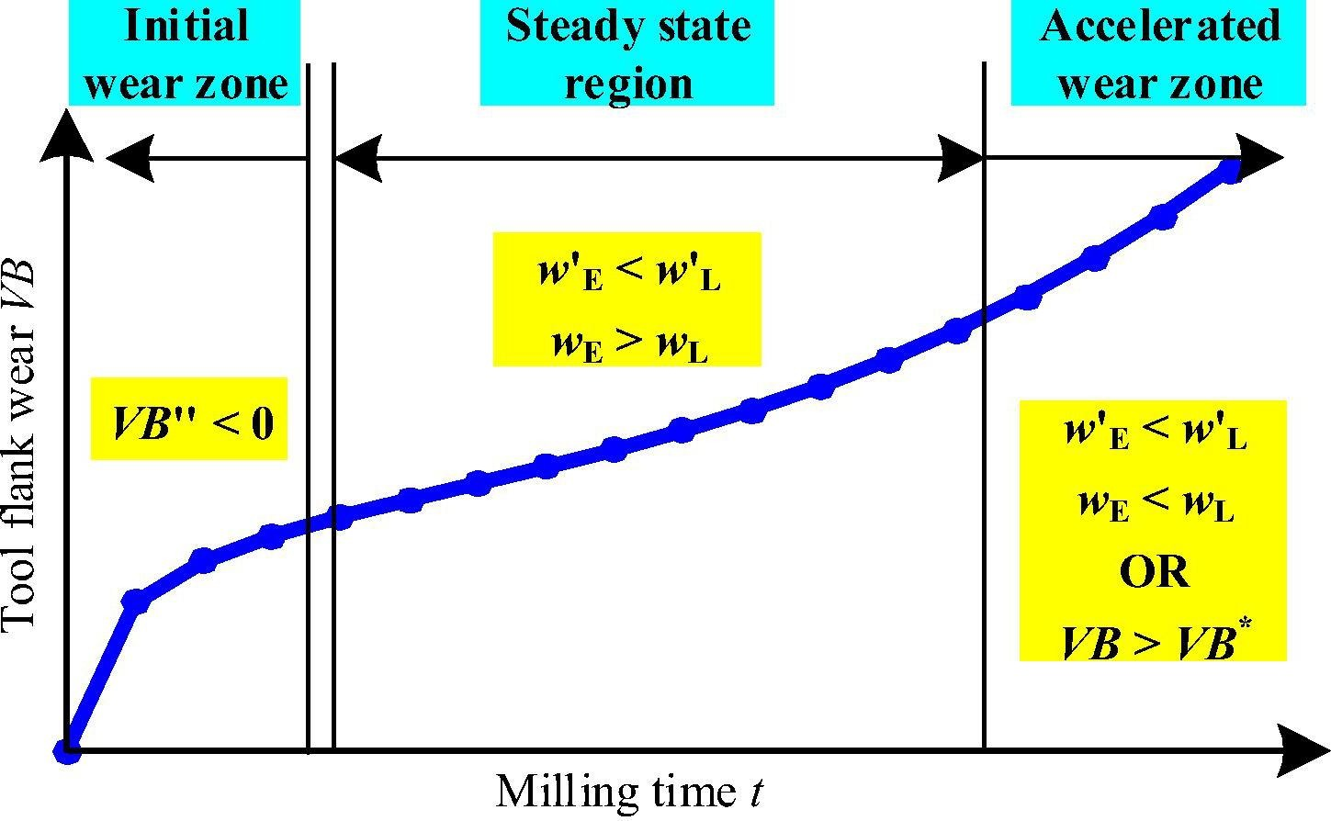
Problem
Tool wear progresses from initial wear to steady wear and eventually to accelerated wear
Existing monitoring systems can require expensive sensors and a complex setup
Our problem: how can we predict maximum flank wear (V_{b} )in a cost-efficient way
ME 452
Zhu et al. (2019) Mechanical Systems and Signal Processing 115 (2019) 147-161

Slide 4
Proposed Solution
Use Machine Learning (ML) to estimate tool wear from machining signals
Input signals: force/torque, vibration, and sound data from milling cycles
Process raw data into meaningful statistical and frequency features
Train a neural network to estimate tool wear and compare sensor input cases
Long-term goal: warn operators or stop machining before severe tool failure
Use ML to estimate maximum flank wear, V_{b,max}, from machining signals
Determine whether ML-based tool wear prediction is supported by previous studies
Evaluate how accurately our model predicts tool wear
Compare full sensor input vs. force/torque-only input
Assess whether this approach can support future tool condition monitoring
ME 452

Slide 5
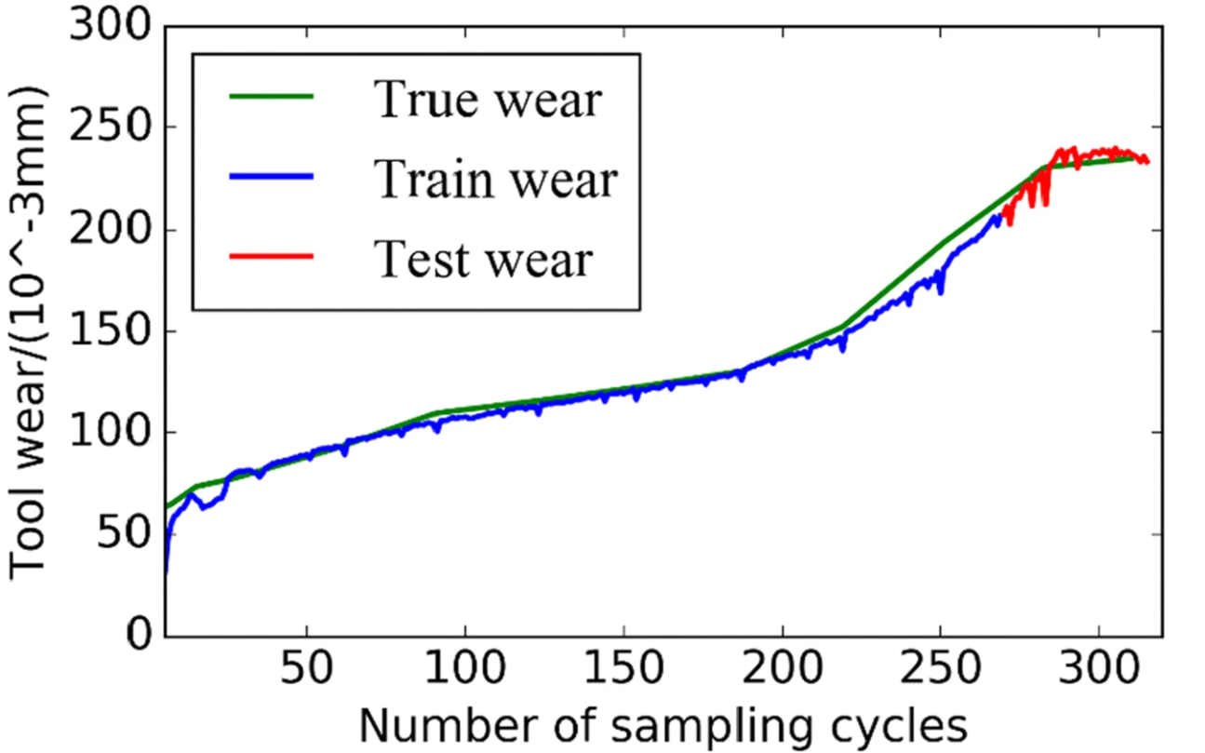
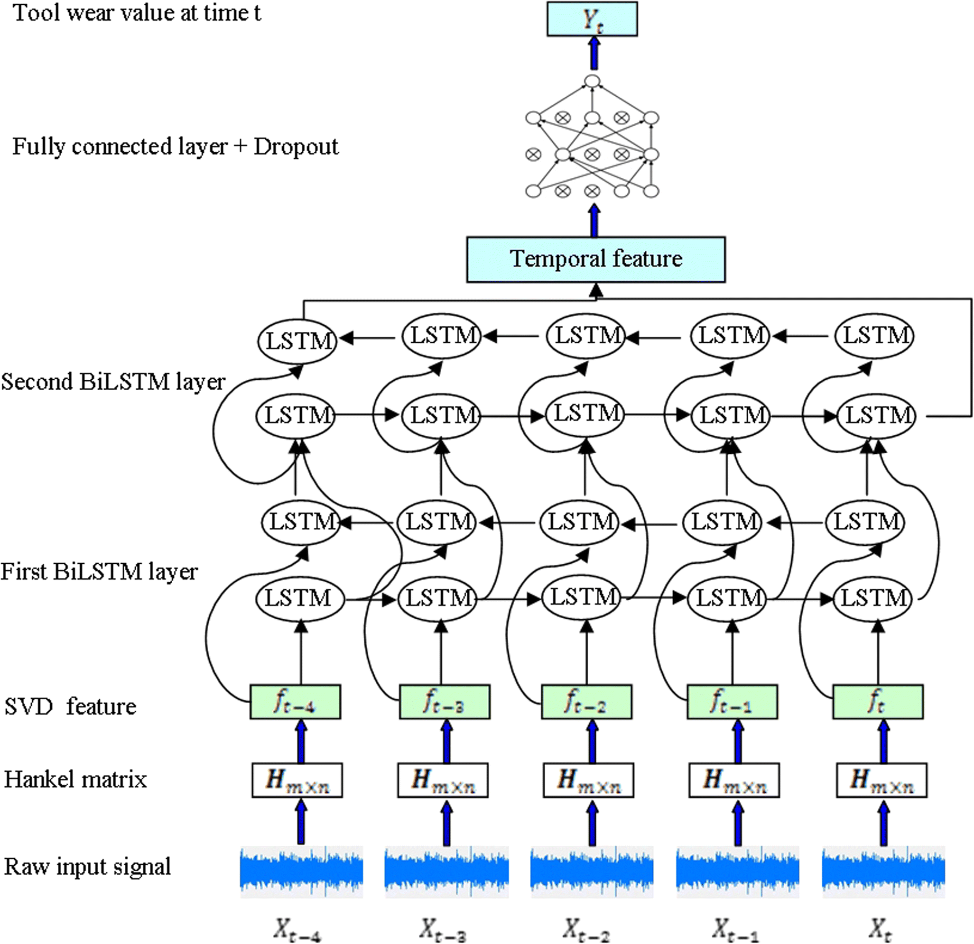

Literature review (1)
Milling process
Collected data during machining:
Cutting force
Vibration signals
Acoustic signals
Loss function
BiLSTM | Training | Test
MSE | 3.6 | 5.0
Note: BiLSTM = Bidirectional Long Short-Term Memory
ME 452
Wu et al. (2020) The International Journal of Advanced Manufacturing Technology 106 (2020) 4391-4399

Slide 6
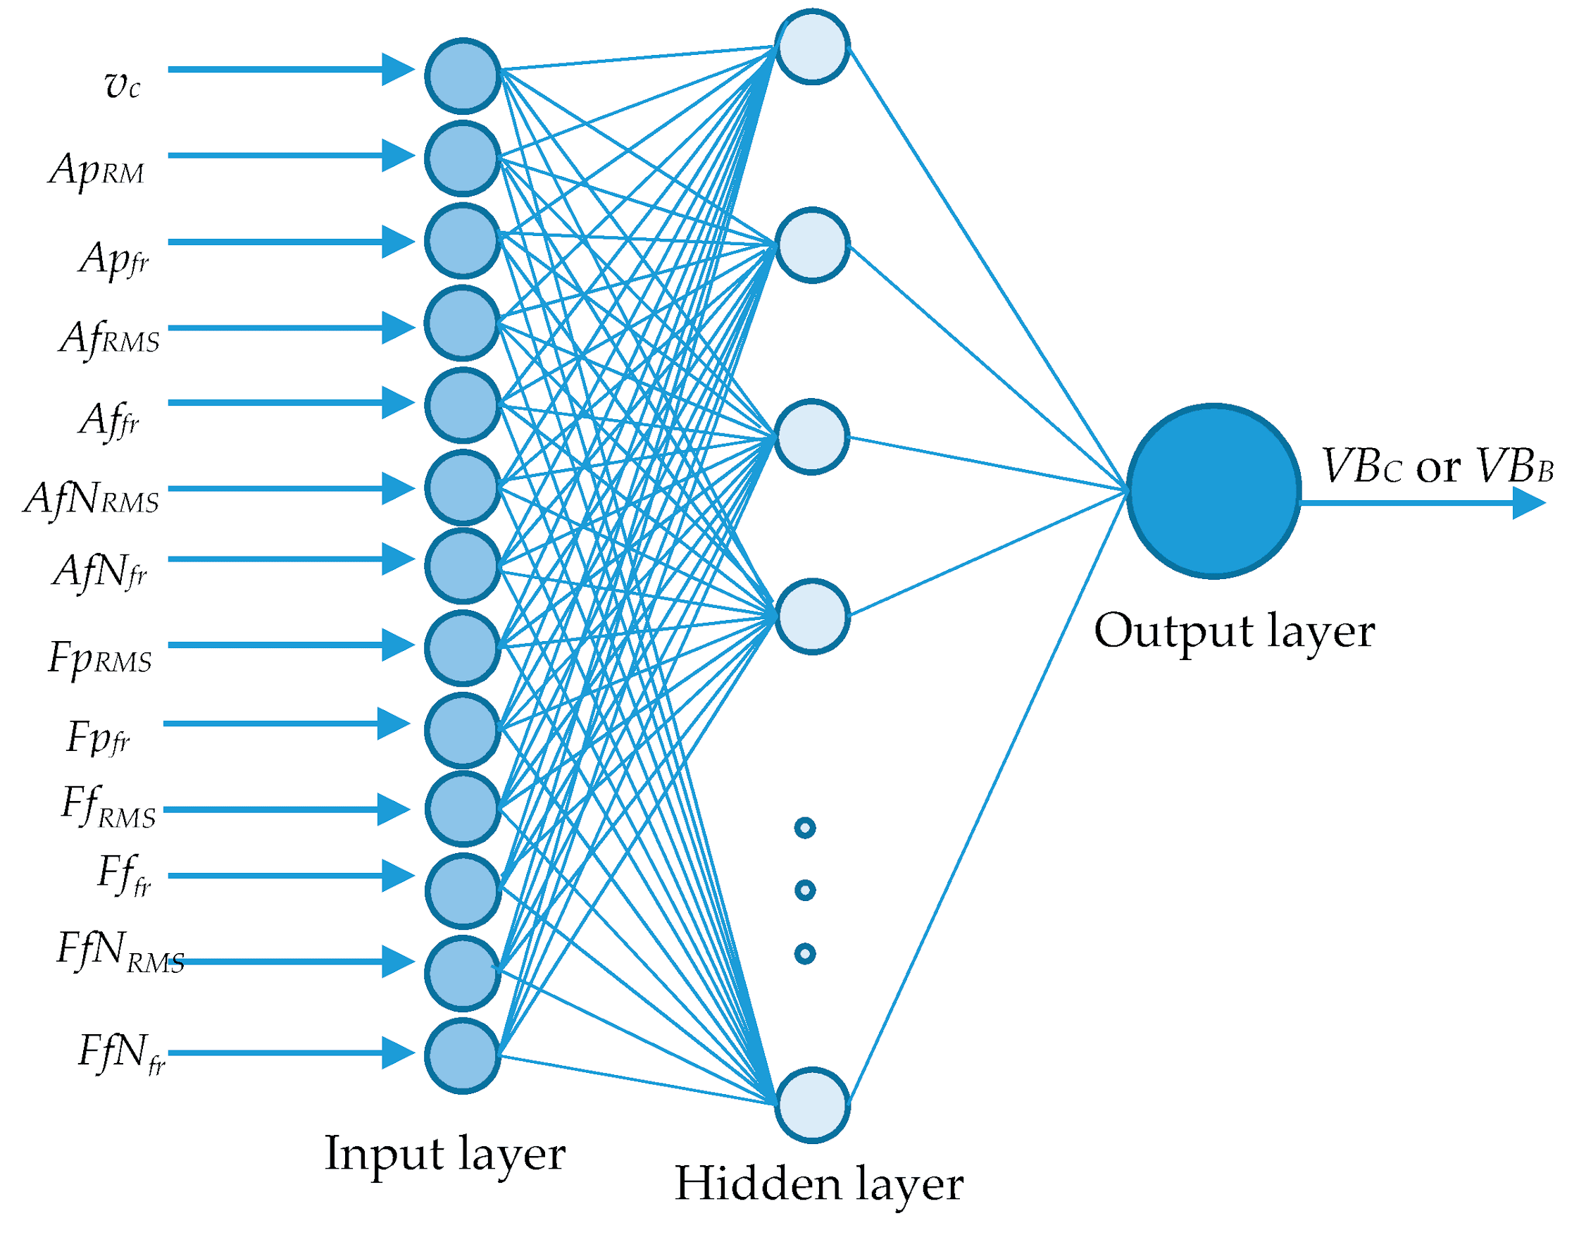
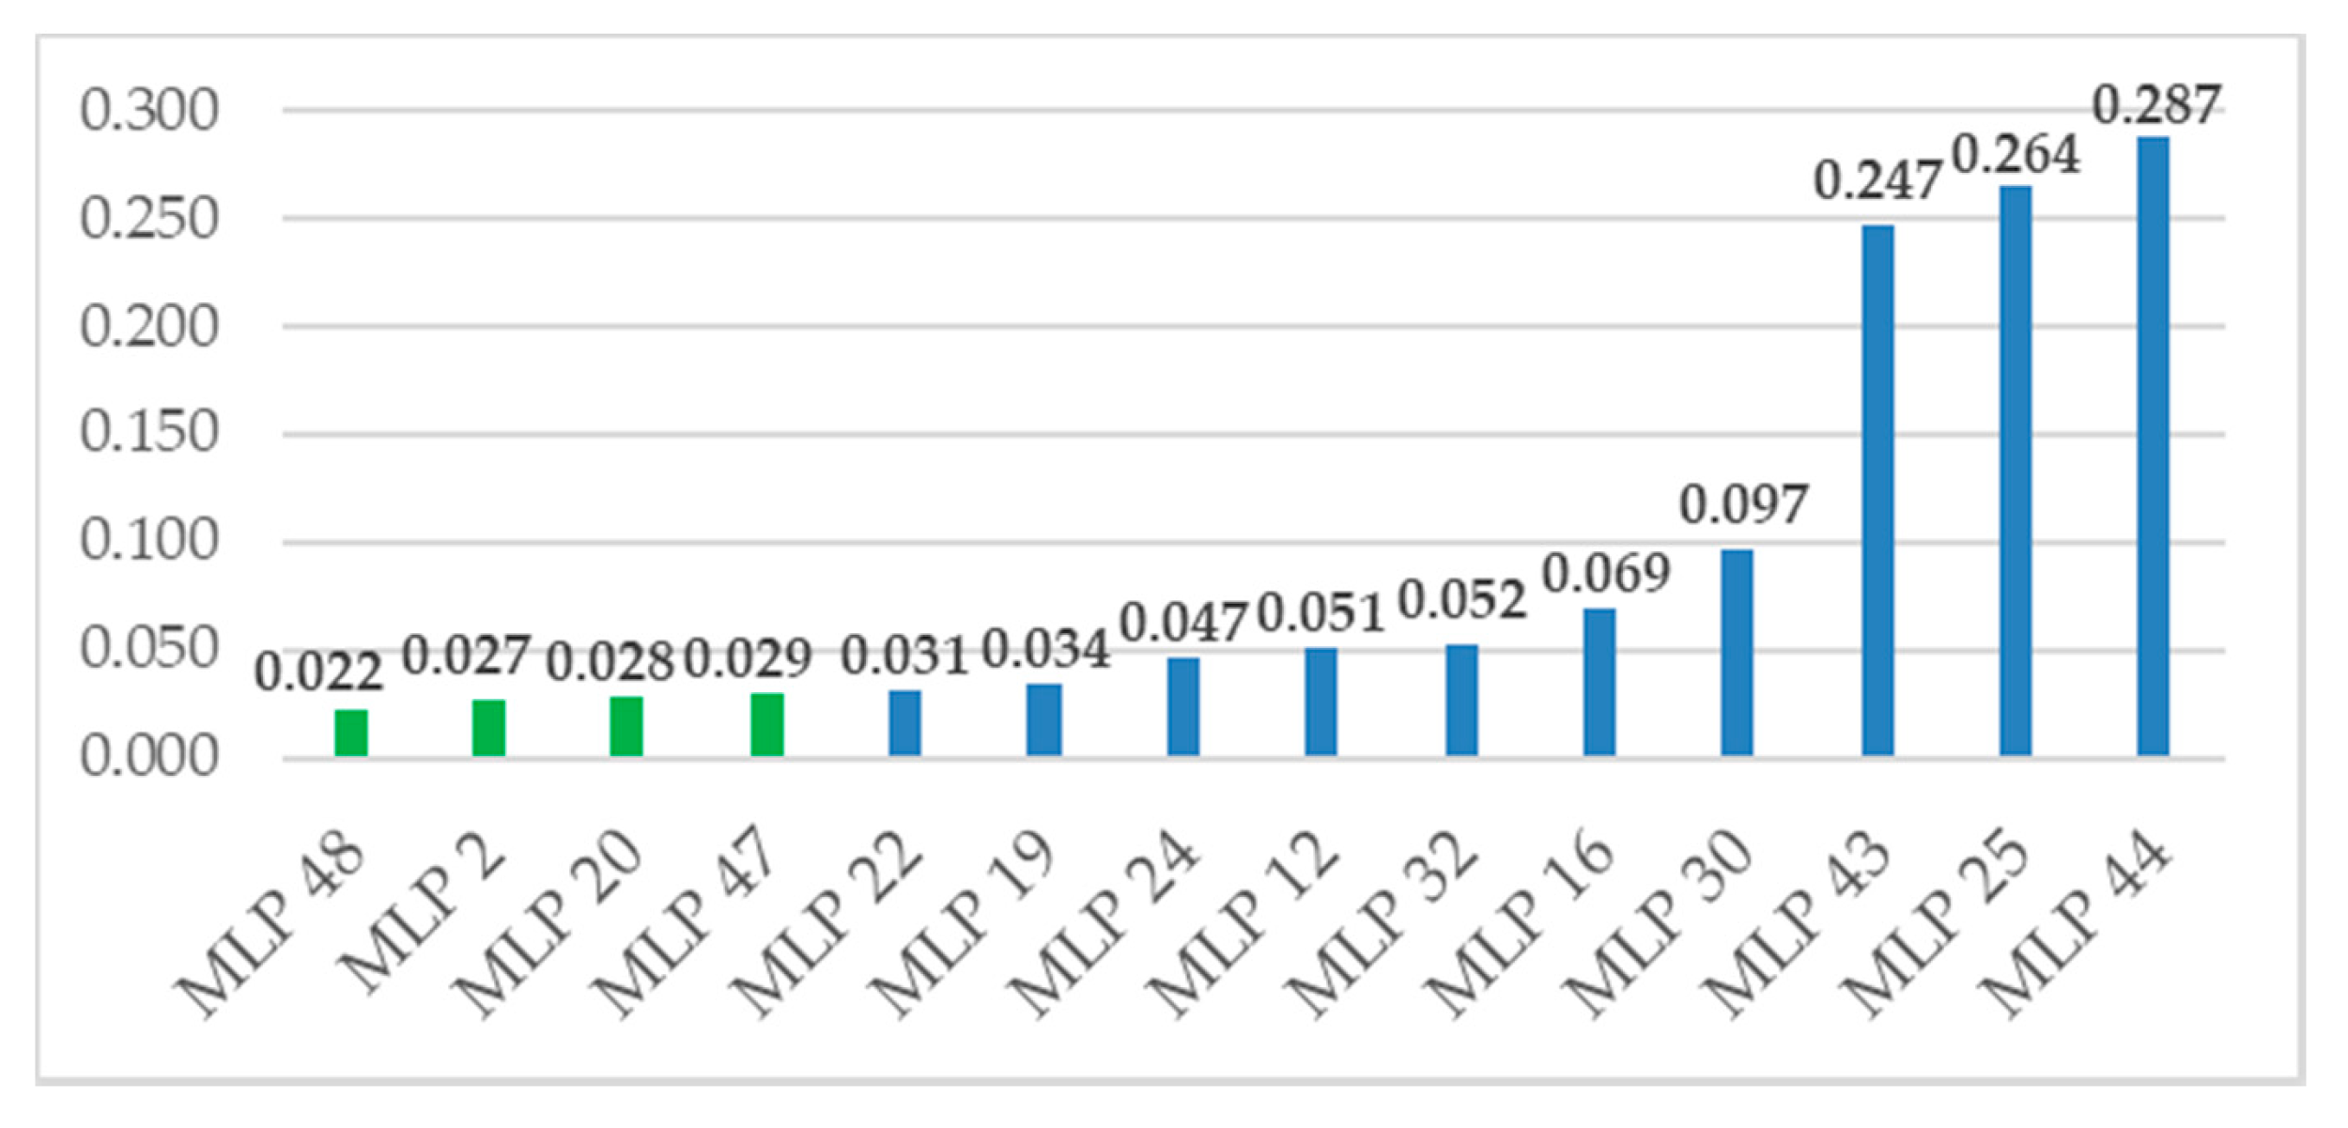
Literature review (2)
Milling process
Collected data during machining:
Cutting force
Vibration signals
Cutting speed
Loss function
ME 452
Wiciak-Pikuła et al. (2020) Sensors 20 (2020) 5798

Slide 7
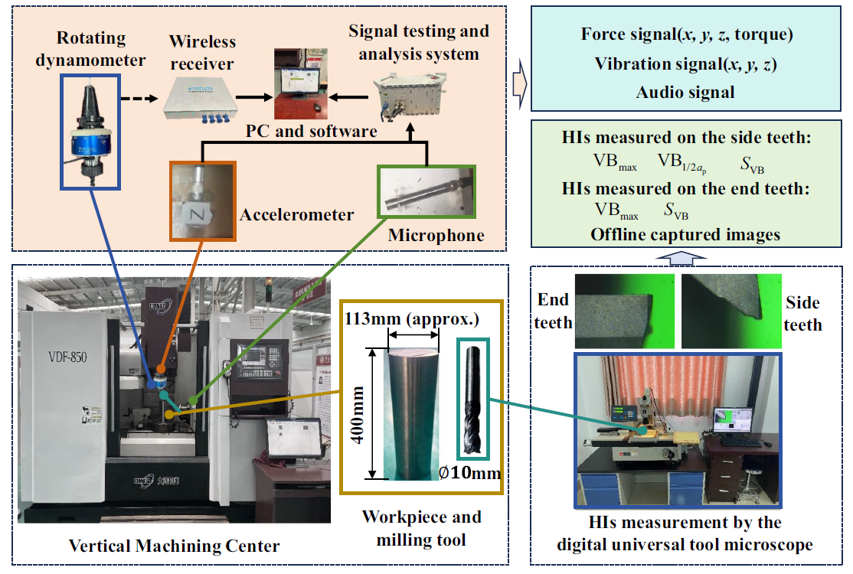
Our Dataset
A multi-feature dataset of coated end milling cutter tool wear whole life cycle
Milling process
Machining Path: circular
Tool: Coated TiAlN
68 cutting cycle
Collected data during machining:
Cutting force
Vibration signals
Acoustic signals
ME 452
Li et al. (2025) A multi-feature dataset of coated end milling cutter tool wear whole life cycle. Scientific Data, 12(1), 16.

Slide 8












Our ML Architecture
Case 1
Case 2
Inputs:
Cutting force:
Vibration signals
Acoustic signals
X-axis
Y-axis
Z-axis
Torque
X-axis
Y-axis
Z-axis
Input layer
Hidden layer
Input layer
Hidden layer
Architecture:
Only cutting phase
20 time frames
Feature Extraction (Mean, Standard deviation, Max, Min, Kurtosis, Skewness, peak to peak (max - min), 25th percentile, 75th percentile, Mean frequency
Output = Vb average from edges
3 hidden layers + 1 output layer
64 → 32 → 16 → 1
ME 452

Slide 9
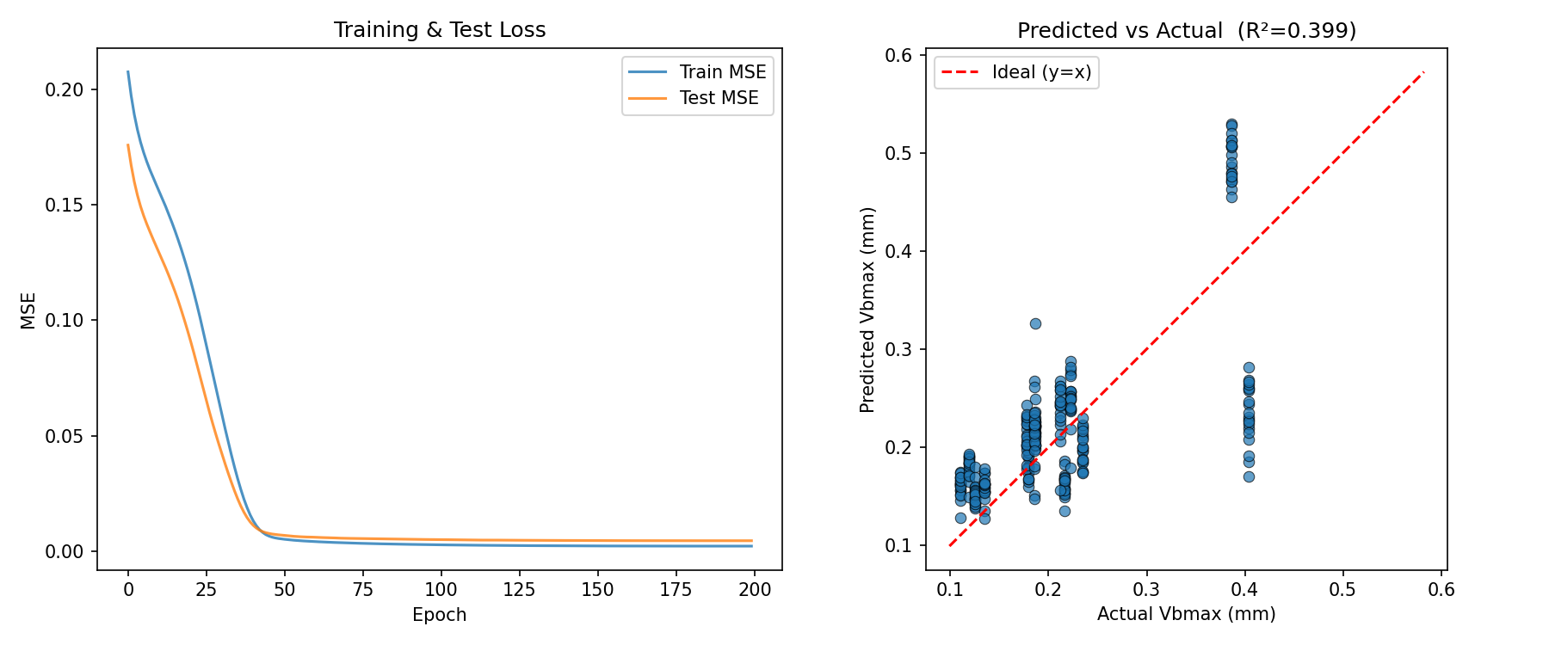
Result (1)
Case 1: force + torque + vibration + Acoustic
Both train and test MSE drop fast in the first ~50 epochs
Train MSE: 0.002120 | Test MSE: 0.004456
Successfully predicts upward going behavior
Cluster around low wear + overprediction
High wear: saturation of force
ME 452

Slide 10
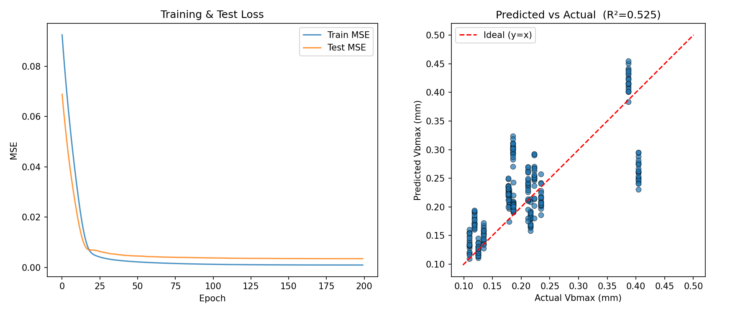


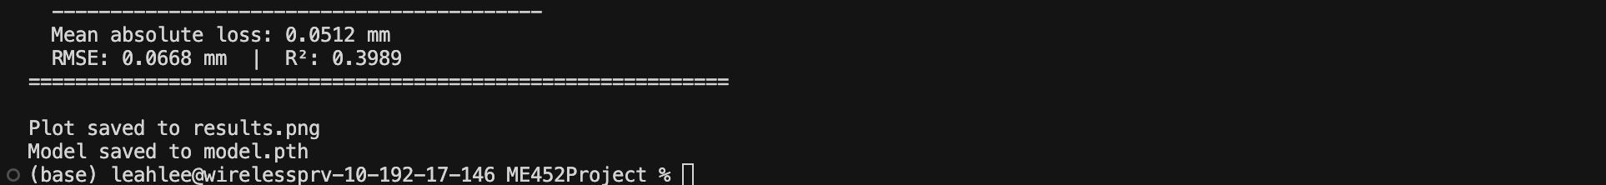
Result (2)
Case 2: force + torque
Both train and test MSE drop fast in the first ~30 epochs
Train MSE: 0.000993 | Test MSE: 0.003518
starting MSE is much lower: model learns patterns more quickly with fewer and cleaner features
scatter is more tightly grouped around the ideal line, especially at higher Vbmax
ME 452

Slide 11
Result
MSE
Limitation
Comp. time < 10 sec
 | Training | Test
Wu et al. (2020) | 3.6 | 5.0
Wiciak-Pikuła et al. (2020) |  | 0.022
Ours (case 1) | 0.002120 | 0.0026
Ours (case 2) | 0.000993 | 0.0019
Dataset is relatively small
Not counting for cutting speed,.etc
Lack of extreme wear data
Future work
Try the same pipeline with a diff. dataset
Try different feature extractions
Try to implement at UIUC machine shop
ME 452

Slide 12
Backup slides
ME 452

Slide 13
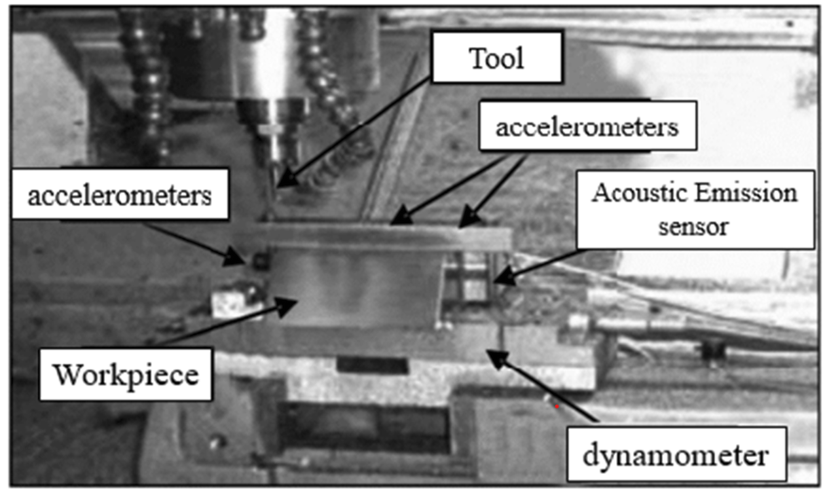
Literature review
ML pipeline
ME 452
Wu et al. (2020) The International Journal of Advanced Manufacturing Technology 106 (2020) 4391-4399

Slide 14
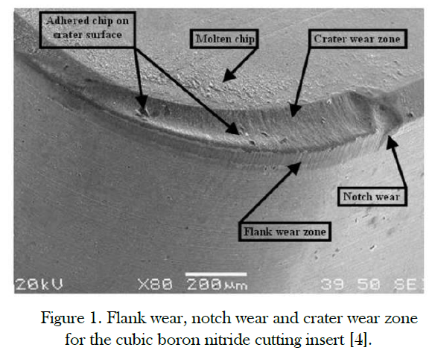
ME 452

Slide 15
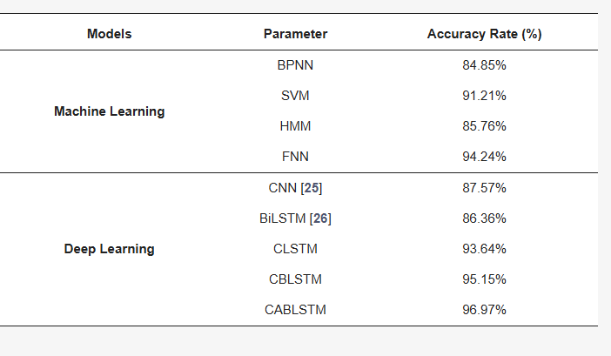
ME 452
Caggiano (2018) Sensors 18 (2018) 823

Slide 16
ME 452
Zhu et al. (2019) Mechanical Systems and Signal Processing 115 (2019) 147-161

Slide 17
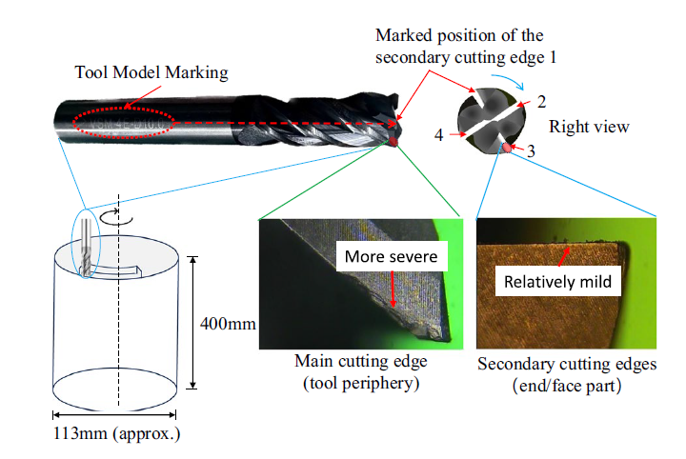
Our Dataset
Milling process
Machining Path: circular
Tool: Coated TiAlN
Collected data during machining:
Cutting force
Vibration signals
Acoustic signals
A multi-feature dataset of coated end milling cutter tool wear whole life cycle
ME 452
Li et al. (2025) A multi-feature dataset of coated end milling cutter tool wear whole life cycle. Scientific Data, 12(1), 16.

Slide 18
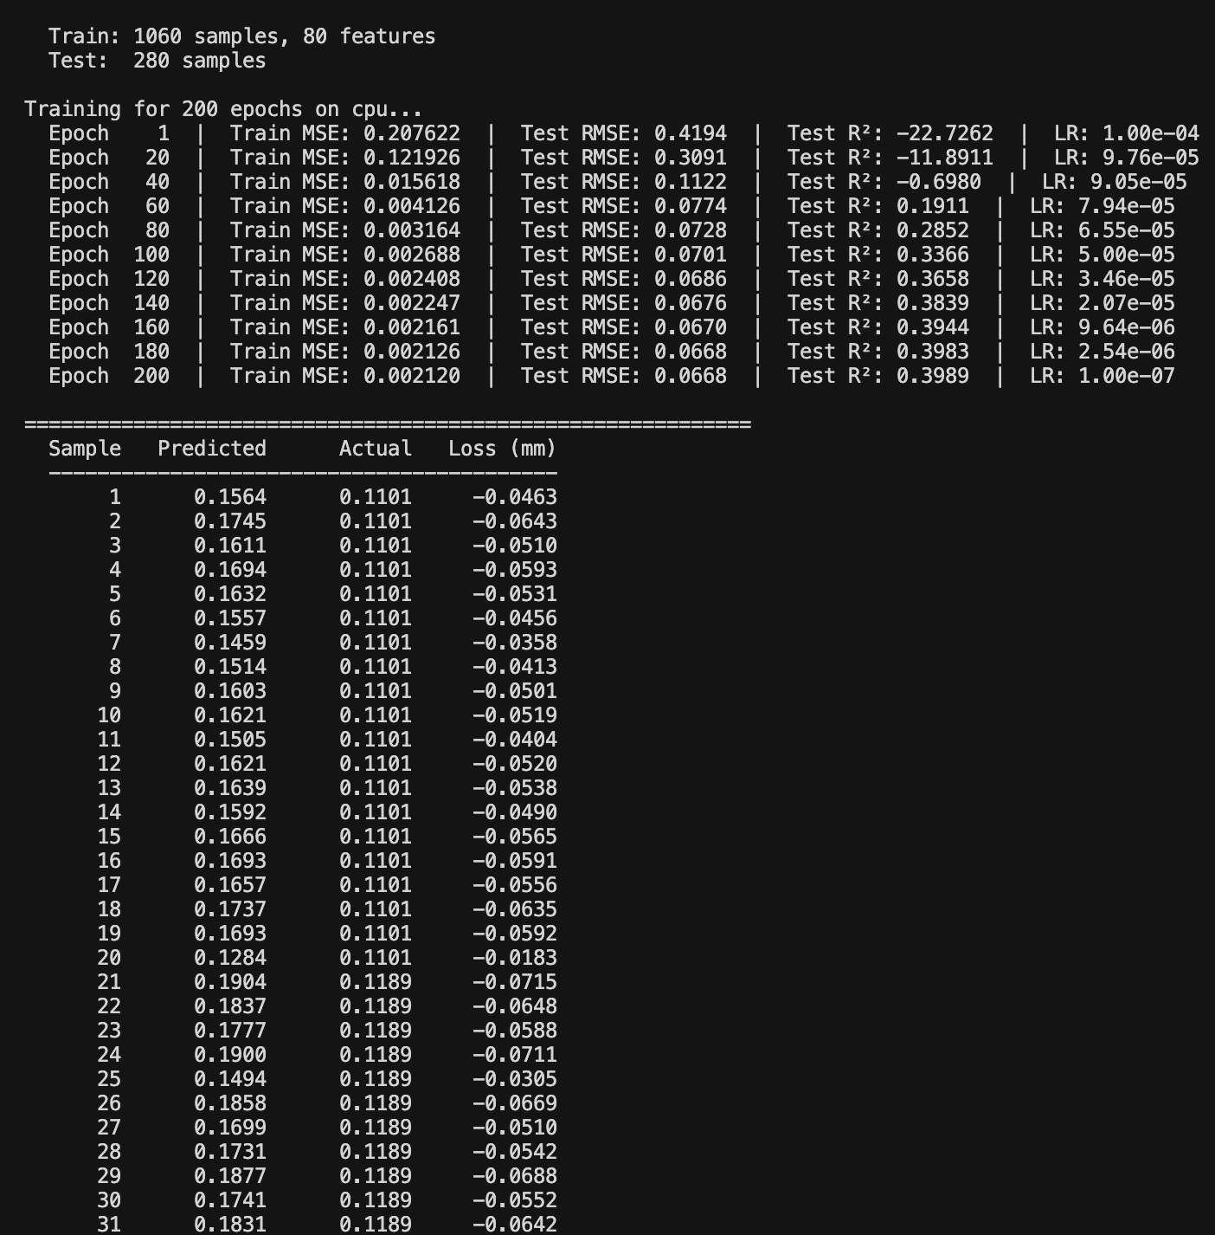
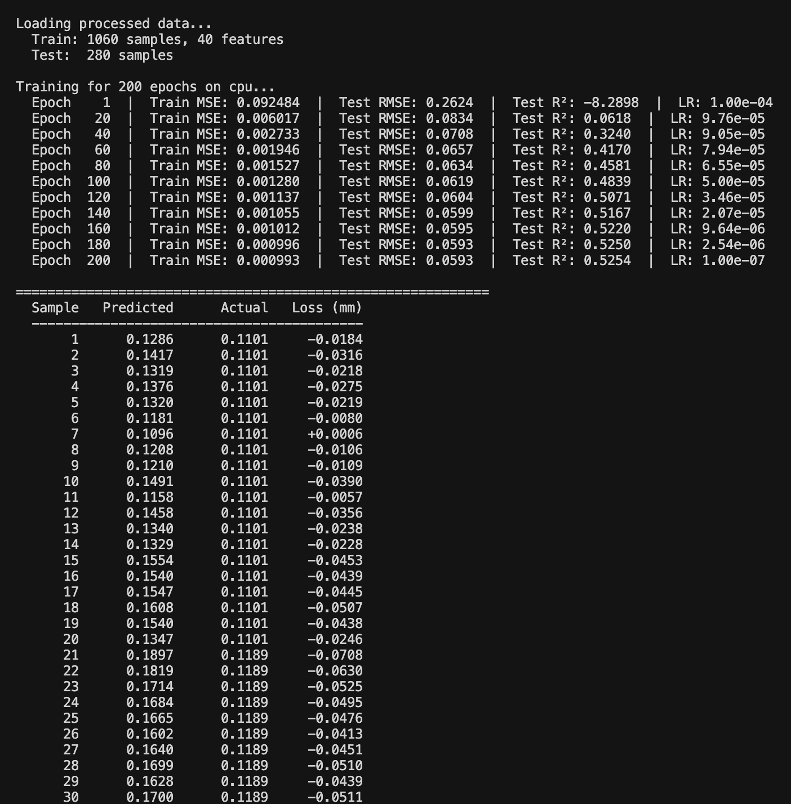
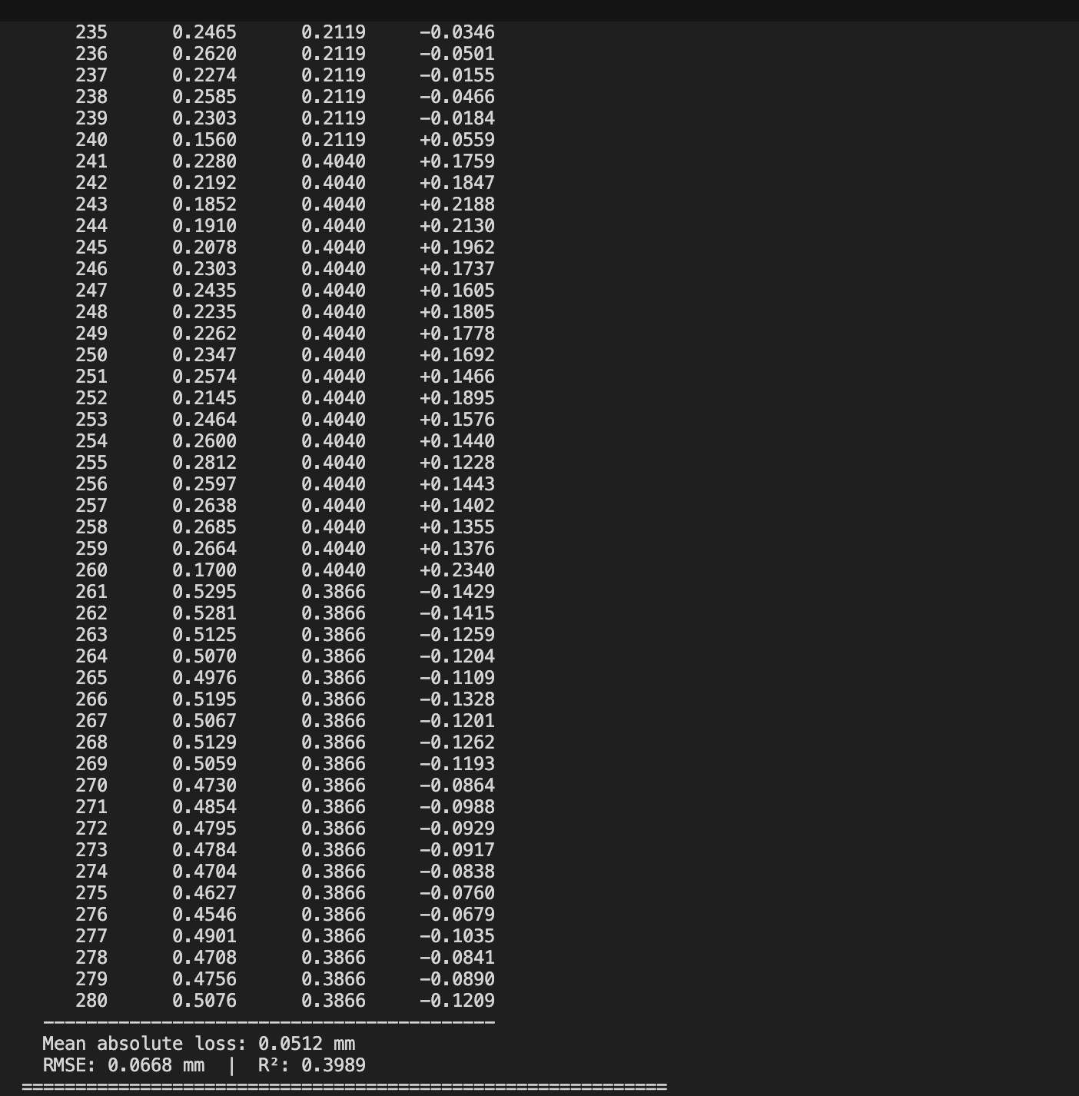
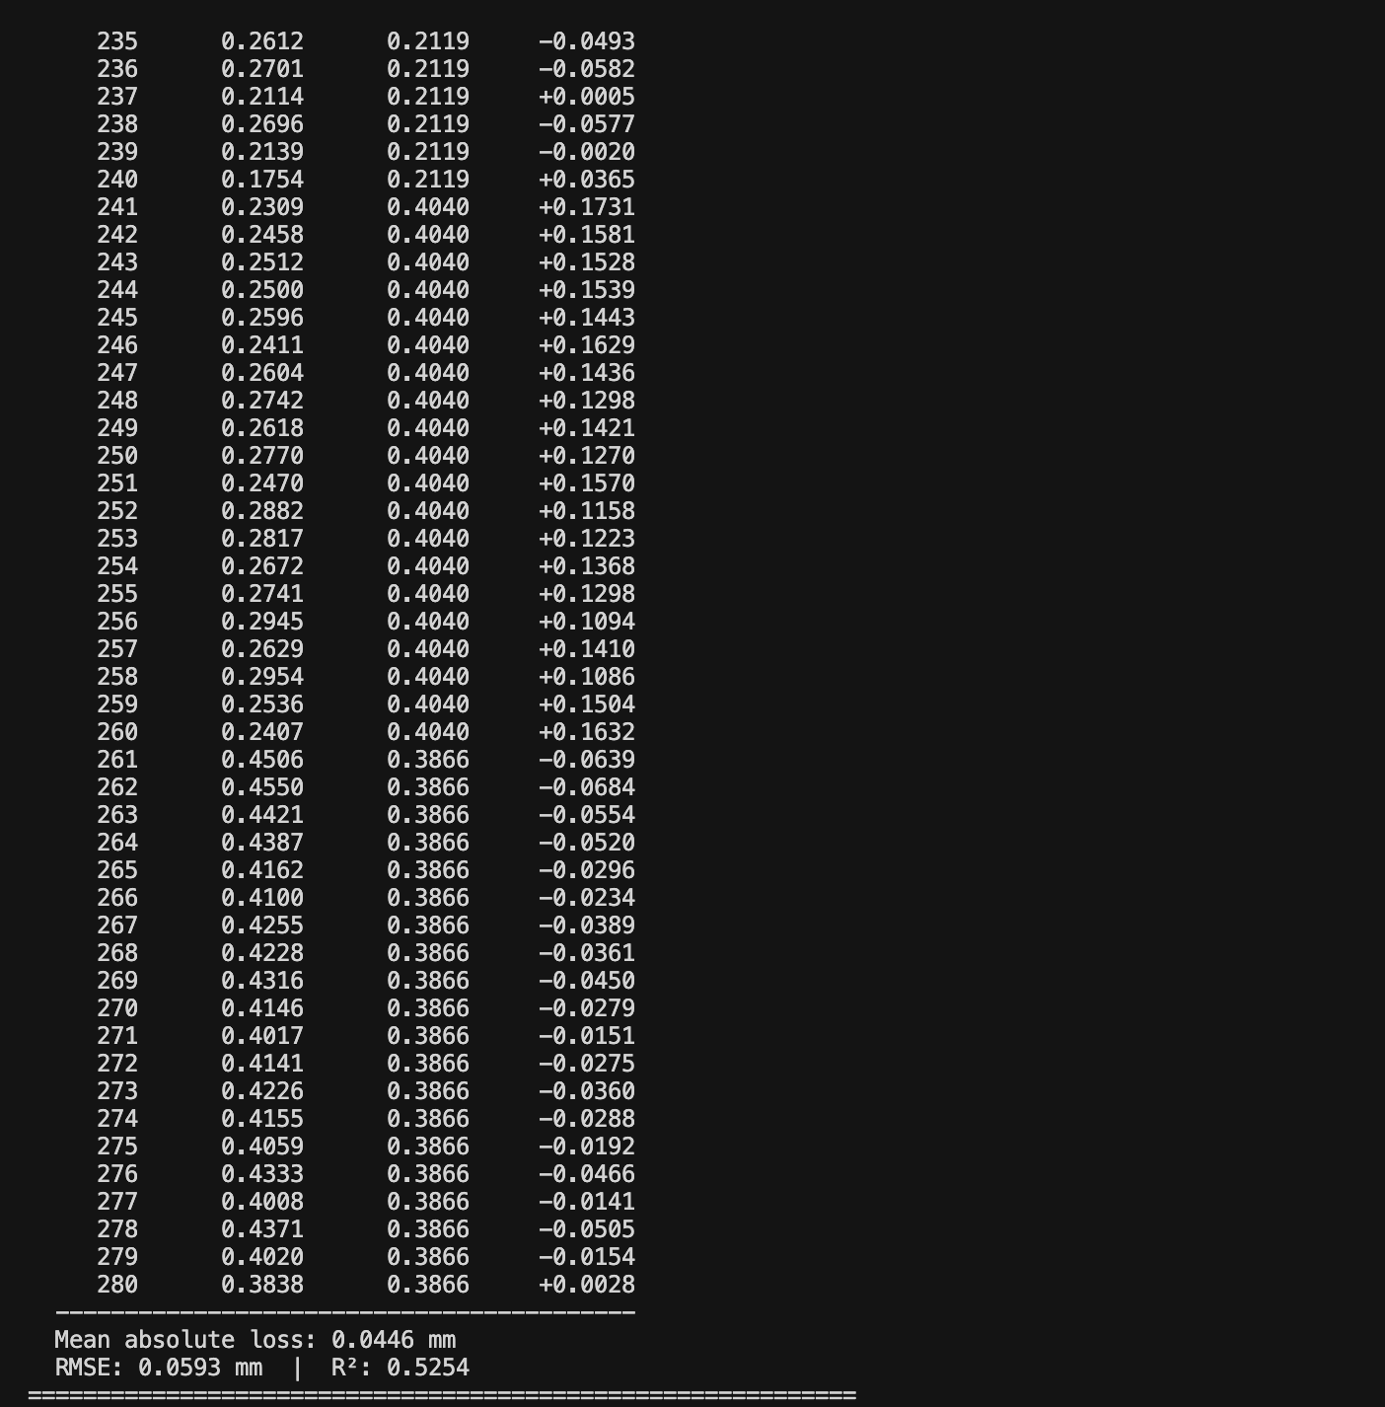
Case 1
Case 2
ME 452

Slide 19
Sources
https://www.mdpi.com/2076-3417/11/24/12041
ME 452

