Slide 1
OTTO The Robot.
Presented by:
Leah Brennan,
Benjamin Scallan,
Timothy McCann,
Raigridas Bartkus.

Slide 2
Introduction:
Intricate gear system: Trial and Error, our only option.
Advantages of working as a team:
a) Solutions reached quicker together.
b) Individual Contribution.
c) Collective Co-operation.

Slide 3
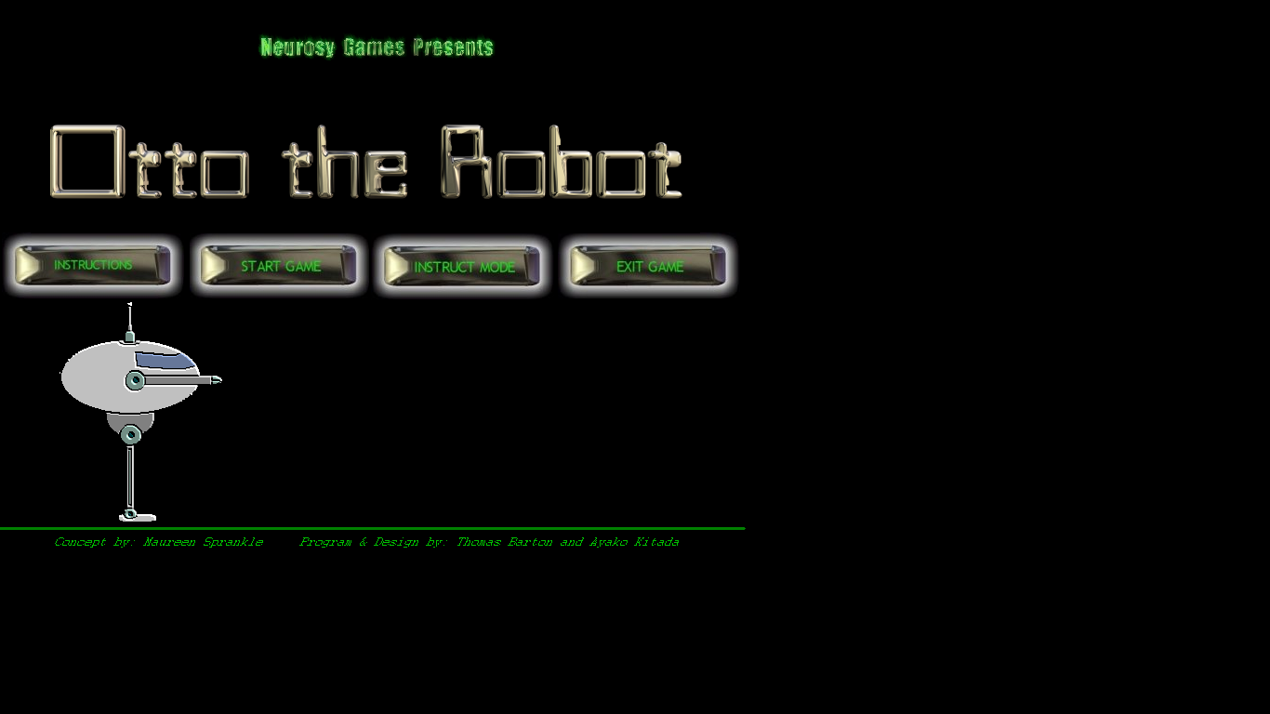
Our Thought Process: Lab 1.
Unfamiliar maze for Otto: Doesn’t recognise his charging pad.
Irregular Shaped Maze: Go beyond the obvious problems.
‘Small constituent parts’ treat each environment individually

Slide 4
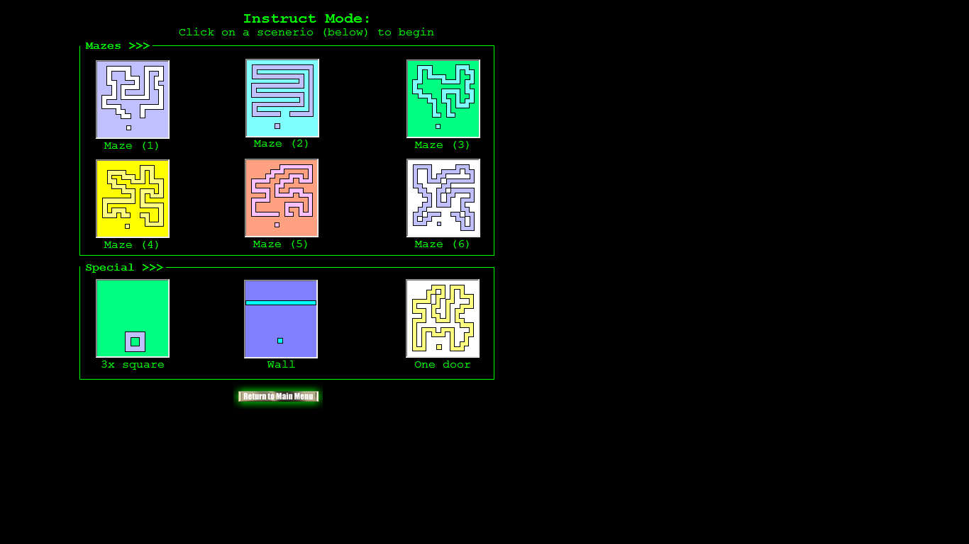
Lab 2:
Small Constituent Parts:
a)Turn Right.
b)Turn Left.
Solving the most difficult task:
a)Find the commands for the simplest tasks
b)Set of commands: Solve any maze

Slide 5
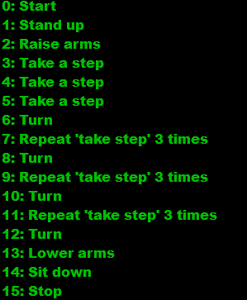
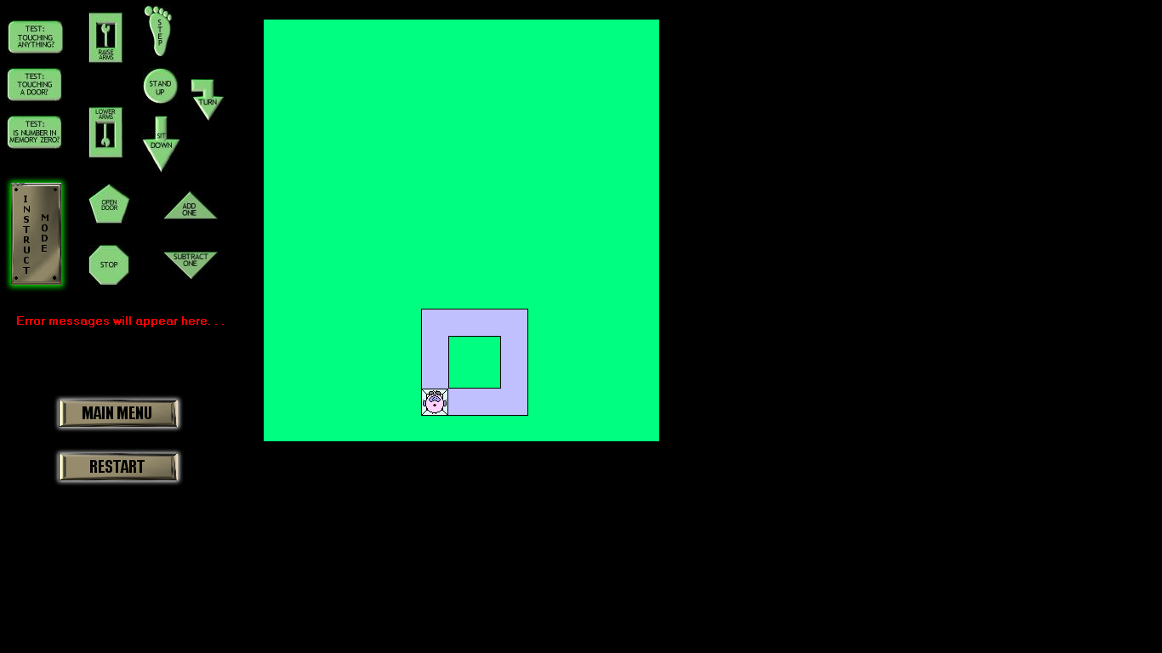
Part Two: Finding Solutions
Task One: Instruct Otto to Walk in a Square… *
*Typed/Unsuccessful Commands Included in Report

Slide 6
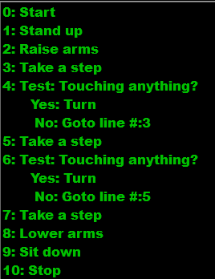
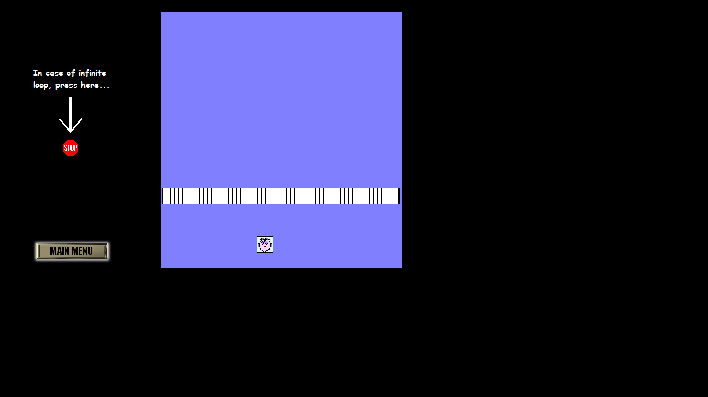
Task Two: Instruct Otto to walk to a wall…

Slide 7
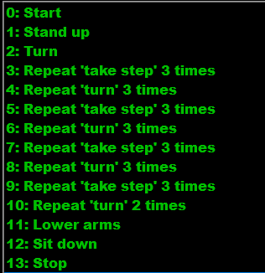

Task Three: Sub-Task One

Slide 8
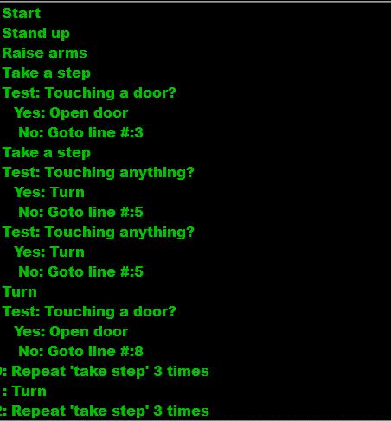
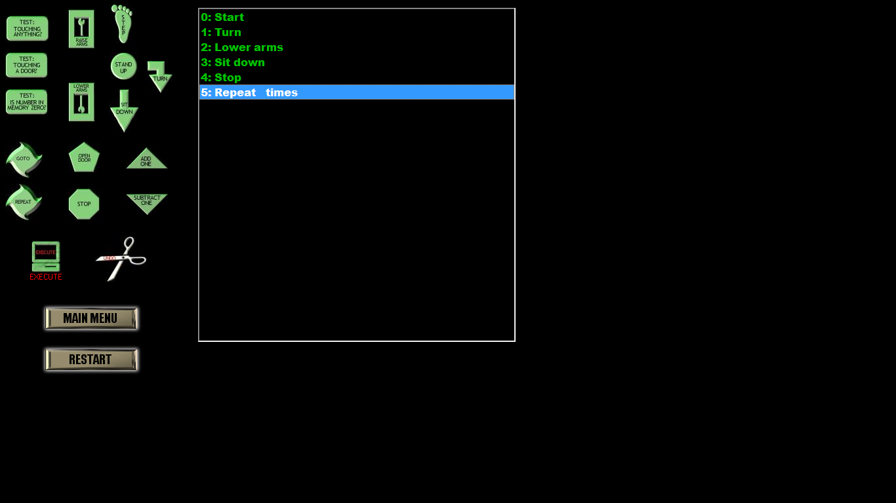
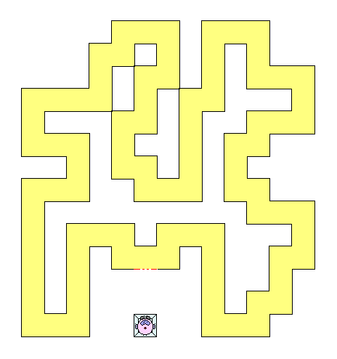
Task Three: Sub-Task Two
Correction: Step: Go to line 8, should be go to line 7.
Screenshot: Example with one door

Slide 9
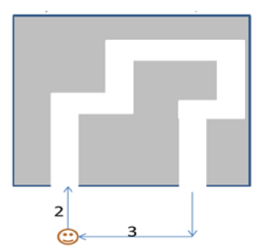
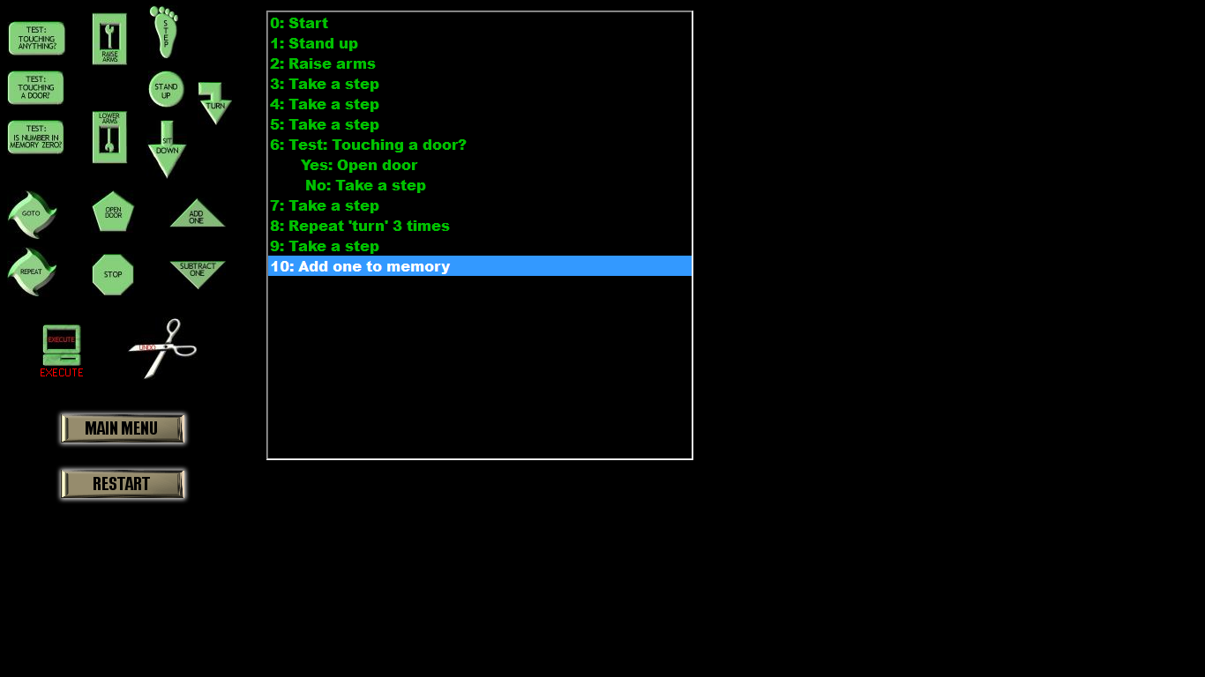
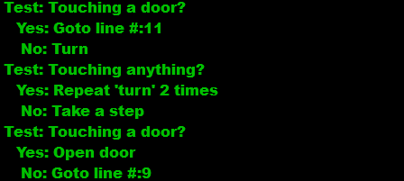

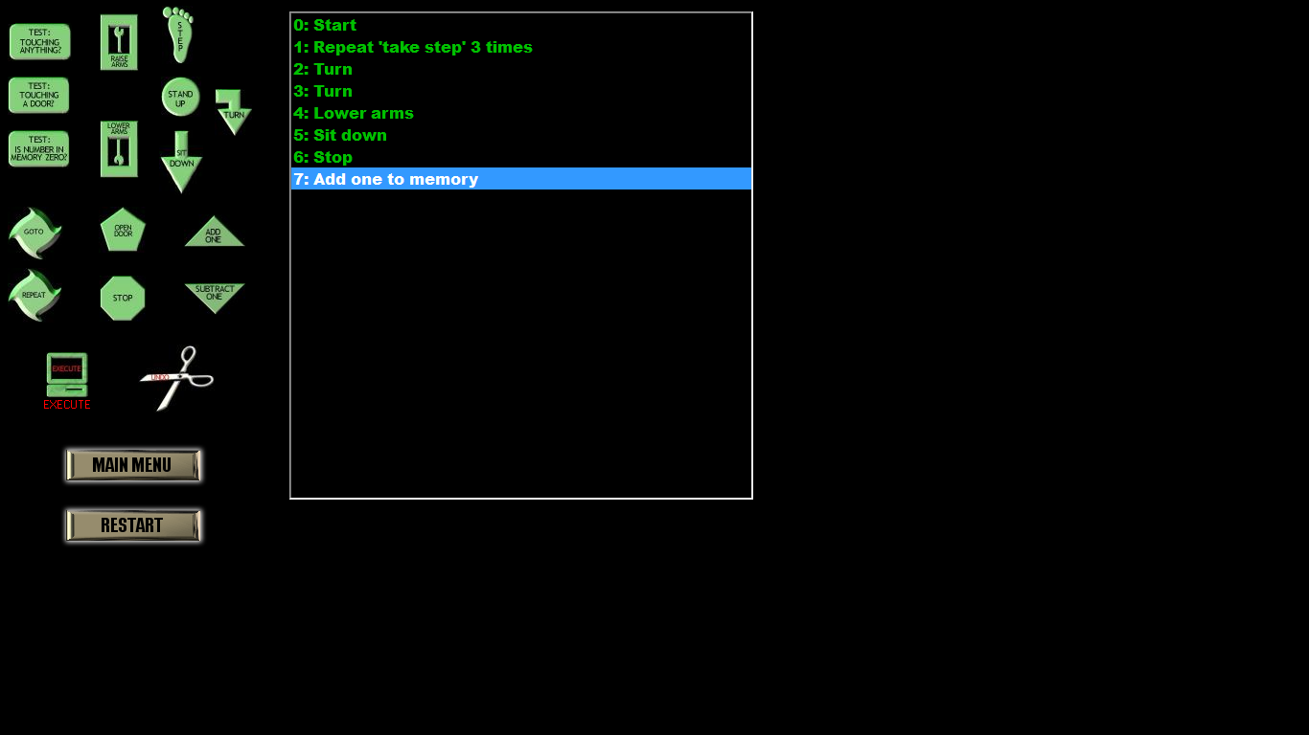
Task Three: Sub-Task 3
Start
Middle
End

Slide 10
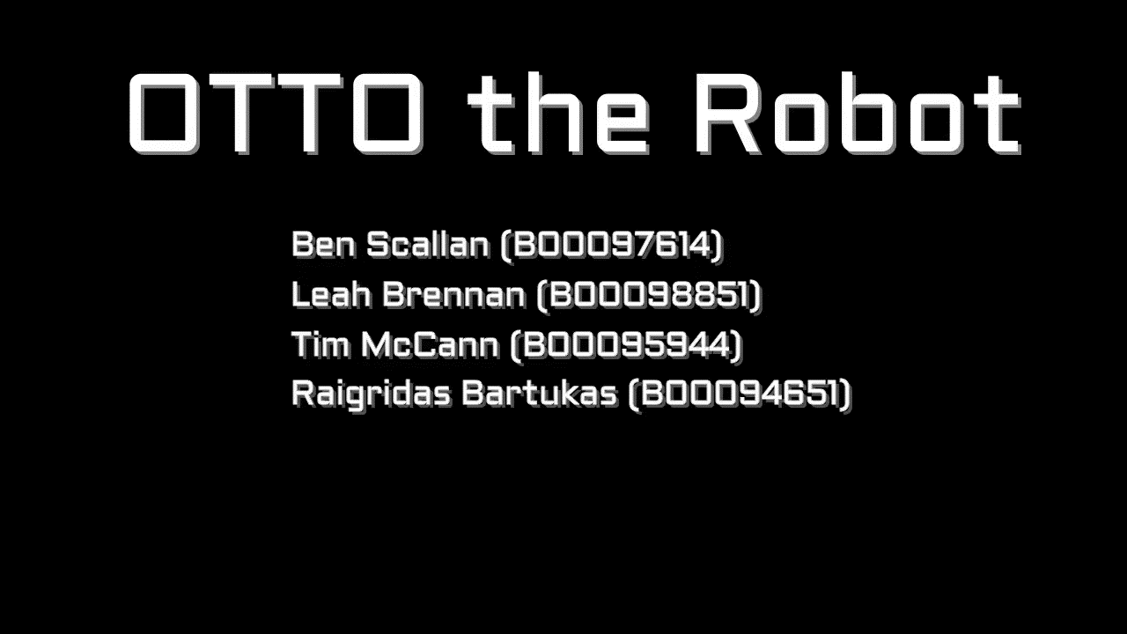
===VIDEO===

Slide 11
CONCLUSION
Labs: Organise, discuss and focus.
Write down, Test, Find, Solve.
Making an effort to solve a problem is worthwhile.

Slide 12
QUESTIONS?
Thank you for listening!

Slide 13
References:
Otto.exe program.
APS Project Description.

