Slide 1

SUMMARY OF PROJECT
Data Preparation, Data Visualization & Univariate Time Series Forecasting for Panel Data
Leah Pathan Khan

Slide 2
Coal Production & Consumption (Worldwide)
Data Preparation Stage & EDA
Data Visualization Stage
Comparison
Time Series forecasting for Large Regions

Slide 3
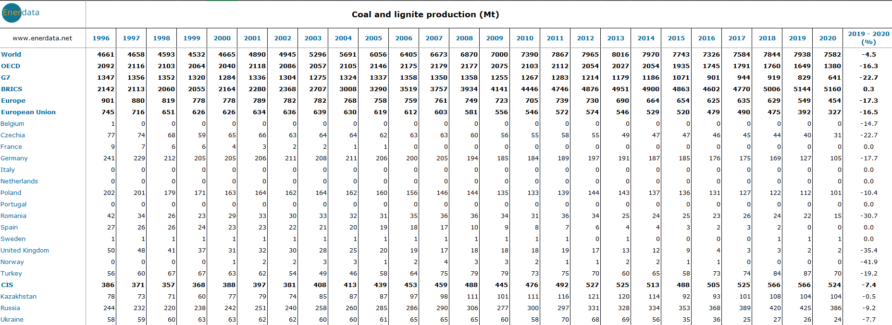
Coal Dataset
Production Dataset

Slide 4
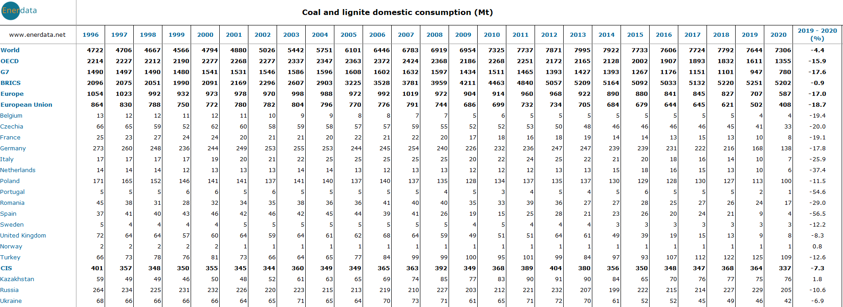
Coal Dataset
Consumption Dataset

Slide 5

Dataset Source
Global Energy Statistical Yearbook 2021

Slide 6
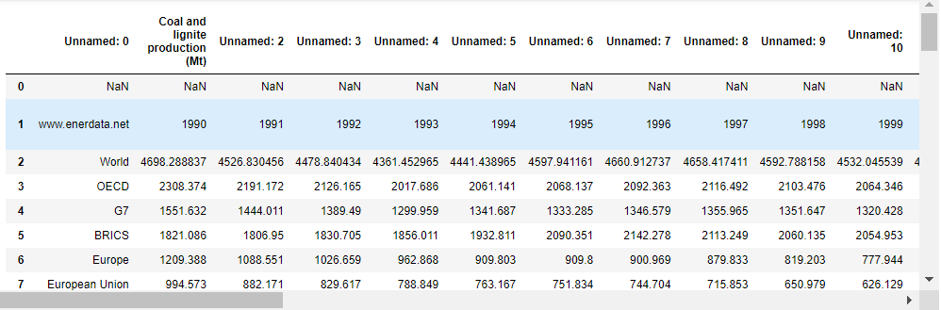
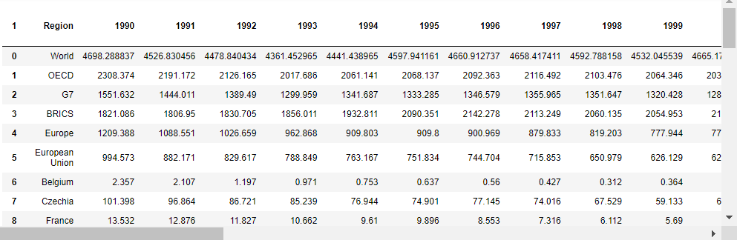
Data Preparation
Cleaning &
Preparation of Dataframe

Slide 7
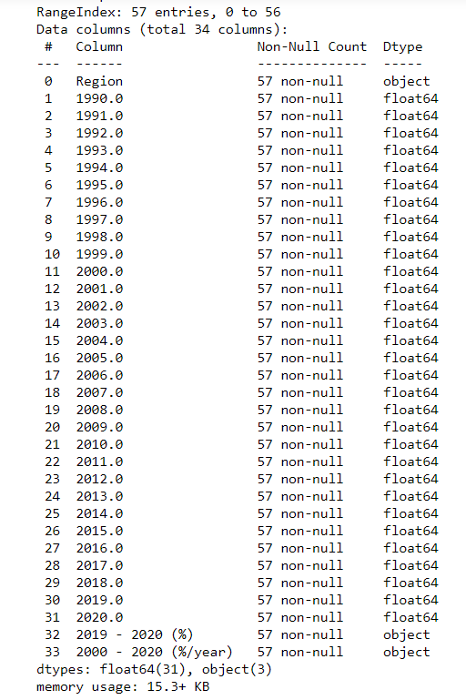
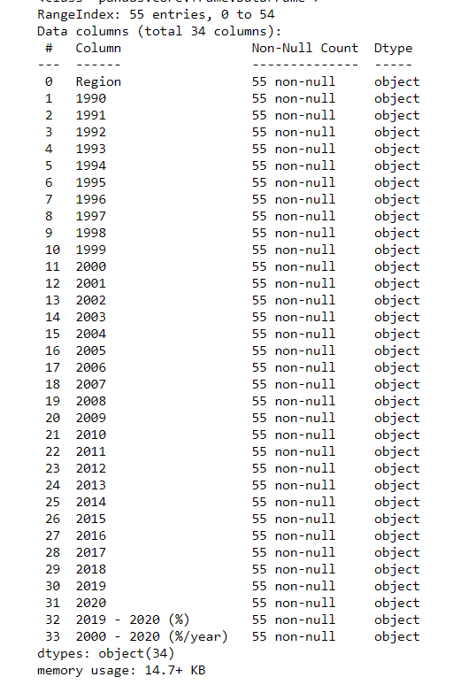
Data Preparation
Checking for NULL values
Consumption
Production

Slide 8
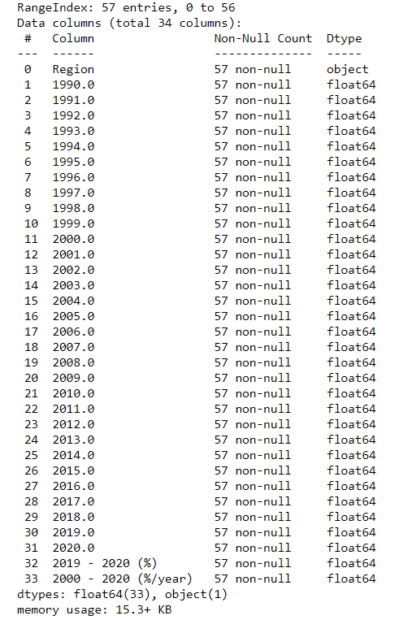
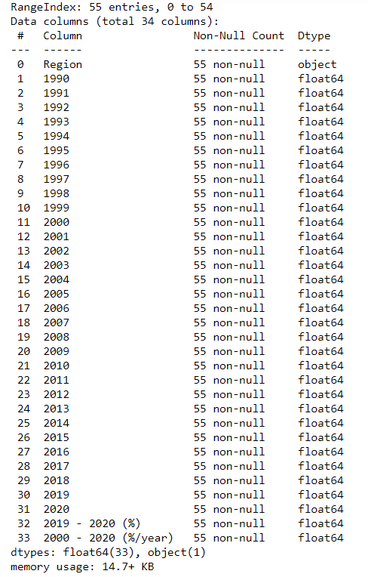
Data Preparation
Converting datatypes of attributes – using .apply(pd.to_numeric)
Consumption
Production

Slide 9
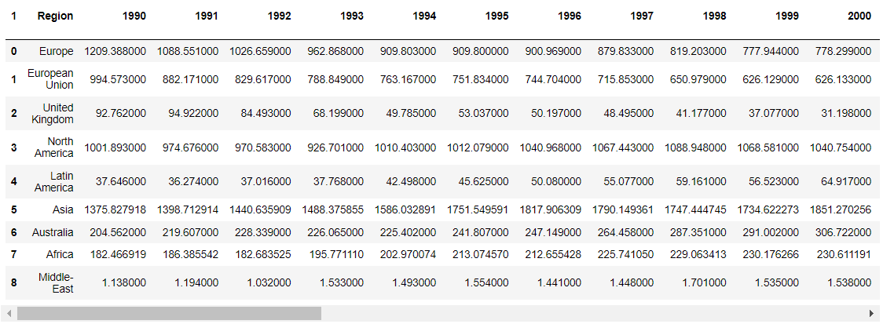
Data Preparation
Dataset division – I [Large Regions]

Slide 10
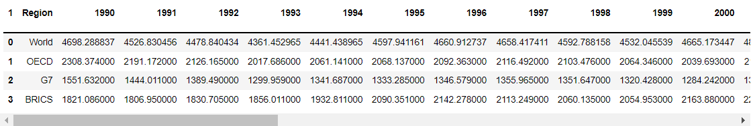
Data Preparation
Dataset division – II [Associations]

Slide 11
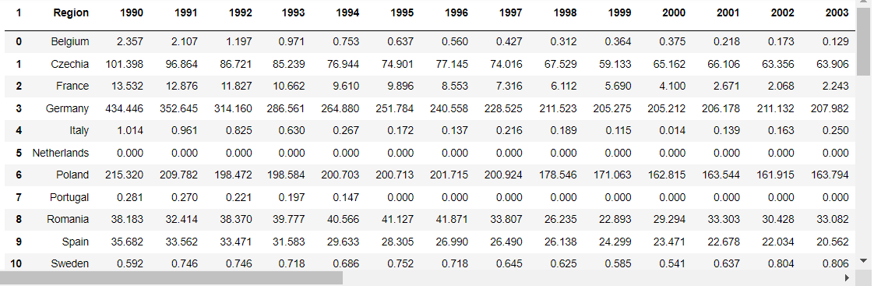
Data Preparation
Dataset division – III [Countries]

Slide 12
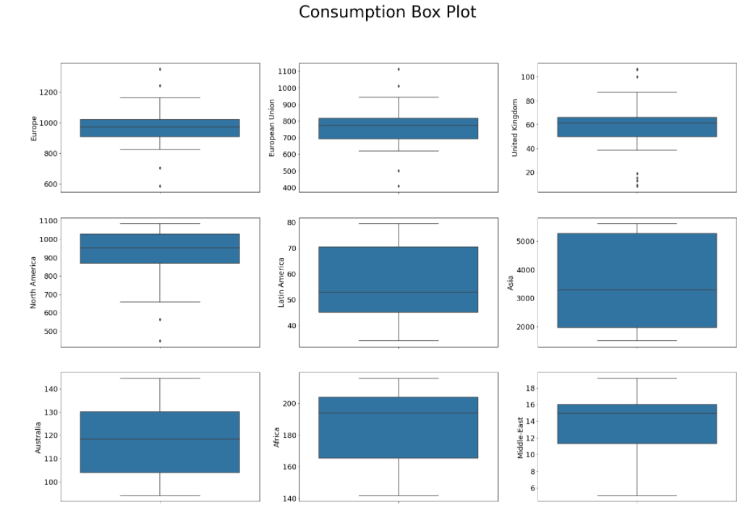
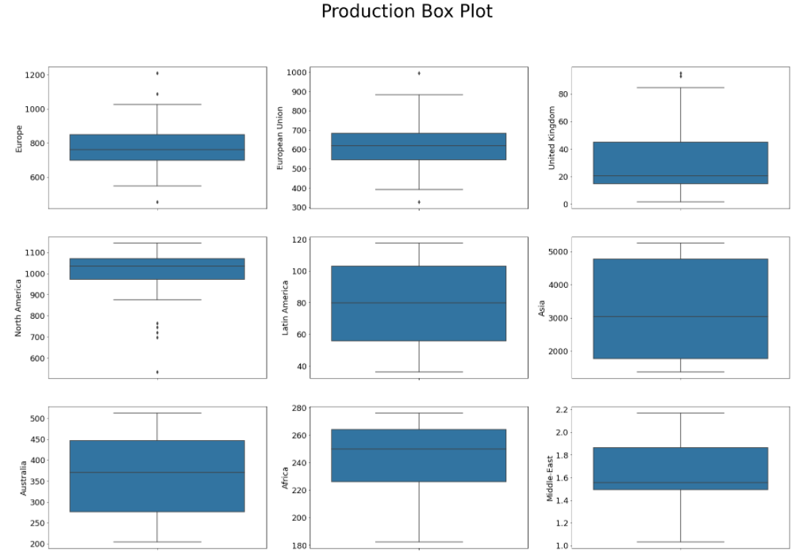
EDA
Large Regions’ Analysis

Slide 13
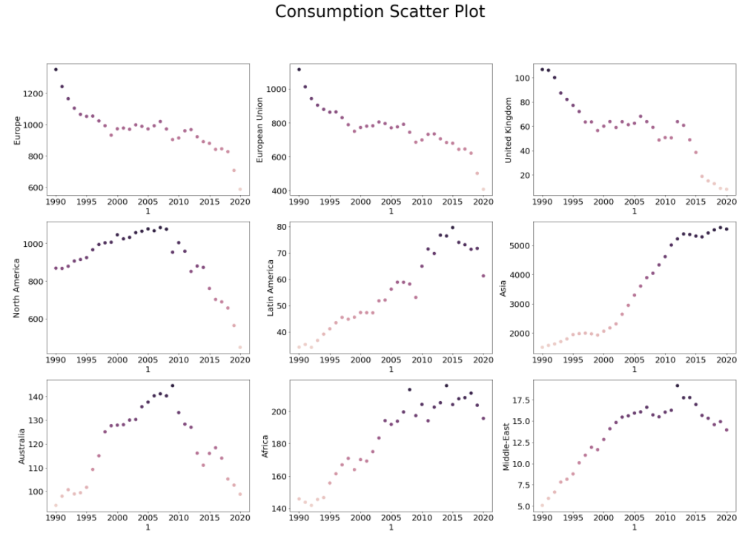
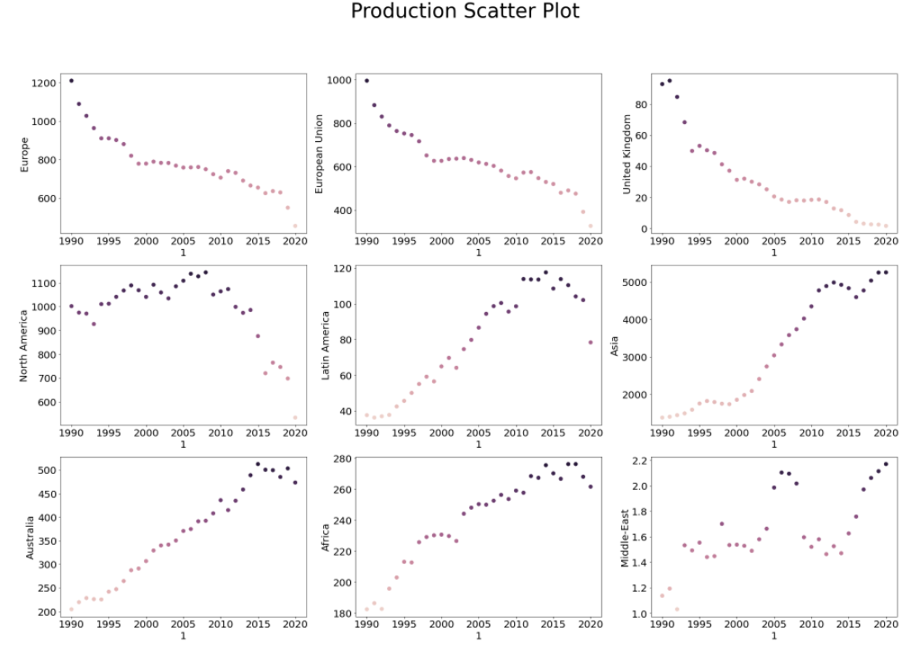
EDA
Large Regions’ Analysis

Slide 14
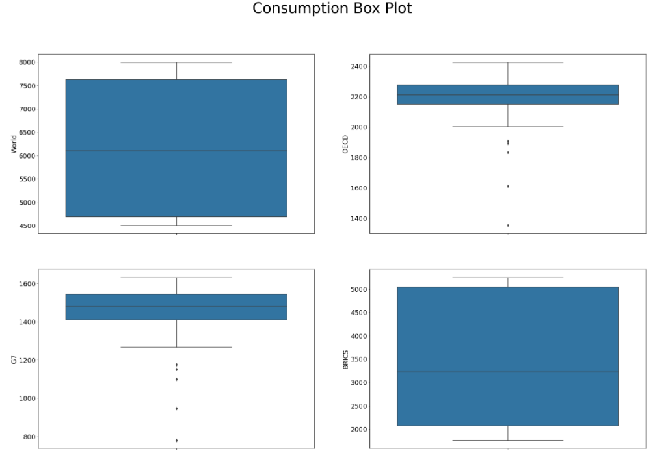
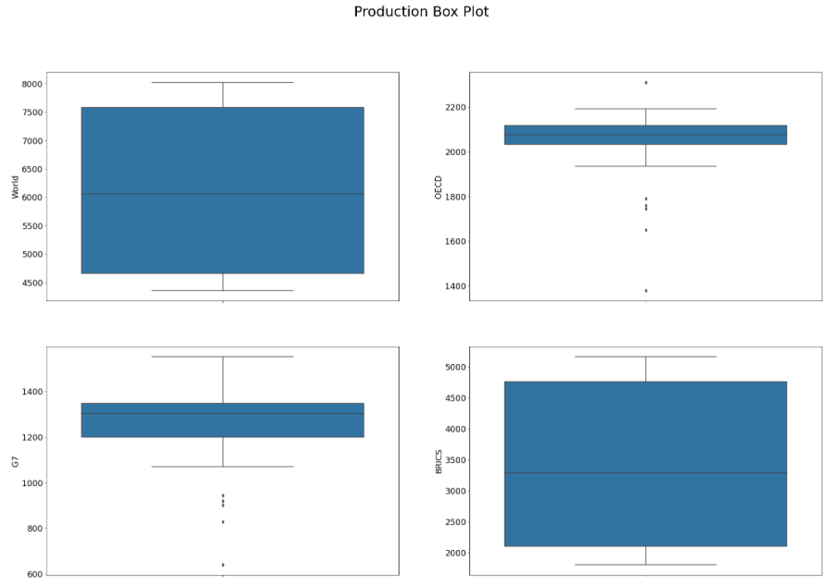
EDA
Associations’ Analysis

Slide 15
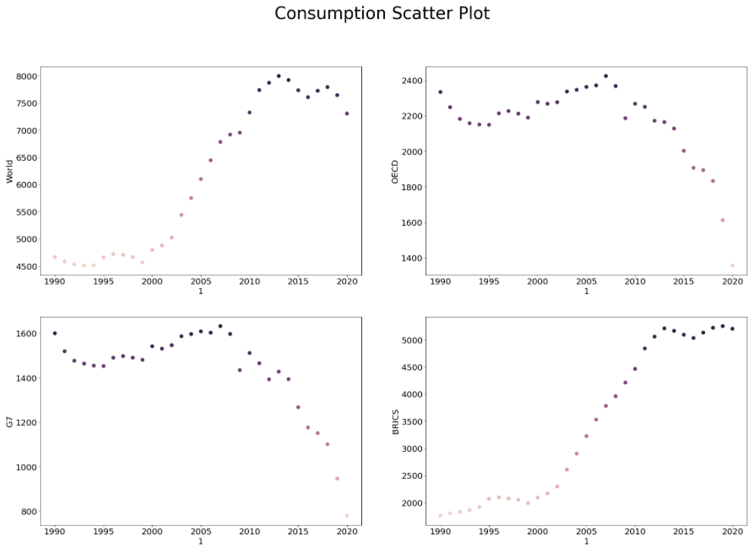
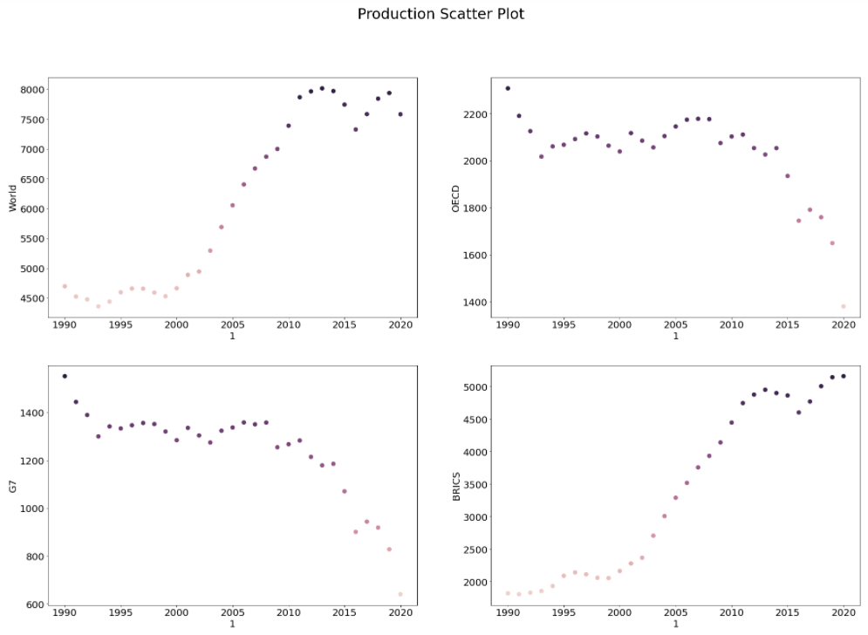
EDA
Associations’ Analysis

Slide 16
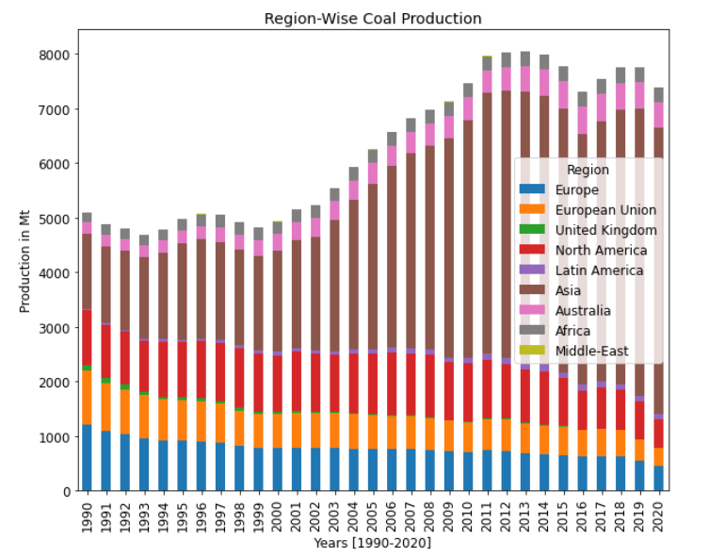
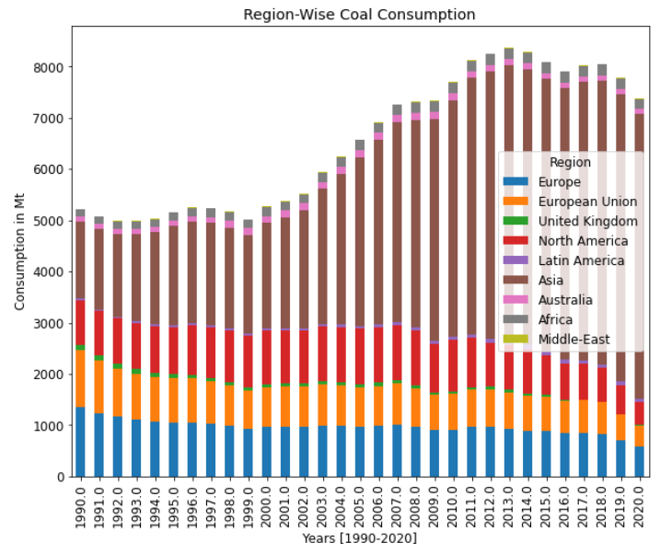
Data Visualization
Large Regions’ Analysis

Slide 17
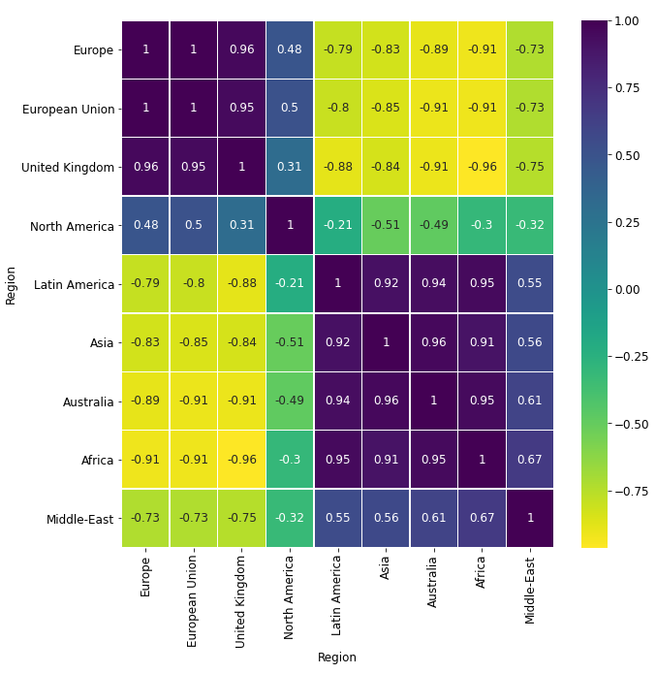
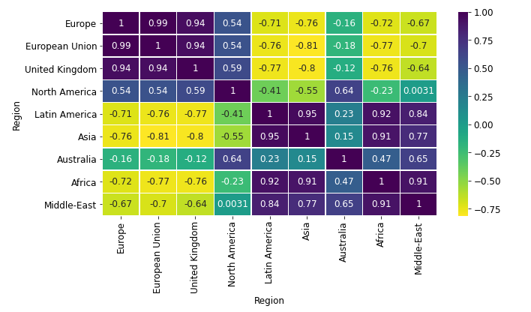
Data Visualization
Large Regions’ Analysis

Slide 18
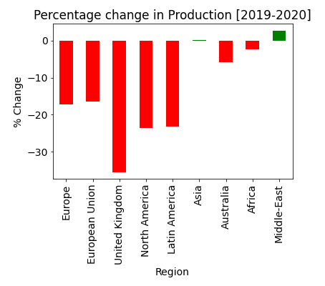
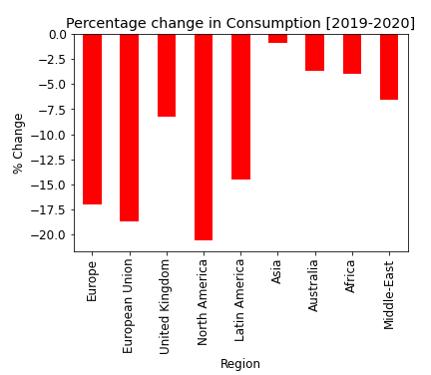
Data Visualization
Large Regions’ Analysis

Slide 19
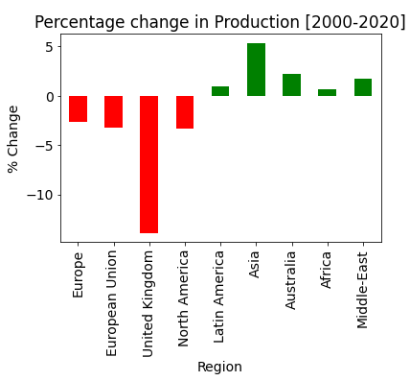
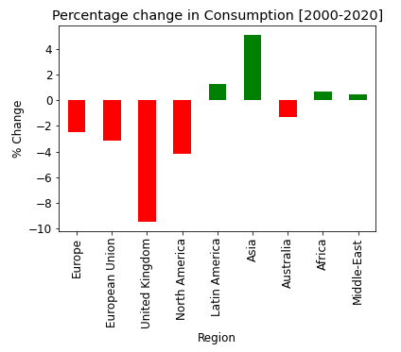
Data Visualization
Large Regions’ Analysis

Slide 20
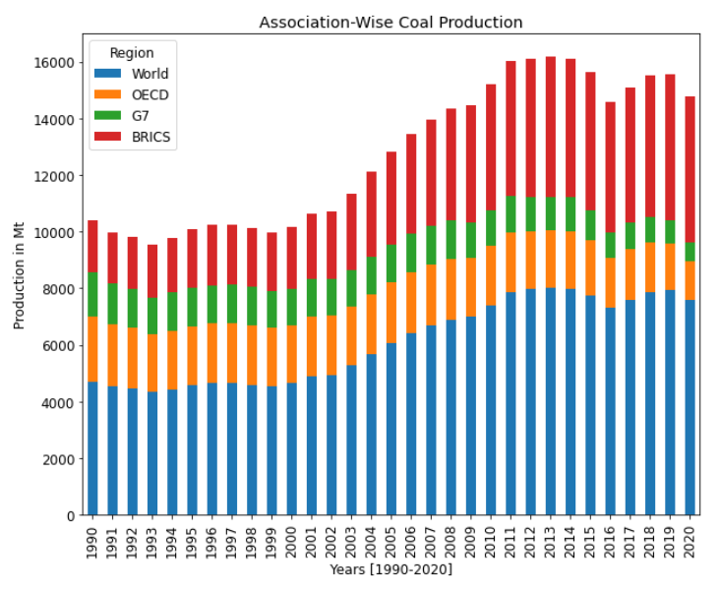
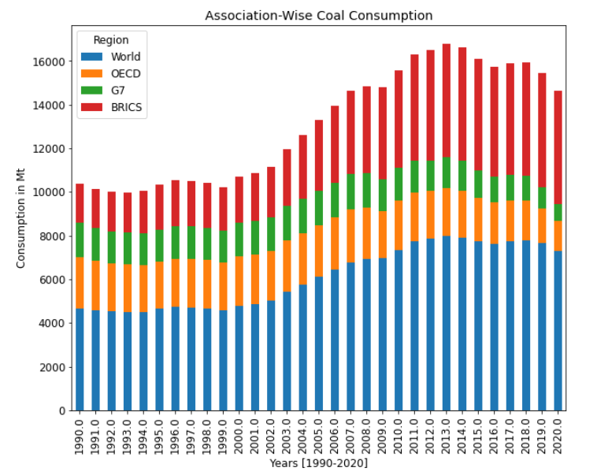
Data Visualization
Associations’ Analysis

Slide 21
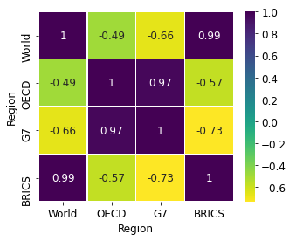
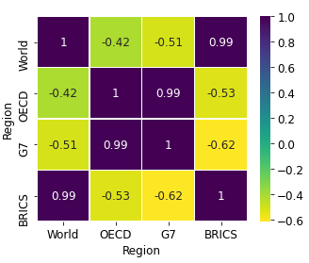
Data Visualization
Associations’ Analysis

Slide 22
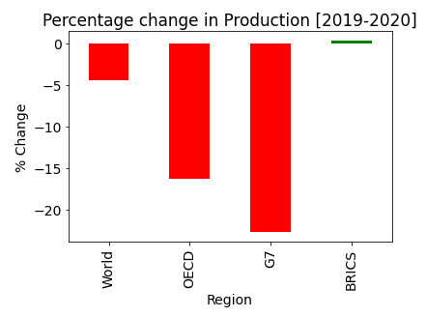
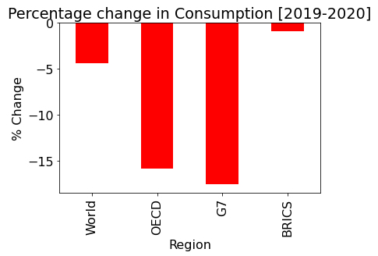
Data Visualization
Associations’ Analysis

Slide 23
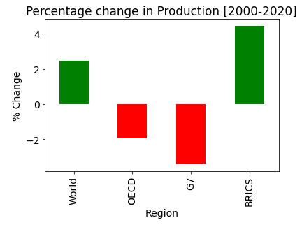
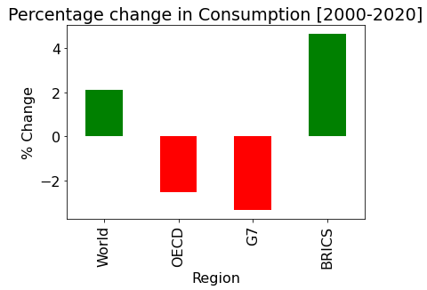
Data Visualization
Associations’ Analysis

Slide 24
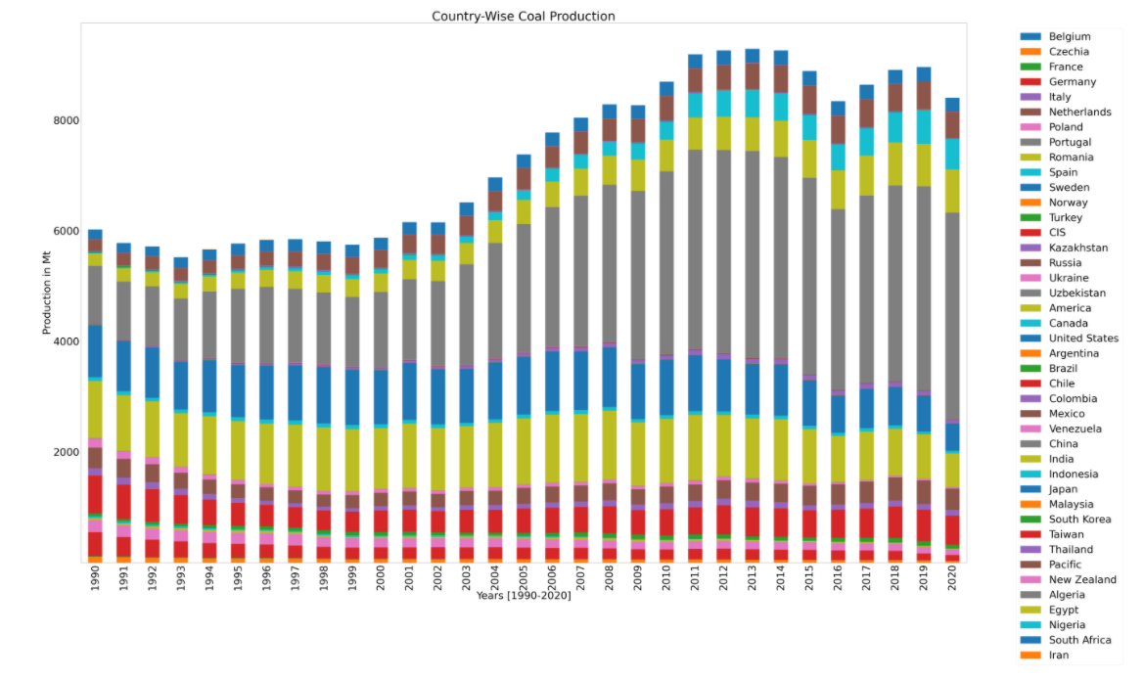
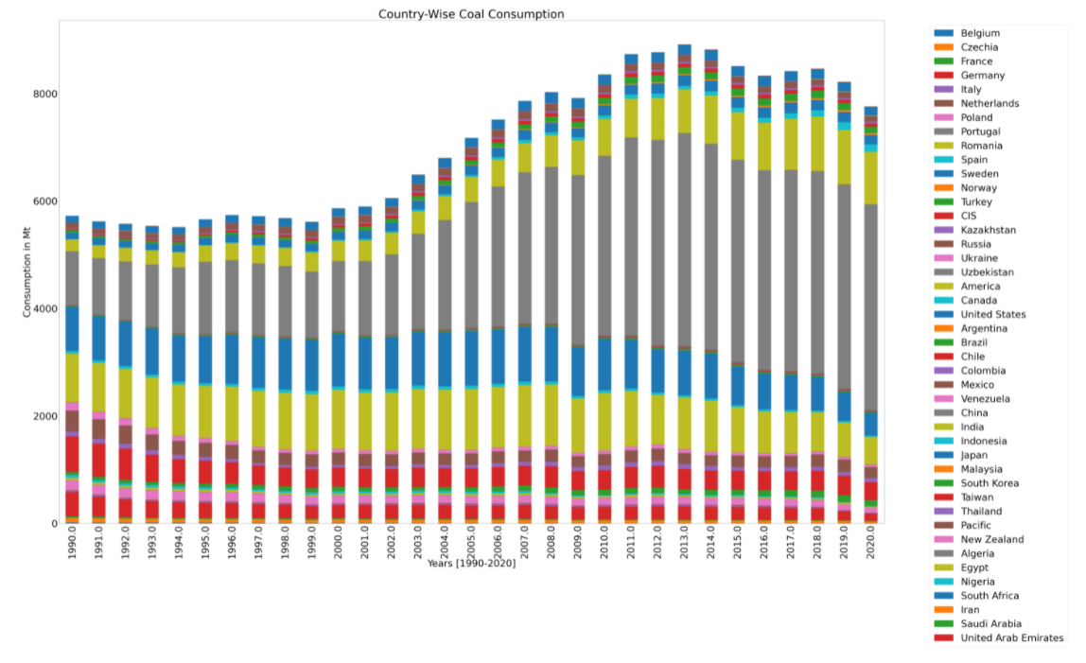
Data Visualization
Countries’ Analysis

Slide 25
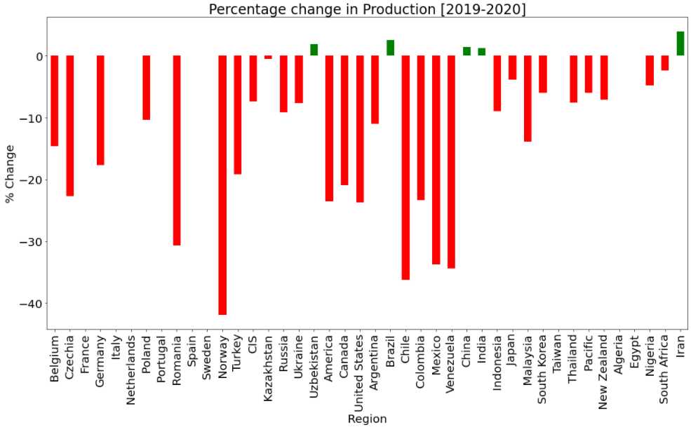
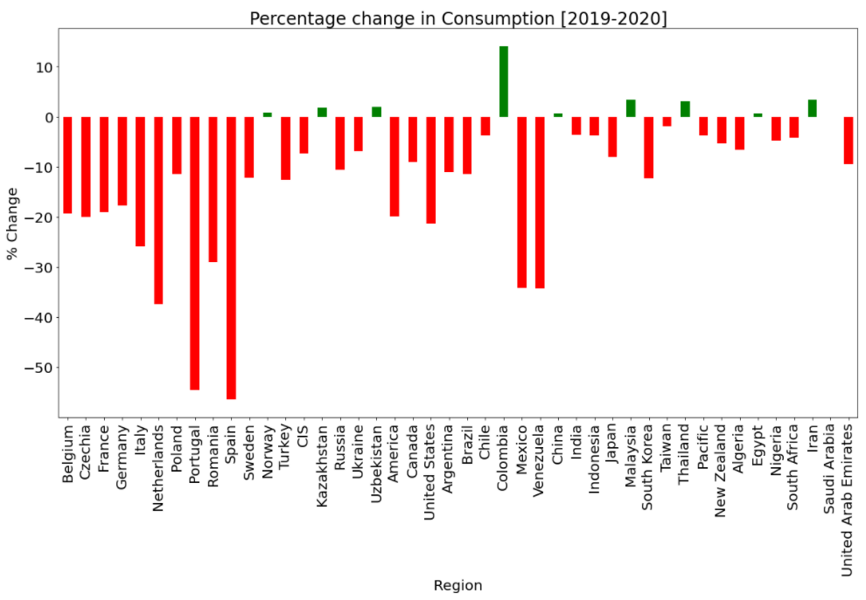
Data Visualization
Countries’ Analysis

Slide 26
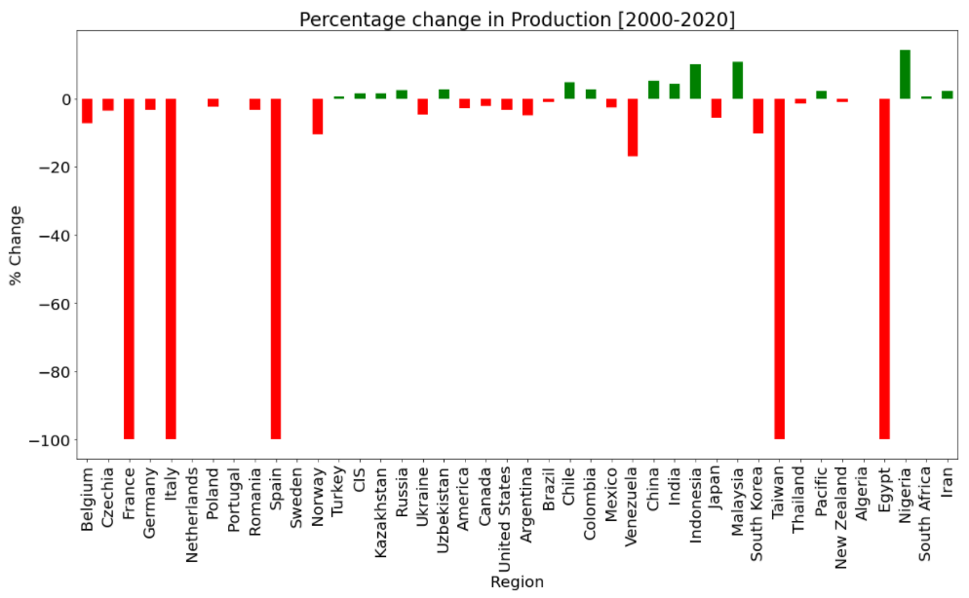
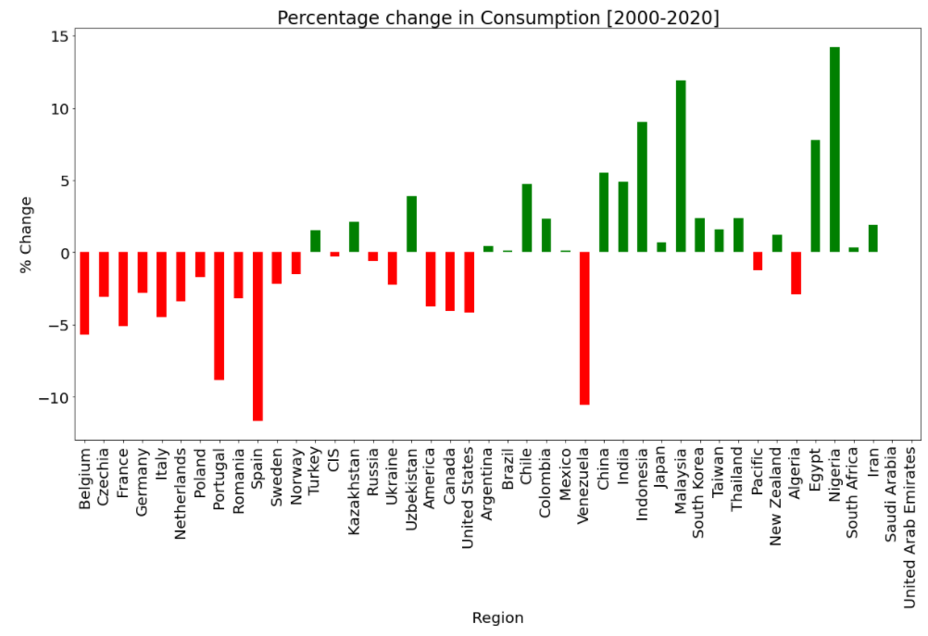
Data Visualization
Countries’ Analysis

Slide 27
Major Inferences
For Large Regions (i.e. continents), the consumption and production trends have been more or less of the same pattern. → Except Australia, which has shown significant decrease in the consumption rate over the past 3 decades and a significant increase in the Production trend.
Asia has the maximum proportion of Consumption and Production rates followed by North America.
Among the countries, China possesses the highest rates of consumption and production of coal.
The 4 associations’ consumption and production rates have also not seen any changes in the 3 decades.
The visualization of the overall production and consumption rates help us to determine whether a region/association/country has undergone increase or decrease in the rates and by how much.

Slide 28
Univariate Time Series Forecasting
ARIMA Model
An autoregressive integrated moving average, or ARIMA, is a statistical analysis model that uses time series data to either better understand the data set or to predict future trends.
They are widely used in technical analysis to forecast future security prices.
Autoregressive models implicitly assume that the future will resemble the past.
ARIMA forecasting is achieved by plugging in time series data for the variable of interest. Statistical software will identify the appropriate number of lags or amount of differencing to be applied to the data and check for stationarity. It will then output the results, which are often interpreted similarly to that of a multiple linear regression model.

Slide 29
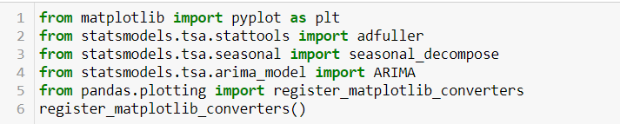
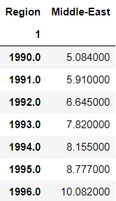
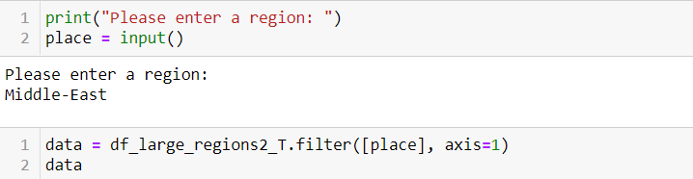
Univariate Time Series Forecasting
Data Preparation

Slide 30

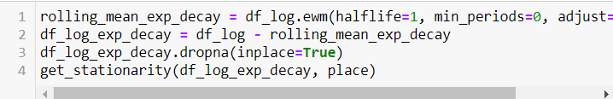

Univariate Time Series Forecasting
Making the trends stationary
Rolling Mean & Rolling Standard Deviation used to check for trend stationarity.
ADF Statistic - The time series is considered stationary if the p-value is low (according to the null hypothesis) and the critical values at 1%, 5%, 10% confidence intervals are as close as possible to the ADF Statistics

Slide 31
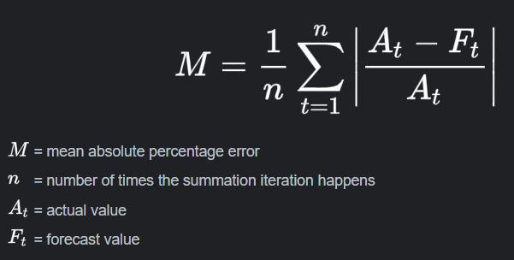

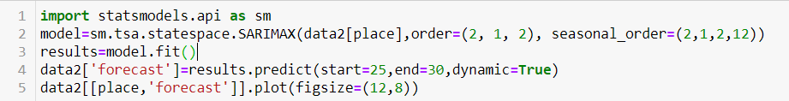
Univariate Time Series Forecasting
Calculating the First Difference & forecasting values
Depending on the formula that gives best ADF Statistic → First Difference is calculated
AutoCorrelation & Partial Autocorrelation plots – Help determine AR and MA orders.
Forecast Accuracy measurement – MAPE [Mean Absolute Percentage Error]

Slide 32
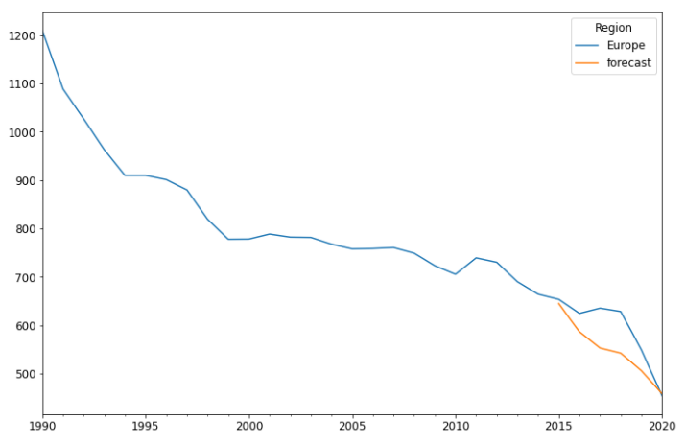
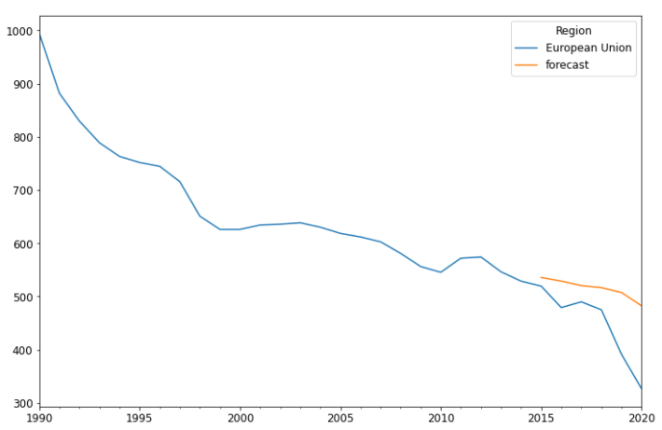
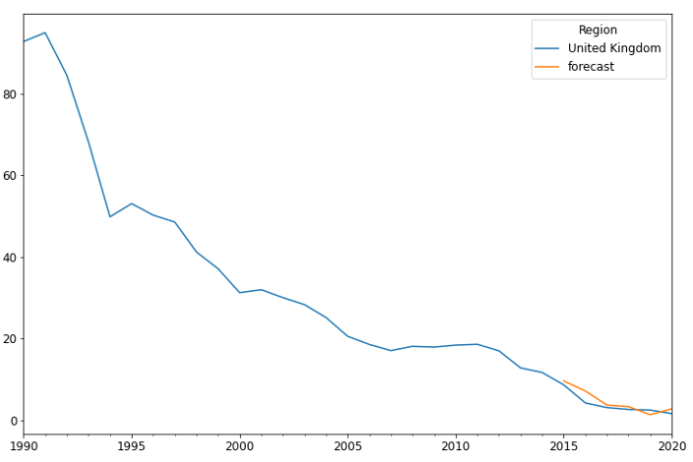



Univariate Time Series Forecasting
Model Analysis – Production Dataset

Slide 33



Univariate Time Series Forecasting
Model Analysis – Production Dataset

Slide 34






Univariate Time Series Forecasting
Model Analysis – Consumption Dataset

Slide 35



Univariate Time Series Forecasting
Model Analysis – Consumption Dataset

Slide 36






Univariate Time Series Forecasting
Forecasting Future years’ data - Production

Slide 37



Univariate Time Series Forecasting
Forecasting Future years’ data - Production

Slide 38






Univariate Time Series Forecasting
Forecasting Future years’ data - Consumption

Slide 39



Univariate Time Series Forecasting
Forecasting Future years’ data Consumption

Slide 40
Thank You

