Slide 1
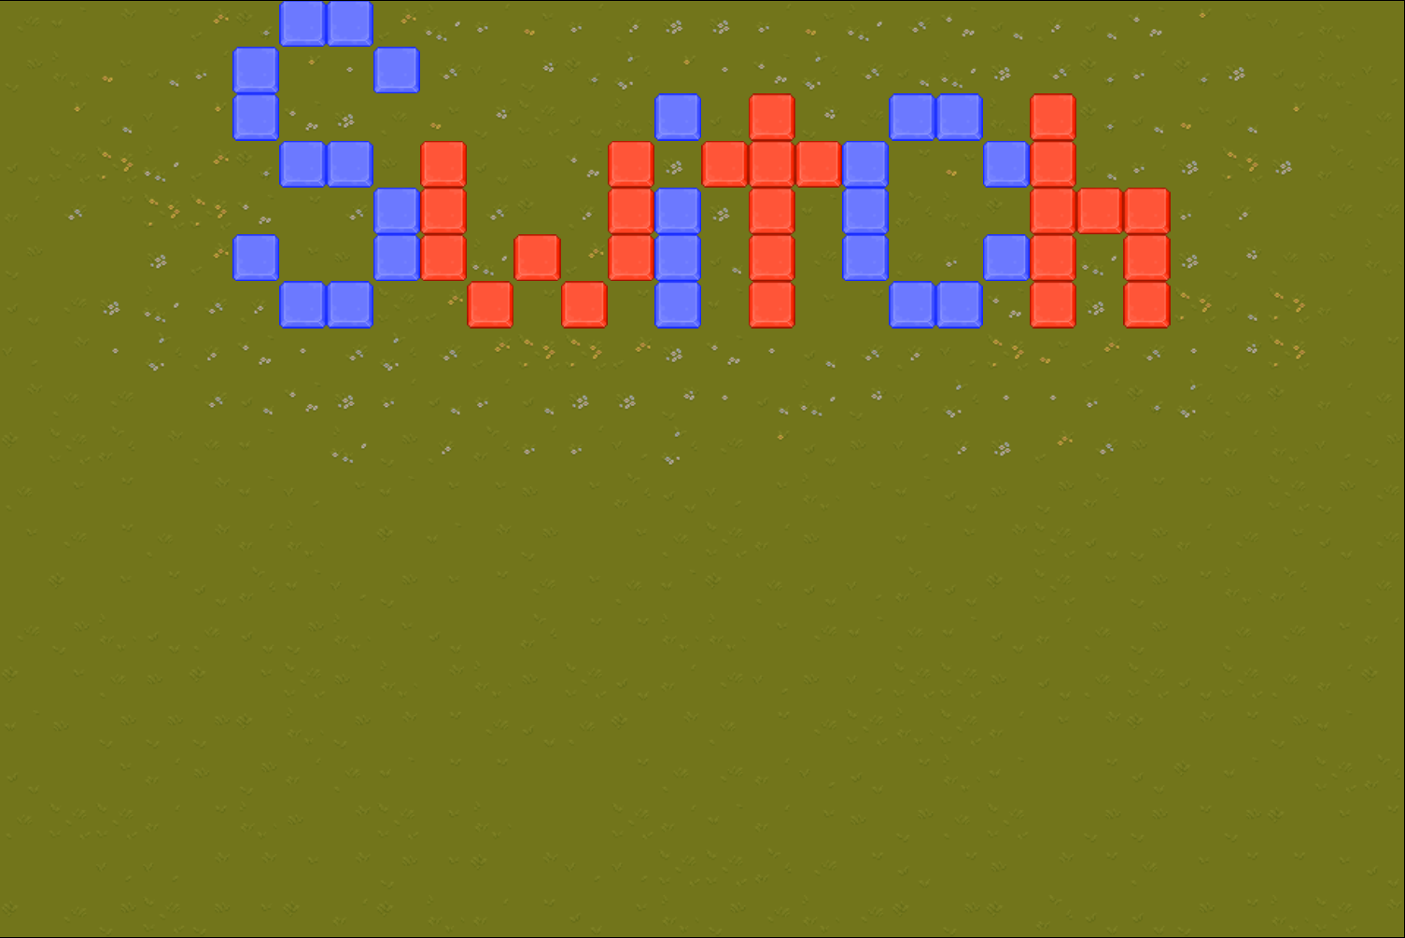
By Leah Taurisano

Slide 2
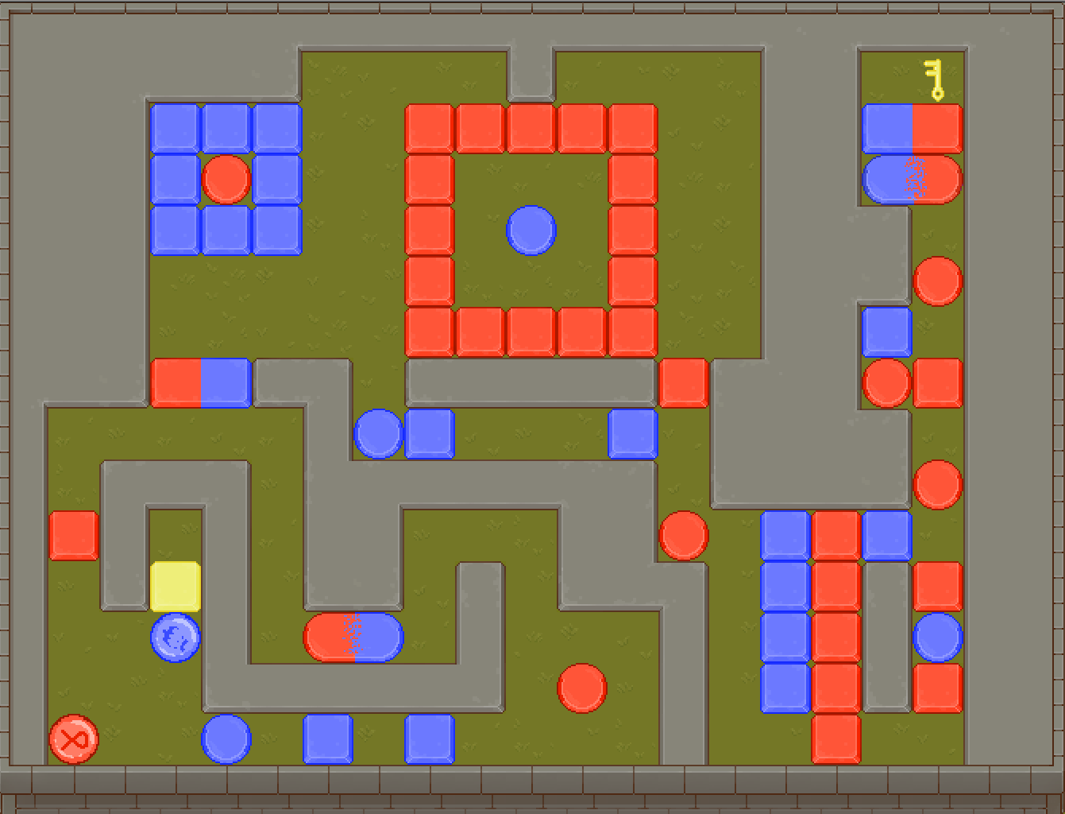
Summary
Switch is a cooperative puzzle game where two players must work together to navigate through a series of switch-based puzzles. The players need to reach the key at the end of the level, and then navigate their way back through the level to reach the exit.

Slide 3
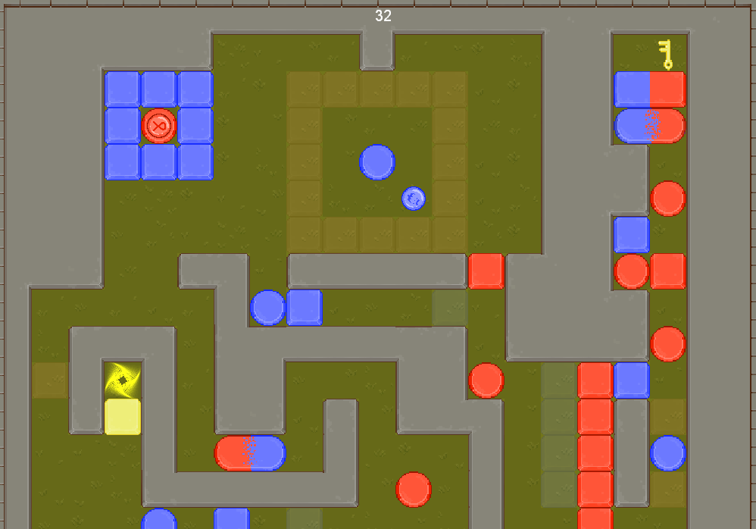
Gameplay/Features
Stepping on switches matching your players color will flip the corresponding gates. After navigating through certain puzzles, the players will need to step on dual-switches together to unlock access to the next area, forcing them to work and progress through the level together.
Reaching the end of the level will progress you to the next level, and display how long it took you to beat the level.

Slide 4
Controls
Controls are straightforward, player 1 uses the arrow keys to move, and player 2 uses WASD to move. Both players can move at the same time, entirely independently of one another.
Hitting ‘R’ will reset both players to the start of the level, there are traps that will prevent progress if you fall into them! However, resetting this will also reset the key if you’ve grabbed it, so no taking a shortcut back to the start of the level.

Slide 5
What Took Time
A few

Slide 6
What I Didn’t Have Time For
There are a lot of systems that I would have liked to have implement, but unfortunately didn’t have time for.
Adding traps that could kill the player, and giving players a certain amount of lives to beat the level, would add a some more engaging mechanics for the player’s to handle.
Adding a level select screen to the main menu for levels that players have cleared, and serializing their save file to maintain it across different playthroughs is something I also would have loved to have added as well.
Finally, I would have like to add a unique ability for each character other than just their corresponding color switches to allow for more complex and deeper puzzles.

