Slide 1
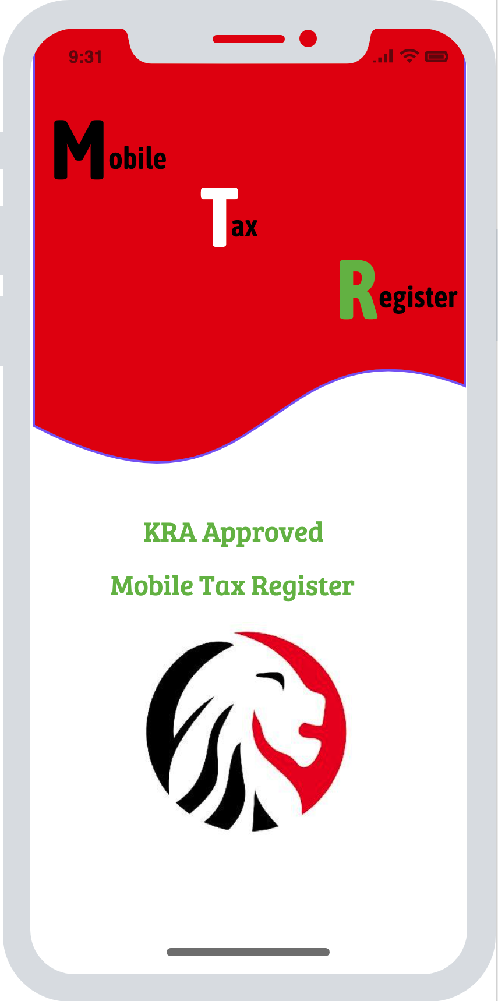
Mobile Tax Register Splash Screen

Slide 2
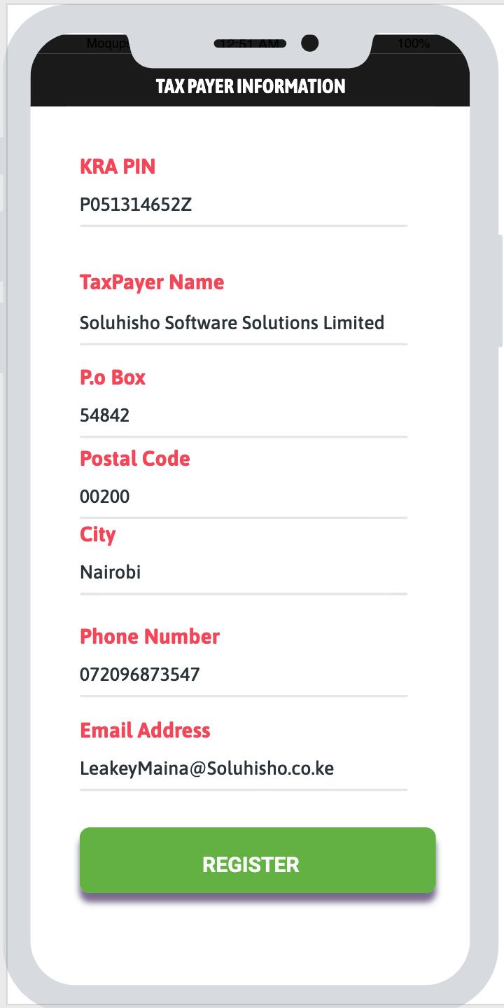
Taxpayer Registration Screen If App is NOT Registered

Slide 3
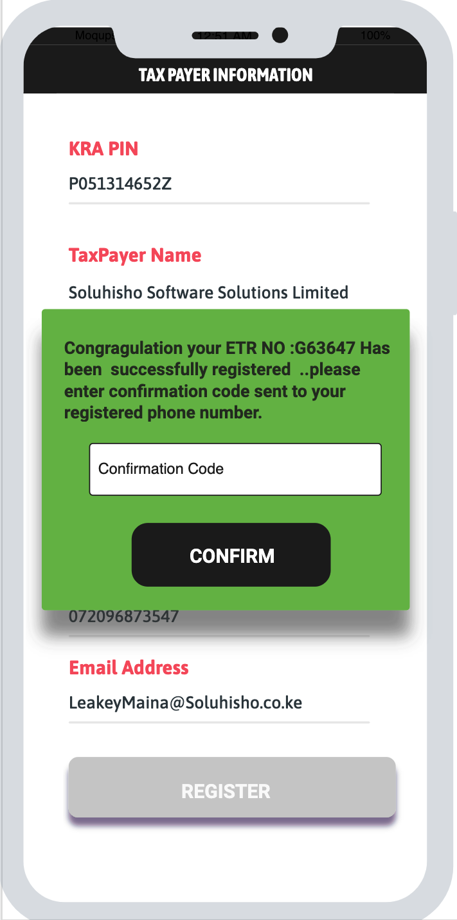
Taxpayer Registration Confirmation Screen. Confirmation code sent to the Taxpayers Registered phone Number

Slide 4
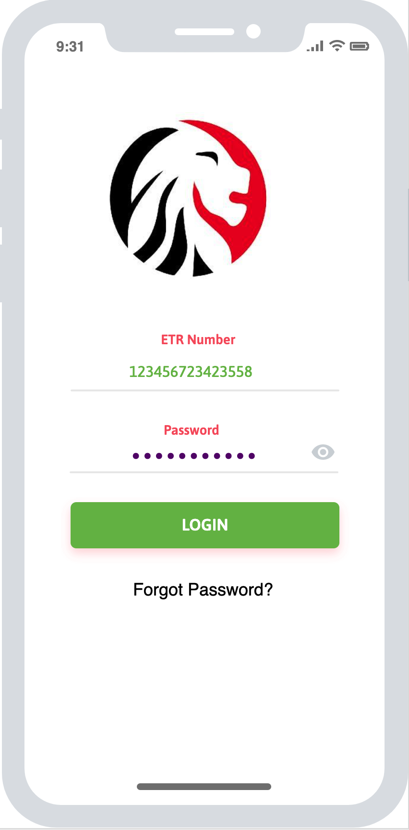
Taxpayer Login Screen If App is Registered

Slide 5
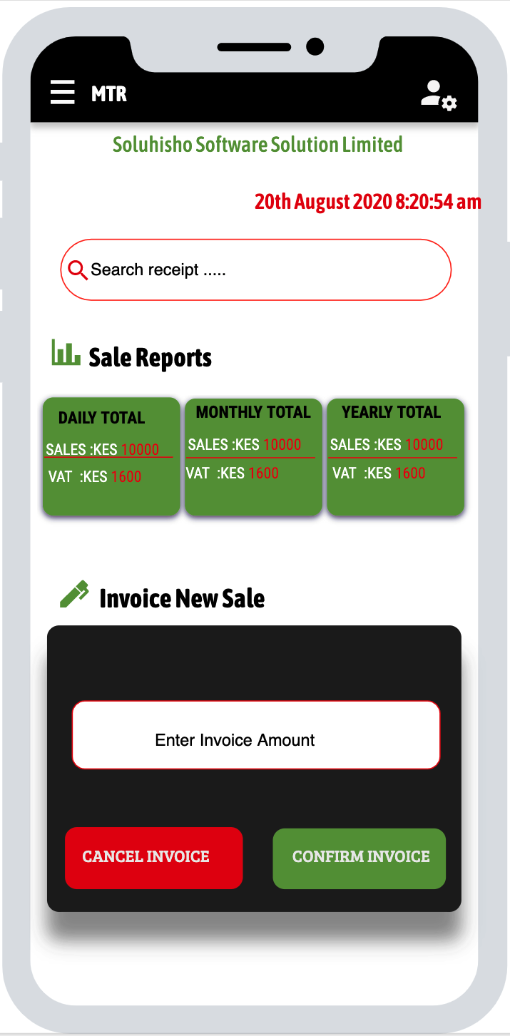
Main Screen Sale Search Sale Reports New Sale

Slide 6
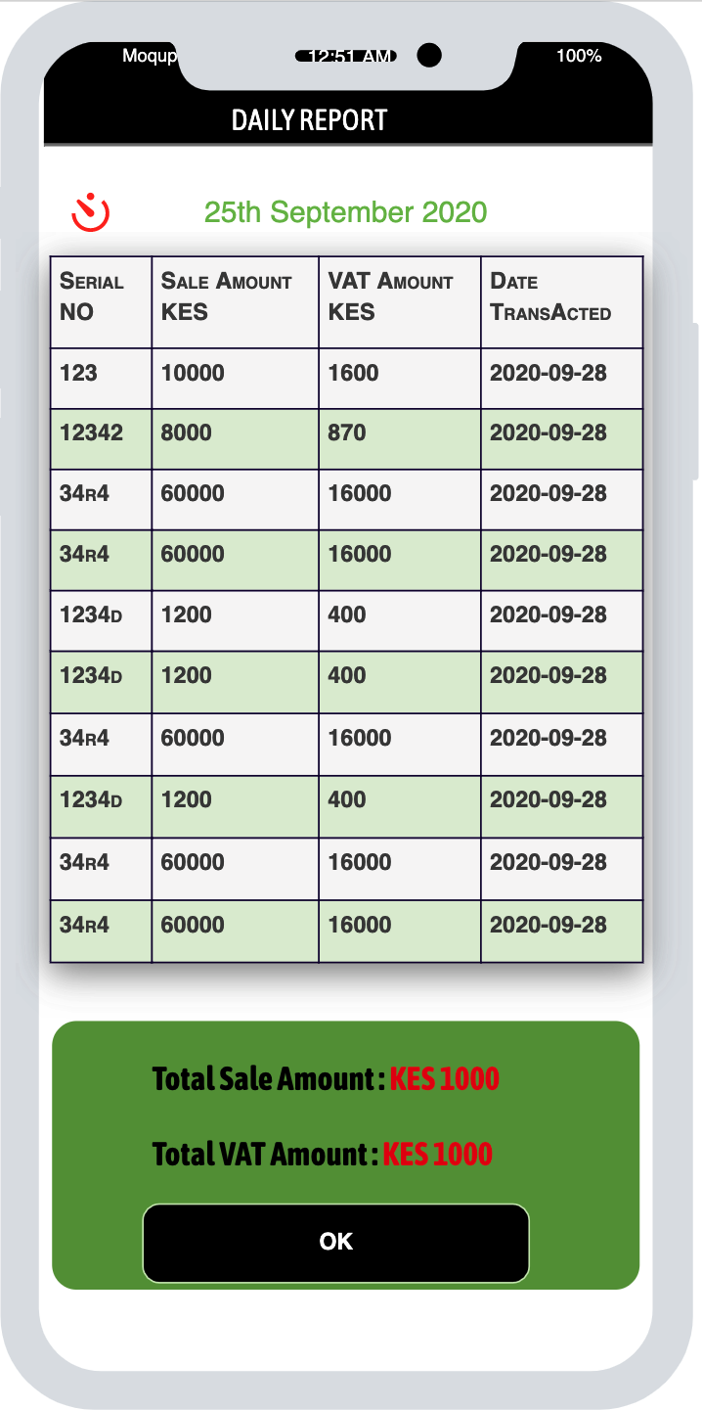
Current Day Sales Report

Slide 7
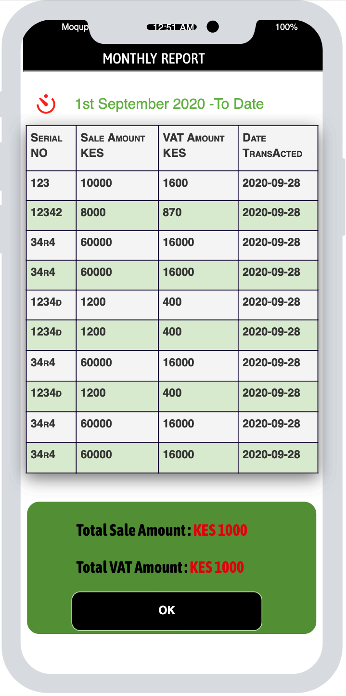
Current Month To Date Sales Report

Slide 8
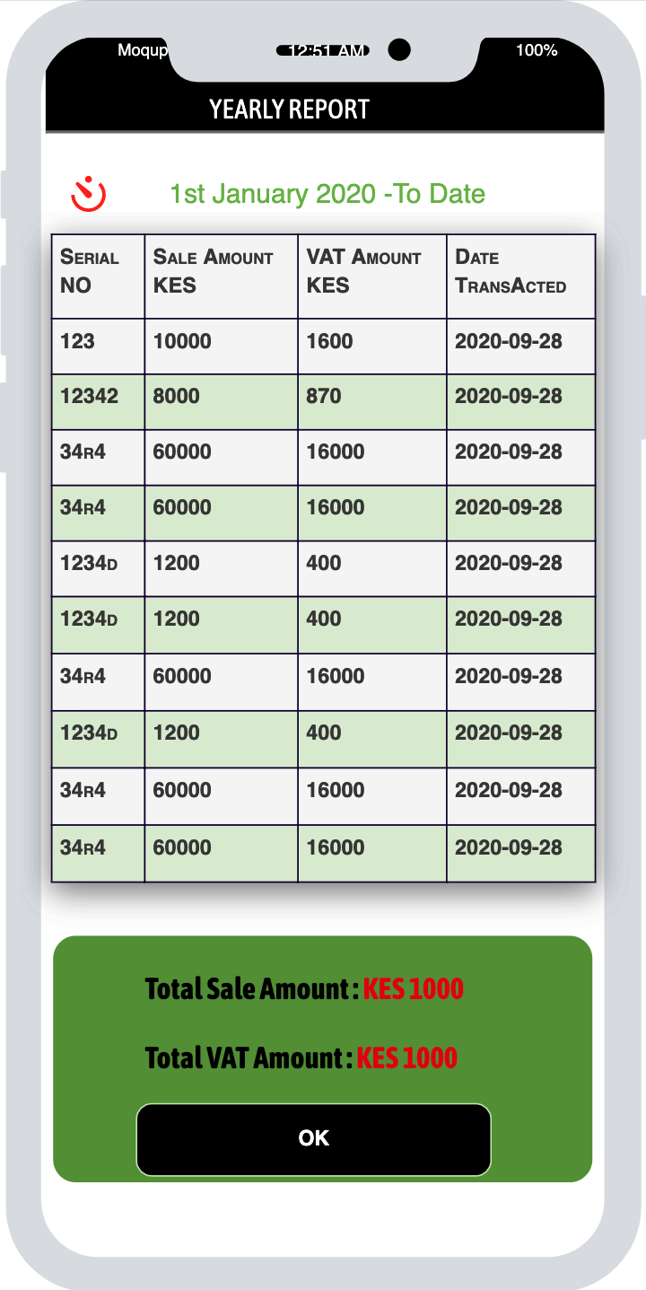
Current Year To Date Sales Report

Slide 9
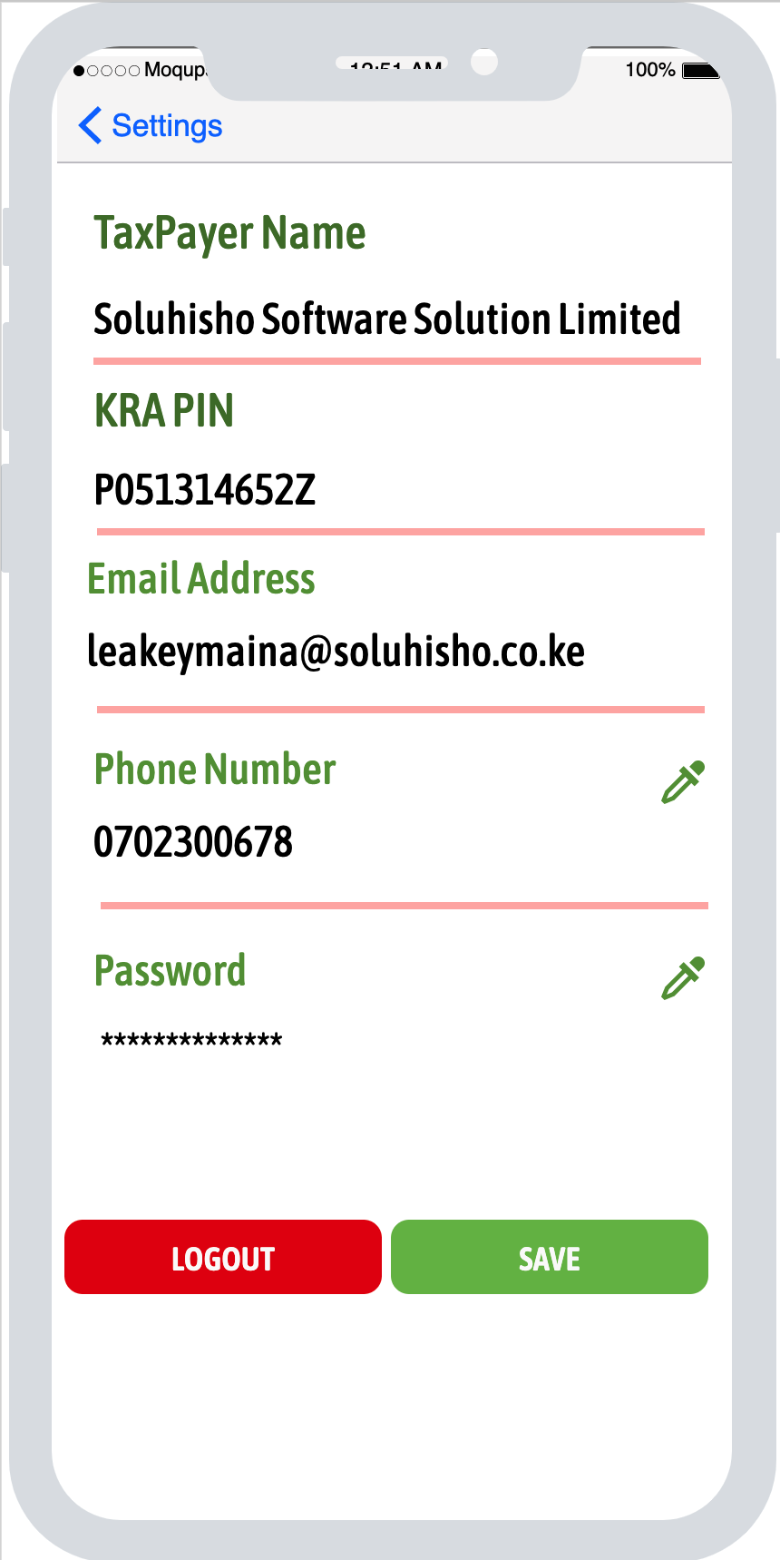
SETTINGS

