Slide 1
CSS key frame animation
Sara Leal Silverio

Slide 2
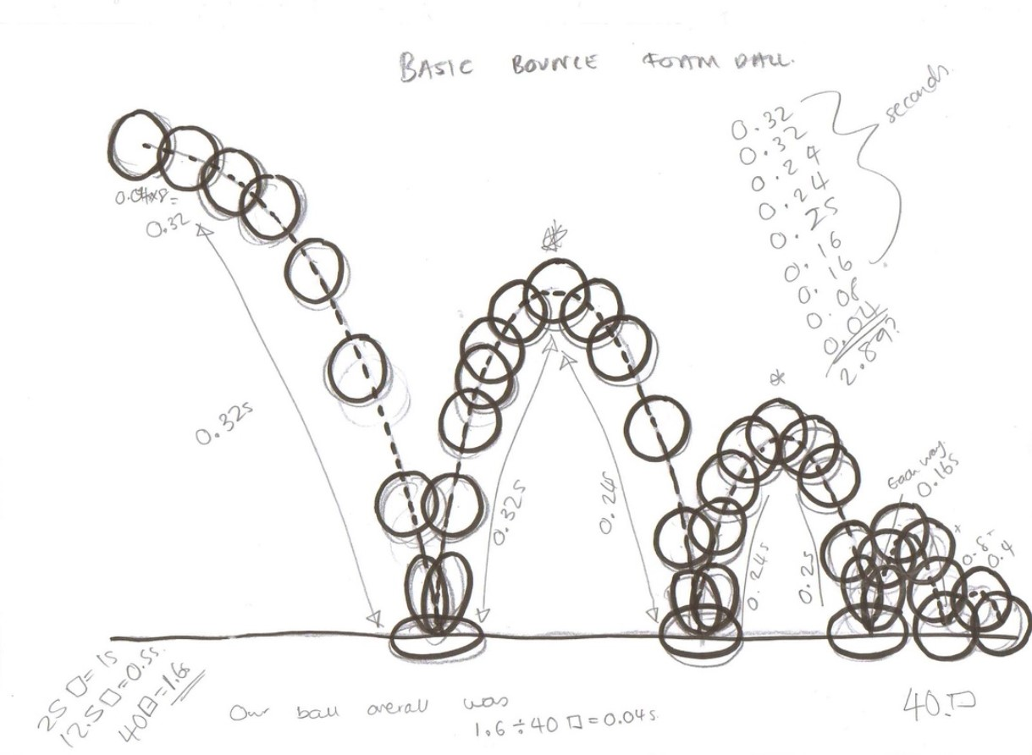

Slide 3
CSS Animation
Transition from one style to another
Key frame
@keyframe
Time %
Sub-Properties
animation-delay
animation-direction
animation-duration
animation-fill-mode
animation-iteration-count
animation-name
animation-play-state
animation-timing-function
Notes:
The animation is created by gradually changing from one set of CSS styles to another.
The @keyframes rule specifies the animation code.
During the animation, you can change the set of CSS styles many times.
!important ignored

Slide 4
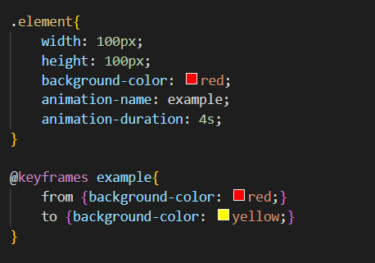
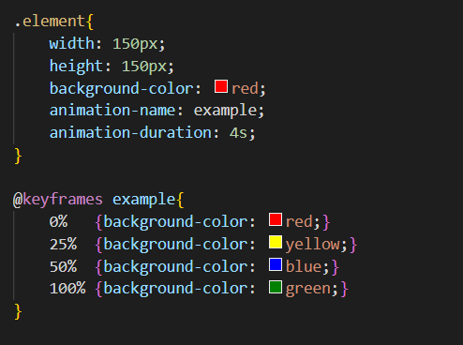
examples

Slide 5
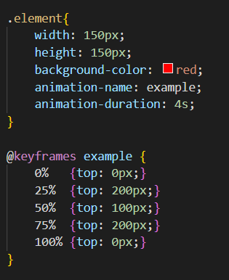
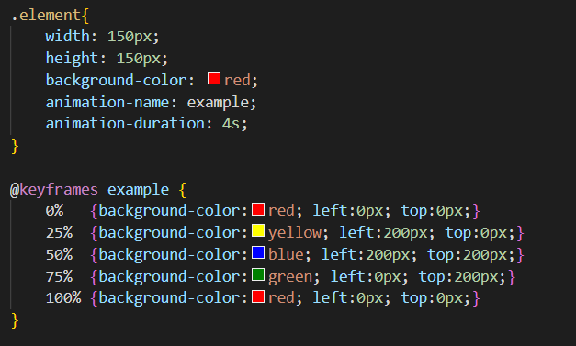
examples

Slide 6
demonstration
Notes:
https://lealsilverio.github.io/wdd230/presentation/index.html

