Slide 1

Android Jetpack
Lifecycles, LiveData, MVVM

Slide 2
Lifecycles
A set of methods

Slide 3
Lifecycles
A set of methods
Create, Start, Pause, Stop, Destroy

Slide 4
Lifecycles
A set of methods
Create, Start, Pause, Stop, Destroy
Activities, Fragments, ViewModel

Slide 5
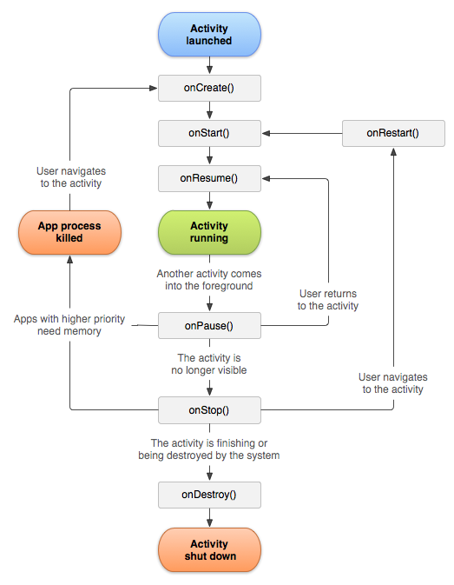
Lifecycles - Activity lifecycle

Slide 6
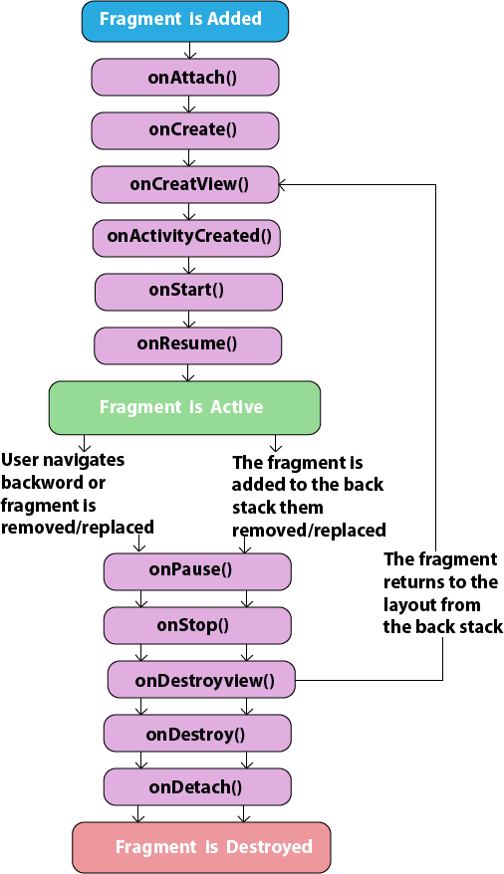
Lifecycles - Fragment lifecycle

Slide 7
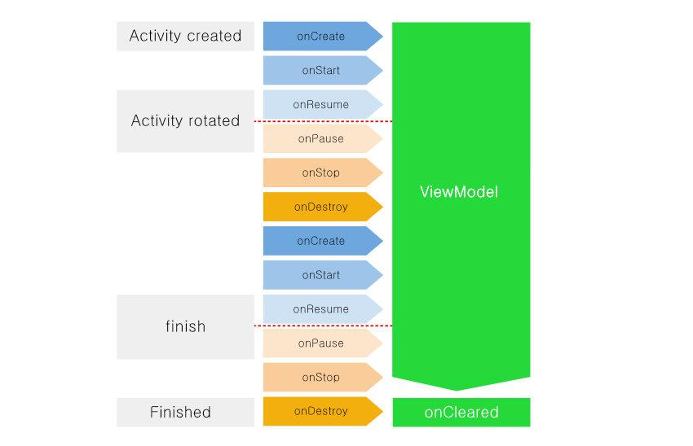
Lifecycles - ViewModel lifecycle

Slide 8
Lifecycles - LiveData
An observable

Slide 9
Lifecycles - LiveData
An observable
Lifecycle aware

Slide 10
Lifecycles - LiveData
An observable
Lifecycle aware
No memory leaks

Slide 11
Lifecycles - LiveData
An observable
Lifecycle aware
No memory leaks
Always up to date data

Slide 12
Lifecycles - LiveData
An observable
Lifecycle aware
No memory leaks
Always up to date data
Manages configuration changes

Slide 13
Lifecycles - MVVM
Architectural pattern

Slide 14
Lifecycles - MVVM
Architectural pattern
Model - View - ViewModel

Slide 15
Lifecycles - MVVM
Architectural pattern
Model - View - ViewModel
ViewModel prepares data for the UI

Slide 16
Lifecycles - MVVM
Architectural pattern
Model - View - ViewModel
ViewModel prepares data for the UI
Independent lifecycle

Slide 17
Lifecycles - MVVM
Architectural pattern
Model - View - ViewModel
ViewModel prepares data for the UI
Independent lifecycle
UI component lifecycle aware

