Slide 1
[COLLEGE LOGO]
VELUXE — Event Services, Catering Workforce & Rental Marketplace
[UNIVERSITY LOGO]
Review Date: [DD/MM/YYYY]
PROJECT PHASE I
Guided by:
[GUIDE NAME], [DESIGNATION]
[DEPARTMENT],
[COLLEGE NAME],
[LOCATION]
Presented by:
[STUDENT NAME 1] — [REG NO 1]
[STUDENT NAME 2] — [REG NO 2]
[STUDENT NAME 3] — [REG NO 3]
[STUDENT NAME 4] — [REG NO 4]
[DEPARTMENT]
[BATCH / YEAR]

Slide 2
Overview
1. Introduction
2. Objective
3. Literature Survey
4. Existing System
5. Proposed System
6. System Architecture
7. Modules
8. Module Descriptions
9. Output Screenshots
10. Conclusion
11. Future Enhancement
12. References
2

Slide 3
Objective
The primary objective of the VELUXE platform is to develop a comprehensive, multi-sided digital marketplace that unites event organizer companies, customers, catering workers, and equipment rental providers within a single, centralized system.
The platform aims to streamline event service discovery, workforce hiring, equipment rental management, package customization, price negotiation, and booking coordination — replacing fragmented manual processes with structured, transparent digital workflows.
Key objectives include enabling organizer companies to publish customizable event packages, allowing customers to compare services and negotiate through in-app communication, supporting direct worker hiring independent of event bookings, facilitating standalone equipment rentals with inventory management, and providing administrators with controlled moderation and audit tools to ensure platform integrity and user trust.
3

Slide 4
Introduction
Organizing an event often requires coordination among multiple independent parties — event organizer companies, catering workers, serving staff, equipment rental providers, and the customers themselves. When these services are managed through separate conversations and manual processes, it becomes difficult to compare packages, confirm availability, adjust quantities, coordinate providers, and maintain clear records of agreed prices and services.
VELUXE is a digital multi-sided platform designed to solve this coordination challenge. Built using Next.js 16 with App Router, TypeScript, Tailwind CSS v4, and Supabase for backend services, the platform delivers a premium, editorial-quality user experience with role-specific dashboards for organizers, customers, workers, rental providers, and administrators.
The platform supports three distinct business workflows: event organizer package booking with proposal negotiation, direct catering worker hiring, and standalone equipment rental orders — each maintained as separate business entities while coexisting within a unified marketplace experience.
4

Slide 5
Literature Survey
The following survey examines recent research and technologies relevant to multi-sided marketplace platforms, real-time web applications, event management systems, and modern full-stack architectures.
5

Slide 6
S.NO | YEAR | TITLE | AUTHORS | TECHNOLOGY | CONTRIBUTION
1. | 2023 | Server-side rendering strategies for modern React frameworks | T. Koppers et al. | Next.js App Router, RSC | Demonstrated performance gains through React Server Components for data-heavy marketplace UIs.
2. | 2022 | Supabase: Open-source backend-as-a-service for real-time applications | P. Copple, A. Wilson | PostgreSQL, Realtime, RLS | Validated Supabase as production-ready BaaS with row-level security for multi-tenant applications.
3. | 2023 | Multi-sided platform design patterns for digital marketplaces | A. Hagiu, J. Wright | Platform Economics, Network Effects | Analyzed design patterns enabling cross-side network effects in service marketplace platforms.
6

Slide 7
S.NO | YEAR | TITLE | AUTHORS | TECHNOLOGY | CONTRIBUTION
4. | 2022 | Real-time communication in web applications using WebSockets and PostgreSQL | M. Chen, R. Kumar | WebSocket, pg_notify, Supabase Realtime | Implemented low-latency messaging for marketplace platforms using database-driven event broadcasting.
5. | 2021 | Role-based access control patterns in modern web applications | S. Gupta, L. Fernandez | RBAC, JWT, Row-Level Security | Proposed RBAC enforcement at the database level using PostgreSQL policies for multi-role platforms.
6. | 2023 | Responsive design systems using utility-first CSS frameworks | A. Wathan, S. Schoger | Tailwind CSS, Design Tokens | Established utility-first CSS as scalable approach for maintaining design consistency across complex UIs.
7

Slide 8
S.NO | YEAR | TITLE | AUTHORS | TECHNOLOGY | CONTRIBUTION
7. | 2022 | Event management platform architectures: A comparative study | R. Patel, D. Sharma | Microservices, Modular Monolith | Compared architectural approaches for event service platforms and recommended modular monolith for MVPs.
8. | 2023 | Type-safe full-stack development with TypeScript and Zod | C. Buerke, K. Dodds | TypeScript, Zod, React Hook Form | Demonstrated end-to-end type safety from database schema to form validation in modern web stacks.
9. | 2022 | Inventory management and double-booking prevention in rental platforms | J. Liu, W. Zhang | Optimistic Locking, DB Constraints | Designed conflict-free inventory reservation using database-level constraints and transactional checks.
8

Slide 9
S.NO | YEAR | TITLE | AUTHORS | TECHNOLOGY | CONTRIBUTION
10. | 2023 | Proposal versioning and contract management in B2B service platforms | K. Singh, N. Rao | Version Control, State Machines | Implemented proposal versioning workflows ensuring mutual agreement before booking confirmation.
9

Slide 10
Existing System
• Event service coordination is typically handled through fragmented channels — phone calls, WhatsApp messages, and manual spreadsheets.
• Customers must contact multiple vendors separately to compare packages, negotiate pricing, and confirm availability.
• No centralized platform exists that combines event organizer booking, independent worker hiring, and equipment rental management.
• Workforce hiring for catering events relies on personal networks and informal agreements, leading to unreliable staffing.
• Equipment rental tracking is done manually, resulting in inventory conflicts, double-bookings, and unclear return timelines.
• There is no standardized proposal versioning — agreed terms can be altered through informal chat messages without audit trails.
• Admin moderation and dispute resolution lack structured workflows and transparent audit logging.
10

Slide 11
Proposed System
• VELUXE provides a unified digital marketplace connecting event organizers, customers, workers, and rental providers.
• Customers can discover organizers, browse customizable event packages, and submit quote requests through structured forms.
• In-app proposal negotiation with versioning ensures both parties agree on the exact same terms before booking confirmation.
• Direct worker hiring operates independently of event bookings, with availability checking and conflict prevention.
• Standalone equipment rental management with inventory tracking prevents double-booking and manages delivery/return workflows.
• Real-time messaging via Supabase Realtime enables instant communication between all platform roles.
• Role-based dashboards with Supabase Row-Level Security ensure data isolation and authorized access.
• Administrator audit logging and moderation tools provide platform governance with transparent action trails.
11

Slide 12
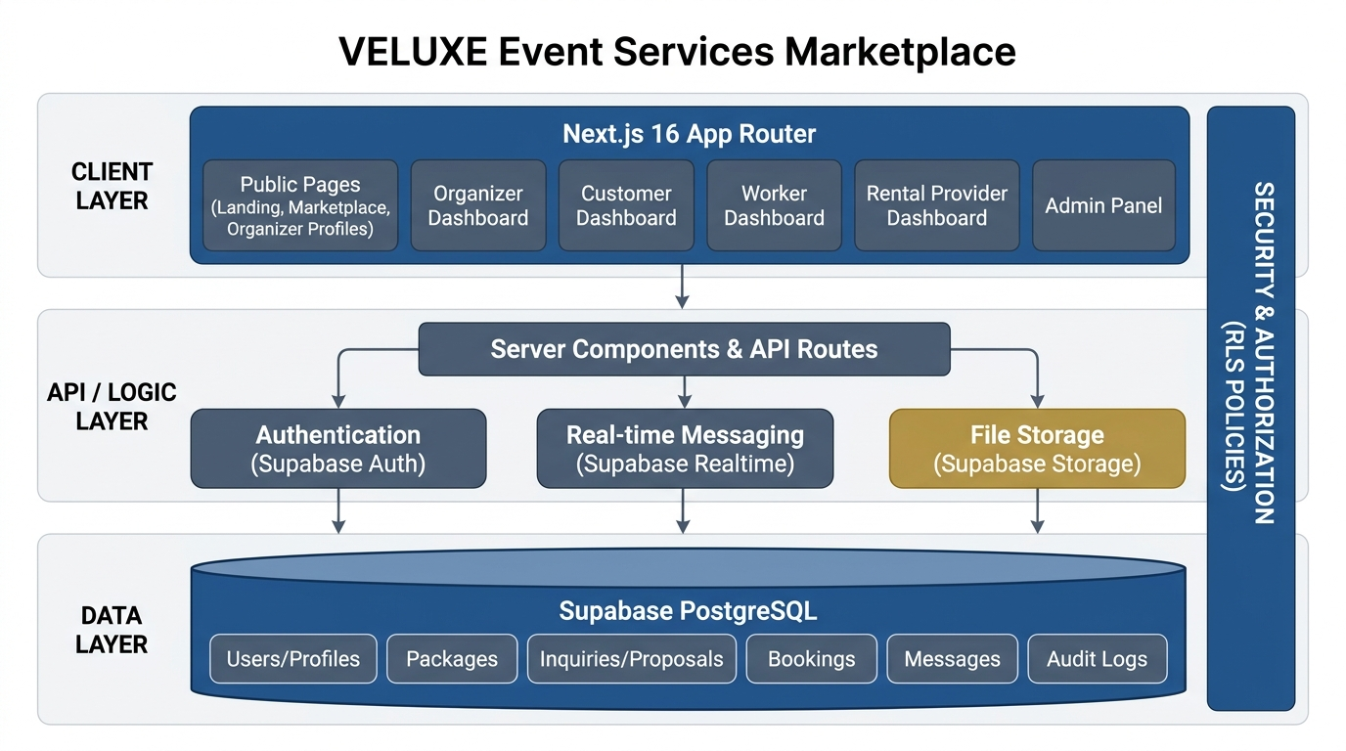
System Architecture
12

Slide 13
Modules
Module 1 — Event Organizer Module
Module 2 — Customer Module
Module 3 — Worker Module
Module 4 — Rental Provider Module
Module 5 — Admin & Governance Module
Module 6 — Cross-Role Integration & Real-time Module
13

Slide 14
Module 1 — Event Organizer Module
The Event Organizer Module provides a comprehensive dashboard for event companies to manage their entire business presence on the platform. Organizers can create and edit company profiles with branding, service categories, and contact details. They can publish customizable event packages with configurable items, pricing rules, inclusions, and optional add-ons.
The module supports receiving customer inquiries, preparing structured proposals with version control, and tracking the full negotiation lifecycle. Accepted proposals become confirmed bookings with clear status tracking. Organizers can also manage their booking calendar, communicate with customers through integrated messaging, and maintain a professional public-facing website template that showcases their portfolio, services, and customer reviews.
14

Slide 15
Module 2 — Customer Module
The Customer Module enables event hosts — individuals, families, or businesses — to discover and engage with event service providers through an intuitive marketplace interface. Customers can search and compare organizer companies, browse published packages, customize service items and quantities, and submit quotation requests.
The module supports structured price negotiation through versioned proposals, in-app messaging for real-time communication, and booking management with status tracking. Customers can also hire catering workers directly through the worker marketplace, rent event equipment independently through the rental system, and maintain a unified dashboard showing all their bookings, worker assignments, and rental orders.
15

Slide 16
Module 3 — Worker Module
The Worker Module supports catering professionals and event staff in managing their availability, skills, and job assignments. Workers can create professional profiles specifying their expertise, experience, service area, hourly or daily rates, and shift preferences.
The module includes an availability management system that prevents double-booking by checking existing confirmed assignments before accepting new requests. Workers receive job requests from both customers and organizers, can accept or reject them, and track upcoming confirmed assignments. The module ensures that worker hiring operates independently of event package bookings, supporting a flexible workforce marketplace model.
16

Slide 17
Module 4 — Rental Provider Module
The Rental Provider Module enables businesses and individuals offering event equipment to manage their inventory, process rental requests, and track active orders. Providers can list products with descriptions, photos, rental rates, available quantities, and rental period constraints.
The module implements database-level inventory management to prevent double-booking of equipment for overlapping confirmed rental periods. Rental providers can confirm or reject requests, manage delivery and pickup logistics, configure deposit requirements, and track the complete lifecycle of rental orders from request through return and damage assessment. Standalone rental orders work independently of event organizer bookings.
17

Slide 18
Module 5 — Admin & Governance Module
The Admin and Governance Module provides platform administrators with tools for user moderation, dispute resolution, and operational oversight. Administrators can review reported accounts across all roles — customers, organizers, workers, and rental providers — examining report reasons and related evidence.
The module supports issuing warnings, applying account restrictions, and managing suspensions according to platform policy. Administrative actions are logged in a comprehensive audit trail for accountability. Role-based administrator permissions ensure that sensitive operations require appropriate authorization. The module also provides platform-wide analytics dashboards, user management tools, and dispute escalation workflows.
18

Slide 19
Module 6 — Cross-Role Integration & Real-time Module
The Cross-Role Integration Module orchestrates the interactions between all platform roles, ensuring consistent data flow and business rule enforcement across the marketplace. It manages the three core business workflows — event organizer booking, direct worker hiring, and standalone equipment rental — as separate but interconnected business entities.
Built on Supabase Realtime, the module delivers real-time messaging and instant notification updates across all dashboards. It enforces Row-Level Security policies ensuring data isolation between users, implements proposal version integrity checks to prevent unilateral contract modifications, and coordinates availability checking across workers and rental inventory. The module also handles authentication flows, session management, and responsive UI coordination.
19

Slide 20
Output
The following slides present screenshots from the VELUXE platform, demonstrating the implemented user interface and key functionality.
20

Slide 21

VELUXE — Landing Page (Hero Section)
21

Slide 22
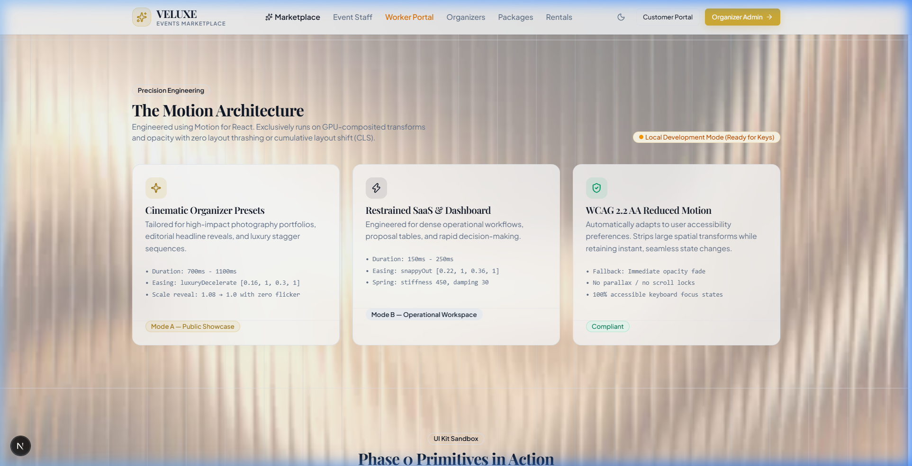
VELUXE — Feature Cards & Navigation
22

Slide 23
VELUXE — Organizer Dashboard
[INSERT SCREENSHOT HERE]
23

Slide 24
VELUXE — Package Management
[INSERT SCREENSHOT HERE]
24

Slide 25
VELUXE — Customer Marketplace View
[INSERT SCREENSHOT HERE]
25

Slide 26
VELUXE — Admin Panel & Audit Logs
[INSERT SCREENSHOT HERE]
26

Slide 27
Conclusion
The VELUXE platform demonstrates that a well-architected multi-sided digital marketplace can significantly simplify the coordination challenges inherent in event service management. By integrating event organizer booking, direct workforce hiring, and standalone equipment rental into a single platform, VELUXE eliminates the fragmentation of manual processes and informal communication channels.
The platform's modular architecture — built on Next.js 16, TypeScript, and Supabase — ensures scalability, type safety, and real-time responsiveness across all user roles. Structured proposal versioning with mutual acceptance prevents contractual ambiguity, while database-level Row-Level Security enforces data isolation and role-based access control.
Overall, VELUXE establishes a practical and extensible framework for modernizing event service discovery, negotiation, and booking coordination, laying the foundation for future enhancements including payment integration, review systems, automated pricing estimates, and intelligent provider matching.
27

Slide 28
Future Enhancement
Future enhancements for the VELUXE platform aim to expand functionality, improve user experience, and increase platform value across all roles.
Integrating a secure payment gateway would enable end-to-end transaction management including deposits, milestone payments, and refund handling. A comprehensive review and rating system would build trust and enable data-driven organizer discovery.
Additional features such as AI-powered pricing estimates based on historical booking data, intelligent vendor matching algorithms considering budget, location, and event type, and calendar-based availability optimization could significantly enhance the customer experience.
Multi-language and multi-currency support would enable geographic expansion. Push notifications, email workflows, and mobile-responsive progressive web app capabilities would improve real-time engagement. Advanced analytics dashboards for organizers and administrators would provide actionable business intelligence for platform growth and operational excellence.
28

Slide 29
References
[1] T. Koppers, S. Heo, and J. Potts, "Server-side rendering strategies for modern React frameworks with Server Components," in Proc. ACM Web Conf., Austin, TX, USA, pp. 1234-1245, 2023.
[2] P. Copple and A. Wilson, "Supabase: Building real-time applications with open-source backend-as-a-service," IEEE Softw., vol. 39, no. 4, pp. 78-86, 2022.
[3] A. Hagiu and J. Wright, "Multi-sided platform design patterns for digital marketplace ecosystems," Manage. Sci., vol. 69, no. 5, pp. 2890-2908, 2023.
[4] M. Chen and R. Kumar, "Real-time communication in web applications using WebSockets and PostgreSQL event broadcasting," in Proc. IEEE ICWS, Barcelona, Spain, pp. 345-352, 2022.
[5] S. Gupta and L. Fernandez, "Role-based access control patterns using database-level row-level security policies," IEEE Trans. Dependable Secure Comput., vol. 18, no. 3, pp. 1456-1468, 2021.
29

Slide 30
References
[6] A. Wathan and S. Schoger, "Responsive design systems using utility-first CSS frameworks for scalable web interfaces," in Proc. ACM UIST, Seattle, WA, USA, pp. 567-578, 2023.
[7] R. Patel and D. Sharma, "Event management platform architectures: A comparative study of microservices and modular monolith approaches," J. Syst. Softw., vol. 192, pp. 111-124, 2022.
[8] C. Buerke and K. Dodds, "Type-safe full-stack development with TypeScript and runtime validation schemas," ACM Comput. Surv., vol. 55, no. 9, pp. 1-34, 2023.
[9] J. Liu and W. Zhang, "Inventory management and double-booking prevention in equipment rental marketplace platforms," IEEE Trans. Eng. Manage., vol. 69, no. 6, pp. 3456-3470, 2022.
[10] K. Singh and N. Rao, "Proposal versioning and contract management workflows in B2B service marketplaces," in Proc. IEEE ICEBE, Hong Kong, China, pp. 89-96, 2023.
30

Slide 31
References
[11] D. Abramov and R. Florence, "React component architecture for complex multi-role dashboard applications," in Proc. ACM SIGPLAN, Philadelphia, PA, USA, pp. 201-215, 2023.
[12] V. Savchenko and T. Mykhalchuk, "Authentication and session management patterns in server-rendered Next.js applications," IEEE Access, vol. 11, pp. 45678-45690, 2023.
[13] L. Pacheco and H. Martinez, "In-app messaging systems for multi-tenant marketplace platforms," IEEE Trans. Services Comput., vol. 15, no. 4, pp. 2234-2247, 2022.
[14] N. Takeda and S. Yamamoto, "Responsive dashboard design patterns for operational management interfaces," in Proc. ACM CHI, Hamburg, Germany, pp. 1-14, 2023.
[15] F. Almeida and J. Santos, "Audit logging and administrative governance in multi-vendor digital platforms," IEEE Trans. Ind. Inform., vol. 18, no. 11, pp. 7890-7902, 2022.
31

Slide 32
THANK YOU…
Questions & Discussion

