Slide 1

On the Road with a PhD: A Personal View of the Opportunities Inside and Outside of Academia
Dr. Leandro Liborio leandro.liborio@gmail.com

Slide 2









Outline: The Speaker and the Talk
2002-2006 – PhD Physics
Belfast, Northern Ireland
2006-2011– PDRA Nanotech
and Post-Graduate Diploma
Science Communication, London, England
1996-2002– MRes Physics
Rosario, Argentina
2016 – Present Computational
Scientist, Harwell, England
2011-2015 – Trainee Patent Attorney, Technical Assistant and Post – Graduate Certificate in Intellectual Property, London-Reading-Oxford, England

Slide 3
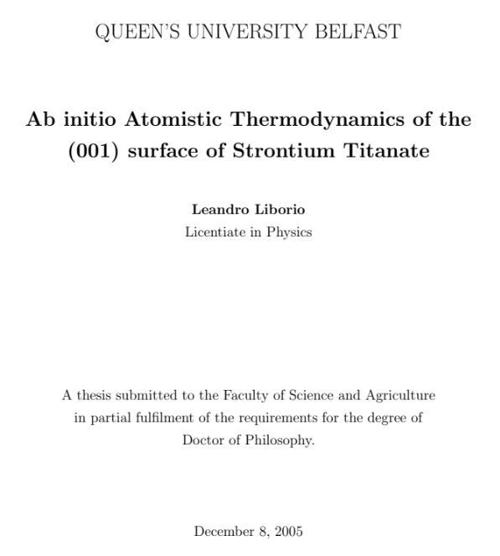
Academic-Related Activities
2002-2006– PhD Physics
Belfast, Northern Ireland
2006-2011– PDRA Nanotech
London, England
1996-2002– MRes Physics
Rosario, Argentina
Worked on modelling of nanomaterials for energy applications and materials for thin films.
Collaborated with experimental groups and industry ( Pilkington Glass and Applied Multilayers).
Did postgraduate Diploma in Science Communication.
Worked as Editor for Form and Content Media Limited¹.
5^{1/2} year degree with one-year thesis.
1/3 of course mathemathics.
Thesis on Experimental physics: “Synthesis of ZrO Thin Films Doped with Semiconductor Nanoparticles.”
Spent 4 months in Lisbon, Portugal, working at INESC.
Decided to go abroad to do PhD in theoretical physics.

Slide 4
Intellectual Property
Patent: Territorial right granted by a government for a limited period of time. The patent owner can exclude others from, for instance, making, using, selling and importing the invention. This is done in exchange for the public disclosure of the invention. The invention has to be novel and inventive and needs to have industrial applicability.
Trade mark: a recognizable sign that distinguishes products or services that originate from different traders.
Copyright: Copyright gives the creator of an original intellectual, creative or artistic work the exclusive reproduction rights to it for a limited amount of time. Copyright arises naturally and do not cover ideas: it only cover the way in which ideas are expressed.
Design Right: protects the visual design of objects that are not purely defined by this design (i.e.: a knife). An industrial design consists of the creation of a shape, a configuration or a composition of pattern or color containing aesthetic value.

Slide 5

The Patent Profession
Where did I find out? Which are the main options in the patent profession?
Patent Attorney
Patent Examiner
A patent attorney is anyone qualified in patents, who acts for others – inventors and companies usually – in securing, enforcing or advising about patents.
Draft and prosecute patents in different patent offices.
Work in patent firms or (Big) Companies.
Have to work and pass exams: UK and European.
Generally work on a broad area of expertise: Mechanics, Electronics, Biotech
Patent examiners analyze inventions from a technical standpoint.
Search through earlier publications and online databases to make sure that the application is new.
consider legal matters affecting acceptability and entitlement to the monopoly claimed by the applicant;
Work in national patent offices or in international organizations such as the European Patent Office (Need to speak 3 EU official languages).
Generally highly focused on a particular area of expertise: Mechanics, Electronics, Biotech, etc.

Slide 6
The Patent Attorney Profession
APPLICATION PROCESS
Apply to Patent Law Firm or Company.
Send CV and covering letter. Be very careful about mistakes!!!
In Patent Law Firms there are normally between two or three interviews.
  Questions about your background. Know your CV very well!!
  Describe something technical: In writing or orally (eg.: a stapler, a post-it).
  Write something – Proof-read and edit something.
  Interview with senior partners: a bit more personal (eg.: Why did you do a PhD? Why did you move to the UK? Which are your plans for the future?)
  Read claims and explain them:
1. A motor vehicle for transporting people and objects, having a chassis and a body mounted on the chassis, the motor vehicle comprising:
a) a plurality of wheels under the body, supporting the chassis;
b) a motor mounted on the chassis, having a fluid input and an output coupled to the transmission; and
c) a fluid supply mounted within the body
2. The motor vehicle of claim 1, in which the fluid supply is a tank of compressed gas.

Slide 7
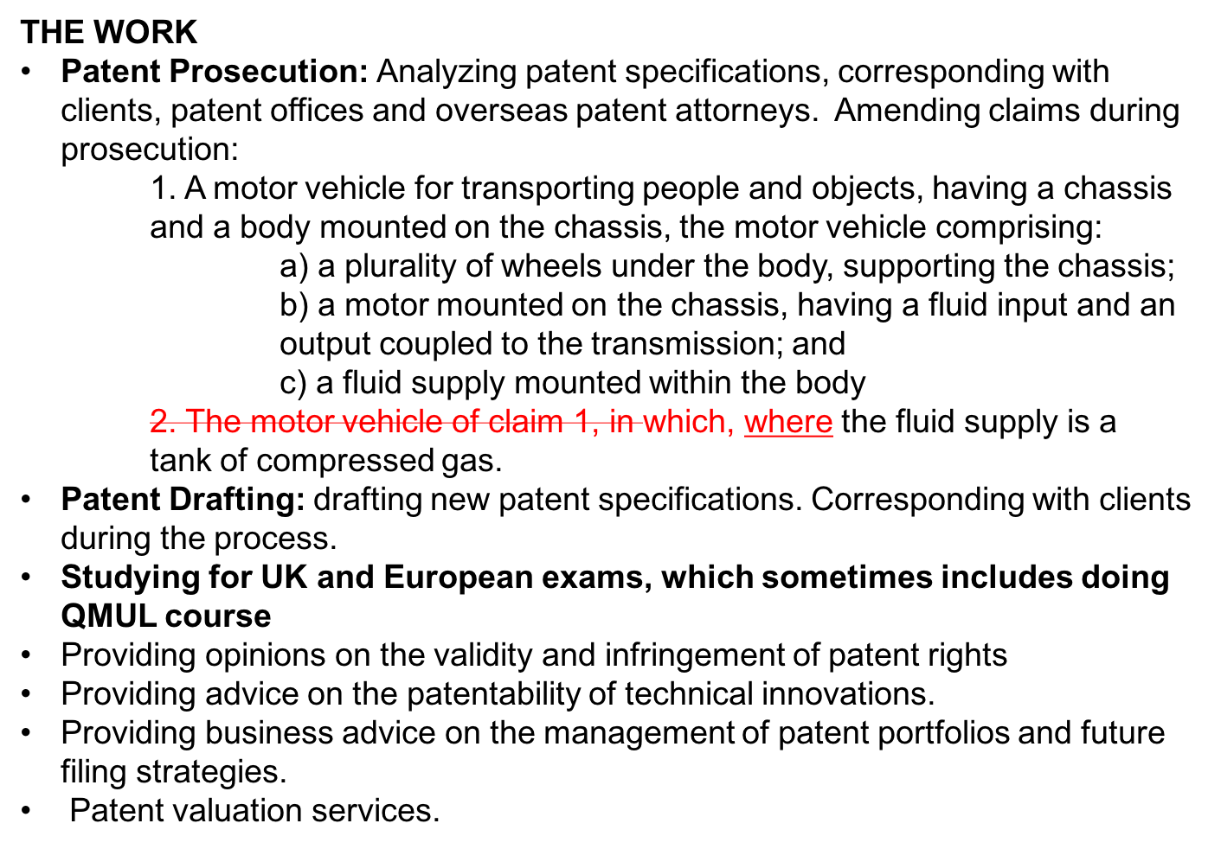
The Patent Attorney Profession

Slide 8
Conclusions
To do a PhD is, essentially, to provide an answer to a complex new problem.
This process gives you skills that are relevant in areas such as academia and industry.
The patent profession could be a good option for people with technical PhDs.
The patent profession involves a lot of work and includes studying for exams. It can be a very rewarding career.
Considering the amount of work, the pay at the beginning is not very high. It can get high after qualification and very high if you become, for instance, partner in a firm.
An alternative could be to become a patent examiner, either in the UK Patent Office or the European Patent Office (EPO) (need to know the three official languages. EPO is not connected to the EU.).
My personal experience tells me that you can move from academia to industry and then come back. Skills such as management or intellectual property can be quite relevant for some sectors of academia.

Slide 9
References
Academic and Other Related Activities:
Atomistic Simulation Centre, QUB:
http://titus.phy.qub.ac.uk
Thomas Young Centre, Imperial College London:
http://www.thomasyoungcentre.org
Form and Content Media:
http://www.fac-media.com
Science Communication:
http://sciencecentres.org.uk/resources/postgrad_courses.html
The Patent Profession:
Nature Career Events:
http://www.nature.com/naturejobs/career-expo/event/naturejobs-career-expo-london
Patent Attorney Profession
http://www.insidecareers.co.uk/professions/patent-attorneys/
Chartered Institute of Patent Attorneys
http://www.cipa.org.uk
UK Patent Office
https://www.gov.uk/government/organisations/intellectual-property-office
European Patent Office
https://www.epo.org/index.html

Slide 10
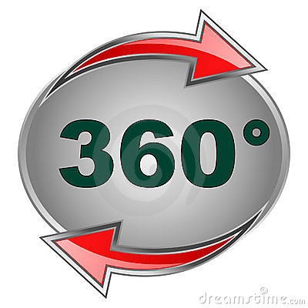
Academia
Industry
Thank you for your attention

