Slide 1
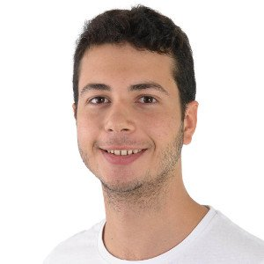
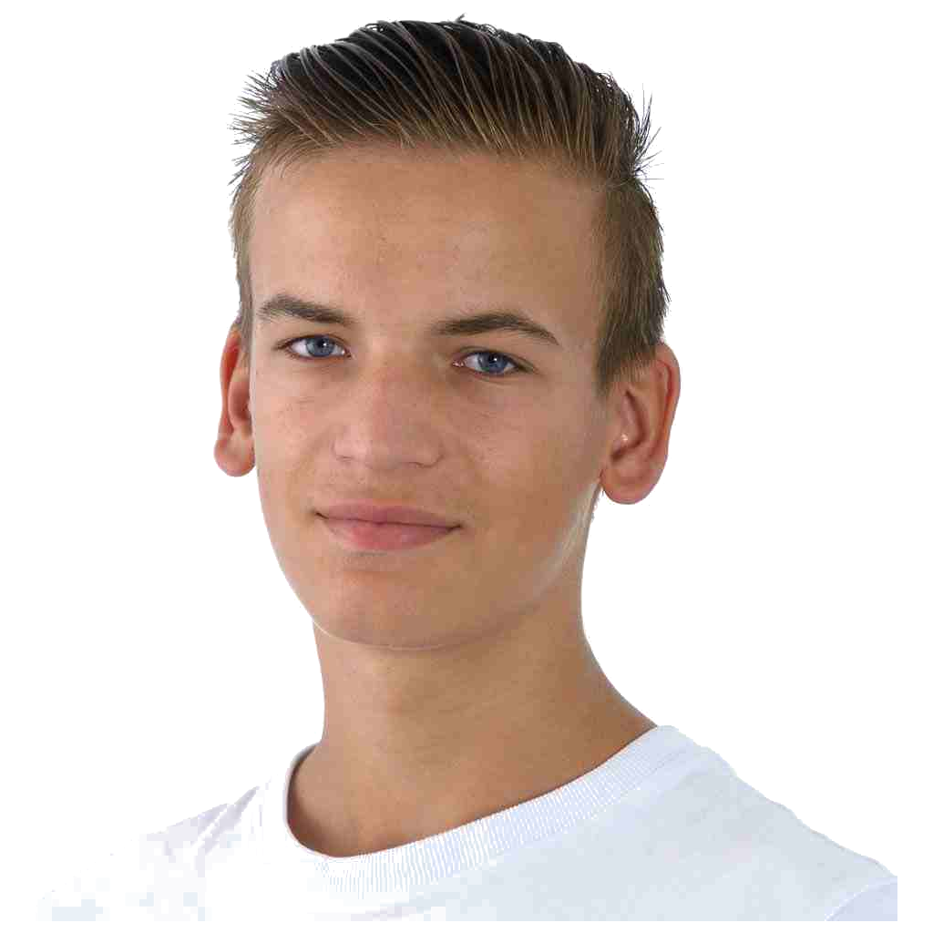
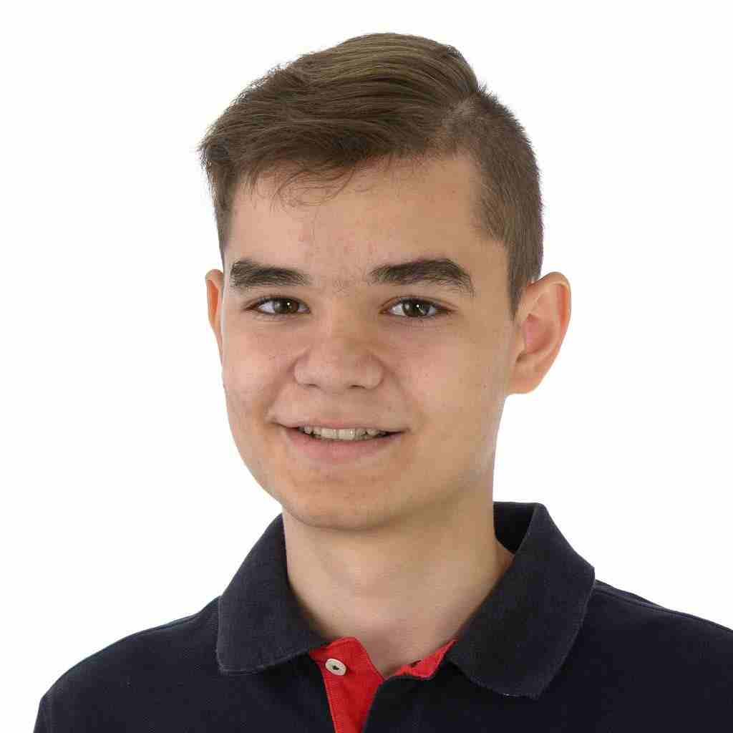
Unseres Team
Duarte Ramos
Noser Engineering
Applikationsentwickler
Bastian Steingruber
SIX
Applikationsentwickler
Leandro Ferreira
Crealogix
Applikationsentwickler

