Slide 1

DATA STRUCTURES OVERVIEW FOR C#
Leandro Yukio Haraoka

Slide 2
What is data structure?
A data structure is a way of organizing data so that it can be used efficiently.

Slide 3
Create and manage groups of related objects
IEnumerable
IEnumerator GetEnumerator();
Returns an enumerator that iterates over a collection.

Slide 4
Create and manage groups of related objects
IEnumerator
object Current { get; } // The element in the collection at the current position of the enumerator.
bool MoveNext() // True if the enumerator was succesfully advanced to the next element; False if the enumerator has passed the end of the collection.
void Reset() // Sets the enumerator to its initial position, which is before the first element in the collection.

Slide 5
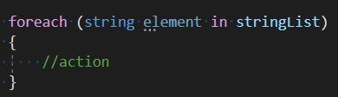
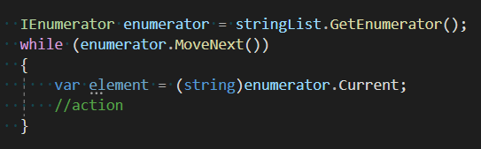
IEnumerable + IEnumerator
This code snippet:
You can’t use foreach on “stringList”
unless it implements IEnumerable!
is functionally equivalent to…

Slide 6
C# Collections
Queues:
Queue<T>
ConcurrentQueue<T>
Stacks:
Stack<T>
ConcurrentStack<T>
IList<T>:
LinkedList<T>
List<T>
HashTable
Array
ArrayList
BlockingCollection<T>
ConcurrentBag<T>
ISet<T>:
HashSet<T>
SortedSet<T>
IDictionary<TKey,TValue>:
Dictionary<TKey,TValue>
ConcurrentDictionary<TKey,TValue>
SortedDictionary<TKey,TValue>
SortedList<TKey,TValue>

Slide 7
Big-O Notation
Big-O Notation defines level of complexity, considering the worst case, helping to quantify performance as the input size becomes arbitrarily large.
Complexity | Representation
constant | O(1)
logarithmic | O(log(n))
linear | O(n)
linearithmic | O(nlog(n))
quadratic | O(n²)
cubic | O(n³)
exponential | O(b^n), b>1
factorial | O(n!)
n – The size of the input
complexity

Slide 8
Big-O Notation - Examples
Big-O Notation defines level of complexity, considering the worst case, helping to quantify performance as the input size becomes arbitrarily large.

Slide 9
Array
Stores multiple variables of the same type.
The number of dimensions and the length of each array dimension can’t be changed during the lifetime of the instance.
You declare na array by specifying the type of its elements followed by [].
Some useful methods: Clone, Copy, GetLength, GetLongLength, GetLowerBound, GetUpperBound, GetValue.
Complexity
Access | O(1)
Search | O(n)
Insertion | O(n)
Deletion | O(n)

Slide 10
Single Dimensional Array
Examples
new int[] {1, 2, 3, 4, 5}
new string[] {“Pedro”, “Maria”, “Ana”, “Felipe”}
new DateTime[] {new DateTime(2019, 01, 01), new DateTime(2018, 01, 01)}

Slide 11
ArrayList
Implements the IList interface using an array whose size is dynamically increased as required.
Allows grouping different types in the same structure.
Some useful methods: Add, Insert, Remove, RemoveAt, Sort, Reverse, Contains.

Slide 12
LinkedList
Unlike arrays, linked list elements are linked using pointers.
Fast elements insertion and deletion. Does require elements shift, just changes node pointers.
Does not allow random access. Must access sequentially starting from the first node.
Some useful methods: AddLast, AddBefore, AddAfter, RemoveFirst, RemoveLast.
Complexity
Access | O(n)
Search | O(n)
Insertion | O(1)
Deletion | O(1)

Slide 13
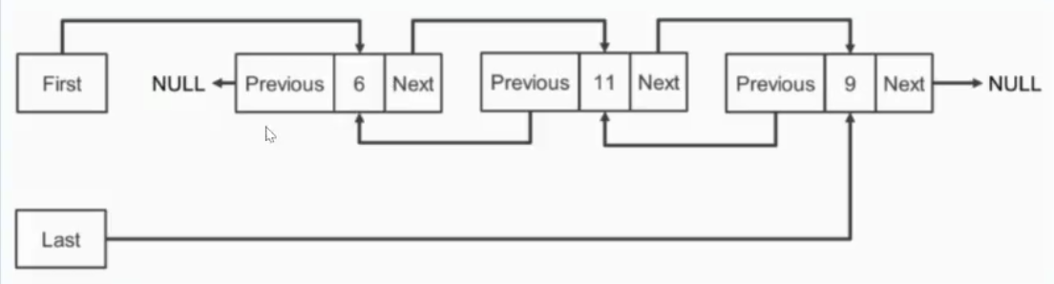
LinkedList

Slide 14
SortedList
Represents a collection of key/value pairs that are sorted by the keys and are accessible by key or by index.
Some useful methods: ContainsKey, ContainsValue, TryAdd, TryGetValue.
Complexity
Access | O(n)
Search | O(n)
Insertion | O(n)
Deletion | O(n)

Slide 15
Dictionary
Dictionary is a key-value-pair collection.
In Dictionary, you store key value pairs of same type. You must specify the type of a key and value.

Slide 16
HashTable
HashTable is essentially a key-value-pair collection.
Key cannot be duplicated and cannot be null.
In hashtable, you can store key/value pairs of diferente types.
It doesn’t maintain the order of stored values.
Complexity
Access | O(n)
Search | O(n)
Insertion | O(n)
Deletion | O(n)

Slide 17
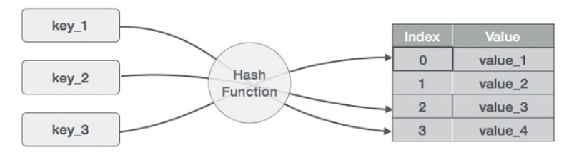
HashTable

Slide 18
HashSet
A HashSet collection is not sorted and cannot contain duplicate elements.
HashSet allows you to add a unique value and you do not define keys.
HashSet provides mathematical set operations, such as union and intersection.

Slide 19
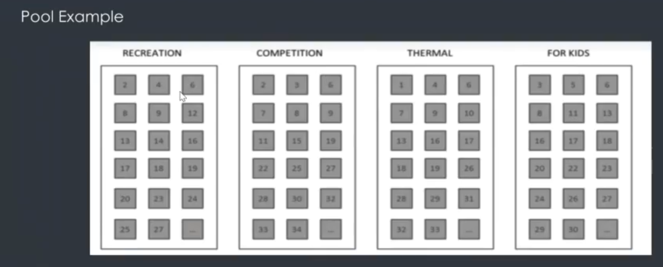
HashSet

Slide 20
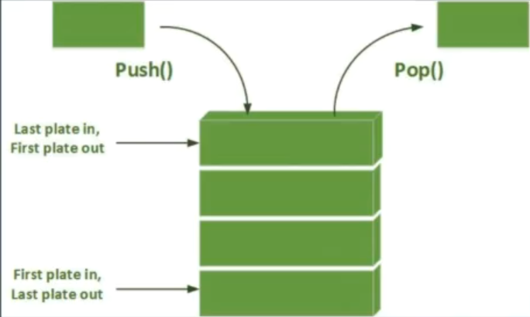
Stack
Represents a last-in-first-out (LIFO) collection of objects.
Complexity
Pushing | O(1)
Popping | O(1)
Peeking | O(1)
Searching | O(n)

Slide 21
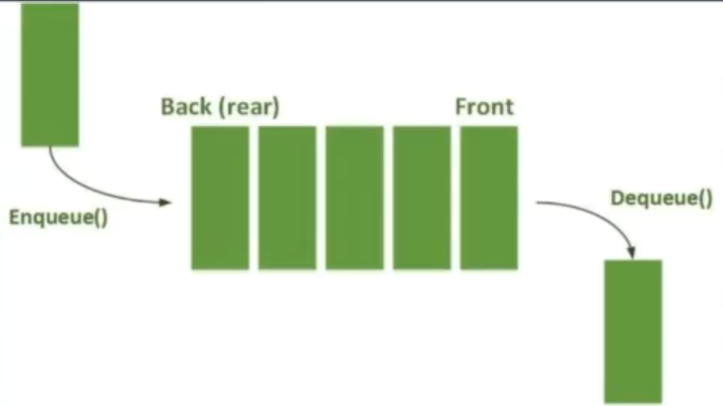
Queue
Represents a first-in-first-out (FIFO) collection of objects.
Complexity
Enqueue | O(1)
Dequeue | O(1)
Peeking | O(1)
Searching | O(n)

Slide 22
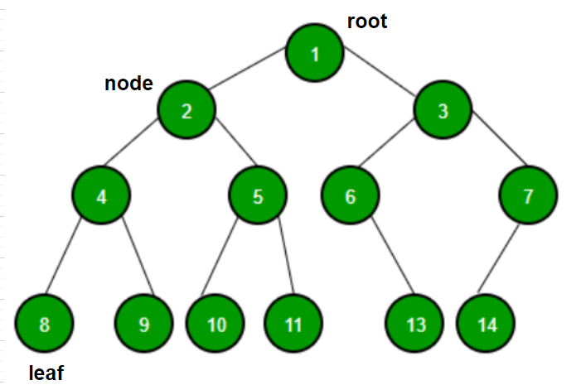
Binary tree
A tree whose elements have at most 2 children is called a binary tree.

Slide 23
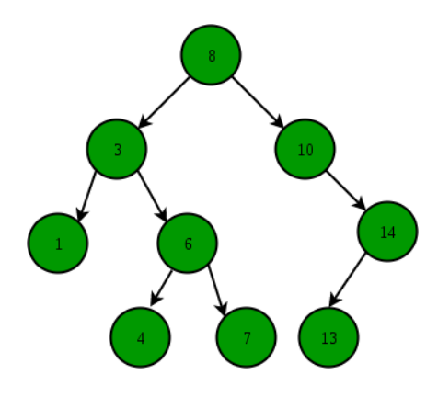
Binary search tree (BST)
The left subtree of a node contains only nodes with keys lesser than the node’s key.
The right subtree of a node contains only nodes with keys greater than the node’s key.
The left and right subtree each must also be a binary search tree.
Complexity
Enqueue | O(n)
Dequeue | O(n)
Peeking | O(n)
Searching | O(n)

Slide 24
Thanks!

