Slide 1
Jacques Dainat PhD
Methods in genome annotation
2018

Slide 2
This lecture will focus on eukaryotes
Introduction - Understanding gene annotation
The different annotation approaches
Our method of choice: MAKER2
Check an annotation
Closing remarks

Slide 3
1. Introduction

Slide 4
Introduction
What is annotation ?
Structural annotation:
Find out where the regions of interest (usually genes) are in the sequence data and what they look like.
functional annotation:
Find out what the regions do. What do they code for?
VS
It is the annotation that bridges the gap from the sequence to the biology of the organism

Slide 5
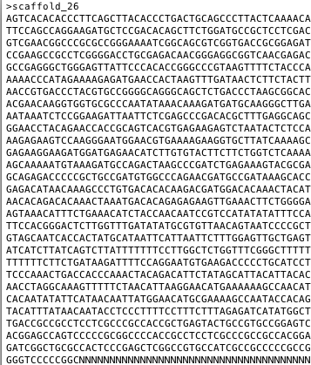
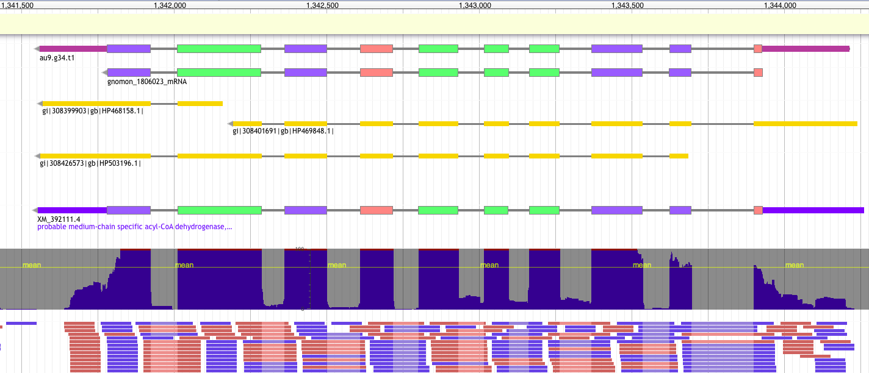
Introduction
From a genome…
FASTA
…to an annotated gene
GFF
9 columns
1 feature = 1 line
2. source
4. start
6. score
8. phase
Ctg123 maker Gene 1000 9000 . + . ID=gene1; Name=EDEN
1. sequence id
3. feature type
5. end
7. strand
9. attribute(s)
tag=value

Slide 6
Introduction
One gene in GFF3 format:
##gff-version 3.2.1
##sequence-region ctg123 1 1497228
ctg123 . Gene 1000 9000 . + . ID=gene1;Name=EDEN
ctg123 . mRNA 1050 9000 . + . ID=mRNA1;Parent=gene1
ctg123 . exon 1050 1500 . + . ID=exon1;Parent=mRNA1
ctg123 . exon 7000 9000 . + . ID=exon2;Parent=mRNA1
ctg123 . CDS 1201 1500 . + 0 ID=cds1;Parent=mRNA1;Name=edenprotein.1
ctg123 . CDS 7000 7600 . + 0 ID=cds1;Parent=mRNA1;Name=edenprotein.1
/!\ different version 1, 2, 2.5, 3
GTF = GFF version 2
/!\ different type of gff: annotation / alignment / other

Slide 7
Introduction
The main steps in genome annotation
5
Submission
1
QC assembly
2
Structural annotation
3
Manual curation
4
Functional annotation
5
Downstream analysis

Slide 8
Introduction
Before annotation – check assembly quality
The quality of the assembly will heavily influence the quality of the annotation
SNP-errors can change start/stop-codons
Indels can cause frame-shifts
Annotation tools often have problems with incomplete loci
And of course, if a locus is completely missing from the assembly, it cannot be annotated

Slide 9

Introduction
Assembly check and preparation
Fragmentation (N50, number of sequences, how many small contigs)
Sanity of the fasta file (Ns, IUPAC, lowercase nucleotides)
Completeness / duplication / fragmentation
Presence of Organelles
Other (GC content, how distant from other species)

Slide 10
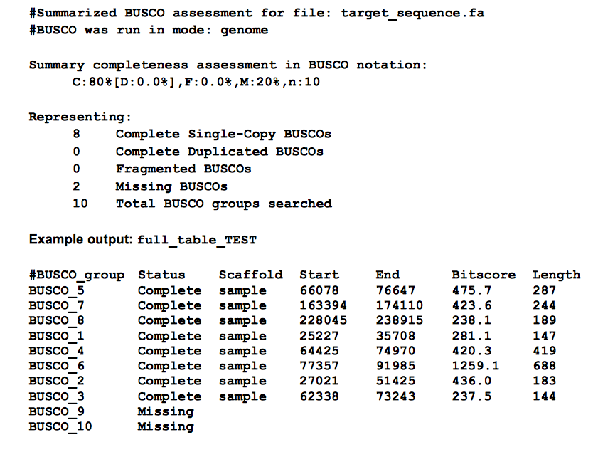
Introduction
BUSCO output

Slide 11
Introduction
Repeat Masking
Repeatmodeler to find new repeats
http://www.repeatmasker.org/RepeatModeler/
Repeatmasker to mask known repeats
http://www.repeatmasker.org
+ Save time
+ Increase quality of the annotation

Slide 12
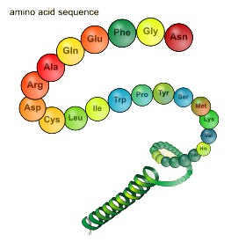
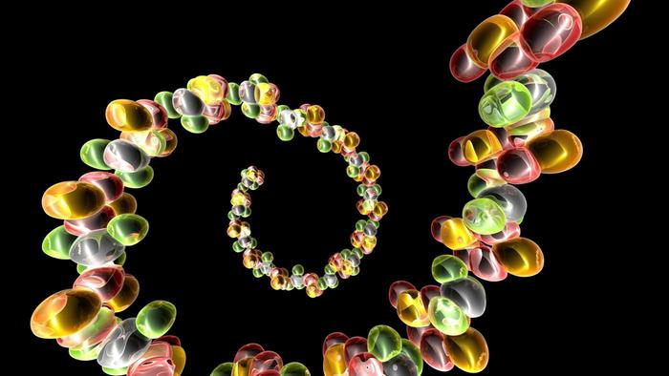
Introduction
Types of data used
Proteins
Transcripts
Known amino acid sequences from other organisms
Assembled from RNA-seq or downloaded ESTs

Slide 13
Introduction
Types of data used: Proteins
Conserved in sequence => conserved annotation with little noise
Proteins from model organisms often used => bias?
Proteins can be incomplete => problems as many annotation procedures are heavily dependent on protein alignments
>ENSTGUP00000017616 pep:novel chromosome:taeGut3.2.4:8_random:2849599:2959678:-1 gene:ENSTGUG00000017338 transcript:ENSTGUT00000018018 gene_biotype:protein_coding transcript_biotype:protein_coding
RSPNATEYNWHHLRYPKIPERLNPPAAAGPALSTAEGWMLPWGNGQHPLLARAPGKGRER
DGKELIKKPKTFKFTFLKKKKKKKKKTFK
>ENSTGUP00000017615 pep:novel chromosome:taeGut3.2.4:23_random:205321:209117:1 gene:ENSTGUG00000017337 transcript:ENSTGUT00000018017 gene_biotype:protein_coding transcript_biotype:protein_coding
PDLRELVLMFEHLHRVRNGGFRNSEVKKWPDRSPPPYHSFTPAQKSFSLAGCSGESTKMG
IKERMRLSSSQRQGSRGRQQHLGPPLHRSPSPEDVAEATSPTKVQKSWSFNDRTRFRASL
RLKPRIPAEGDCPPEDSGEERSSPCDLTFEDIMPAVKTLIRAVRILKFLVAKRKFKETLR
PYDVKDVIEQYSAGHLDMLGRIKSLQTRVEQIVGRDRALPADKKVREKGEKPALEAELVD
ELSMMGRVVKVERQVQSIEHKLDLLLGLYSRCLRKGSANSLVLAAVRVPPGEPDVTSDYQ
SPVEHEDISTSAQSLSISRLASTNMD

Slide 14
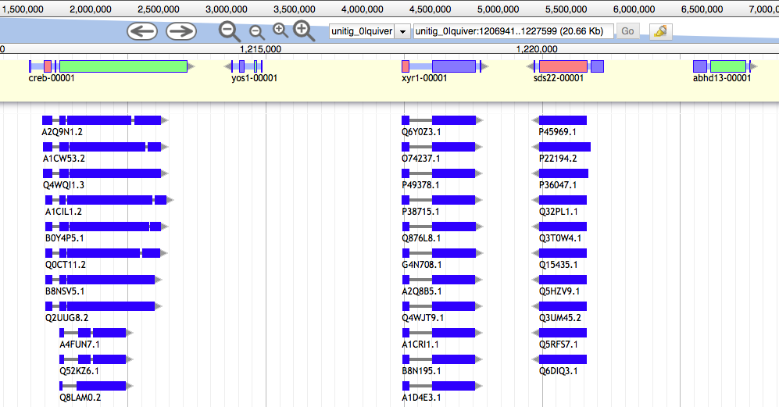
Introduction
Protein sequences are aligned to the genome

Slide 15
Introduction
Types of data used: RNA-seq
DNA
Exon
Intron
Exon
Intron
Exon
Intron
Exon
UTR
UTR
ATG
Start codon
GT
AG
GT
AG
GT
AG
TAG, TAA, TGA
Stop codon
Transcription
Pre-mRNA
UTR
UTR
AA
ATG
Start codon
TAG, TAA, TGA
Stop codon
AAAAA
Splicing
mRNA
UTR
UTR
AAAAAAAAA
ATG
Start codon
TAG, TAA, TGA
Stop codon
Translation

Slide 16
Introduction
Types of data used: RNA-seq
Should always be included in an annotation project
From the same organism as the genomic data => unbiased
Can be very noisy (tissue/species dependent), can include pre-mRNA
Sample different tissues or life stages if possible
Avoid gonads; muscle or liver is good

Slide 17
Introduction
RNA-seq - Spliced reads
DNA
Exon
Intron
Exon
Intron
Exon
Intron
Exon
UTR
UTR
ATG
Start codon
GT
AG
GT
AG
GT
AG
TAG, TAA, TGA
Stop codon
Transcription
Pre-mRNA
UTR
UTR
AA
ATG
Start codon
TAG, TAA, TGA
Stop codon
AAAAA
Splicing
mRNA
UTR
UTR
AAAAAAAAA
ATG
Start codon
TAG, TAA, TGA
Stop codon
Translation

Slide 18
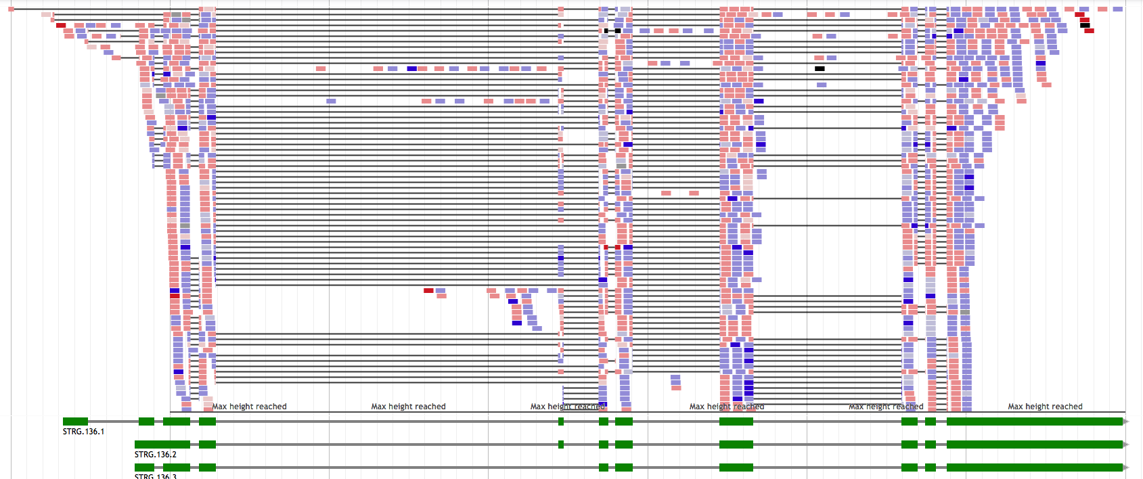
Introduction
RNA-seq - Spliced reads

Slide 19
Introduction
Pre-mRNA
DNA
Exon
Intron
Exon
Intron
Exon
Intron
Exon
UTR
UTR
ATG
Start codon
GT
GT
GT
TAG, TAA, TGA
Stop codon
Transcription
Pre-mRNA
UTR
UTR
AA
ATG
Start codon
TAG, TAA, TGA
Stop codon
AAAAA
Splicing
mRNA
UTR
UTR
ATG
Start codon
TAG, TAA, TGA
Stop codon
Translation

Slide 20
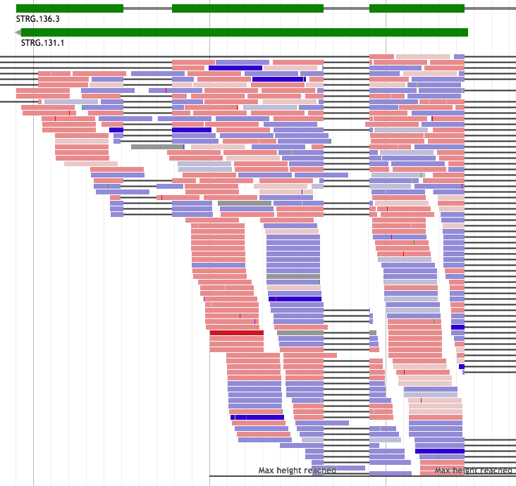
Introduction
RNA-seq – pre-mRNA noise

Slide 21

Introduction
Types of data used: RNA-seq
RNA-seq need to be assembled first
Genome guided asssembly
=> Cufflinks/Stringtie/…: mapped reads -> transcripts
De novo
=> Trinity: assembles transcripts without a genome

Slide 22
2. The different annotation approaches

Slide 23
The different approaches
Similarity-based methods :
These use similarity to annotated sequences like proteins, cDNAs, or ESTs
Ab initio prediction :
Likelihood based methods
Hybrid approaches :
Ab initio tools with the ability to integrate external evidence/hints
Comparative (homology) based gene finders :
These align genomic sequences from different species and use the alignments to guide the gene predictions
Chooser, combiner approaches :
These combine gene predictions of other gene finders
Pipelines :
These combine multiple approaches

Slide 24
The different approaches
Similarity-based methods :
These use similarity to annotated sequences like proteins, cDNAs, or ESTs
Ab initio prediction :
Likelihood based methods
Hybrid approaches :
Ab initio tools with the ability to integrate external evidence/hints
Comparative (homology) based gene finders :
These align genomic sequences from different species and use the alignments to guide the gene predictions
Chooser, combiner approaches :
These combine gene predictions of other gene finders
Pipelines :
These combine multiple approaches

Slide 25
2) The different annotation approaches
2.1) Ab-initio annotation tools
“intrinsic approach”

Slide 26
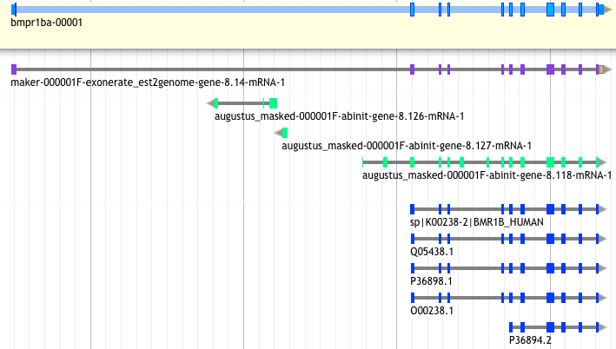
Ab initio method
Uses likelihoods to find the most likely gene models
Easy to use!
augustus --species=chicken contig.fa > augustus_chicken.gff

Slide 27
Ab initio method
method based on gene content :
(statistical properties of protein-coding sequence )
codon usage
hexamer usage
GC content
compositional bias between codon positions
nucleotide periodicity
exon/intron size
…
and on signal detection:
Promoter
ORF
Start codon
Splice site (Donor and acceptor)
Stop codon
Poly(A) tail
CpG islands
…
=> Ab initio tools will combine this information through different Probabilistic models: HMM, GHMM, WAM, etc.
These models need to be created if not already existing for your organism => training!
Notes:
HMM = hidden Markov models
GHMM = General Hidden Markov Mode
(GHMM may be a DNA sequence of any length, whereas in ordinary HMMs, the observation is always a single nucleotide.)
WAM = Weight array model
WMM = Weight matrix model

Slide 28
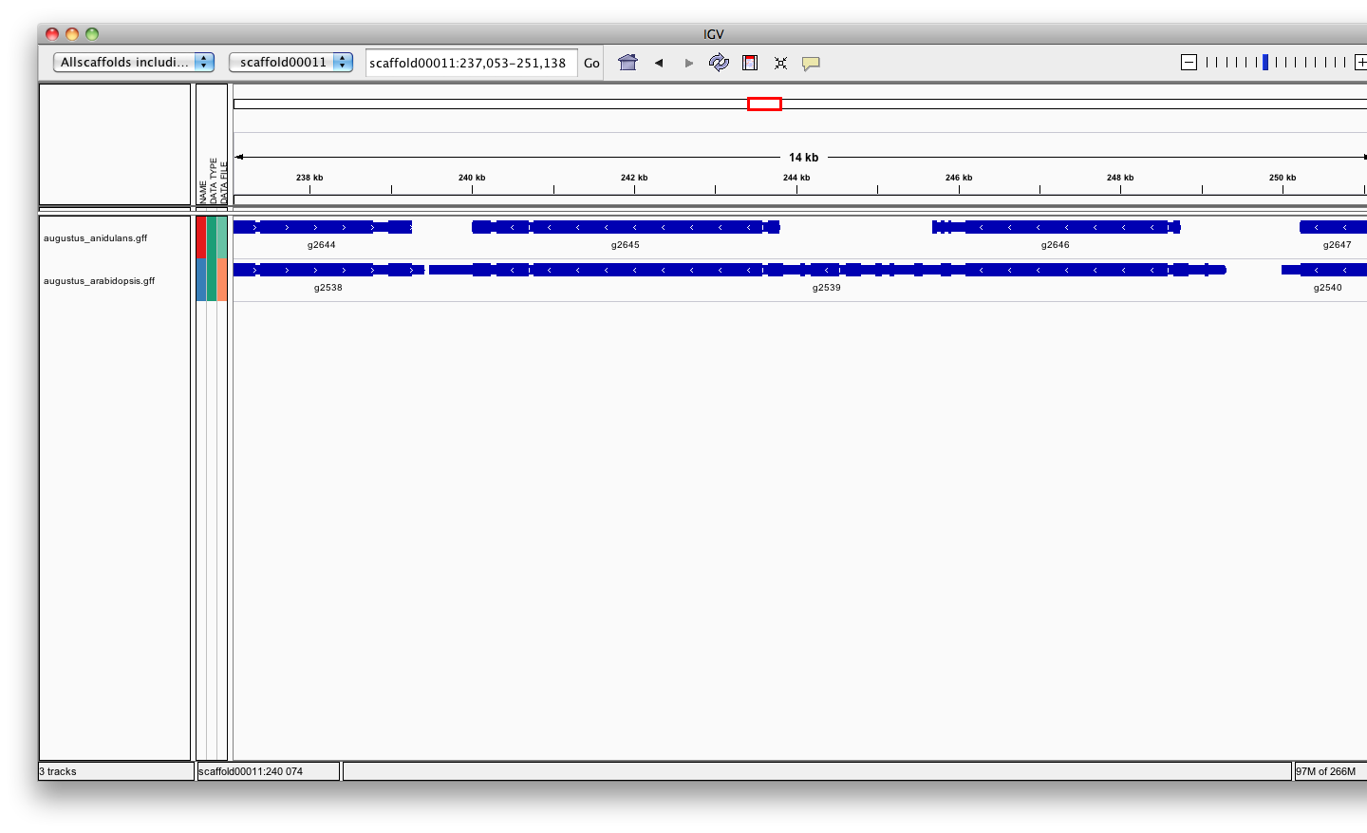
Ab initio method
Training ab-initio gene-finders
Some gene-finders train themselves, others need a separate training procedure
Around 1000 already known genes are usually needed to train the gene-finder
These ”known” genes can be inferred from aligned transcripts or proteins
The quality of the gene-finder results hugely relies on the quality of the training!
A fungal genome
Fungi
Plants

Slide 29
Ab initio method
Assess the quality of the ab-initio model/training:
TN
FN
TP
FP
TN
FN
TP
FN
TN
~
REALITY
PREDICTION
Sensitivity is the proportion of true predictions compared to the total number of correct genes (including missed predictions)
Specificity is the proportion of true predictions among all predicted genes (including incorrectly predicted ones)
Ab Initio methods can approach 100% sensitivity, however as the sensitivity increases, accuracy suffers as a result of increased false positives.

Slide 30
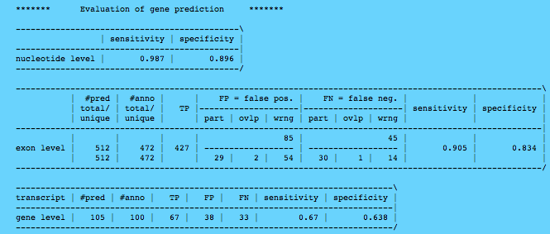
Ab initio method

Slide 31
Ab initio method
Popular tools:
SNAP Works ok, easy to train, not as good as others especially on longer intron genomes.
Augustus Works great, hard to train (but getting better).
GeneMark-ES Self training, no hints, buggy, not good for fragmented genomes or long introns (Best suited for Fungi).
FGENESH Works great, costs money even for training.
GlimmerHMM (Eukaryote)
GenScan
Gnomon (NCBI)
Supported by MAKER
http://weatherby.genetics.utah.edu/MAKER/wiki/index.php/MAKER_Tutorial
Notes:
Glimmer: apparently easy to train but manually tuning needed.

Slide 32
Ab initio method
Strengths :
Fast and easy means to identify genes
Annotate unknown genes
“Exhaustive” annotation
Need no external evidence
Limits :
No UTR*
No alternatively spliced transcripts*
Over prediction (exons or genes)
Training needed to perform well in terra incognita’
Split single gene into multiple predictions
Fused with neighboring genes
Less accurate than homology based method:
Exon boundaries
Splicing sites
Hybrid method
Notes:
Gene finders generally do a poor job (~50%) predicting genes in eukaryotes

Slide 33
2) The different annotation approaches
2.2) Hybrid approaches
from the beginning

Slide 34
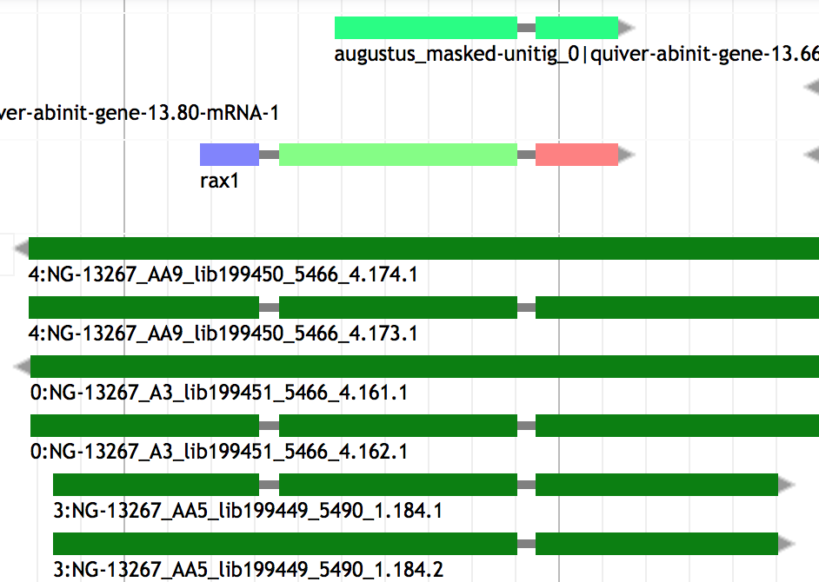
Hybrid method
Hybrid (evidence-drivable gene predictors) approaches incorporate hints in the form of EST or protein alignments to increase the accuracy of the gene prediction.
Notes:
GenomeScan : The blast hits have to be converted into a probability, but this is made relatively easily, as the E-values give guidance… ( Understanding Bioinformatics, Par Marketa J. Zvelebil,Jeremy O. Baum). It’s a version based on genscan.
EuGene* can be seen as a combiner because collect information about splice sites and ATG has to be done outside the program.

Slide 35
Hybrid method
Hybrid (evidence-drivable gene predictors) approaches incorporate hints in the form of EST alignments or protein profiles to increase the accuracy of the gene prediction.
GenomeScan Blast hit used as extra guide
Augustus 16 types of hints accepted (gff): start, stop, tss, tts, ass, dss, exonpart, exon, intronpart, intron, CDSpart, CDS, UTRpart, UTR, irpart, nonexonpart.
GeneMark-ET EST-based evidence hints
GeneMark-EP Protein-based evidence hints
SNAP Accepts EST and protein-based evidence hints.
Gnomon Uses EST and protein alignments to guide gene prediction and add UTRs
FGENESH+ Best suited for plant
EuGene* Any kind of evidence hints. Hard to configure (best suited for plant)
Self training !
Notes:
GenomeScan : The blast hits have to be converted into a probability, but this is made relatively easily, as the E-values give guidance… ( Understanding Bioinformatics, Par Marketa J. Zvelebil,Jeremy O. Baum). It’s a version based on genscan.
EuGene* can be seen as a combiner because collect information about splice sites and ATG has to be done outside the program.

Slide 36
Hybrid method
Strength : High accuracy
Limits :
- Extra computation to generate alignments
- heterogeneous sequence quality :
Incomplete,
Error during transcriptome assembly
Contamination
Sequence missing
Orientation error

Slide 37
Hybrid method
The BRAKER1 gene finding pipeline:
BRAKER1: Unsupervised RNA-Seq-Based Genome Annotation with GeneMark-ET and AUGUSTUS
Katharina J. Hoff et al.
Bioinformatics (2016) 32 (5): 767-769. doi: 10.1093/bioinformatics/btv661
BRAKER1 was more accurate than MAKER2 when it is using RNA-Seq as sole source for training and prediction.
BRAKER1 does not require pre-trained parameters or a separate expert-prepared training step.

Slide 38
2) The different annotation approaches
2.3) Chooser / combiner

Slide 39
Chooser / combiner
Overview
combining different lines of evidence into gene models
Evidence:
ESTs / Transcripts
Proteins
Ab-initio prediction
Combining

Slide 40
Chooser / combiner
Use battery of gene finders and evidence (EST, RNAseq, protein) alignments and:
Tool | Consensus based chooser | Evidence based chooser | weight of different sources | Comment
A) select the prediction whose structure best represents the consensus
JIGSAW | X
B) choose the best possible set of exons and combine them in a gene model
EVM Evidencemodeler | X | X | X | User can set the expected evidence error rate manually or/and learn from a training set
Evigan | X |  | X | Unsupervised learning method
Ipred |  | X |  | Does not require any a priori knowledge Can also combine only evidences to create a gene model
Strength => They improve on the underlying gene prediction models
Notes:
EVM choose the post-processed gene model that is most consistent with the evidences
~ GAZE : GAZE (Howe et al. 2002), pro- vides a general framework to assemble an optimal set of gene structures given a user-supplied feature set, scoring scheme,
Ipred: Franziska Zickmann and Bernhard Y Renard BMC Genomics. 2015; 16(1): 134.doi: 10.1186/s12864-015-1315-9
EVIGAN is the scuccessor of GLEAN

Slide 41
2) The different annotation approaches
2.4) Gene annotation pipelines
(The ultimate step)
Align evidence, add UTRs and more
Notes:
Much more complex, align themselves the evidences, annotate UTRs, repeat mask, annotate other kind of features within the genome…

Slide 42
Annotation pipeline
PASA Produces evidence-driven consensus gene models
- minimalist pipeline ()
+ good for detecting isoforms
+ biologically relevant predictions
=> using Ab initio tools and combined with EVM it does a pretty good job !
- PASA + Ab initio + EVM not automatized
NCBI pipeline Evidence + ab initio (Gnomon), repeat masking, gene naming, data formatting, miRNAs, tRNAs
Ensembl Evidence based only ( comparative + homology ) …
MAKER2 Evidence based and/or ab initio …
…
Notes:
PASA: Does not do anything else that align evidences and define gene models with UTRs
NCBI pipeline integrates gnomon ; data formatting = Save in correct format for dowmstream hanmdling/analysis

Slide 43
2) The different annotation approaches
2.5) Annotation of other genome features

Slide 44
Other genome features
Feature type | DB associated | Tool example | approach
ncRNA | Rfam | infernal | HMM + CM
tRNA | Sprinzl database | tRNAscan-SE | CM + WMA
snoRNA |  | snoscan | HMM + SCFG
miRNA | miRBase | Splign miR-PREFeR (for plant) | sequence alignment Based on expression patterns
Repeats | Repbase, Dfam | repeatMasker | HMM, blast
Pseudogenes |  | pseudopipe | homology-based (blast)
…
Notes:
ncRNA annotation are less reliable but are of good interest to give clue about them. Should call them putative ncRNA
SCFG and HMM are al probabilistic models
CM is a type of stochastic context-free grammar (profile SCFG) that describes both sequence and secondary structure.
it is more capable of identifying RNA homologs that conserve their secondary structure more than their primary sequence.
Infernal uses CMs to search for new family members in sequence databases and to create potentially large multiple sequence alignments. Version 1.1 of Infernal introduces a new filter pipeline for RNA homology search based on accelerated profile hidden Markov model (HMM) methods and HMM-banded CM alignment methods.
WMA = weight matrix anaylsis
snoRNAs = Small nucleolar RNAs
snoGPS for the detection of pseudouridylation-guide snoRNAs
Pseudopipe : To be launched after gene annotation

Slide 45

3) Gene annotation pipelines
(The ultimate step)
3) MAKER

Slide 46
MAKER2
MAKER – developed as an easy-to-use alternative to other pipelines
- can be used pure evidence-based, pure ab initio, or evidence-driven (on the fly) ab initio.
- add UTR when ESTs are supplied.
- Evidence based chooser : select post processed gene model which is most consistent with evidence (protein / EST / RNAseq)
Advantages over competing solutions:
Easy to use and to configure
Almost unlimited parallelism built-in (limited by data and hardware)
Largely independent from the underlying system it is run on
Everything is run through one command, no manual combining of data/outputs
Follows common standards, produces GMOD compliant output
Annotation Edit Distance (AED) metric for improved quality control
Provides a mechanism to train and retrain ab-initio gene predictors
Annotations can be updated by re-launching Maker with new evidence
But how does Maker work exactly?
Notes:
GMOD=Generic Model Organism Database project

Slide 47
MAKER2
Step 1: Raw compute phase
RepeatMasking
Nucleotide repeats
Transposons/viral proteins
Soft-masking
Hard-masking
ATGCGTTTGacgtttaataattggGCATAGCCCT
ATGCGTTTGNNNNNNNNNNGCATAGCCCT
Masked genome
Notes:
Soft masking excludes these regions from nucleating BLAST alignments (Korf et al. 2003) but leaves them available for inclusion in annotations, as many protein-coding genes contain runs of low complexity sequence.

Slide 48
MAKER2
Step 1: Raw compute phase
Masked genome
Blastx
Blastn
Proteins
ESTs

Slide 49
MAKER2
Step 2: Filter and cluster alignments
Filtering is based on rules defined in the Maker configuration for a given project
Example: EST alignment – 80% coverage and 85% identity
Default settings sensible for most projects, but can be changed!

Slide 50
MAKER2
Step 2: Filter and cluster alignments
Clustering groups evidence-alignments into ’loci’

Slide 51
MAKER2
Step 2: Filter and cluster alignments
Problematic data can complicate clustering
Needs to be fixed by => using clean data

Slide 52
MAKER2
Step 2: Filter and cluster alignments
Clustering groups evidence alignments into ’loci’
Amount of data in any given cluster is then collapsed to remove redundancy
Threshold for the collapsing is also user-definable

Slide 53
MAKER2
Step 2: Filter and cluster alignments
Clustering groups evidence alignments into ’loci’
Amount of data in any given cluster is then collapsed to remove redundancy
Threshold for the collapsing is also user-definable
Performed for all lines of evidence

Slide 54
MAKER2
Step 3: Polishing alignments
Blast-based alignments are only approximations, need to be refined

Slide 55
MAKER2
Step 3: Polishing alignments
Blast-based alignments are only approximations, need to be refined
Exonerate is used to create splice-aware alignments
Notes:
BLAST alignment oddities include mixed order of aligned segments or staggered

Slide 56
MAKER2
Step 4: Synthesis
Synthesis refers to the extraction of information to generate evidence for annotations
Done by identifying genomic regions overlapping with sequence features
Notes:
Define exon, intron, intergenic

Slide 57
MAKER2
Step 4: Synthesis
Notes:
Can define isoform

Slide 58
MAKER2
Step 4: Synthesis...and ab-initio gene finding
Evidence alignments provide support for the identification of gene loci
Ab-initio predictions can enhance these signals and fill gaps with no evidence

Slide 59
MAKER2
Step 4: Synthesis...and ab-initio gene finding
Ab-intio predictions can be improved when evidence is provided (hints)
Help refine and calibrate a computational inference for a given locus
Notes:
After polishing the evidence, MAKER takes the results and talks to the gene predictors, telling them the mostl likely locations of splice sites, protein coding regions, and intron/exon structure

Slide 60
MAKER2
Step 4: Synthesis...and ab-initio gene finding
Ab-intio predictions can be improved when evidence is provided (hints)
Help refine and calibrate a computational inference for a given locus
Hints: Introns, intergenic sequence, CDS

Slide 61
MAKER2
Step 5: Annotate
Refined ab-initio models may still be incomplete / partially wrong
The gene best models will be selected in agreement with the available evidence
-> The minimum agreement threshold can be chosen
Isoforms accepted if parameter activated
Notes:
If you accept pure abinitio + isoform all gene models willl be kept.
If you accept pure abinitio + no isoform only the best gene model by locus will be kept.
If you chose an agreement threshold really high, you can loose some annotated locus (the last one as example).

Slide 62
MAKER2
Step 5: Annotate
Synthesized transcript structures are compared against evidence to find UTRs

Slide 63






MAKER2
GMOD
WORLD
Output = Annotation in gff3 format
Genome browser
Browser-based annotation editor
Biological database schema
Tripal: Chado web interface
BioMart: Data mining system
Notes:
GMOD is a collection of open source software tools for managing, visualising, storing, and disseminating genetic and genomic data.
List non-exhaustive of GMOD tools

Slide 64
5) Check an annotation

Slide 65
Visualization / Manual curation
Selection of most common visualization or/and Manual curation tools
Name | Standalone | Web tool | Manual curation | year | comment
Artemis | X |  | X | 2000 | Can save annotation in EMBL format
IGV | X |  |  | 2011 | Popular
Savant | X |  |  | 2010 | Sequence Annotation, Visualization and ANalysis Tool. enable Plug-ins
Tablet | X |  | X | 2013
IGB | X |  |  | 2008 | enable Plug-ins. Can load loacl and remote data (dropbox, UCSC genome, etc)
Jbrowse |  | X |  | 2010 | GMOD (successor of Gbrowse)
Web Apollo |  | X | X | 2013 | Active community (gmod). Based on Jbrowse. Real-time collaboration
UCSC |  | X |  | 2000 | A large amount of locally stored data must be uploaded to servers across the internet
Ensembl genome browsers |  | X |  | 2002 | A large amount of locally stored data must be uploaded to servers across the internet
FOR AN EXHAUSTIVE LIST: https://en.wikipedia.org/wiki/Genome_browser

Slide 66
6) To resume / Closing remarks

Slide 67
Closing remarks
Plethoric choice of methods
year | Gene finder Name | Type | Nb citation | Comments
1991 | GRAIL | Ab initio |  | No longer supported
1992 | GeneID | Ab initio
1993 | GeneParser | Ab initio
1994 | Fgeneh | Ab initio |  | Finds single exon only
1996 | Genie | Hybrid
1996 | PROCRUSTES | Evidence based
1997 | Fgenes | Hybrid |  | No download version
1997 | GeneFinder | Ab initio |  | Unpublished work
1997 | GenScan | Ab initio
1997 | HMMGene | Ab initio |  | No download version
1997 | GeneWise | Evidence based
1998 | GeneMark.hmm | Ab initio
2000 | GenomeScan
2001 | Twinscan
2002 | GAZE
2004 | Ensembl
2004 | GeneZillq/TIGRSCAN | Ab initio |  | No longer supported
2004 | GlimmerHMM | Ab initio
2004 | SNAP | Ab initio
2006 | AUGUSTUS+
2006 | N-SCAN
2006 | TWINSCAN_EST
2006 | N_Scan_EST | Comparative+ Evidence
2007 | Conrad | Ab initio
2007 | Contrast | Comparative | 90 | can also incorporate information from EST alignment
2008 | Maker
2009 | mGene | Ab initio |  | No longer supported
2015 | Ipred | Combiner evidence-based
2016 | BRAKER1
 | Eugene | Hybrid | Semi-Markov Conditional Random Fields
Hybrid = ab initio and evidence based;
Comparative = genome sequence comparison
_____________________
CHMM: class HMM
DP: dynamic programming
GHMM: generalized HMM
HMM: hidden MM
IMM: Interpolated MM
MDD: maximal dependence decomposition
ML: maximum likelihood
MM: Markov Model
NN: Neural Networks
WAM: weight array matrix
(baczkowski review)
Notes:
Slide made based on 10.1371/journal.pone0050609.t001
Evaluating High-Throughput Ab Initio Gene Finders to Discover Proteins Encoded in Eukaryotic Pathogen Genomes Missed by Laboratory Techniques. Stephen J. Goodswen, Paul J. Kennedy, John T. Ellis )
CRAIG = abinitio the first CRF (conditional random fields ) (1 CRF). Use only targested genome
Conrad = 2em CRF (not adapted to big genome). Use multi genome, many of its parameters are trained in the same way as GHMM parameters
Contrast = 3em CRF , Use multi genome
FGENESH = widely used for plant
Salzberg says: Integrated approaches. These combine multiple forms of evidence, such as the predictions of other gene finders
Jigsaw, EuGène(graph-based ), Gaze.
Mark Yandell says: GAZE Highly configurable gene predictor (Ab initio tool)
Dans la publication EuGène they say : GAZE: is not a proper gene predictor, because it cannot produce a list of possible coding regions alone.
In another EuGene publication they say about Eugene : We first collect information about splice sites and ATG by submitting the sequence to NetGene2 [20], SplicePredictor [2] and NetStart [13] using a dedicated Perl script.

Slide 68
Closing remarks
Plethoric choice of methods
year | Gene finder Name | Type | Nb citation | Comments
1998 | GeneMark.hmm | Ab initio
2000 | GenomeScan
2001 | Twinscan
2002 | GAZE
2004 | Ensembl
2004 | GeneZillq/TIGRSCAN | Ab initio |  | No longer supported
2004 | GlimmerHMM | Ab initio
2004 | SNAP | Ab initio
2006 | AUGUSTUS+
2006 | N-SCAN
2006 | TWINSCAN_EST
2006 | N_Scan_EST | Comparative+ Evidence
2007 | Conrad | Ab initio
2007 | Contrast | Comparative | 90 | can also incorporate information from EST alignment
2008 | Maker
2009 | mGene | Ab initio |  | No longer supported
2015 | Ipred | Combiner evidence-based
2016 | BRAKER1
 | Eugene | Hybrid | Semi-Markov Conditional Random Fields
 | eCRAIG
Hybrid = ab initio and evidence based;
Comparative = genome sequence comparison
_____________________
CHMM: class HMM
DP: dynamic programming
GHMM: generalized HMM
HMM: hidden MM
IMM: Interpolated MM
MDD: maximal dependence decomposition
ML: maximum likelihood
MM: Markov Model
NN: Neural Networks
WAM: weight array matrix
(baczkowski review)
Notes:
Slide made based on 10.1371/journal.pone0050609.t001
Evaluating High-Throughput Ab Initio Gene Finders to Discover Proteins Encoded in Eukaryotic Pathogen Genomes Missed by Laboratory Techniques. Stephen J. Goodswen, Paul J. Kennedy, John T. Ellis )
CRAIG = abinitio the first CRF (conditional random fields ) (1 CRF). Use only targested genome
Conrad = 2em CRF (not adapted to big genome). Use multi genome, many of its parameters are trained in the same way as GHMM parameters
Contrast = 3em CRF , Use multi genome
FGENESH = widely used for plant
Salzberg says: Integrated approaches. These combine multiple forms of evidence, such as the predictions of other gene finders
Jigsaw, EuGène(graph-based ), Gaze.
Mark Yandell says: GAZE Highly configurable gene predictor (Ab initio tool)
Dans la publication EuGène they say : GAZE: is not a proper gene predictor, because it cannot produce a list of possible coding regions alone.
In another EuGene publication they say about Eugene : We first collect information about splice sites and ATG by submitting the sequence to NetGene2 [20], SplicePredictor [2] and NetStart [13] using a dedicated Perl script.

Slide 69
Closing remarks
Plethoric choice of methods
year | Gene finder Name | Type | Nb citation | Comments
2007 | Contrast | Comparative | 90 | can also incorporate information from EST alignment
2008 | Maker
2009 | mGene | Ab initio |  | No longer supported
2015 | Ipred | Combiner evidence-based
2016 | BRAKER1 | Hybrid
Hybrid = ab initio and evidence based;
Comparative = genome sequence comparison
List not exhaustive !!
Hybrid = ab initio and evidence based;
Comparative = genome sequence comparison
_____________________
CHMM: class HMM
DP: dynamic programming
GHMM: generalized HMM
HMM: hidden MM
IMM: Interpolated MM
MDD: maximal dependence decomposition
ML: maximum likelihood
MM: Markov Model
NN: Neural Networks
WAM: weight array matrix
(baczkowski review)
Notes:
Slide made based on 10.1371/journal.pone0050609.t001
Evaluating High-Throughput Ab Initio Gene Finders to Discover Proteins Encoded in Eukaryotic Pathogen Genomes Missed by Laboratory Techniques. Stephen J. Goodswen, Paul J. Kennedy, John T. Ellis )
CRAIG = abinitio the first CRF (conditional random fields ) (1 CRF). Use only targested genome
Conrad = 2em CRF (not adapted to big genome). Use multi genome, many of its parameters are trained in the same way as GHMM parameters
Contrast = 3em CRF , Use multi genome
FGENESH = widely used for plant
Salzberg says: Integrated approaches. These combine multiple forms of evidence, such as the predictions of other gene finders
Jigsaw, EuGène(graph-based ), Gaze.
Mark Yandell says: GAZE Highly configurable gene predictor (Ab initio tool)
Dans la publication EuGène they say : GAZE: is not a proper gene predictor, because it cannot produce a list of possible coding regions alone.
In another EuGene publication they say about Eugene : We first collect information about splice sites and ATG by submitting the sequence to NetGene2 [20], SplicePredictor [2] and NetStart [13] using a dedicated Perl script.

Slide 70
Closing remarks
How to choose Method:
Scientific question behind ( need of a conservative annotation vs exhaustive)
Species dependent (plant / Fungi / eukaryotes)
phylogenetic relationship of the investigated genome to other annotated genomes (Terra incognita, close, already annotated).
Data available (hmm profile, RNAseq, etc…)
Depending on computing resources (ab initio ~ hours < vs > pipeline ~ weeks)
effort versus accuracy
Notes:
conservative will be more based on evidence without ab-initio (Ensembl). <= You want only real/existing gene
Exhaustive will be more ab initio <= you don’t care about over prediction (you will filter … by clusterisation ?)

Slide 71
Closing remarks
Pipelines give good results
MAKER2 the most flexible, adjustable
Most methods only build gene models, no functional inference
Computational pipelines make mistakes !!
Annotation requires manual curation
As for assembly, an annotation is never finished, it can always be improved (e.g. Human)
=> Practical session will focus on the MAKER2 pipeline

Slide 72
THE END
https://github.com/NBISweden/GAAS

