Slide 1
Jacques Dainat PhD
Functional annotation
Notes:
For sure it comes after structural prediction !

Slide 2
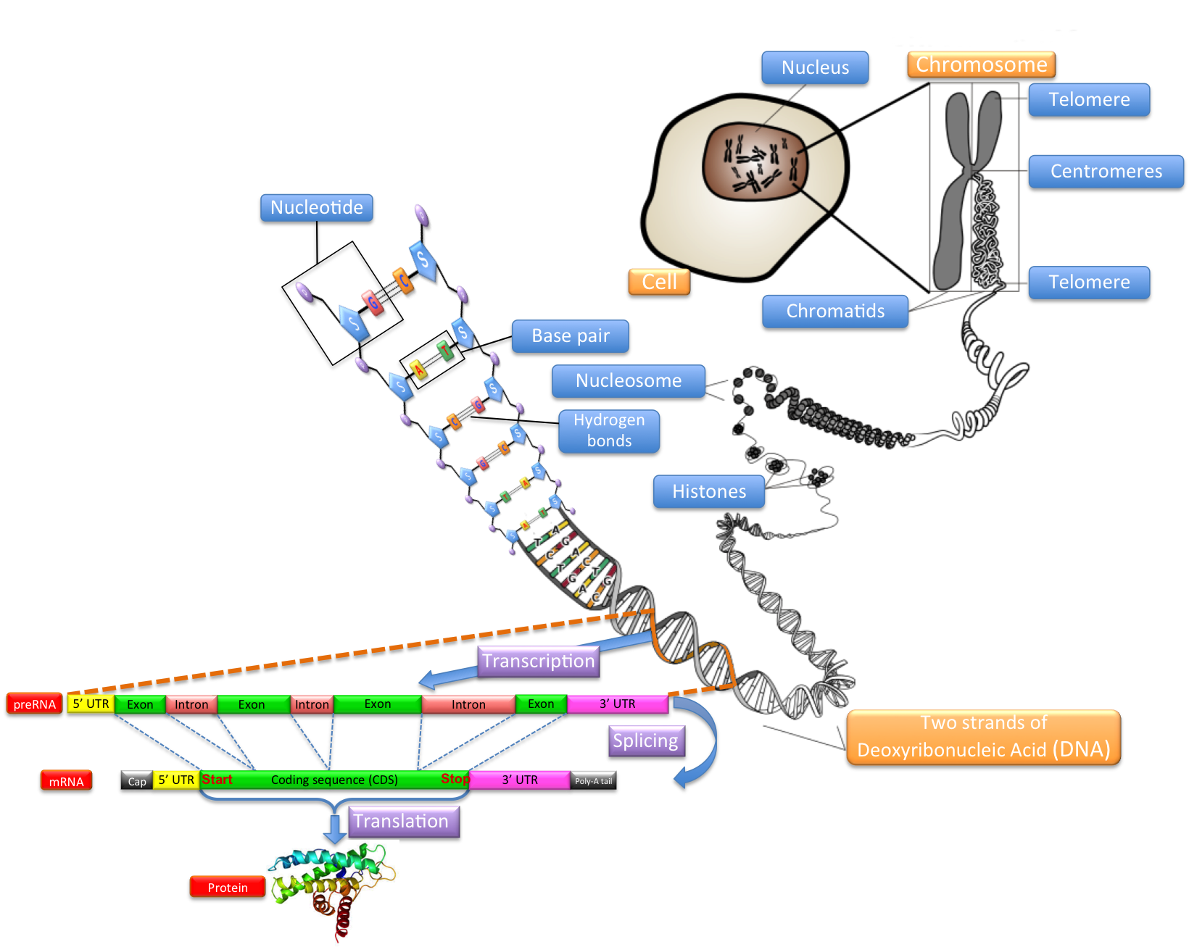
Overview
?

Slide 3
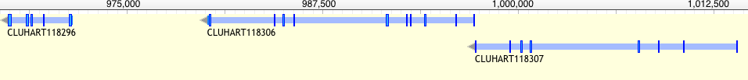
Functional annotation – Why?
Understanding the function of gene product is key to understanding how a limited number of interacting gene products can generate life, from simple unicellular organisms to the incredibly complex multi-cellular Homo sapiens.
Rison,S.C., Hodgman,T.C. and Thornton,J.M. (2000) Comparison of functional annotation schemes for genomes. Funct. Integr. Genomics, 1, 56–69.
Proteins vary in structure as well as function
?
?
?
Antibodies?
Enzyme?
Energy?
Contractile protein?
Transport Protein?
Storage Protein?
Hormone?
Structural Protein?
Notes:
Metabolic reconstruction. What can an organism do and how?
Evolutionaly analysis. How does an organism compare to the rest?

Slide 4
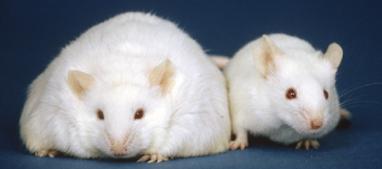
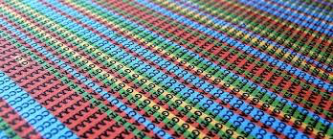
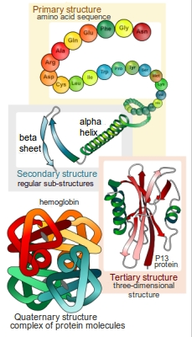
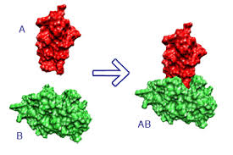
Functional annotation – HOW?
Experimentally
=> Mutants, knockout, etc.
Accurate
Computationally
Sequence-based
Structure based
Protein-protein interaction data
limited accuracy
Mice homozygous for the diabetes 3J spontaneous mutation
Notes:
Gene inactivated by homologous recombination

Slide 5
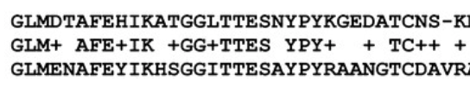
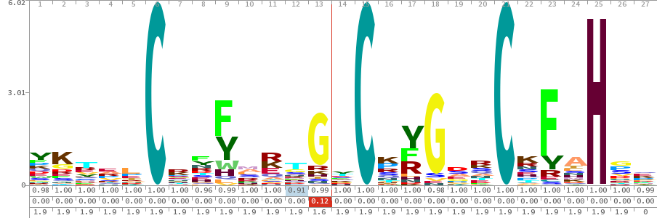
Methods - Sequence-based
Based on similarity
=>Best blast hit
Based on Motif
Proscan, MEME, QuasiMotiFinder
Based on Profile (HMM or other statistical signature )
Q
S
D-X-[KR]-P-{WYF}-X5
…
Whole sequence
e.g. Psi-BLAST*, PIRSF
structural classification
e.g. SUPERFAMILY
domain
e.g. PFAM
Localization (e.g membrane, golgi, secreted)
e.g. SignalP, TMHMM
Notes:
Clustering => How choose the representative in the cluster ? Need to prioritize … by organism model as example.
Motif = pattern = regular expression: basic because there is no weight for each position.

Slide 6
Methods - Sequence-based
Based on evolutionary relationship (Orthology)
Clustering: KOG / COG
Based on synteny
Whole genome alignment (lastZ)
(NBIS) Satsuma + kraken + custom script
Based on phylogeny
Quite complicated at large scale
Notes:
Clustering => How choose the representative in the cluster ? Need to prioritize … by organism model as example.
Motif = basic because there is no weight for each position.

Slide 7
Methods - Structure-based
Similarity to known structures.
Global structure-comparison
CATH and SCOP, the two most comprehensive structure-based family resources
localized regions
might be relevant to function: clefts, pockets and surfaces
active-site residues (catalytic clusters and ligand-binding sites)
active-site residues is often more conserved than the overall fold
=> PDBSiteScan
no single method is always successful
Notes:
other global structure-comparison methods (for example, DALI, MSDFold, VAST, CE, STRUCTAL and FATCAT]) can identify structural neighbors in the Protein Data Bank (PDB).

Slide 8
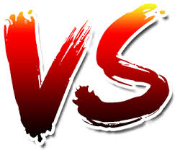
Functional annotation – HOW?
It is actually kind of complex…
Multi-dimensional problem : e.g. A protein can have a molecular function, a cellular role, and be part of a functional complex or pathway
Molecular function can be illustrated by multiple descriptive levels (e.g. 'enzyme' category versus a more specific 'protease' assignment).
Similarities (structural or in sequence) function.
Similar sequence but different function (new domain => new combination => different function)
Different sequence may have same function (convergence) : Profiles helpful
Two proteins may have a similar fold but different functions
Looks for conserved domains more reliable than whole sequence ?
How to go from conserved domains to assigning a function for your protein?
=> Importance to gathering as much information as possible
Notes:
A notable challenge is deciphering the connection between the detected similarities (structural or in sequence) and the actual level of functional relatedness.
The last question is a general question in functional annotation.

Slide 9
Functional annotation – HOW?
Let’s focus on Sequence-based methods
The most used (popular)
Quick
Easy to use
Accurate (>70%)
Many resources: even structural domains information
Less computationally demanding
Watson JD, Sanderson S, Ezersky A, Savchenko A, Edwards A, Orengo C, Joachimiak A, Laskowski RA, Thornton JM: Towards fully automated structure-based function prediction in structural genomics: a case study. J Mol Biol. 2007, 367: 1511-1522. 10.1016/j.jmb.2007.01.063.

Slide 10
Functional annotation – HOW?
Get sequences

Slide 11
Functional annotation – HOW?
First you need the sequences
Extract sequences from the browser (Webapollo)
GFF3 => fasta
Fasta available (Biomart, FTP, output of annotation tools)
If CDS=> translate in AA

Slide 12
Functional annotation – HOW?
Get sequences
gene name + description

Slide 13

Blast-based approach
Annotate the function of the sequences using Blast:
Uniprot | Swissprot
exhaustive | reliable
Choice of the DB e.g:
Blast the protein-sequences using blastp from the Blast+ package
Extract the name and the description from the blast output and add it to the gff annotation
Minimum Threshold
>sp|P03928|ATP8_HUMAN ATP synthase protein 8 OS=Homo sapiens GN=MT-ATP8 PE=1 SV=1
MPQLNTTVWPTMITPMLLTLFLITQLKMLNTNYHLPPSPKPMKMKNYNKPWEPKWTKICS
LHSLPPQS
Notes:
Often only the best blast hit is used.
Could be necessary to filter by evalue, in case where the best blast hit is not significant enough (1e-6 usually)

Slide 14
Blast-based approach
Strengths
Fairly fast and easy
Allow gene naming + descritpion
Limits
Orthology not certain - best blast-hit does not equal orthologous!
Bias due to well conserved domains
Best Hit ( use as template) is not necessary the best annotated sequence to use => Could apply a prioritization rule (Human first, then mouse, etc).

Slide 15
Blast-based approach
Blast-based annotation are tightly dependent to the quality of the structural annotation
Gene Fusion
Gene split
Gene Partial (Well conserved domain)
Over prediction
Wrong ORF
Notes:
Gene partial: Domain contained tot necessary reflect the function

Slide 16
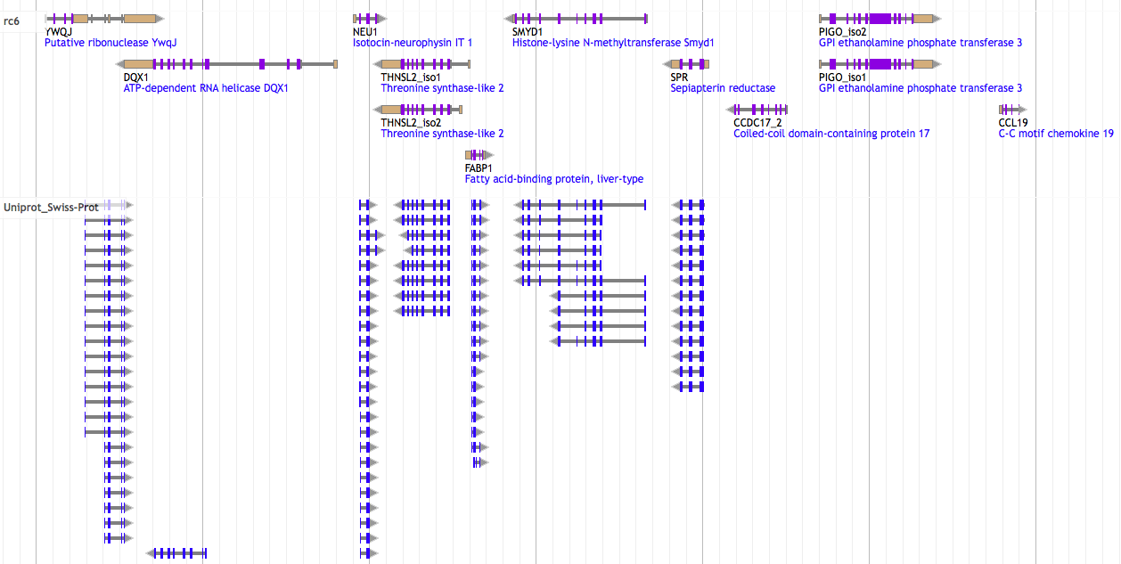
Blast-based approach : result

Slide 17
Functional annotation – HOW?
Get sequences
gene name + description
Pathways
(KEGG, MetaCyc, Reactome …)
Controlled vocabulary
(GO)
Domains
(Pfam, interpro)
Notes:
Compare against databases

Slide 18
Databases
Database | Information | Comment
KEGG | Pathway | Kyoto Encyclopedia of Genes and Genomes
MetaCyc | Pathway | Curated database of experimentally elucidated metabolic pathways from all domains of life (NIH)
Reactome | Pathway | Curated and peer reviewed pathway database
UniPathway | Pathway | Manually curated resource of enzyme-catalyzed and spontaneous chemical reactions.
GO | Gene Ontology | Three structured, controlled vocabularies (ontologies) : biological processes, cellular components and molecular functions
Pfam | Protein families | Multiple sequence alignments and hidden Markov models
Interpro | Protein families, domains and functional sites | Run separate search applications, and create a signature to search against Interpro.
Have a look on the Interpro web page: All the database they search into are listed. It gives a nice overview of different types of databases available.

Slide 19
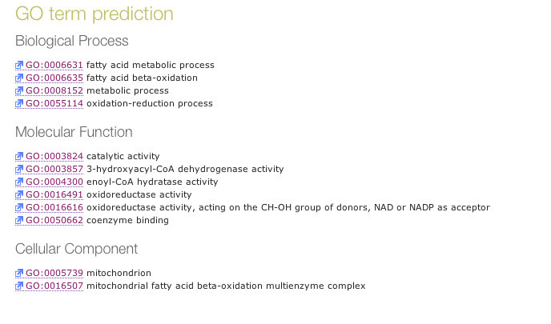
Gene Ontology
Gene Ontology: the framework for the model of biology. The GO defines concepts/classes used to describe gene function, and relationships between these concepts. It classifies functions along three aspects:
More than 60 000 terms
pathways and larger processes
made up of the activities
of multiple gene products.
molecular activities
of gene products
where gene products are active
Notes:
Gene ontology (GO) is a major bioinformatics initiative to unify thanks to a control vocabulary the representation of gene and gene product attributes across all species.
GO classifies functions along three aspects :
1)biological process
pathways and larger processes made up of the activities of multiple gene products.
2)molecular function
molecular activities of gene products
3)cellular component
where gene products are active

Slide 20
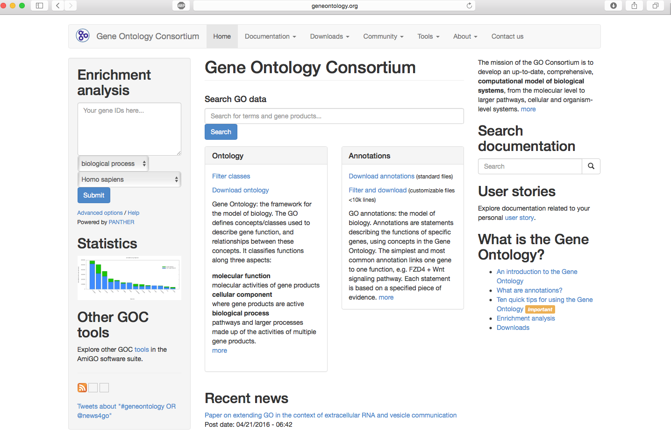
Gene Ontology
http://www.geneontology.org/
Notes:
Gene ontology (GO) is a major bioinformatics initiative to unify thanks to a control vocabulary the representation of gene and gene product attributes across all species.

Slide 21
Tools
Tool | Approach | Comment
Trinotate | Best blast hit + protein domain identification (HMMER/PFAM) + protein signal peptide and transmembrane domain prediction (signalP/tmHMM), and leveraging various annotation databases (eggNOG/GO/Kegg databases). | Not automated
Annocript | Best blast hit | Collects the best-hit and related annotations (proteins, domains, GO terms, Enzymes, pathways, short)
Annot8r | Best blast hits | A tool for Gene Ontology, KEGG biochemical pathways and Enzyme Commission EC number annotation of nucleotide and peptide sequences.
Sma3s | Best blast hit + Best reciprocal blast hit + clusterisation | 3 annotation levels
afterParty | BLAST, InterProScan | web application
Interproscan | Run separate search applications HMMs, fingerprints, patterns => InterPro | Created to unite secondary databases
Blast2Go | Best* blast hits | Retrieve only GO Commercial !
Notes:
Adapted to transcriptome: Trinotate, Annocript

Slide 22
Interproscan
“InterPro is a resource that provides functional analysis of protein sequences by classifying them into families and predicting the presence of domains and important sites.
To classify proteins in this way, InterPro uses predictive models, known as signatures,
provided by several different databases (referred to as member databases) that make up the InterPro consortium.”
https://www.ebi.ac.uk/interpro/about.html
Notes:
CATH-Gene3D database describes protein families and domain architectures in complete genomes. Protein families are formed using a Markov clustering algorithm, followed by multi-linkage clustering according to sequence identity. Mapping of predicted structure and sequence domains is undertaken using hidden Markov models libraries representing CATH and Pfam domains. CATH-Gene3D is based at University College, London, UK. CDD is a protein annotation resource that consists of a collection of annotated multiple sequence alignment models for ancient domains and full-length proteins. These are available as position-specific score matrices (PSSMs) for fast identification of conserved domains in protein sequences via RPS-BLAST. CDD content includes NCBI-curated domain models, which use 3D-structure information to explicitly define domain boundaries and provide insights into sequence/structure/function relationships, as well as domain models imported from a number of external source databases. MobiDB offers a centralized resource for annotations of intrinsic protein disorder. The database features three levels of annotation: manually curated, indirect and predicted. The different sources present a clear tradeoff between quality and coverage. By combining them all into a consensus annotation, MobiDB aims at giving the best possible picture of the "disorder landscape" of a given protein of interest. HAMAP stands for High-quality Automated and Manual Annotation of Proteins. HAMAP profiles are manually created by expert curators. They identify proteins that are part of well-conserved proteins families or subfamilies. HAMAP is based at the SIB Swiss Institute of Bioinformatics, Geneva, Switzerland. PANTHER is a large collection of protein families that have been subdivided into functionally related subfamilies, using human expertise. These subfamilies model the divergence of specific functions within protein families, allowing more accurate association with function, as well as inference of amino acids important for functional specificity. Hidden Markov models (HMMs) are built for each family and subfamily for classifying additional protein sequences. PANTHER is based at at University of Southern California, CA, US. Pfam is a large collection of multiple sequence alignments and hidden Markov models covering many common protein domains. Pfam is based at EMBL-EBI, Hinxton, UK. PIRSF protein classification system is a network with multiple levels of sequence diversity from superfamilies to subfamilies that reflects the evolutionary relationship of full-length proteins and domains. PIRSF is based at the Protein Information Resource, Georgetown University Medical Centre, Washington DC, US. PRINTS is a compendium of protein fingerprints. A fingerprint is a group of conserved motifs used to characterise a protein family or domain. PRINTS is based at the University of Manchester, UK. ProDom protein domain database consists of an automatic compilation of homologous domains. Current versions of ProDom are built using a novel procedure based on recursive PSI-BLAST searches. ProDom is based at PRABI Villeurbanne, France. PROSITE is a database of protein families and domains. It consists of biologically significant sites, patterns and profiles that help to reliably identify to which known protein family a new sequence belongs. PROSITE is base at the Swiss Institute of Bioinformatics (SIB), Geneva, Switzerland. SFLD (Structure-Function Linkage Database) is a hierarchical classification of enzymes that relates specific sequence-structure features to specific chemical capabilities. SMART (a Simple Modular Architecture Research Tool) allows the identification and annotation of genetically mobile domains and the analysis of domain architectures. SMART is based at at EMBL, Heidelberg, Germany. SUPERFAMILY is a library of profile hidden Markov models that represent all proteins of known structure. The library is based on the SCOP classification of proteins: each model corresponds to a SCOP domain and aims to represent the entire SCOP superfamily that the domain belongs to. SUPERFAMILY is based at the University of Bristol, UK. TIGRFAMs is a collection of protein families, featuring curated multiple sequence alignments, hidden Markov models (HMMs) and annotation, which provides a tool for identifying functionally related proteins based on sequence homology. TIGRFAMs is based at the J. Craig Venter Institute, Rockville, MD, US.

Slide 23
Interproscan
Interproscan
PROSITE
GENE3D
PIR
SUPERFAMILY
PRINT
PANTHER
…
TIGRFAMS
PFAM
SMART
PRODOM
Notes:
CATH-Gene3D database describes protein families and domain architectures in complete genomes. Protein families are formed using a Markov clustering algorithm, followed by multi-linkage clustering according to sequence identity. Mapping of predicted structure and sequence domains is undertaken using hidden Markov models libraries representing CATH and Pfam domains. CATH-Gene3D is based at University College, London, UK. CDD is a protein annotation resource that consists of a collection of annotated multiple sequence alignment models for ancient domains and full-length proteins. These are available as position-specific score matrices (PSSMs) for fast identification of conserved domains in protein sequences via RPS-BLAST. CDD content includes NCBI-curated domain models, which use 3D-structure information to explicitly define domain boundaries and provide insights into sequence/structure/function relationships, as well as domain models imported from a number of external source databases. MobiDB offers a centralized resource for annotations of intrinsic protein disorder. The database features three levels of annotation: manually curated, indirect and predicted. The different sources present a clear tradeoff between quality and coverage. By combining them all into a consensus annotation, MobiDB aims at giving the best possible picture of the "disorder landscape" of a given protein of interest. HAMAP stands for High-quality Automated and Manual Annotation of Proteins. HAMAP profiles are manually created by expert curators. They identify proteins that are part of well-conserved proteins families or subfamilies. HAMAP is based at the SIB Swiss Institute of Bioinformatics, Geneva, Switzerland. PANTHER is a large collection of protein families that have been subdivided into functionally related subfamilies, using human expertise. These subfamilies model the divergence of specific functions within protein families, allowing more accurate association with function, as well as inference of amino acids important for functional specificity. Hidden Markov models (HMMs) are built for each family and subfamily for classifying additional protein sequences. PANTHER is based at at University of Southern California, CA, US. Pfam is a large collection of multiple sequence alignments and hidden Markov models covering many common protein domains. Pfam is based at EMBL-EBI, Hinxton, UK. PIRSF protein classification system is a network with multiple levels of sequence diversity from superfamilies to subfamilies that reflects the evolutionary relationship of full-length proteins and domains. PIRSF is based at the Protein Information Resource, Georgetown University Medical Centre, Washington DC, US. PRINTS is a compendium of protein fingerprints. A fingerprint is a group of conserved motifs used to characterise a protein family or domain. PRINTS is based at the University of Manchester, UK. ProDom protein domain database consists of an automatic compilation of homologous domains. Current versions of ProDom are built using a novel procedure based on recursive PSI-BLAST searches. ProDom is based at PRABI Villeurbanne, France. PROSITE is a database of protein families and domains. It consists of biologically significant sites, patterns and profiles that help to reliably identify to which known protein family a new sequence belongs. PROSITE is base at the Swiss Institute of Bioinformatics (SIB), Geneva, Switzerland. SFLD (Structure-Function Linkage Database) is a hierarchical classification of enzymes that relates specific sequence-structure features to specific chemical capabilities. SMART (a Simple Modular Architecture Research Tool) allows the identification and annotation of genetically mobile domains and the analysis of domain architectures. SMART is based at at EMBL, Heidelberg, Germany. SUPERFAMILY is a library of profile hidden Markov models that represent all proteins of known structure. The library is based on the SCOP classification of proteins: each model corresponds to a SCOP domain and aims to represent the entire SCOP superfamily that the domain belongs to. SUPERFAMILY is based at the University of Bristol, UK. TIGRFAMs is a collection of protein families, featuring curated multiple sequence alignments, hidden Markov models (HMMs) and annotation, which provides a tool for identifying functionally related proteins based on sequence homology. TIGRFAMs is based at the J. Craig Venter Institute, Rockville, MD, US.

Slide 24
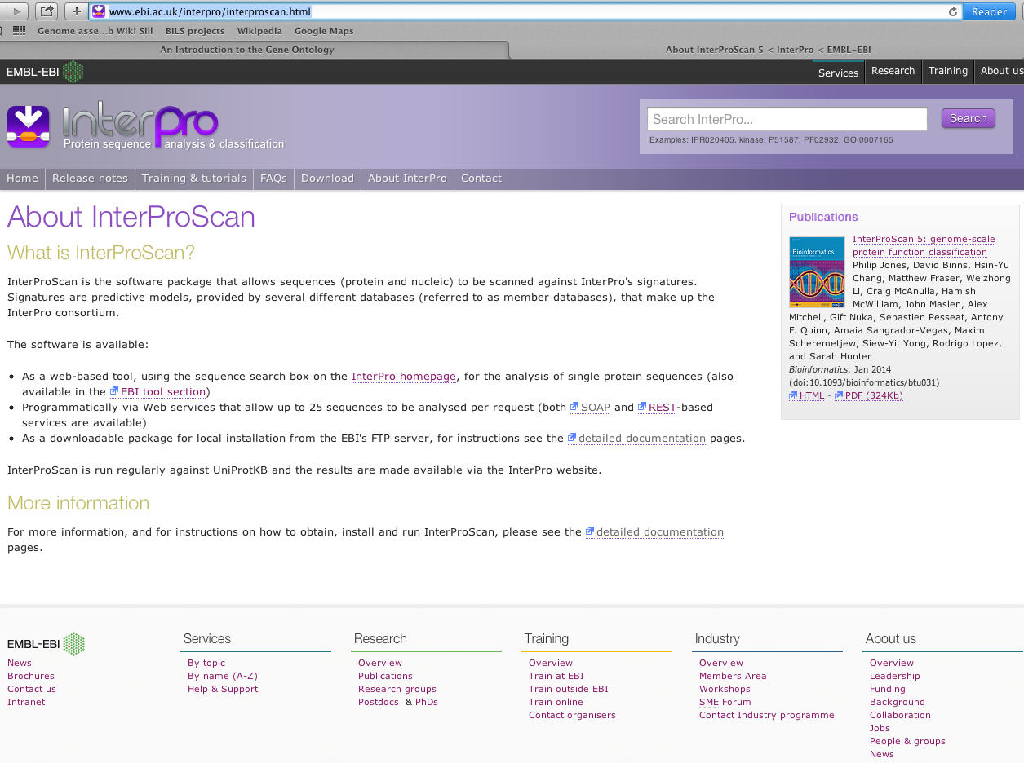
Interproscan
Annotate the sequences functionally using Interproscan
Jones,P.etal.InterProScan5:genome-scale protein function classification. Bioinformatics 30, 1236–1240 (2014).
Quevillon E., Silventoinen V., Pillai S., Harte N., Mulder N., Apweiler R., et al. . (2005). InterProScan: protein domains identifier. Nucleic Acids Res. 33, W116–W120. 10.1093/nar/gki442

Slide 25
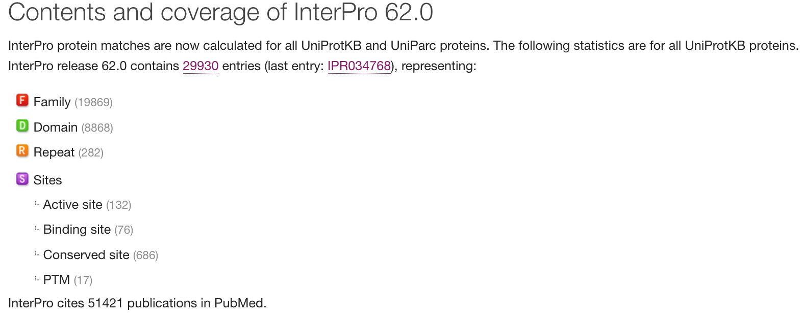
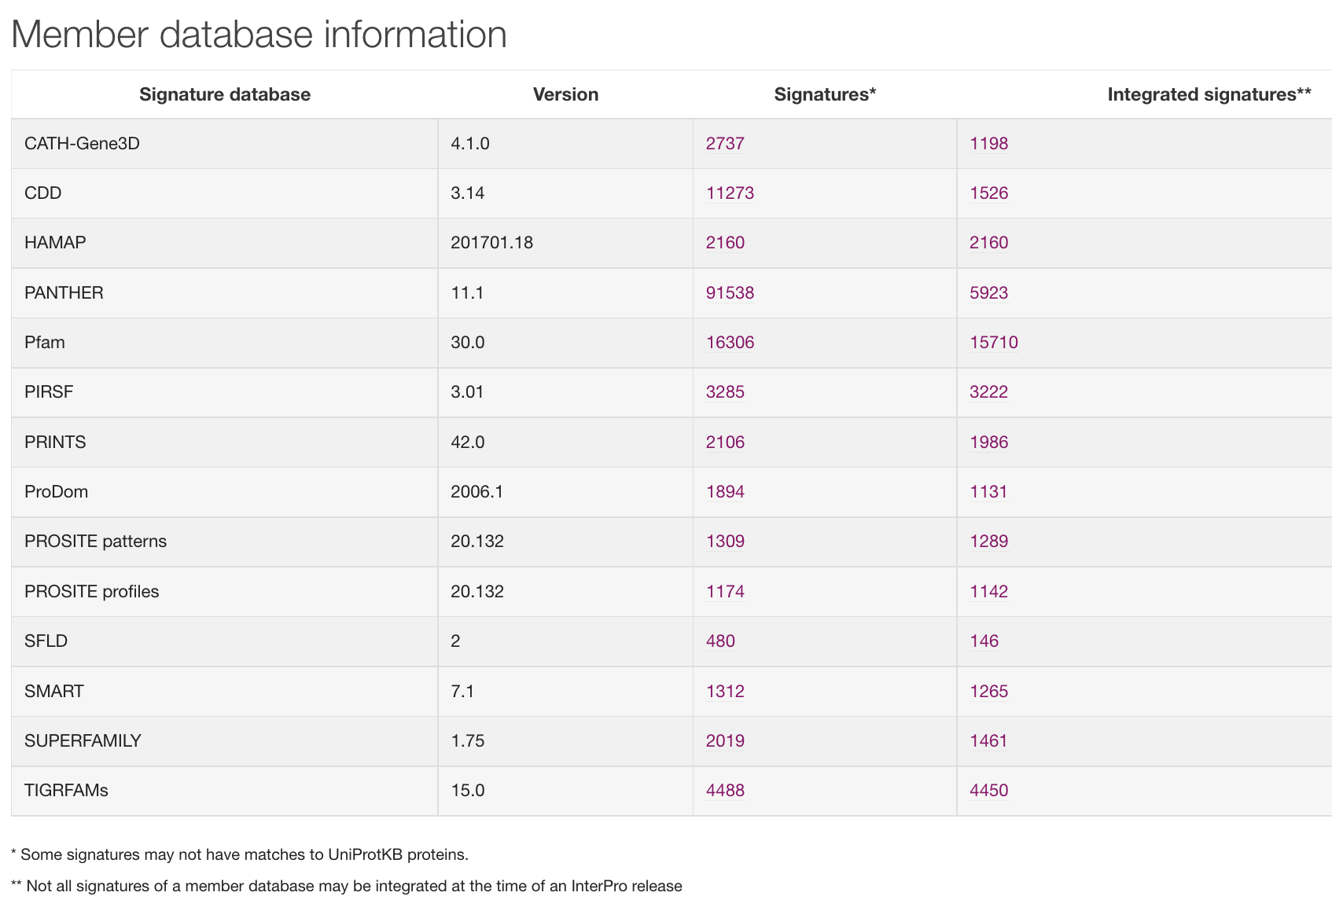

Interproscan
Structural domains

Slide 26
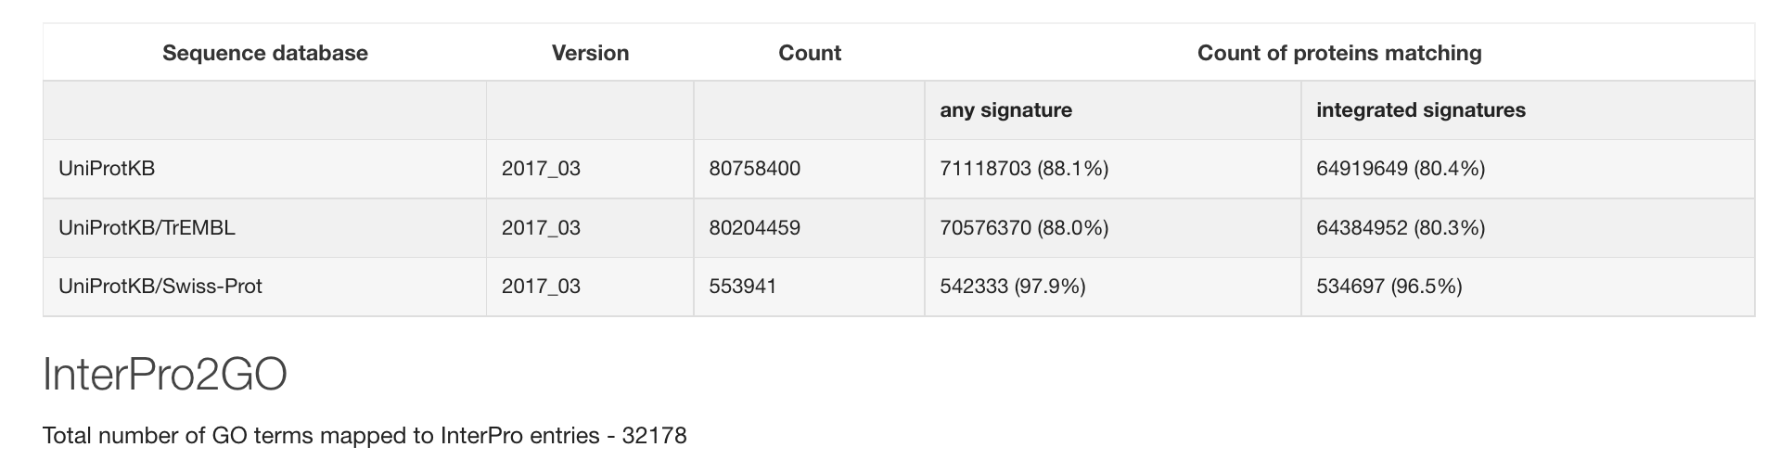
Interproscan
Not integrated signatures = signature not yet curated or do not reach InterPro's standards for integration
pathway information available as well:
- KEGG
- MetaCyc
- Reactome
- UniPathway

Slide 27
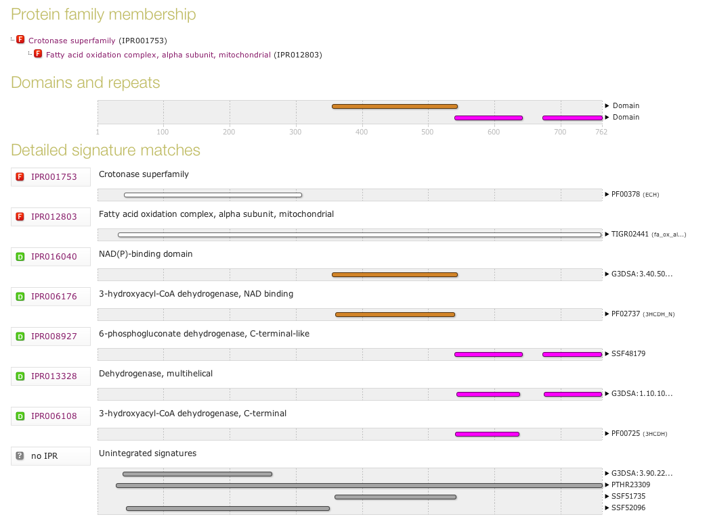
Interproscan results

Slide 28
Interproscan results
Ouput: TSV, XML, SVG, etc
gene-2.44-mRNA-1 a9deba5837e2614a850c7849c85c8e9c 447 Pfam PF02458 Transferase family 98 425 1.4E-15 T 31-10-2015 IPR003480 Transferase GO:0016747
gene-0.13-mRNA-1 61882f1a46b15c8497ed9584a0eb1a35 459 Pfam PF01490 Transmembrane amino acid transporter protein 49 439 2.0E-39 T 31-10-2015 IPR013057 Amino acid transporter, transmembrane
gene-1.4-mRNA-1 b867bbb377084bba6ea84dcda9f27f4e 511 SUPERFAMILY SSF103473 42 481 4.19E-50 T 31-10-2015 IPR016196 Major facilitator superfamily domain, general substrate transporter
gene-1.4-mRNA-1 b867bbb377084bba6ea84dcda9f27f4e 511 Pfam PF07690 Major Facilitator Superfamily 67 447 3.5E-30 T 31-10-2015 IPR011701 Major facilitator superfamily GO:0016021|GO:0055085
MAKER supplies scripts to merge the interproscan-results to the Maker annotations.gff file
Notes:
Protein Accession (e.g. P51587)
Sequence MD5 digest (e.g. 14086411a2cdf1c4cba63020e1622579)
Sequence Length (e.g. 3418)
Analysis (e.g. Pfam / PRINTS / Gene3D)
Signature Accession (e.g. PF09103 / G3DSA:2.40.50.140)
Signature Description (e.g. BRCA2 repeat profile)
Start location
Stop location
Score - is the e-value of the match reported by member database method (e.g. 3.1E-52)
Status - is the status of the match (T: true)
Date - is the date of the run
(InterPro annotations - accession (e.g. IPR002093) - optional column; only displayed if -iprlookup option is switched on)
(InterPro annotations - description (e.g. BRCA2 repeat) - optional column; only displayed if -iprlookup option is switched on)
(GO annotations (e.g. GO:0005515) - optional column; only displayed if --goterms option is switched on)
(Pathways annotations (e.g. REACT_71) - optional column; only displayed if --pathways option is switched on)

Slide 29

Blast2GO
Another way : use the (mostly) commercial alternative
Combines a blast-based search with a search for functional domains
Blast at NCBI -> picks out GO terms based on blast hits and uniprot -> statistical significance test -> done!
Blast2Go relies entirely on sequence similarity … but InterProScan searches can also be launched within blast2go
Command line tool or Plugin for Geneious or CLC bio Workbench (commercial tools for downstream analyses)
=> Contain nice downstream analysis/visualization components
Notes:
RNA SEQ EXPRESSION,

Slide 30
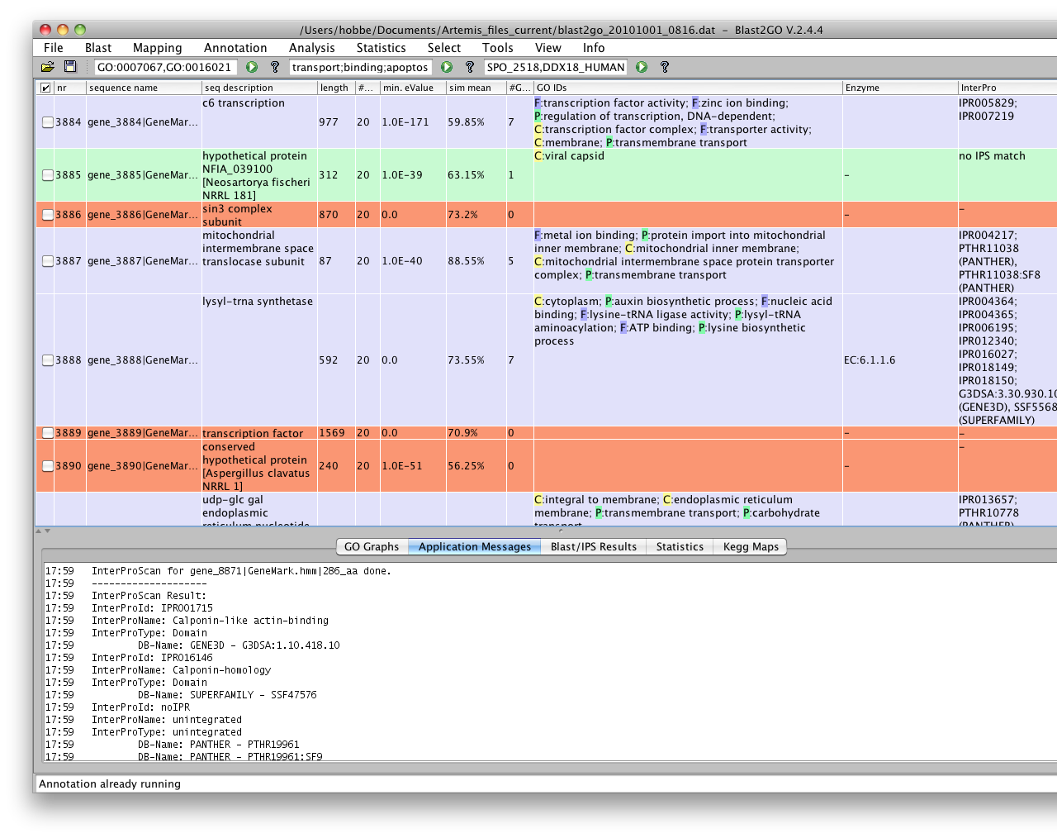
Blast2GO

Slide 31
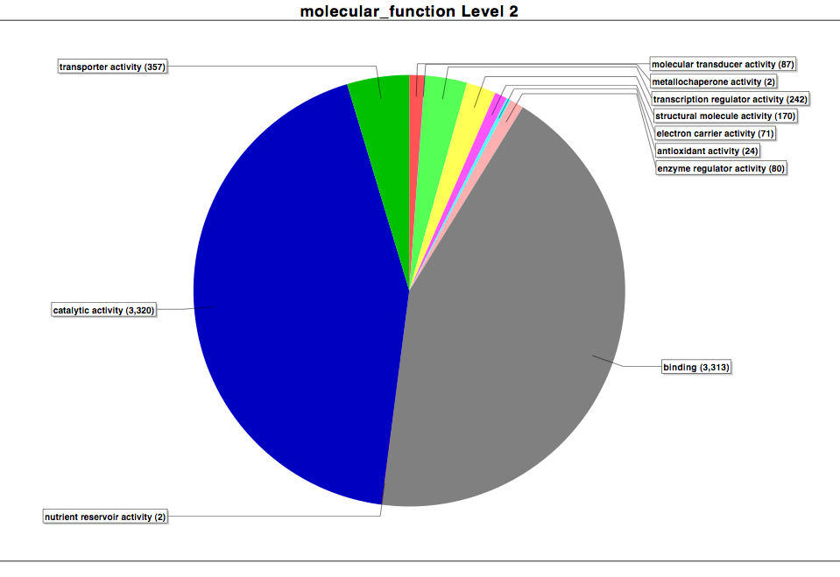
Blast2GO
Notes:
You can choose one of the 3 mains groups and then choose the depth level

Slide 32
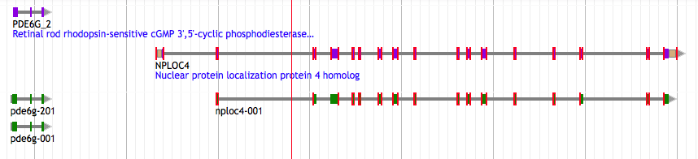
Quick view of synteny-based method
Liftovers are very useful for orthology determination
Align two genomes (Satsuma)
Transfer annotations between aligned regions (Kraken)
Transfer functional annotations between lifted genes that overlap annotated genes

Slide 33
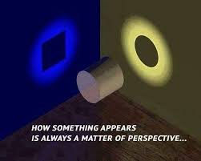
One word about network
Categorizations of gene function (e.g GO) in a hierarchy of categories is helpful
BUT
gene has no function alone
=> Pathways / regulatory networks explain how genes interact so as to enable cellular processes.
KEGG
MetaCyc
Reactome
UniPathway
Notes:
Categorizations of gene function, such as those used in theGene Ontology Project slot each gene into one category in a hierarchy of categories. They are helpful, but they ignore the fact that an individual gene has no function in isolation.
Gene function prediction is a stepping stone to the more important problem of inferring regulatory networks that explain how genes interact so as to enable cellular processes.
Put in perspective of PATWAY is better !

Slide 34
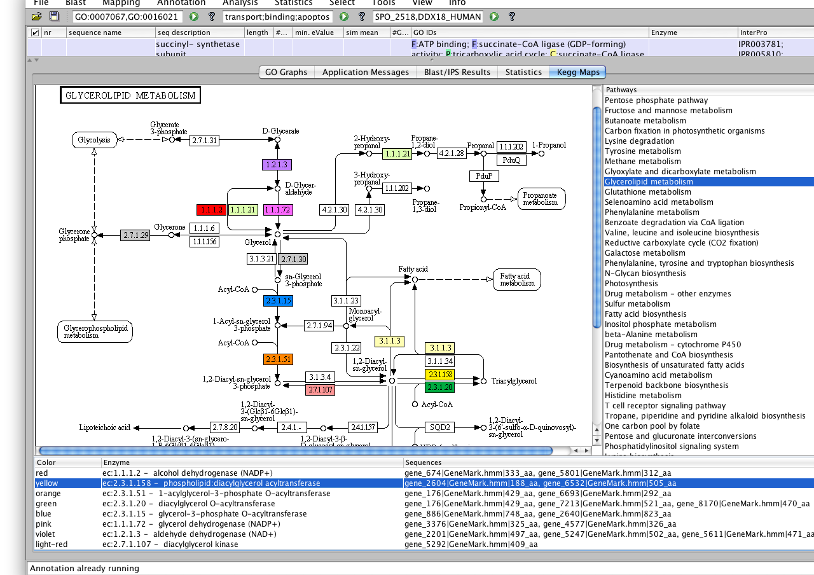
KEGG-mapping

Slide 35
Conclusion
Functional annotation found
/!\ Transmission of error from databases !
Experimental check is good !
Hypothetical protein / Uncharacterized protein
=> depends largely on conventional experiments.
Knowing the function is not enough: Chimp and human => 98% similarity
=> Knowledge of other parameters useful (pathway, positional and temporal regulation of genes)

Slide 36
Jacques Dainat PhD
THE END
https://github.com/NBISweden/GAAS
Notes:
For sure it comes after structural prediction !

