Slide 1
Science for Life Laboratory
Malin Larsson
SciLifeLab long term bioinformatics support
National Bioinformatics Infrastructure Sweden (NBIS)

Slide 2
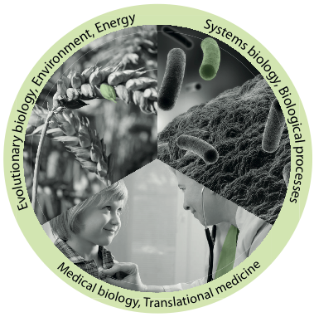
Develops, offers and applies
advanced technologies for molecular biosciences with a focus on health and environment
Joint Uppsala – Stockholm center with two nodes
Hosted by four universities
Official start, 1 July 2013
Approximately 1500 researchers by mid 2014
Infrastructure for molecular bioscience

Slide 3
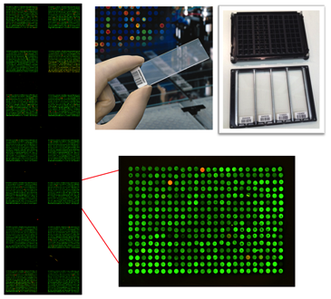
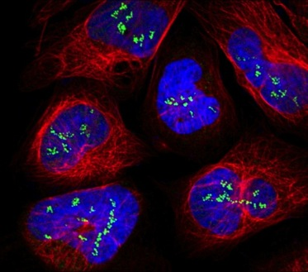
SciLifeLab mission
Technology platforms for national use
Service
Technology Development
Analytical support
Courses and workshops
Generate a strong research environment
Affiliated faculty
SciLifeLab Fellows Program
National projects
International collaborations

Slide 4

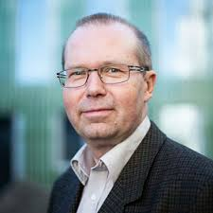
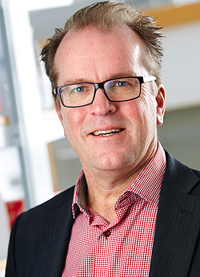
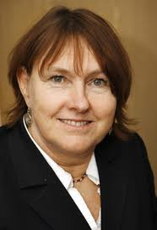

SciLifeLab platforms
SciLifeLab
VR
National Genomics Infrastructure
National Bioinformatics Infrastructure
Sweden
Clinical Diagnostics
…
SNIC
Joakim Lundeberg Ann-Christine Syvänen
Ulf Gyllensten
Bengt Persson
Lars Engstrand
Computer resources free for Swedish researchers
Ongoing merge of BILS, WABI and more; complete 2016.
National, distributed

Slide 5
Upcoming courses
Date | Course
April 12-14 | RNA-seq
April 26-27 | Introduction to Genome Annotation
May 23-27 NOTE! Application deadline April 18 | Perl Programming with Application to Bioinformatics
October 10-14 | Perl Programming with Application to Bioinformatics
October 25-27 | RNA-seq
November 15-16 | De novo Genome Assembly
November 22-23 | Metagenomics
Application Nov/Dec | The Swedish Bioinformatics Advisory Program

Slide 6
www.scilifelab.se

Slide 7
Course schedule
Monday
Room: Campus Valla, House B, Room Odén
09.00-09.15 Registration and Welcome, presentation of SciLifeLab
09.15-10.00 Lecture: Introduction to Linux (Martin Dahlö)
10.00-12.00 Exercise: Introduction to Linux (Martin Dahlö, Malin Larsson)
12.00-13.00 Lunch
13.00-14.00 Lecture: Introduction to UPPMAX/UPPNEX (Martin Dahlö)
14.00-17.00 Exercise: Introduction to UPPMAX/UPPNEX (Martin Dahlö, Malin Larsson)
Tuesday
Room: Campus Valla, House B, Room Odén
09.00-10.00 Lecture: Alignment with BWA; Data Processing with Picard; Variant Calling with GATK; SAM/BAM and VCF Formats
10.00-12.00 Exercise: Alignment with BWA; Data Processing with Picard; Variant Calling with GATK; SAM/BAM and VCF Formats part I (Malin Larsson, Mihaela Martis)
12.00-13.00 Lunch
13:00-17:00 Exercise: Alignment with BWA; Data Processing with Picard; Variant Calling with GATK; SAM/BAM and VCF Formats part II
Wednesday
Room: Campus Valla, House B, Room Odén
09.00-11.30 Lecture: Next Generation Sequencing Overview
11:30-12.00 Lecture: The National Bioinformatics Infrastructure Sweden
12.00-13.00 Lunch
13.00-14.00 Lecture: NGS and bioinformatics analysis pipelines
14.00-17.00 Project discussion
18:00- Course dinner at De Klomp
Gr
Thursday
Room: Campus Valla, House B, Room Odén
09:00-10.00 Lecture: ChIP sequencing and data analysis
10.00-12:00 Exercise: ChIP sequencing and data analysis part I
12.00-13.00 Lunch
13.00-17:00 Exercise: ChIP sequencing and data analysis part II
Friday
Room: Campus Valla, House B, Room Odén
09:00-10:00 Lecture: RNA sequencing, transcriptome and expression quantification
10:00-12:00 Exercise: RNA sequencing, transcriptome and expression quantification part I
12.00-13.00 Lunch
13:00-17.00 Exercise: RNA sequencing, transcriptome and expression quantification part II
Project discussions in smaller groups

Slide 8
Lunch in Universitetsklubben
Odén
Lunch

Slide 9
Project discussions on Wednesday
Groups based on your interest. Proposed groups:
RNA-seq and epigenetics (Agata and Mihaela)
Variant calling including somatic variants (Malin and Adam)
Experimental setup (Olga)
Please plan questions for the discussion:
technology-related
analysis-related
if there is something your would like to discuss 1:1 with a teacher only
?
Time: 14:00 -17:00 on Wednesday
Place: Odén, Fick and Dalton
Groups will be decided during Monday/Tuesday (let me know which group you want to be in)

