Slide 1
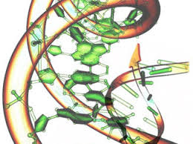
Detection of somatic mutations in cancer tumors
Malin Larsson
malin.larsson@scilifelab.se

Slide 2
Outline
Introduction
The mutational landscape of cancer
Detection of cancer mutations
recap of germline variant calling
Somatic variant calling workflow
Today’s practical

Slide 3
Introduction

Slide 4
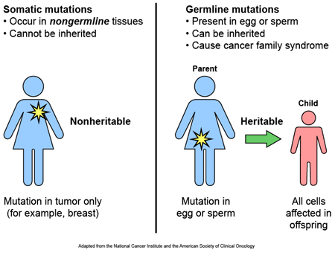
Somatic vs germline mutations
https://www.stjude.org/Images/hosp-misc-ipactr6-1101.gif

Slide 5
Cancer is an evolutionary process
Genetic variation introduced in individual cells
more-or-less random mutations
Clonal expansion - natural selection acting on the resultant phenotypic diversity

Slide 6
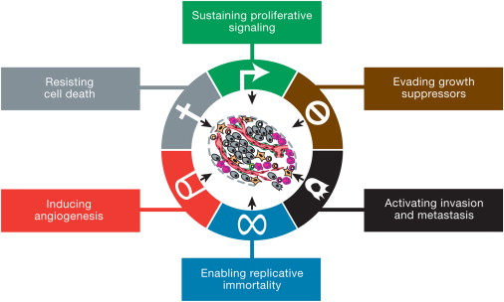
Hallmarks of Cancer
The Hallmarks of CancerThis illustration encompasses the six hallmark capabilities originally proposed by Hanahan et al 2000. The past decade has witnessed remarkable progress toward understanding the mechanistic underpinnings of each hallmark.
Hanahan and Weinberg, Hallmarks of Cancer: The Next Generation, Cell 2011

Slide 7
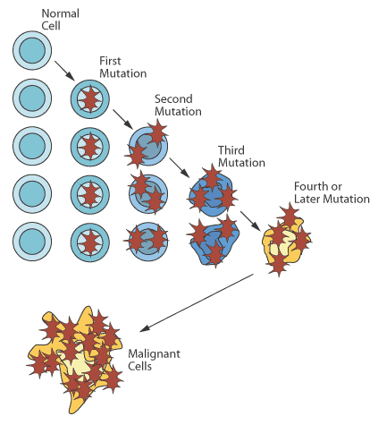
Development of cancer
https://stanfordhealthcare.org/medical-clinics/cancer-genetics-program/understanding-genetics/how-genes-cause-cancer.html

Slide 8
Driver and passenger mutations
Driver’ mutations confer a growth advantage of the cell. They are positively selected during the evolution of the cancer
Passenger mutations are neutral, they just happened to be present in an ancestor of the cancer cell

Slide 9
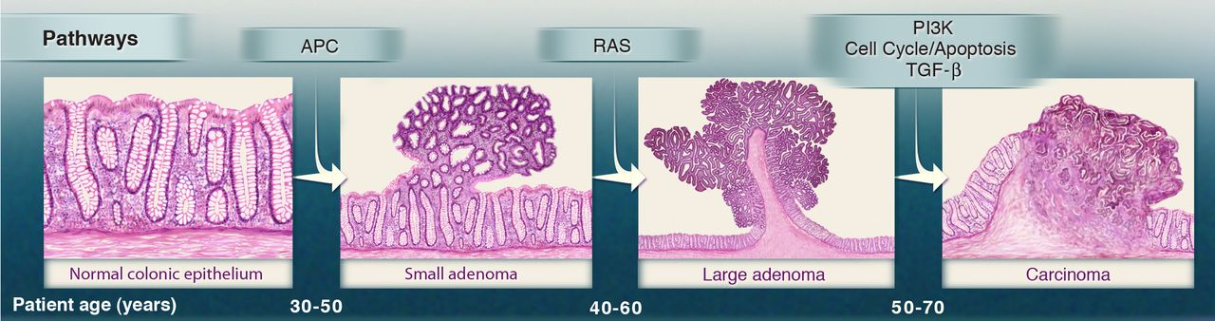

Genetic alterations and the progression of colorectal cancer.
Gatekeeping mutation
Second driver mutation
third driver mutation
Bert Vogelstein et al. Science 2013;339:1546-1558
Published by AAAS
Notes:
Genetic alterations and the progression of colorectal cancer. The major signaling pathways that drive tumorigenesis are shown at the transitions between each tumor stage. One of several driver genes that encode components of these pathways can be altered in any individual tumor. Patient age indicates the time intervals during which the driver genes are usually mutated. Note that this model may not apply to all tumor types. TGF-β, transforming growth factor–β.

Slide 10
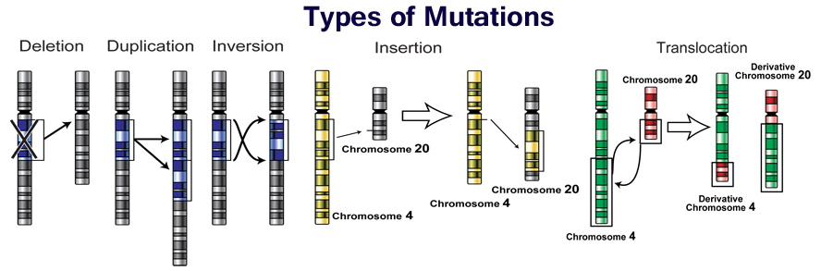
Types of mutations
http://socratic.org/questions/how-do-dna-mutations-occur
Notes:
Substitutions of one base by another
Insertions or deletions of small or large segments of DNA;
rearrangements, in which DNA has been broken and then rejoined to a DNA segment from elsewhere in the genome
copy number increases from the two copies present in the normal diploid genome, sometimes to several hundred copies (known as gene amplification)
copy number reductions that may result in complete absence of a DNA sequence from the cancer genome
External DNA (from viruses such as human papilloma virus, Epstein Barr virus, hepatitis B virus etc.)

Slide 11
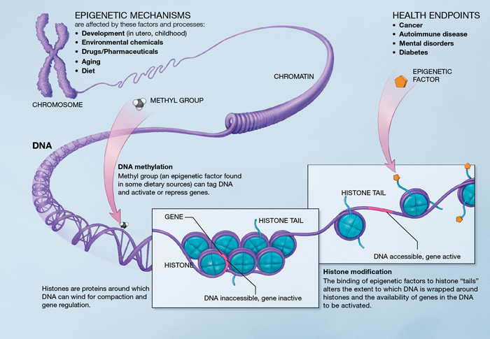
Epigenetic changes
https://en.wikipedia.org/wiki/Epigenetics

Slide 12
Mutational Landscape of Cancer

Slide 13
Some statistics…
From a review published 2013:
~350 cancer driver genes catalogued
5-7 driver mutations per tumor
(Stratton et al, The Cancer Genome, Nature 2013)
Exome seq/WGS studies suggest
higher number of driver genes
Up to 20 driver mutations per tumor

Slide 14
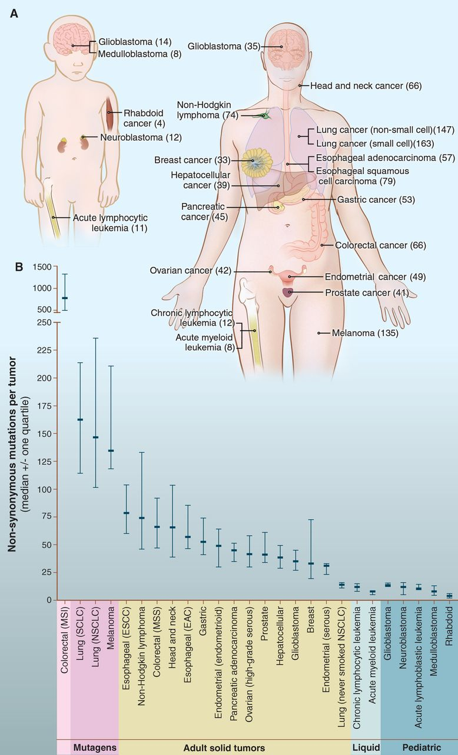
Number of somatic mutations in representative human cancers, detected by genome-wide sequencing studies.
Bert Vogelstein et al. Science 2013;339:1546-1558
Published by AAAS
Notes:
Number of somatic mutations in representative human cancers, detected by genome-wide sequencing studies. (A) The genomes of a diverse group of adult (right) and pediatric (left) cancers have been analyzed. Numbers in parentheses indicate the median number of nonsynonymous mutations per tumor. (B) The median number of nonsynonymous mutations per tumor in a variety of tumor types. Horizontal bars indicate the 25 and 75% quartiles. MSI, microsatellite instability; SCLC, small cell lung cancers; NSCLC, non–small cell lung cancers; ESCC, esophageal squamous cell carcinomas; MSS, microsatellite stable; EAC, esophageal adenocarcinomas. The published data on which this figure is based are provided in table S1C.

Slide 15
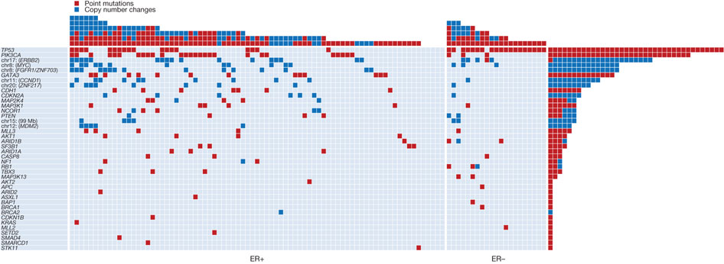

The landscape of driver mutations in breast cancer
Rows: Cancer genes with driver mutations. In case of new
Columns: 100 primary breast cancer tumors (79 ER+, 21 ER-)
Coding exons of 21,416 protein coding genes and 1,664 microRNAs were sequenced
PJ Stephens et al. Nature 000, 1-5 (2012) doi:10.1038/nature11017
Notes:
New cancer genes were identified by detecting non-random clustering of somatic mutations

Slide 16
Detection of cancer mutations

Slide 17
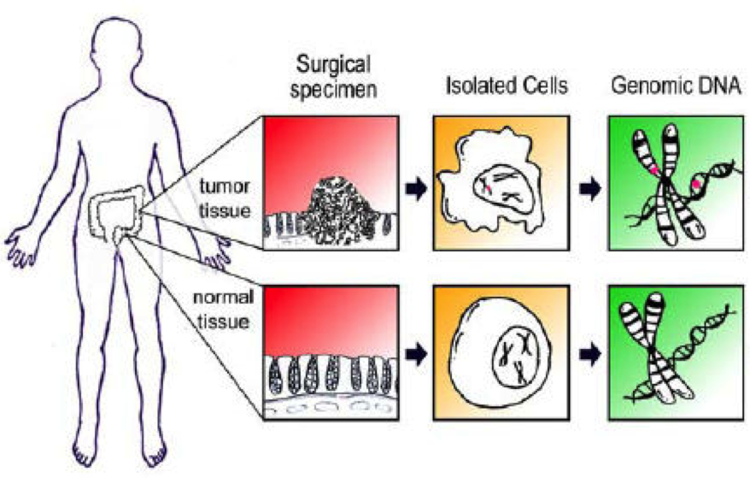
We are interested in somatic events
A matched “normal sample” needed to filter away germline variants
GGGATAC
GGGAGAC

Slide 18
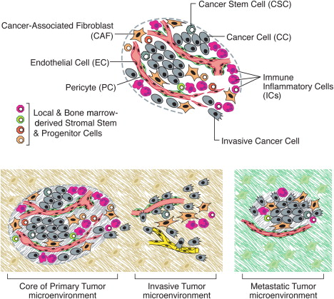
Tumor samples are often impure due to a mixture of tumor and normal cells
Hanahan and Weinberg, Hallmarks of Cancer: The Next Generation, Cell 2011

Slide 19
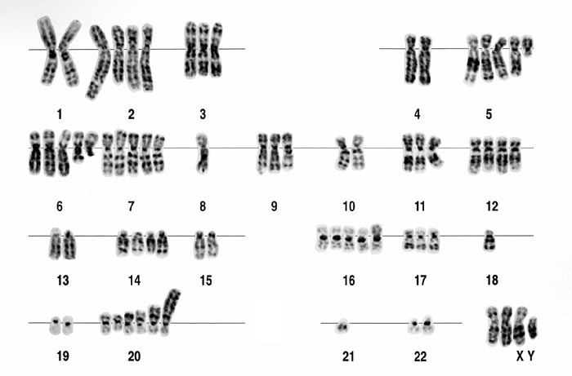
Aneuploidy

Slide 20
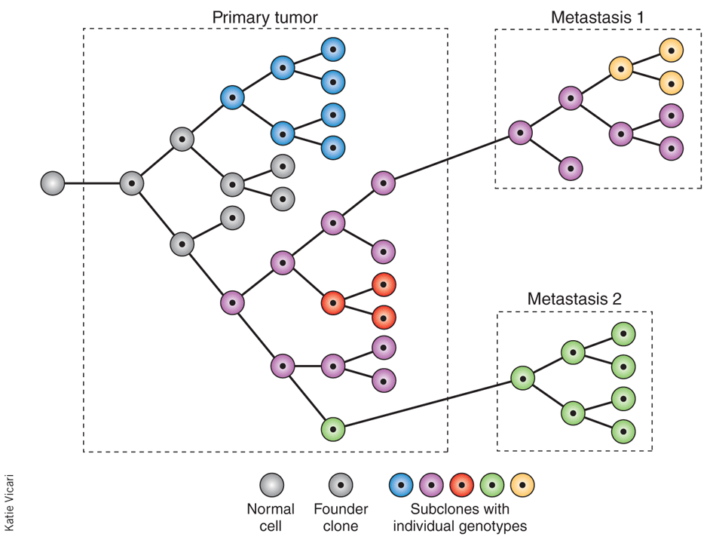
Tumors consists of subclones with different somatic mutations
Carlos Caldas, Nature Biotechnology 30, 408–410 (2012) doi:10.1038/nbt.2213

Slide 21
So, detection algorithms must handle all of this!

Slide 22
Many tools available
single nucleotide variants (SNVs)
MuTect1, Strelka, MuTect2
structural variants (SVs)
Manta, Delly
copy number variants (CNVs)
Control-FREEC, ASCAT, Patchwork

Slide 23
Keep updated!
SciLifeLab WGS toolbox group:
https://wabi-wiki.scilifelab.se/display/SHGATG/SciLifeLab+human+genome+analysis+toolbox+group
Recommended tools and workflow for somatic variant calling (and other things)

Slide 24
Somatic variant calling Workflow

Slide 25
First… recap of germline variant calling workflow

Slide 26
FastQ format
FASTQ format is a text-based format for storing both a nucleotide sequence and its corresponding quality scores.
@HWUSI-EAS100R:6:73:941:1973#0/1
GATTTGGGGTTCAAAGCAGTATCGATCAAATAGTAAATCCATTTGTTCAACTCACAGTTT
+
!''*((((***+))%%%++)(%%%%).1***-+*''))**55CCF>>>>>>CCCCCCC65
1st row: sequence identifier (machine ID, x-y coordinates, additional info)
2nd row: The actual sequence
3rd row: starts with “+” and optionally the same identifier as in the 1st row
4th row: Quality score for each base in read
Quality score: ASCII representation of score for each base (i.e. the probability that the corresponding base call is incorrect.) Platform specific scaling!
For more info: http://en.wikipedia.org/wiki/FASTQ_format

Slide 27
Output of experiment
:@M01674:9:000000000-A4148:1:1101:15048:1349 1:N:0:3
AGACGGTGACCGTGGTCCCTGTGCCCCAGACATCTCGGGTACTACCGTAGTAATCTTCTCTTGCACAGTAATAGACTGCAGAGTCCTCTGATGTCAGGCTGCTGAGCTGCATGTAGGCTGTGTTGGA
+
AABCCCCCCFFCGGGGGGGGGGHHHHGGGHGHHHHHHGGHGHHHHHEFHGGHHHHHHHHHHHHHHHHHGHHHHHHHHHHHHHHHHHHHHHHHHHHHHHHHHGHHEHHHHHHHHHHHHHHHHHHHHHH
@M01674:9:000000000-A4148:1:1101:15003:1351 1:N:0:3
CAGCCTTCATGCAGCTCAGCAGCCTTACATCTGAAGACTCTGCGGTCTATTTCTGCGCAAGAAAGGGGAATTACTACGCCTAGGGGTACTTCGATGTCTGGGGCACAGGGACCACGGTCACCGTCTCCT
+
CCCCCFFFFFFFGGGGGGGGGGHHHGHHHHHHHHHHHHHHHHHGGGGGGHHHHHHHGGGGGGHGHHGGGGHHHHHHHGGGHGHHHGGGHHHHGHHHHHHHHHGGGGHHHGGGGHHGGGGGHHGHGHHHH
@M01674:9:000000000-A4148:1:1101:14577:1352 1:N:0:3
CCTGCTTTTCGGGAAAACGGGATCACCACGATGGAACAGGTTAACGCAGGAATGCGCGTAGCCCGTCGGCAGAATCGACCATTTCTGCCATCACCCGGGCAGTTTGTTGCATGGTGCCGGGAAGAAGCATCCGTTACCGCCGGACTGCCA
+
CCDDDFFFFFDDGGGGGGGGGGGGHHHHHGGHGGHHHHGHHHHHHGGGGGGHHHHGGGGGGGHHGGGGGGGGGHHHHHGGGHHHHHHHHHHHHHHHGGFGGGHHHHHHHHHHHHHHHHGGGGGGHHHHHHHHGGHGGHGGGGGGGGGGGG
@M01674:9:000000000-A4148:1:1101:14770:1355 1:N:0:3
TCCAACACAGCCTTCATGCAACTCAGCAGCCTGACATCTGAGGACTCTGCAGTCTATTACTGTGCAAGATGGGGGTTACTAAGCGCTTACTGGGGCCAAGGGACTCTGGTCACTGTCTCTGCAGGT
+
CCDDDFCEEFDDGGGGGGGGGGHHHHHHHHHHHHHHHHHHGHGGHHHHHHHHHHHHHIHHHHHHHHHHFHHHHGGGGHHHHGHHGGGGGHHHHHGGGGHHGGHGHHHHHHHHHHHHHHHHHHHHHH
@M01674:9:000000000-A4148:1:1101:15309:1358 1:N:0:3
CCAACACAGCCTACATGCAGCTCAGCAGCCTGACATCTGAGGACTCTGCGGTCTATTACTGTGCAAGAGGGGGGCTAATTACTACGGTAGTAGCCGACTACTGGGGCCAAGGCACCACTCTCACAGTCTCCTCAGGTG
+
AACCCDCDFDCFGGGGGGGGGGHHHHHHHHHHHHHHHHHHHGHHHHHHHGGGGGHHHHHHHHHHHHHHHHGGGGGGHHHHHHHHHGGHGGHHHHHGGGGGHHHHHGGGGHHGHHHGGHHGGGGGGGGGGGGGGGGGFF
@M01674:9:000000000-A4148:1:1101:14985:1363 1:N:0:3
AGACGGTGACCGTGGTCCCTGTGCCCCAGACATCGAAGTCGGACCGTAGTAATAAGCCTCTTGCACAGTAATAGACCGCAGAGTCCTCAGATGTCAGGCTGCTGAGTTGCATGAAGGCTGTGTTGGA
+
BCCCCCABBFFCGGGGGGGGGGHHHHGGGHGHHFGHFGEHEGEFGGGHGGHHHHHHHHHHHHHHHHHHGHHHHHHHHGGGGGHHHHHHHHGHHHHFHHHHHGHHFHHHHHHHHHGHHEHHHHHHHHH
@M01674:9:000000000-A4148:1:1101:15048:1349 1:N:0:3
AGACGGTGACCGTGGTCCCTGTGCCCCAGACATCTCGGGTACTACCGTAGTAATCTTCTCTTGCACAGTAATAGACTGCAGAGTCCTCTGATGTCAGGCTGCTGAGCTGCATGTAGGCTGTGTTGGA
+
AABCCCCCCFFCGGGGGGGGGGHHHHGGGHGHHHHHHGGHGHHHHHEFHGGHHHHHHHHHHHHHHHHHGHHHHHHHHHHHHHHHHHHHHHHHHHHHHHHHHGHHEHHHHHHHHHHHHHHHHHHHHHH
@M01674:9:000000000-A4148:1:1101:15003:1351 1:N:0:3
CAGCCTTCATGCAGCTCAGCAGCCTTACATCTGAAGACTCTGCGGTCTATTTCTGCGCAAGAAAGGGGAATTACTACGCCTAGGGGTACTTCGATGTCTGGGGCACAGGGACCACGGTCACCGTCTCCT
+
CCCCCFFFFFFFGGGGGGGGGGHHHGHHHHHHHHHHHHHHHHHGGGGGGHHHHHHHGGGGGGHGHHGGGGHHHHHHHGGGHGHHHGGGHHHHGHHHHHHHHHGGGGHHHGGGGHHGGGGGHHGHGHHHH
@M01674:9:000000000-A4148:1:1101:14577:1352 1:N:0:3
CCTGCTTTTCGGGAAAACGGGATCACCACGATGGAACAGGTTAACGCAGGAATGCGCGTAGCCCGTCGGCAGAATCGACCATTTCTGCCATCACCCGGGCAGTTTGTTGCATGGTGCCGGGAAGAAGCATCCGTTACCGCCGGACTGCCA
+
CCDDDFFFFFDDGGGGGGGGGGGGHHHHHGGHGGHHHHGHHHHHHGGGGGGHHHHGGGGGGGHHGGGGGGGGGHHHHHGGGHHHHHHHHHHHHHHHGGFGGGHHHHHHHHHHHHHHHHGGGGGGHHHHHHHHGGHGGHGGGGGGGGGGGG
@M01674:9:000000000-A4148:1:1101:14770:1355 1:N:0:3
TCCAACACAGCCTTCATGCAACTCAGCAGCCTGACATCTGAGGACTCTGCAGTCTATTACTGTGCAAGATGGGGGTTACTAAGCGCTTACTGGGGCCAAGGGACTCTGGTCACTGTCTCTGCAGGT
+
CCDDDFCEEFDDGGGGGGGGGGHHHHHHHHHHHHHHHHHHGHGGHHHHHHHHHHHHHIHHHHHHHHHHFHHHHGGGGHHHHGHHGGGGGHHHHHGGGGHHGGHGHHHHHHHHHHHHHHHHHHHHHH
Fastq files
~7 Gb / exome

Slide 28
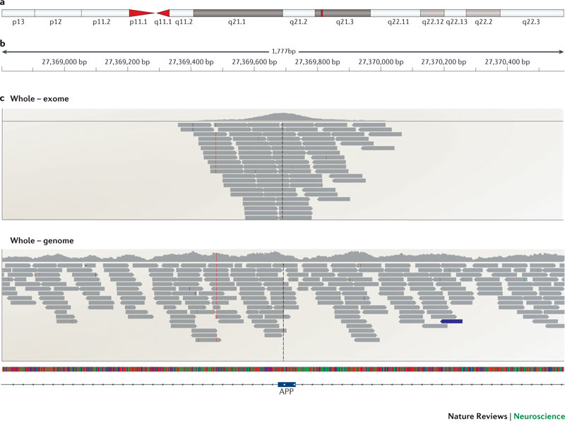
Goal:

Slide 29
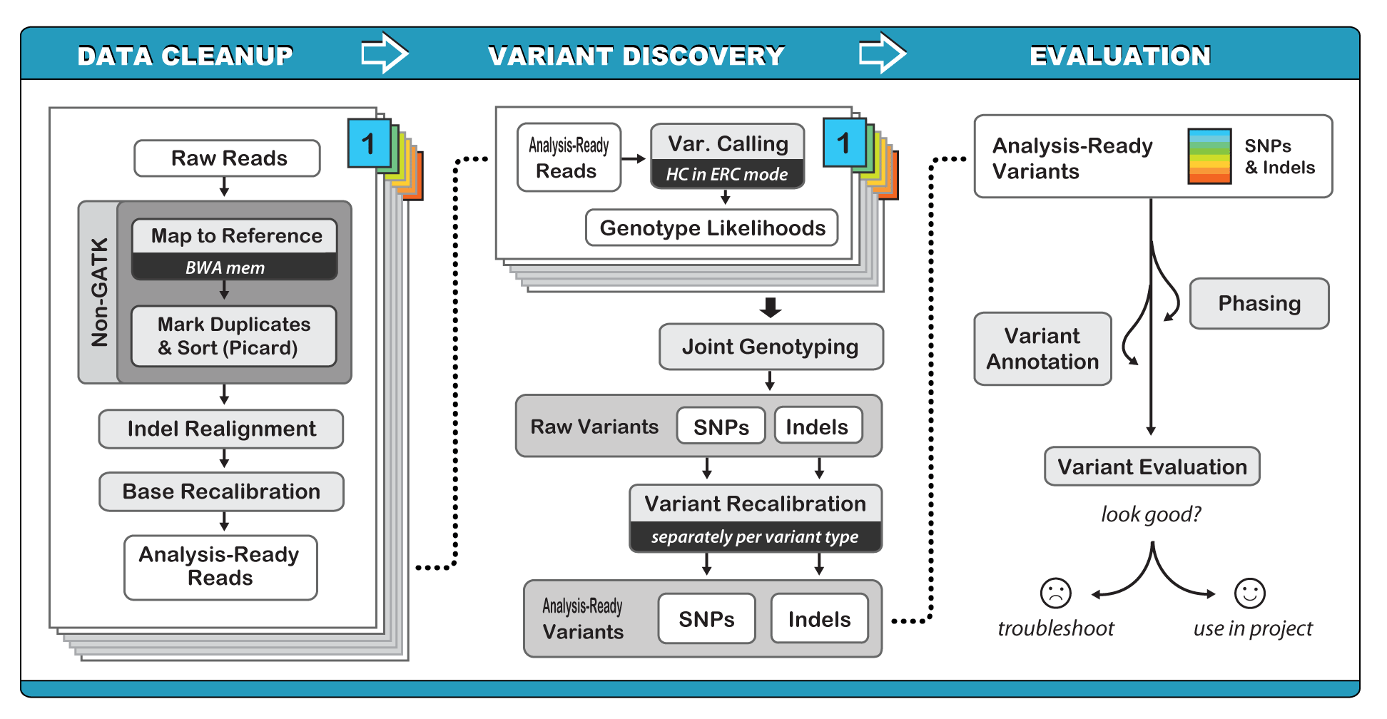
Genome Analysis Tool Kit (GATK)

Slide 30
Somatic variant calling workflow

Slide 31
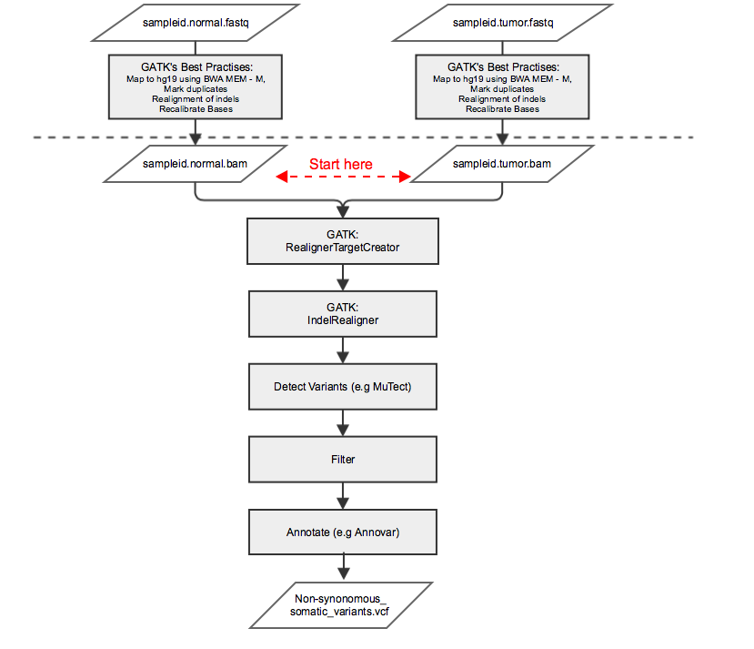

Slide 32
MuTect1
Identifies variants in tumor
Differences between tumor DNA and human reference assembly (hg19)
Post detection filter to remove:
false positives due to non-independent sequencing errors
germ line variations (detected in normal)

Slide 33
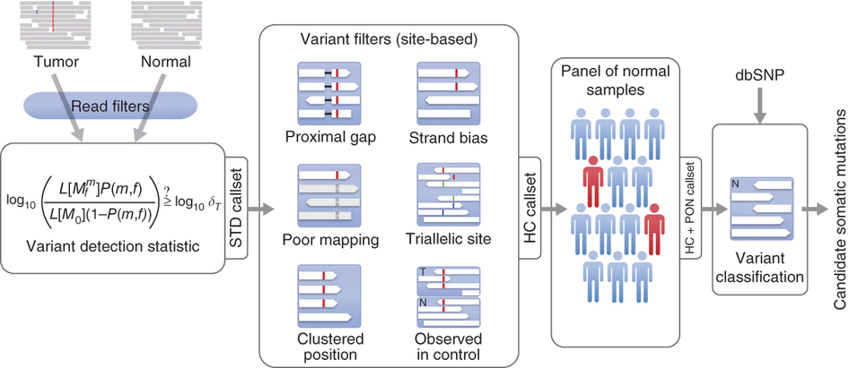
MuTect1
Cibulskis, K. et al. Sensitive detection of somatic point mutations in impure and heterogeneous cancer samples. Nat Biotechnology (2013).doi:10.1038/nbt.2514
Notes:
1) Removal of low quality reads
2) Variant detection in the tumor using a bayesian classifier
3) Filtering to remove false positives due to sequencing artifacts (near insertion/deletion, strand bias, poor mapping, observed in control)
4) Second bayesian classifier – germ line or somatic

Slide 34
mutect.vcf
#CHROM POS ID REF ALT QUAL FILTER INFO FORMAT HCC1143.normal HCC1143.tumor
17 1001315 . C T . REJECT . GT:AD:BQ:DP:FA 0:51,3:.:54:0.056 0/1:29,2:23:33:0.065
17 1001331 . G T . REJECT . GT:AD:BQ:DP:FA 0:30,3:.:33:0.091 0/1:15,2:34:17:0.118
17 1003390 . G A . REJECT . GT:AD:BQ:DP:FA 0:17,2:.:18:0.105 0/1:16,1:28:17:0.059
17 1004967 . A T . REJECT . GT:AD:BQ:DP:FA 0:28,1:.:29:0.034 0/1:16,4:15:20:0.200
17 1004974 . C T . REJECT . GT:AD:BQ:DP:FA 0:27,2:.:29:0.069 0/1:11,3:13:14:0.214
17 1024903 . C T . PASS SOMATIC GT:AD:BQ:DP:FA:SS 0:106,0:.:102:0.00:0 0/1:84,6:34:90:0.067:2
17 1277664 . C A . PASS SOMATIC GT:AD:BQ:DP:FA:SS 0:59,0:.:59:0.00:0 0/1:41,25:34:66:0.379:2
1527066 . C G . PASS SOMATIC GT:AD:BQ:DP:FA:SS 0:35,0:.:31:0.00:0 0/1:26,5:29:31:0.161:2
FORMAT (Each code is described in VCF header)
GT:AD:BQ:DP:FA
GT=Genotype
AD=Allelic depths for the ref and alt alleles in the order listed
BQ=Average base quality for reads supporting alleles
DP=Approximate read depth
FA=Allele fraction of the alternate allele with regard to reference
SS=Variant status
(0=wildtype,1=germline,2=somatic,3=LOH,4=post-transcriptional modification,5=unknown”)

Slide 35
mutect.out file
All statistics used in post-detection filtering
Columns:
contig position context ref_allele alt_allele tumor_name normal_name score dbsnp_site covered
power tumor_power normal_power normal_power_nsp normal_power_wsp total_reads map_Q0_reads init_t_lod t_lod_fstar t_lod_fstar_forward t_lod_fstar_reverse tumor_f contaminant_fraction contaminant_lod
t_q20_count t_ref_count t_alt_count t_ref_sum t_alt_sum t_ref_max_mapq t_alt_max_mapq t_ins_c
ount t_del_count normal_best_gt init_n_lod normal_f n_q20_count n_ref_count n_alt_count n_ref_s
um n_alt_sum power_to_detect_positive_strand_artifact power_to_detect_negative_strand_artifact strand_
bias_counts tumor_alt_fpir_median tumor_alt_fpir_mad tumor_alt_rpir_median tumor_alt_rpir_mad observed_in_nor
mals_count failure_reasons judgement
Example row:
17 1001315 TTTxTTT C T HCC1143.tumor HCC1143.normal 0 DBSNP COVERED 0.954491 0.954491 11 1 103 0 -3.640633 2.499583 0 3.065049 0.064516 0.02 -0.4105
76 41 29 2 893 47 70 70 0 6 CC 5.640677 0.055556 47 51 3 1476 91 0.560361 0.544179 (15,14,0,2) 2.5 0.5 83.5 8.5 0 fstar_t
umor_lod,nearby_gap_events,possible_contamination,alt_allele_in_normal,clustered_read_position REJECT

Slide 36
Annotation
Link detected variants to functional sites in the genome
Protein coding exons
UTR
Regulatory regions
Database of known variation
dbSNP / 1000 Genomes / ExAC for normal variants
Cosmic for cancer mutations
Notes:
Exome Aggregation Consortium (ExAC), an international coalition of investigators with a focus on data from exome sequencing
COSMIC catalogue of somatic mutation in cancer

Slide 37
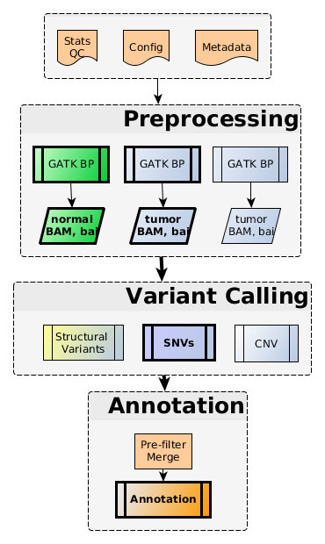
SciLifeLab Cancer Analysis Workflow
https://github.com/SciLifeLab/CAW

Slide 38
Todays practical Part one
Analyze somatic mutations in WGS data from breast cancer cell lines and matched normal controls
Preprocess bam files
Detect SNVs with MuTect
Annotate variants with Annovar (RefGene, ExAC and Cosmic databases)
Only for a small part of chromsome 17

Slide 39
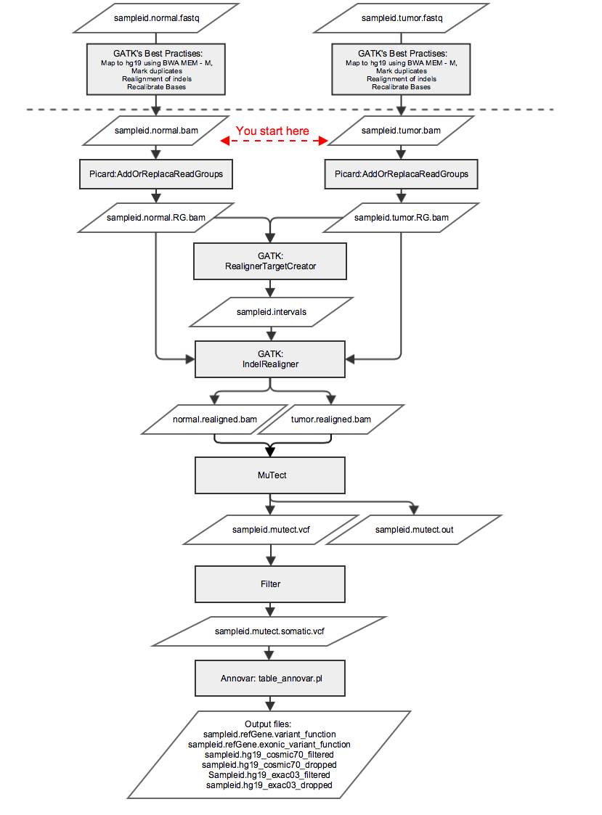
Part 0ne
Answer questions
Answer questions
Answer questions

Slide 40
Todays Practical part two
Same samples - data already generated for entire genome
Check basic statistics (#detected mutations)
Analyze how various degrees of normal contamination of the tumor sample affects allele frequencies
Normal
tumor
20/80
40/60
60/40
80/20

Slide 41
http://scilifelab.github.io/courses/ngsgu/cancergenomics/1610/

