Slide 1
Calibration and registration of multiple RGBD-Sensors

Slide 2
Introduction
Joint coordinate system
Virtual reconstruction for 3D telepresence
Tracked checkerboard => correspondeces between camera space and worldspace
Single calibration for each sensor, mapping all data in one step
Tracking system coordinate system and World space coordinate system linked → reference

Slide 3
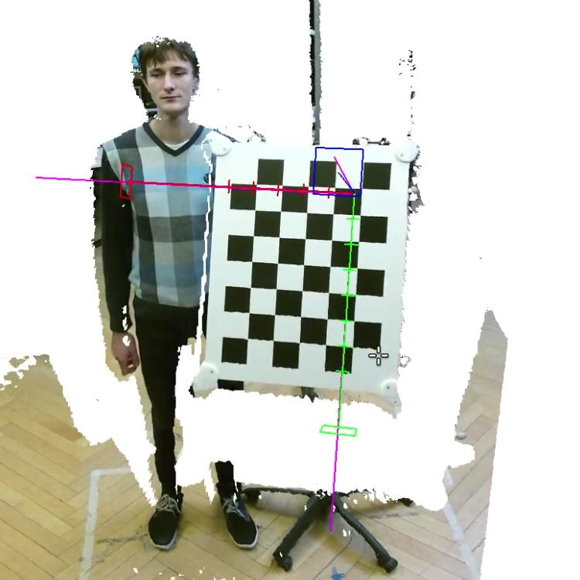
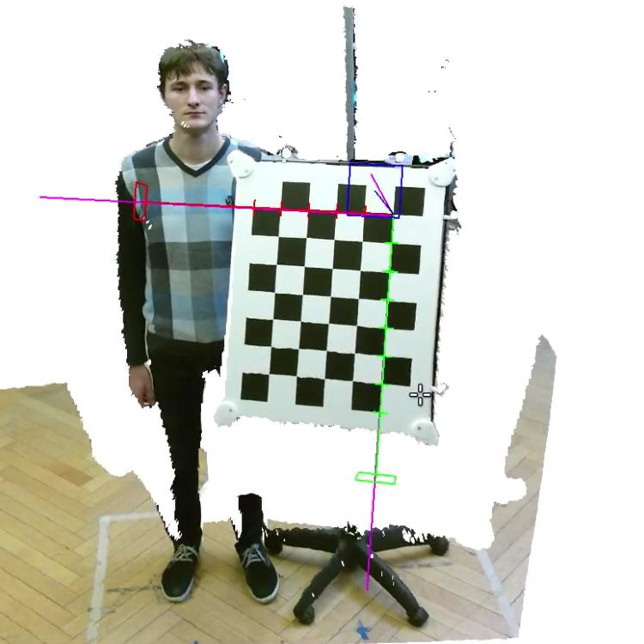
Introduction

Slide 4
Coordinate Systems & Spaces
Joint World coordinate system W
3D-depth sensor coordinate system D + reference system D’
2D color camera coordinate system C + reference system C’
Normalized 3D-volume space V as 3D-LookUp-Table

Slide 5
Parameters
Intrinsic: principal point, focal length
Extrinsic: Relation between color and depth
Factory pre-calibration is not accurate enough

Slide 6
Calibration
Initial calibration ​ɣ
Generating the calibration volume
Reference sampling
Interpolation

Slide 7
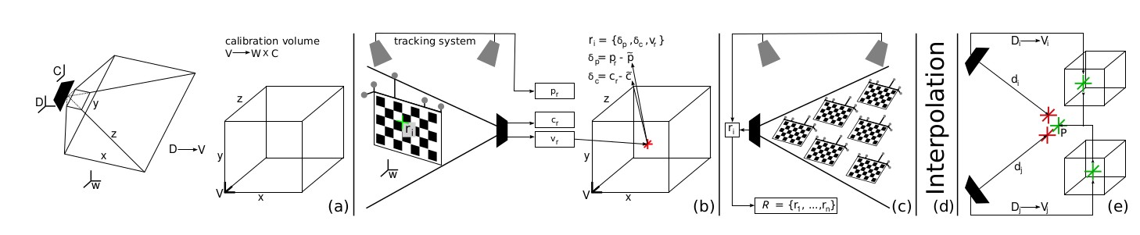
Calibration

Slide 8
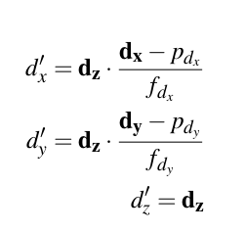

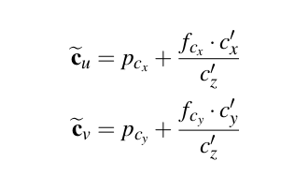

Initial calibration ɣ
Intrinsic parameters with OpenCV
Extrinsic calibration computed

Slide 9
Calibration Volume
D normalized into volume space V
Calibration volume initialized based on ɣ
Accuracy of ɣ

Slide 10


Reference Sampling
Tracked checkerboard on different locations
Measures position in the volume Space V, point in the world space W, color coordinate in C
Each sample r_i results correction tuple
with

Slide 11
Interpolation
Correction of the calibration volume at each v ∈ V
Interpolating offsets in the local neighborhood of R
Result: new calibration Ω with higher accuracy.

Slide 12
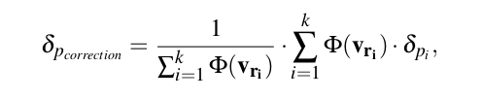
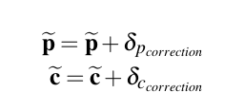
Interpolation
K = number of neighbors
Φ = weighing function
Both depend on the used interpolation method
Inverse distance weighting/ natural neighbor interpolation

Slide 13
Evaluation
More accurate than any other method
Scales with reference density
Limited by hardware

