Slide 1
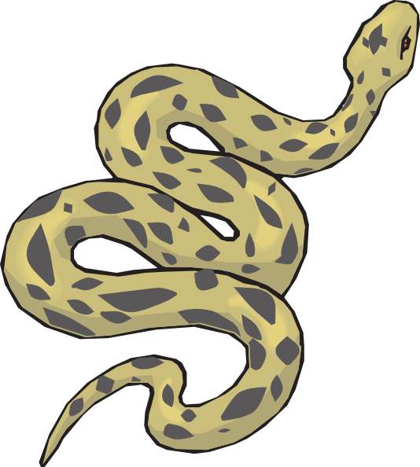
print(“Python!”)
By Leanna Szypowski

Slide 2
Why Python?
Curious to learn something new
Lots of neat extensions (PyGame)
Previous failed attempt

Slide 3
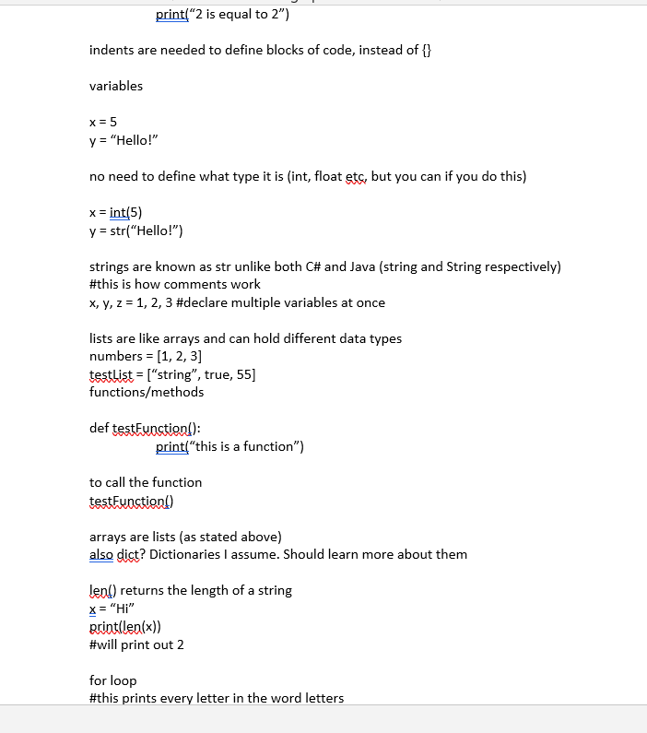
First thing: Syntax
Syntax the first day -> 3.9.2 Documentation (python.org)
Lack of ; and { }
Say hello to indents and :!
Note: Concatenation sucks

Slide 4
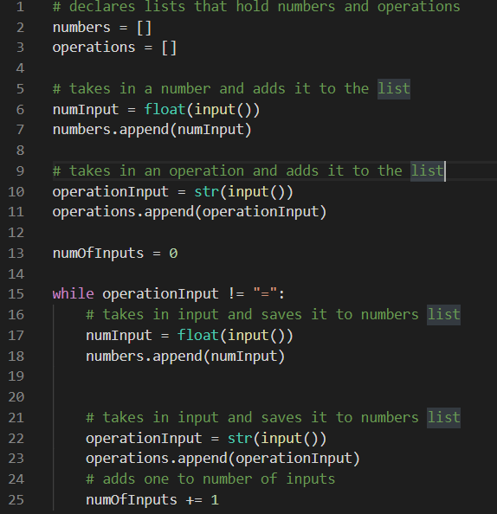
First “Program”
Basics: Numbers from console -> + list
Start of a calculator (which I make later on)
Getting used to basic syntax

Slide 5
Program #1 - Calculator:
Made calculator
Any amount of values & operations
Basic list manipulation (del, append() etc.)
Calculator didn’t know BEDMAS
(more like DMAS but still)

Slide 6
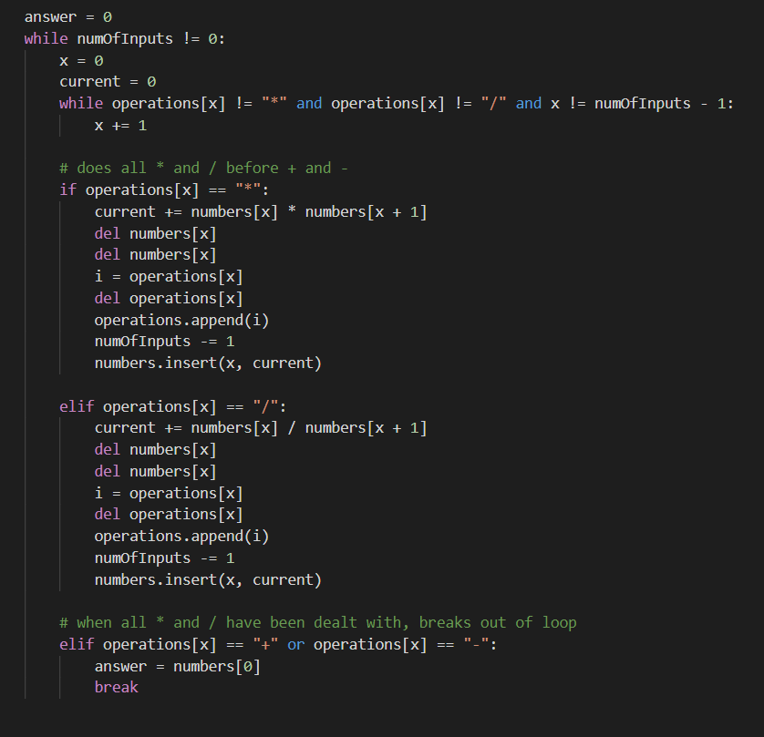
Program #1 – Calculator - Improved
Spent way too long making it do BEDMAS (ahem DMAS)
It functions however!
Code is horrendous and unoptimized…
Demo -> firstTest.py

Slide 7
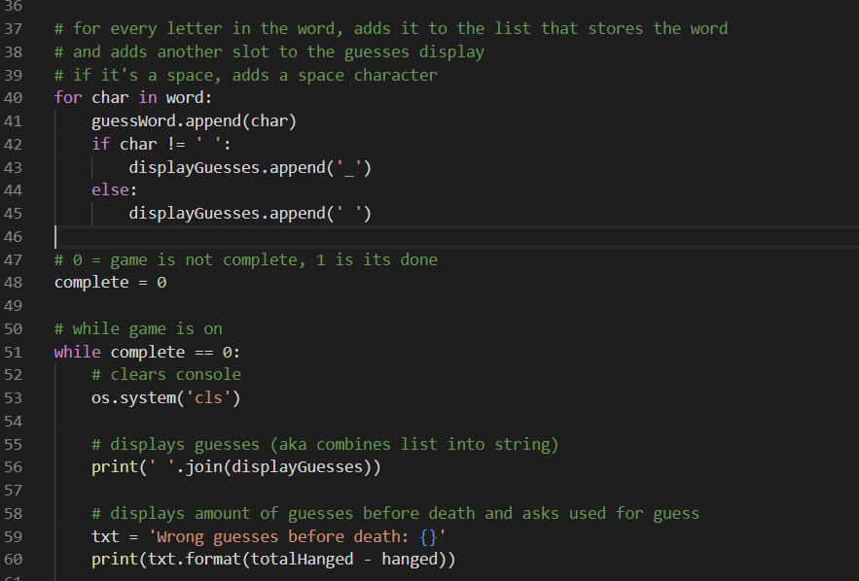
Program #2 – Hangman
Learned the basics – wanted more!
Created hangman -> got better with python
Problems: No actual hangman + others

Slide 8
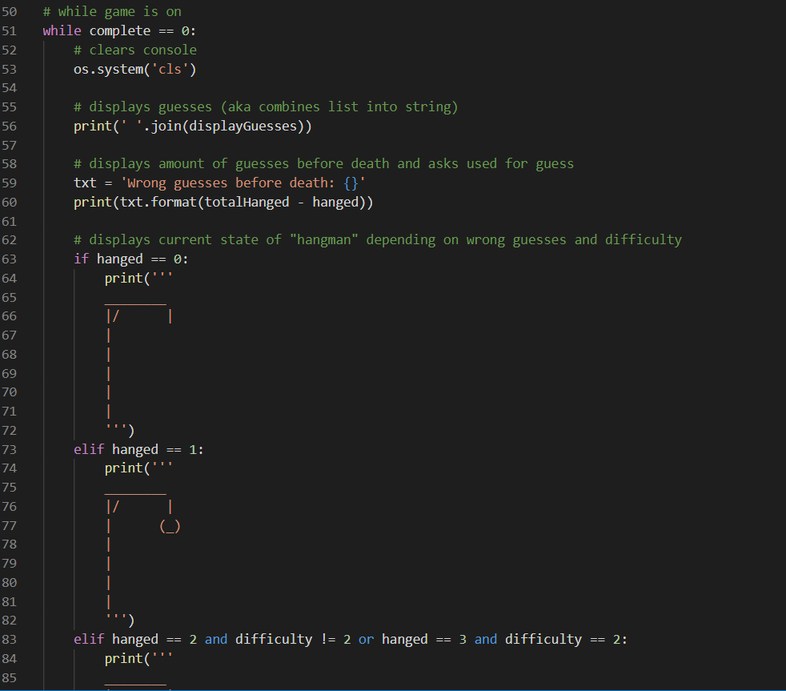
Program #2 – Hangman
+ A proper hangman display
+ “Bad letters” display
Later -> added different difficulties
Demo -> hangman(thegame).py

Slide 9
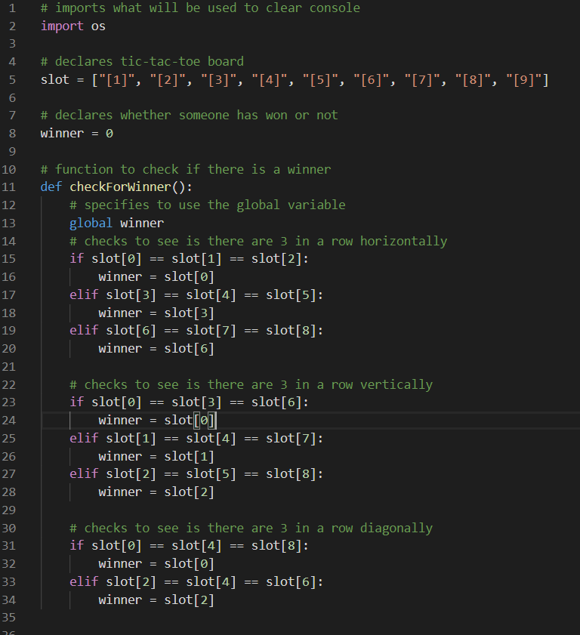
Program #3 – Tic-Tac-Toe
Learnt functions/methods (def)
Demo -> tictactoe.py
Quick to get it to work, easy project

Slide 10
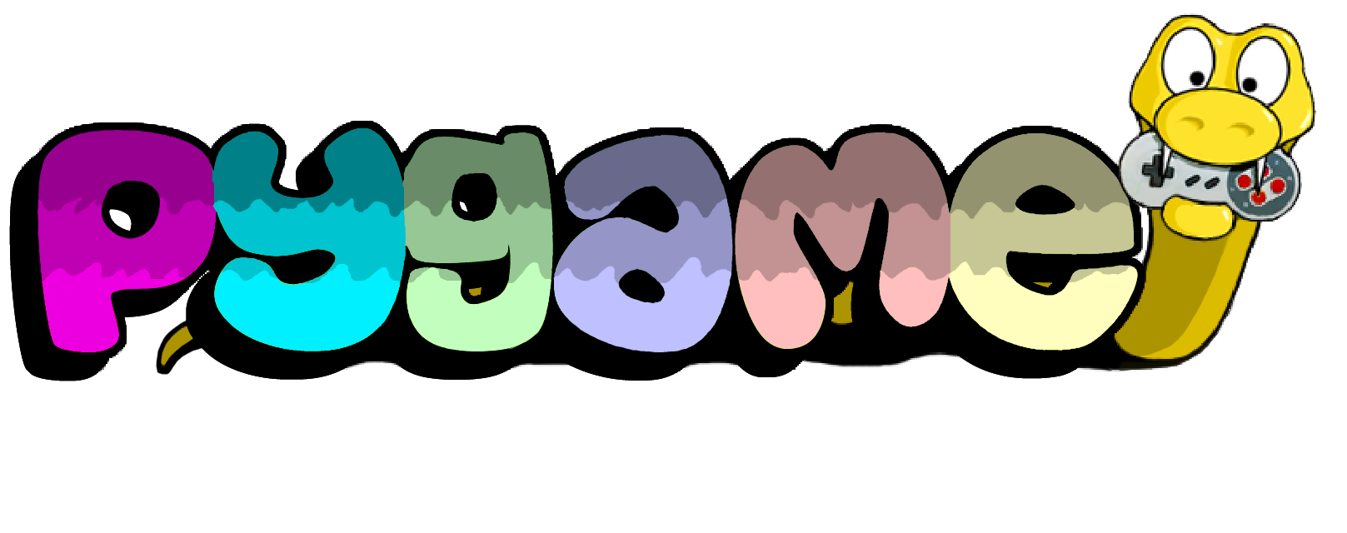
Learning Pygame:

Slide 11


Learning PyGame:
Downloaded PyGame via Microsoft PowerShell
Similar to unity
Learnt extremely basic Pygame concepts

Slide 12
Program #4 – Ship vs Missiles
Made my first real game using PyGame
Followed a tutorial to learn the basics -> PyGame: A Primer on Game Programming in Python – Real Python
Learnt about classes + big game concepts
Again, similar concepts to Unity (with differences of course)

Slide 13
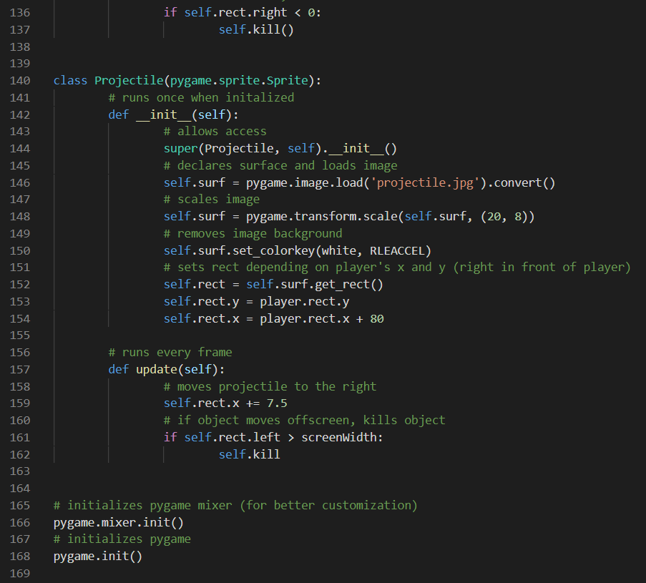
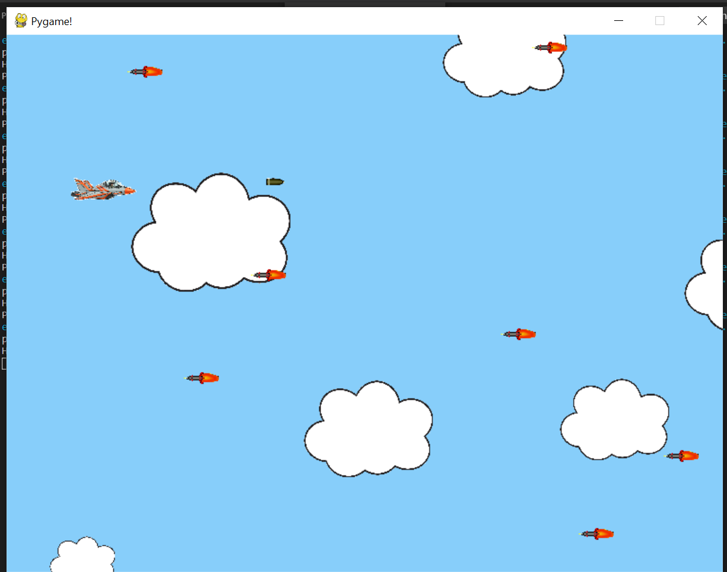
Program #4 – Ship vs Missiles
+ User controllable projectiles
+ Better? Cloud generation (random sizes)
+ Really bad sound effects
Demo -> pygametest.py

Slide 14
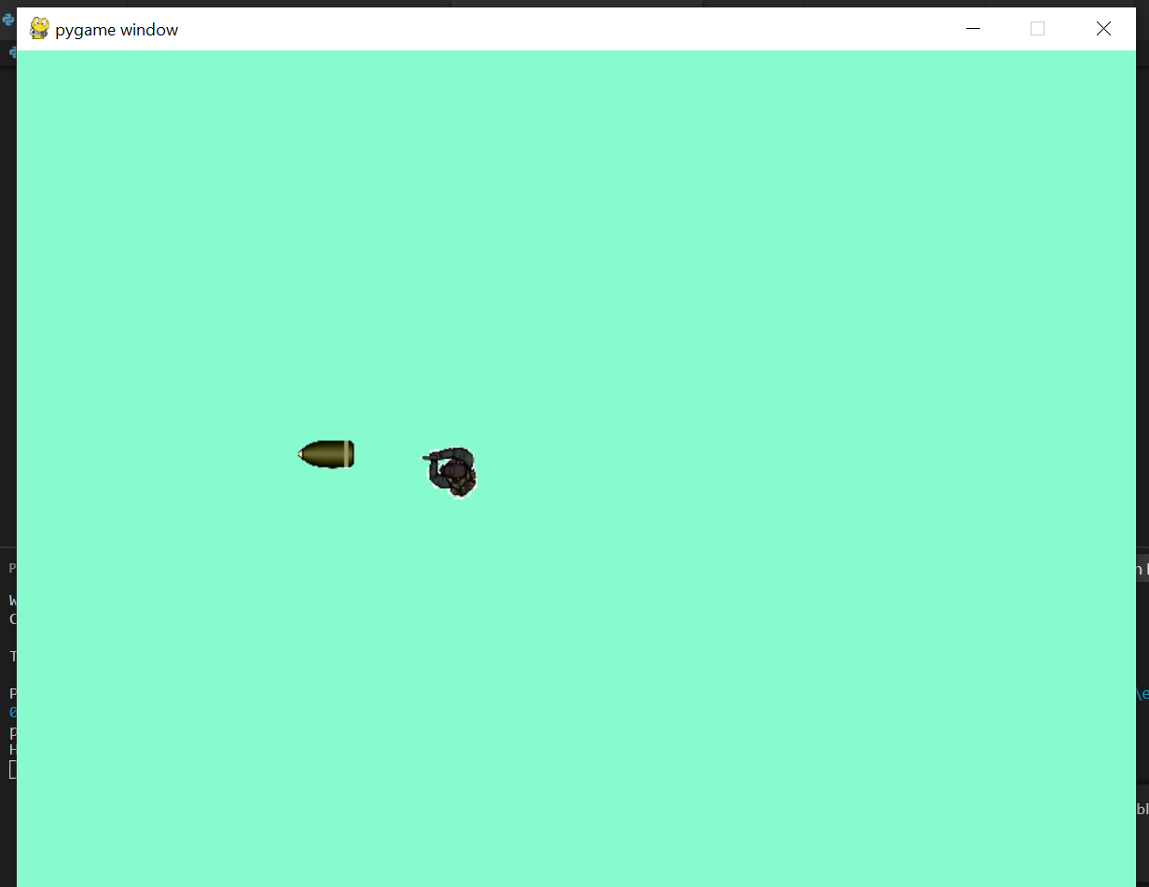
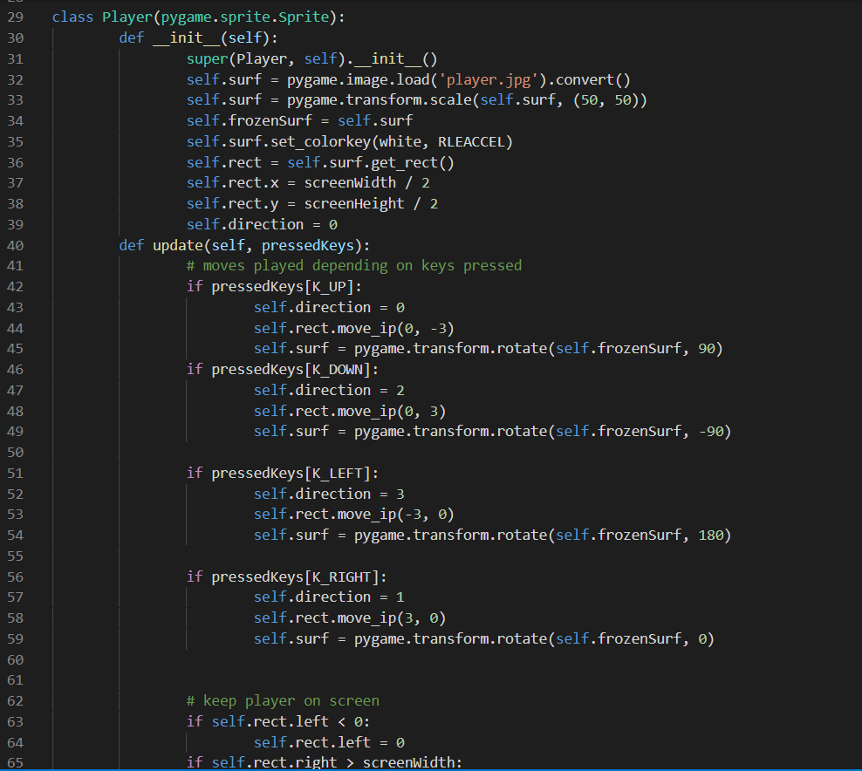
Program #5 – Shooter game
Unfinished - contains moveable character
Projectile shooting implements + sprite rotation
Last project - unfinished

Slide 15

Any Questions?

