Slide 1
HAGGLE
A self-improving negotiation-outcome agent
SIA improves an agent on two axes — its code/prompt AND its model weights — on real B2B negotiation data, entirely on Nebius.
AXIS 1 · the harness
AXIS 2 · the weights
SIA × Nebius Token Factory · one API key for inference + GPU fine-tuning

Slide 2
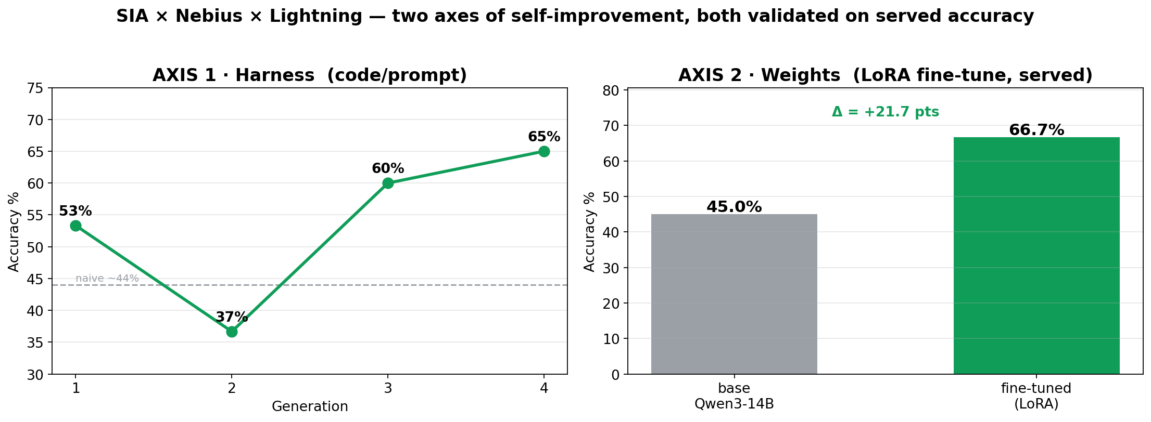
Two axes of self-improvement — one task, one API key
AXIS 1 · HARNESS (code / prompt)
AXIS 2 · WEIGHTS (LoRA fine-tune, served)
44% → 65%
45% → 66.7%
SIA rewrote the agent each generation — no human in the loop.
Same Qwen3-14B, ± LoRA adapter, one endpoint — +21.7 pts.

Slide 3
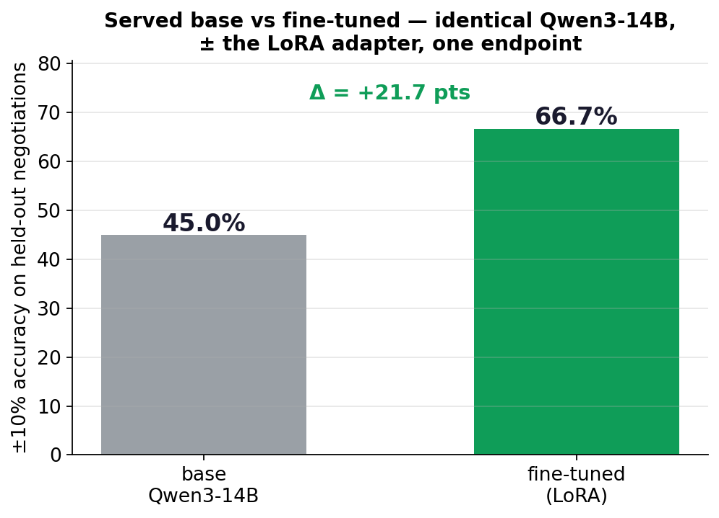
Weights axis — it learned, and it translated to accuracy
Served the base AND the LoRA-tuned model on ONE vLLM endpoint, scored with the same seed prompt on the same 60 held-out negotiations.
Exactly one variable changes: the LoRA adapter (identical Qwen3-14B weights, base vs base+adapter).
→ the +21.7 pts is attributable solely to the fine-tune. (The fine-tune's own training loss fell to ~0.1 on the same L40S — but the headline is served accuracy, not loss.)
VALIDATED (served)
Loss dropping is necessary, not sufficient — so we served it and measured. Base 45% → fine-tuned 66.7% (+21.7 pts), same prompt, same eval set, identical 14B weights ± the LoRA adapter. Trained + served on one Lightning L40S — loop closed.

Slide 4
Why it matters
Real B2B pain
Deal-outcome prediction & forecasting — only 45% of sales leaders trust their forecasts. Negotiation is the core sales skill. Real data, un-gameable ±10% metric.
Two composable levers
SIA improves the scaffold (code/prompt); fine-tuning improves the weights. Orthogonal and stackable on the same task.
Open models, no frontier dependency
Free Nebius OSS inference drives the SIA engine; one Lightning L40S does the fine-tune + serving. No proprietary model needed — reproducible and cheap.
Both axes validated
Harness 44→65% (code/prompt) AND weights 45→66.7% (served LoRA) — both real ±10% accuracy on held-out negotiations, all on open models.

