Slide 1


Slide 2
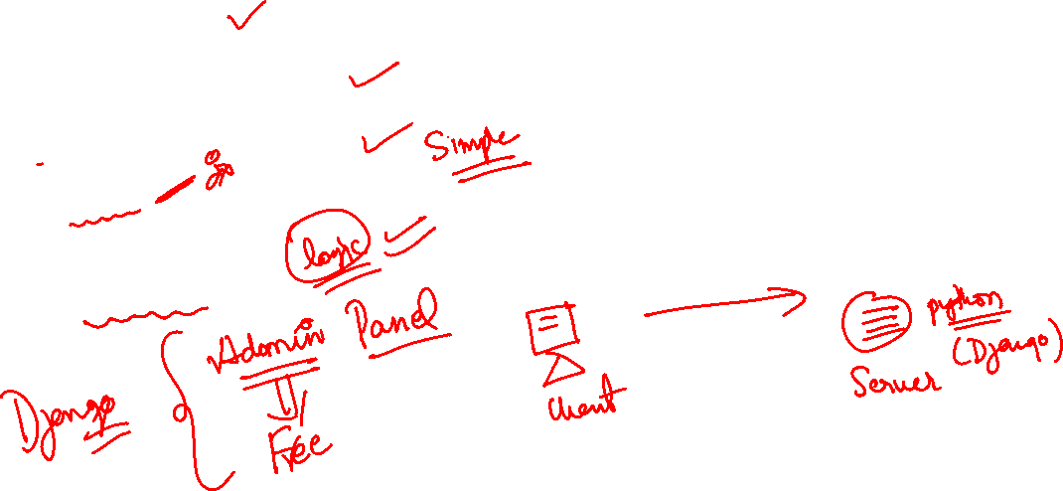
What is Django ?
Django is python web framework.
Django is backend server side web framework.
Django makes easier to build web pages using python.
Take cares of difficult stuff so that we can concentrate on building web apps.
Provides many built in features.

Slide 3
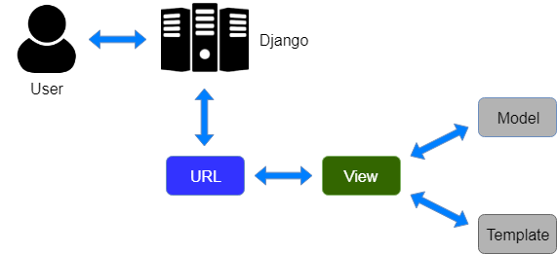
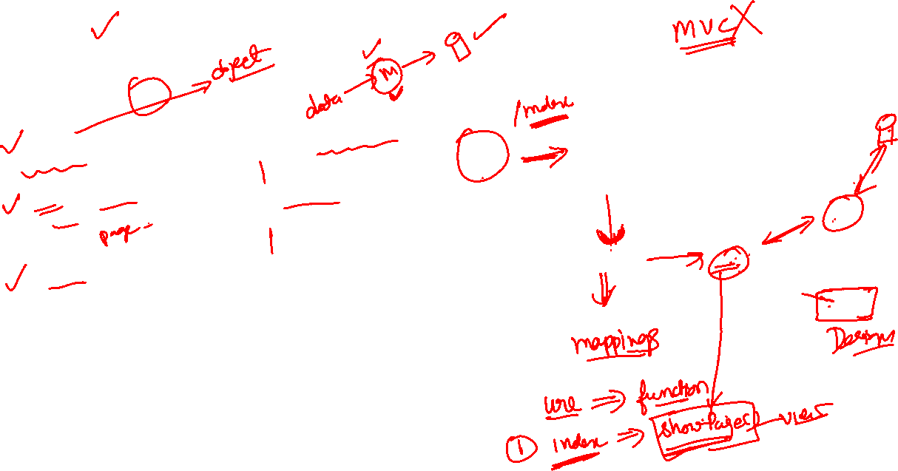
MVT
Django follows MVT design patterns:
Model - data we want to present, usually data from a database.
View - A request handler that returns the relevant template and content - based on the request from the user.
Template - A text file (like an HTML file) containing the layout of the web page, with logic on how to display the data.

Slide 4
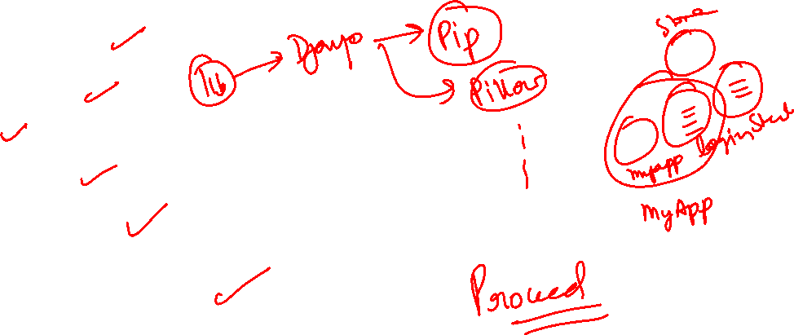
Set up the Environment
Download and install python
Check you pip is working
Install Django
pip install Django
django-admin –version
django-admin startproject <projectname>

Slide 5
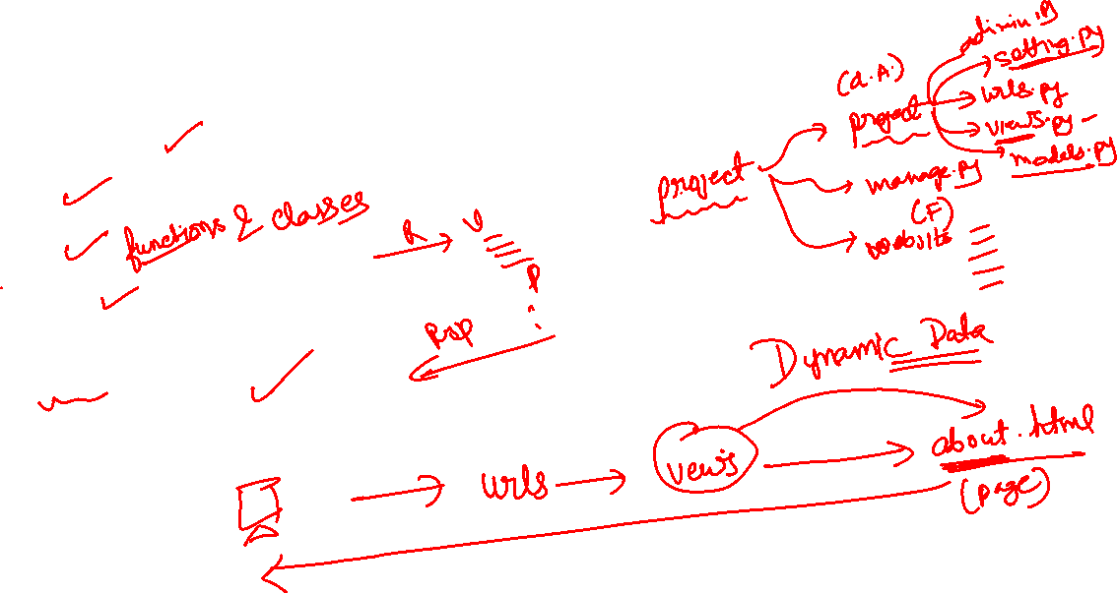
Lets understand
Project structure
URLs
Views
Templates
Models- CRUD OPERATIONS

Slide 6
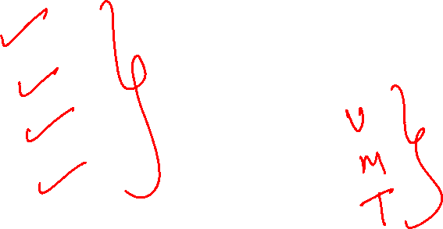
Let build employee management
Add Employee
View Employees
Delete Employee
Update Employee

Slide 7
Django admin
How to configure admin
Admin customization explains
List display(pagination)
Filter
Search
Other stuff

Slide 8
Lets build Testimonial App
Admin can add, delete & update the testimonial from admin panel
We have to display all the testimonials.

Slide 9
Django Forms
Automatic forms creations
Create practical example creating feedback form and take user data and save to database.

