Slide 1


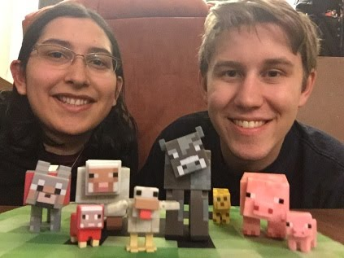
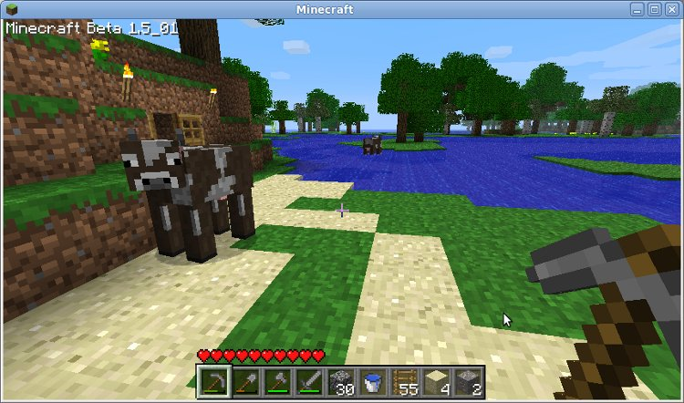
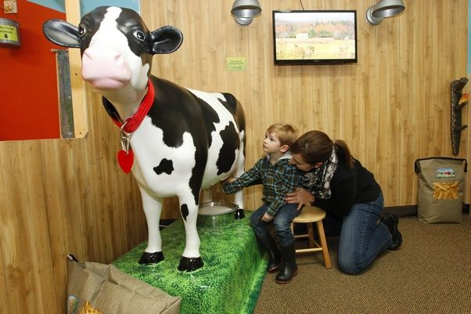
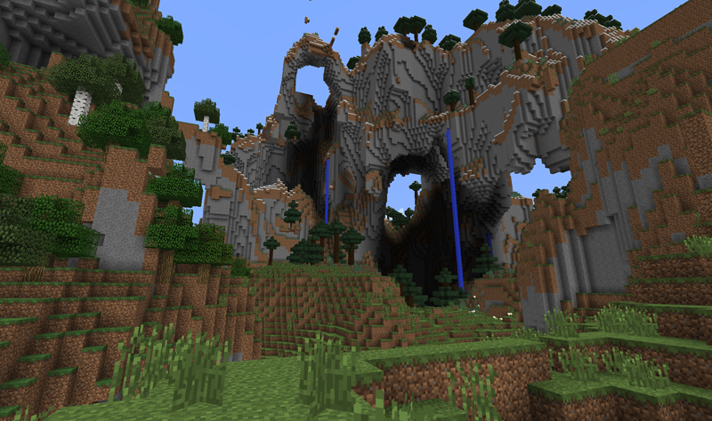
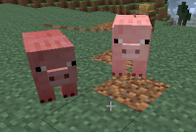
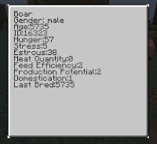

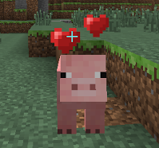
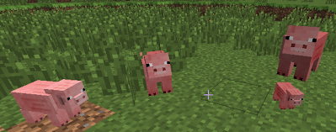
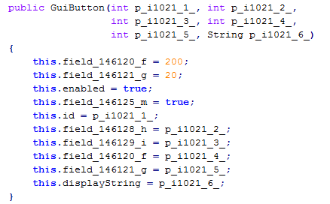
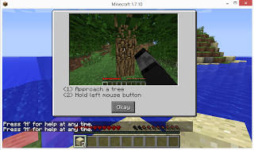
AnimalScienceCraft Using Educational Games to Teach Animal Science
Austin Cory Bart, Eleonor M. Bart
Dr. Eli Tilevich, Dr. Michael Evans
Problem and Motivation
Educational Game Design
Minecraft
Animal Science is the science of "Studying the biology of animals that are under the control of mankind." ^{[13]}
Need to educate public of general issues in Animal Science ^{[1]}
This education needs to start in classrooms at a young age ^{[11]}
Though farm products are crucial to everyone, it is difficult to bring people to real farms.
Solution: An engaging virtual learning environment for Animal Science to promote public knowledge and to encourage people to learn about Animal Science.
Growing body of research on leveraging “serious games” for education
Games offer many educational benefits, including automated assessment, just-in-time feedback, and rich motivating experiences.
However, gracefully integrating the instructional material can be challenging, and the game world can become a source of distraction.
Two kinds of educational games ^{[9]}:
In an endogenous game, understanding the material is key to succeeding in the situated game world at a very deep, integrated level.
In an exogenous game, the educational material has been grafted on - consider a game where you are randomly interrupted with a multiple choice quiz that you must pass before continuing the real game.
A fully-interactive, infinitely-generating, block-based world ^{[13]}
Best selling PC game of all time ^{[3]}
One of the most sophisticated modding communities in the history of gaming, permissive licensing enables game extensions for new mechanics, blocks, etc ^{[4]}
Already leveraged to teach mathematics, biology, digital logic, physics, computer science, and many other subjects ^{[2] [6] [7] [8] [10]}
Animals in Minecraft
Genetic inheritance is faulty
Reproduction is just plain wrong
Gender is non-existent
Age is binary
Animal Science Learning Objectives^{[5]}
Objective | Standards | Summary | Status
Animal Origins | AS.01.01 | Where animals come from | No plans to include
Animal Distribution | AS.01.01 | How animals are distributed across the world | Built-in
Domestication | AS.01.01 | How animals are tamed | Planned
Classification | AS.02.01 | Logically organize animals by use and characteristics | Implemented
Anatomy | AS.02.02 | Identify different parts of an animal's anatomy | No plans to include
Biology | AS.02.02 | Explain the internals of animals | No plans to include
Inheritance | AS.02.03 | Understanding how traits are inherited | Implemented
Healthcare | AS.03.01 | Identify and treat sick animals | No plans to include
Biosecurity | AS.03.02 | Ensure that contagions don't travel between farms | No plans to include
Feeding | AS.04.01 | Determine optimal feeding patterns | No plans to include
Growth Hormones | AS.04.02 | Understand the benefit and safety of Growth Hormones | Planned
Sexual Organs | AS.05.01 | Understand how sexual organs in animals work | No plans to include
Reproduction | AS.05.02 | Understand the process of animal reproduction | Implemented
Trait Breeding | AS.05.03 | Choose which animals to breed | Implemented
Animal Handling | AS.06.01 | Approach, move, and care for animals safely | Planned
Animal Product Safety | AS.06.02 | Ensure that the products of animals are safe to consume/use | No plans to include
Housing Safety | AS.07.01 | Design structures for the housing of animals | No plans to include
Housing Standards | AS.07.02 | Comprehend government standards for animal housing | No plans to include
Environmental Impact | AS.08.01 | Understand the impact that a farm has on the environment | No plans to include
Environmental Factors | AS.08.02 | Understand how the location of a farm impacts the animals | Planned
Mechanics and Pedagogy
Gender
Objectives: Reproduction, Classification
All animals are gendered now
Visible differences in the animal
In order to breed two animals, they must be different genders.
Gender affects the utility of the animal (e.g., male cows do not produce milk)
Genetic Traits
Objectives: Classification, Inheritance, Trait Breeding
Genetic traits are passed on to children
Potential for Production
Meat Quantity
Domestication
Feed Efficiency
Breed for traits by culling underperformers
Animal Products
Objectives: None (Gameplay)
Animals products dropped on death have better return on investment
The quantity of death drops are determined by the Meat Quantity stat
Pigs: Pork at low levels, bacon at high levels
Cattle: Steak at low levels, filet at high levels, leather at all levels
Sheep: Mutton at all levels
Chicken: Chicken meat at all levels
Classification
Objectives: Classification
Animals are based on their species and reproductive capabilities
In-game system uses this taxonomy
Cattle: Calf, Cow, Steer, Bull, Heifer
Pigs: Sow, Gilt, Barrow, Boar, Hog, Piglet
Sheep: Lamb, Ewe, Ram, Wether, Yearling
Chicken: Cockerel, Rooster, Capon, Hen, Pullet, Chick
Hunger
Objectives: Animal Handling
Animals must eat to survive
When their hunger drops to zero, they die
The amount recovered by eating their food source is determined by their Feed Efficiency
Reproduction
Objectives: Reproduction
Adult females have an estrous cycle
Periodically go into heat and seek out a male
Varies by species:
Pigs have large litters
Cattle have single birth
Sheep are inclined to have twins
Chickens hatch from eggs
Domestication
Objectives: Domestication
Wild animals are skittish and hard to interact with
Once bred for domestication, you can breed for production traits
Animal Byproducts
Objectives: None (Gameplay)
Some animals have by-products that do not require killing the animal.
These drops are determined by the Production Potential stat.
Milk: Stacks and don’t require buckets, has a health healing enchantment
Feathers: Dropped passively by chickens
Eggs, Wool: Unchanged from vanilla
Size and Age
Objectives: None (Gameplay)
Animals age and eventually die
Invincible to mob damage
Size is determined by age and health
Baby animals don’t have oversized heads
Incest
Objectives: Reproduction, Inheritance
Breeding related animals leads to genetic problems
Lineage is tracked for each animal
Animals cannot breed if they share a common ancestor in the past two generations
Stress
Objectives: Reproduction, Handling
Stressed animals will not reproduce and become antsy
Complex calculation based on domestication, hunger, proximity to other animals
Growth Hormone
Objectives: Growth Hormone
Offers a boost in production for the animal
Available cheaply from villagers
Technical Details
Future Work
Still at pre-alpha level
So far, only pigs and cows supported
Still have many learning objectives to cover!
LearnCraft: Tutorial system as part of larger effort
Tied to in-game events
Web server architecture
Teach other subjects
Future research is required to determine its effectiveness in terms of usability and instruction.
Need to find funding for the project in order to advance development, research, and publicity
Source Code: github.com/LearnCraft/
Detailed Blog: tinyurl.com/animal-science-craft
References
[1] Fraser D. The "new perception" of animal agriculture: legless cows, featherless chickens, and a need for genuine analysis. J Anim Sci. 2001 Mar;79(3) 634-641. PubMed PMID: 11263823.
[2] "MinecraftEdu - About." MinecraftEdu - About. Web. 26 Dec. 2014. <http://minecraftedu.com/about>.
[3] Mojang. "Minecraft Stats". www.minecraft.net. Microsoft. Retrieved 20 September 2014
[4] Mojang. "MINECRAFT END USER LICENCE AGREEMENT." Mojang. Web. 26 Dec. 2014.
[5] National Council for Agricultural Education. (2009). National agriculture, food and natural resources (afnr) career cluster content standards. Alexandria, VA: National FFA Foundation
[6] OPERAcraft. (n.d.). Retrieved January 12, 2015, <http://www.icat.vt.edu/funding/operacraft>
[7] Phu, L. "Minecraft in the Classroom: When Learning Looks like Gaming." KTOO. 24 Apr. 2014. Web. 26 Dec. 2014. <http://www.ktoo.org/2014/04/24/minecraft-classroom-learning-looks-like-gaming/>.
[8] Short, Daniel. "Teaching Scientific Concepts Using a Virtual World--Minecraft."Teaching Science 58.3 (2012): 55-58.
[9] Squire, K. (2006). From content to context: Videogames as designed experience. Educational researcher, 35(8), 19-29.
[10] ThatWeirdPhysicist. "Learning logic gates in Electronics Class." Imgur. May 5, 2014. Web. 26 Dec 2014. <http://i.imgur.com/CCQiVmj.jpg>.
[11] Thompson PB. From a philosopher's perspective, how should animal scientists meet the challenge of contentious issues? J Anim Sci. 1999 Feb;77(2) 372-377. PubMed PMID: 10100666.
[12] Wikipedia contributors. "Animal Science." Wikipedia, The Free Encyclopedia. Wikipedia, The Free Encyclopedia, 22 Mar. 2015. Web.
[13] Wikipedia contributors. "Minecraft." Wikipedia, The Free Encyclopedia. Wikipedia, The Free Encyclopedia, 19 Dec. 2014. Web.
Technical System
Mod created using Forge for Minecraft 1.7.10
Forge provides a skeleton and nice event system
Challenges
Minecraft modding can be difficult - tutorials and guides are rapidly out of date
Documentation and identifiers are crowd-sourced, but coverage is not 100%
Community support is good, but not immediate
Actual “Deobfuscated” Java code for GuiButton.java:
Architecture
Extended EntityAnimal with a new abstract EntityScientific class - making our animals compatible with existing animal features but incompatible with other mods
Using DataWatcher in order to synchronize client and server state

