Slide 1
Advanced lstm: a study about better time dependency modeling in emotion recognition
Tao, F., & Liu, G. (2017).

Slide 2
Corpus
IEMOCAP
5 sections and 10 actors in total: one male and one female in each section
scripted or spontaneous scenarios to perform specific emotions
10039 utterances with average duration of 4.5 s per utterance (12.55 hr in total)
In this study: neutral, happy, angry and sad. 4490 utterances in total
48 kHz, in this study: downsampled to 16 kHz

Slide 3
Feature
a 36D acoustic feature
13D MFCCs
ZCR, energy, entropy of energy, spectral centroid, spectral spread, spectral entropy, spectral flux, spectral rolloff
12D chroma vector
chroma deviation, harmonic ratio, pitch
25 ms window, shifting step size: 10 ms
z-normalized within each utterance
Notes:
13+8+12+3=36

Slide 4
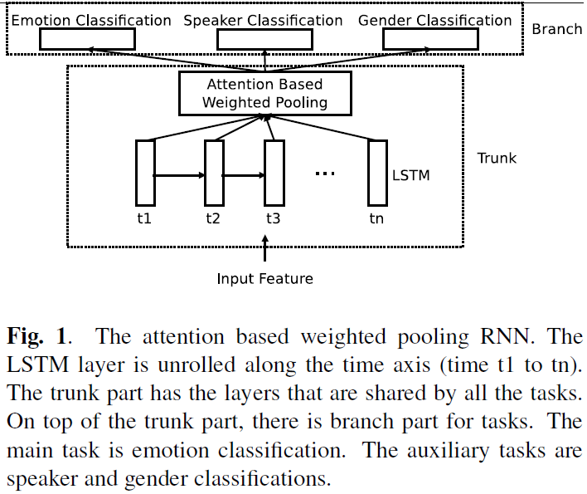
System diagram
Notes:
In this study, we define that trunk part has two hidden layers. The first layer is fully connected layer which has 256 RELU neurons. The second one is a bidirectional LSTM (BLSTM) layer with 128 neurons. The hidden values go to weighted pooling layer after the LSTM layer. In the branch part, each task has one hidden fully connected layer with 256 RELU neurons and one softmax layer performing classification.

Slide 5
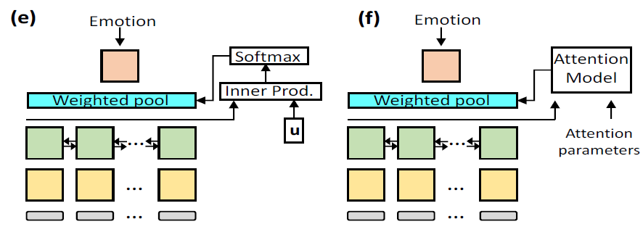
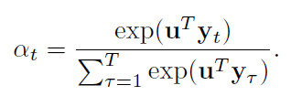
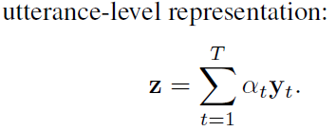
Attention based weighted pooling RNN
Notes:
the statistical functions in the context of neural networks function as pooling layers over the time dimension

Slide 6
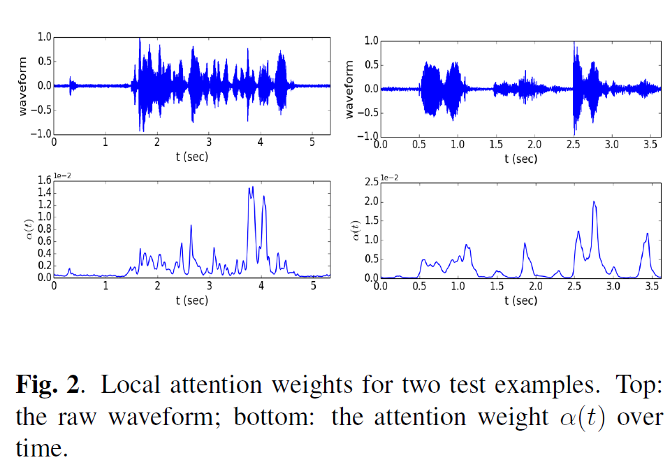
Attention based weighted pooling RNN

Slide 7
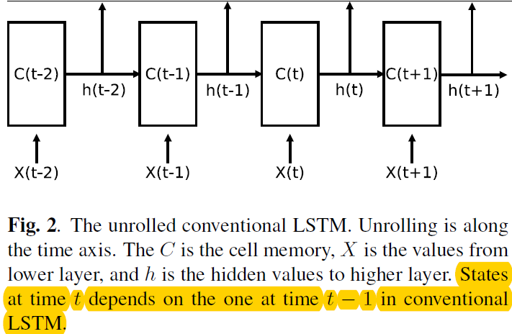
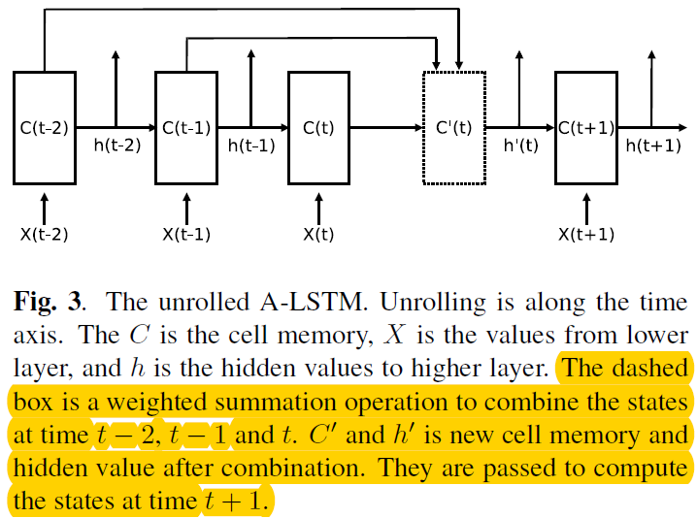
A-LSTM
Notes:
It can be seen that the states at time t depends on the states at time t 􀀀 1, because Ct is computed from ht􀀀1 and Ct􀀀1.
It use weighted summation of multiple states at different time steps to compute cell (C value) and hidden value (h value).

Slide 8
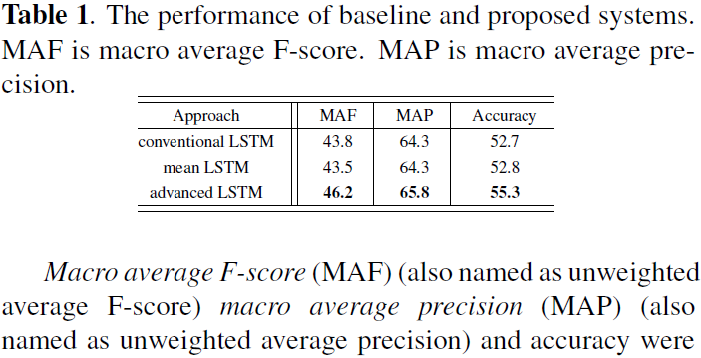
Results

Slide 9
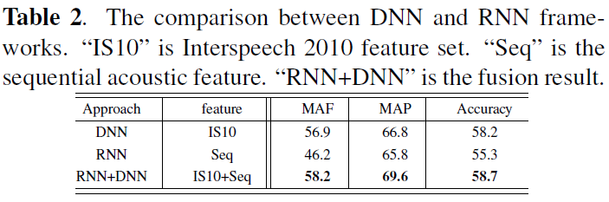
Results
There are two reasons here. First, we have very limited data, which is only about 3200 training utterances. This amount may not train RNN framework sufficiently, especially training RNN is more difficult than DNN. Second, all the utterances were well segmented in IEMOCAP.

Slide 10
References
Tao, F., & Liu, G. (2017). Advanced lstm: a study about better time dependency modeling in emotion recognition.
Tao, F., Liu, G., & Zhao, Q. (2018). An ensemble framework of voice-based emotion recognition system for films and tv programs.
Mirsamadi, S., Barsoum, E., & Zhang, C. (2017). Automatic speech emotion recognition using recurrent neural networks with local attention. IEEE International Conference on Acoustics, Speech and Signal Processing. IEEE.
About LSTM: http://colah.github.io/posts/2015-08-Understanding-LSTMs/

