Slide 1
2

Slide 2
数据集
数据集 | 数据量 | 类型 | Notes
MOUD | 450(448?) utterances; 80 people,101 videos; Each ~5s; Total ~38min; | Product in Spanish from YouTube | Utterance-level annotation;
CMU-MOSI | 2199 utterances; 89 people,93 videos Each ~4.2s(0.2s-52s); Total ~150min; | Topics in English from YouTube | Utterance-level annotation; 已经提取了各种特征
IEMOCAP | 151 segments; 10 people; Each ~5min; Total 755min | Actors act | 还没有拿到text

Slide 3
方案
方案 | 优点 | 缺点
训练 MOSI 测试 MOUD | 只需要训练测试一个神经网络； 有文章对比 | 语言内容不同，要先做翻译；效果比较差
IEMOCAP CV | 集内训练测试，准确率高； 有文章对比 | 10-fold； 数据量大
MOSI/MOUD CV | 集内训练测试，准确率高； | 5fold; 划分方式未定，可能无法和文献比较

Slide 4
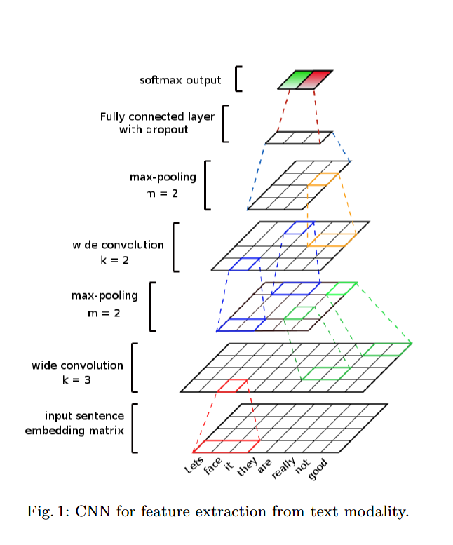
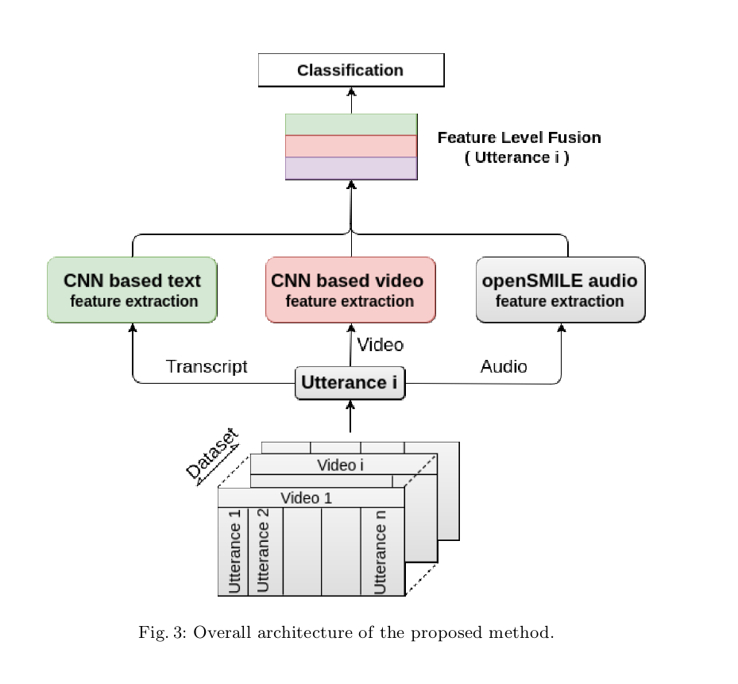
Benchmarking Multimodal Sentiment Analysis

Slide 5
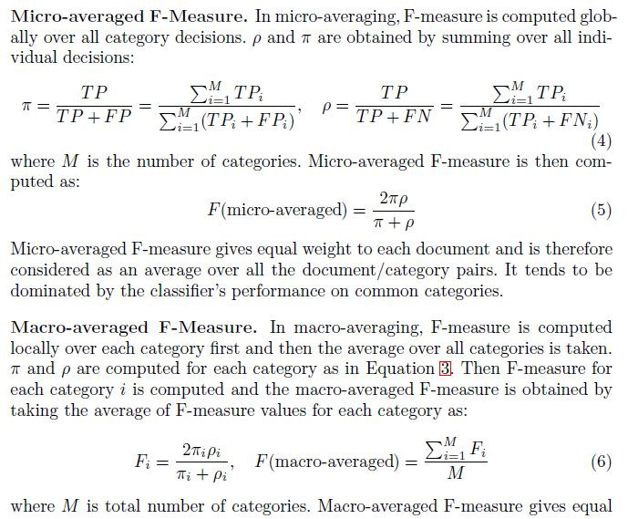
Metric: Macro F-score

Slide 6
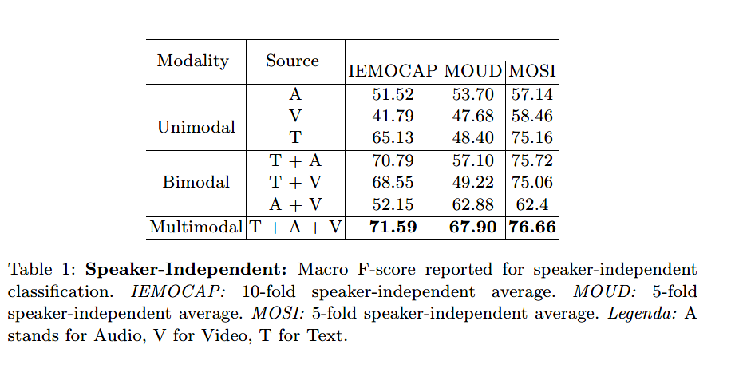
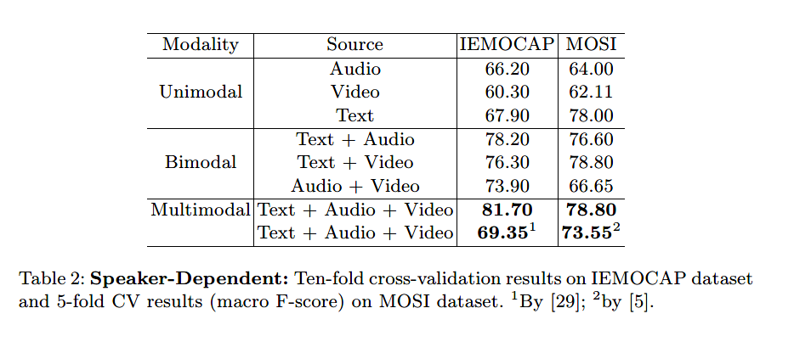

Slide 7
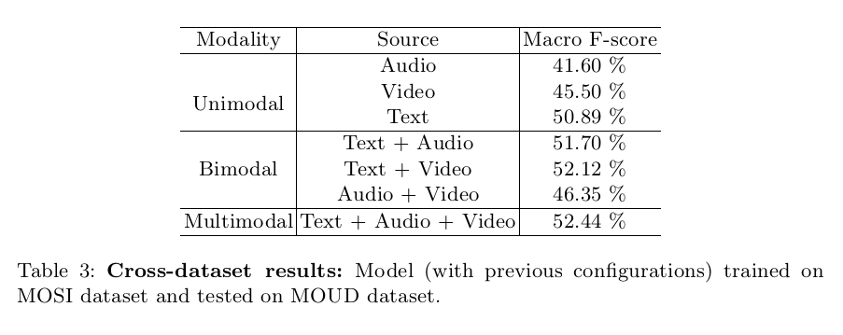

Slide 8
NOTES
数据集下载
http://multicomp.cs.cmu.edu/resources/ict-mmmo-dataset/
Github
https://github.com/LearnDeepLearningDeeply/Multimodal
多人协作
https://www.liaoxuefeng.com/wiki/0013739516305929606dd18361248578c67b8067c8c017b000/0013760174128707b935b0be6fc4fc6ace66c4f15618f8d000

Slide 9
Ref
Dataset | Paper BibTeX
CMU-MOSI | Zadeh, Amir, et al. "Multimodal sentiment intensity analysis in videos: Facial gestures and verbal messages." IEEE Intelligent Systems 31.6 (2016): 82-88.
IEMOCAP | Busso, Carlos, et al. "IEMOCAP: Interactive emotional dyadic motion capture database." Language resources and evaluation 42.4 (2008): 335.
MOUD | Pérez-Rosas, Verónica, Rada Mihalcea, and Louis-Philippe Morency. "Utterance-level multimodal sentiment analysis." Proceedings of the 51st Annual Meeting of the Association for Computational Linguistics (Volume 1: Long Papers). Vol. 1. 2013.

