Slide 1

LearnHub
Baumann, Gossenreiter, Hochbichler, Steinmair
HTBLA Leonding, 3AHITM IT-Medientechnik

Slide 2




Übersicht
01
02
03
04
Team
Ziel
Idee
Zwischenstand

Slide 3

01
Team

Slide 4
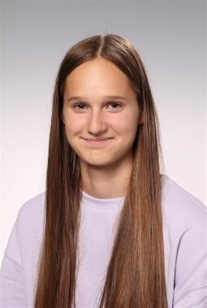

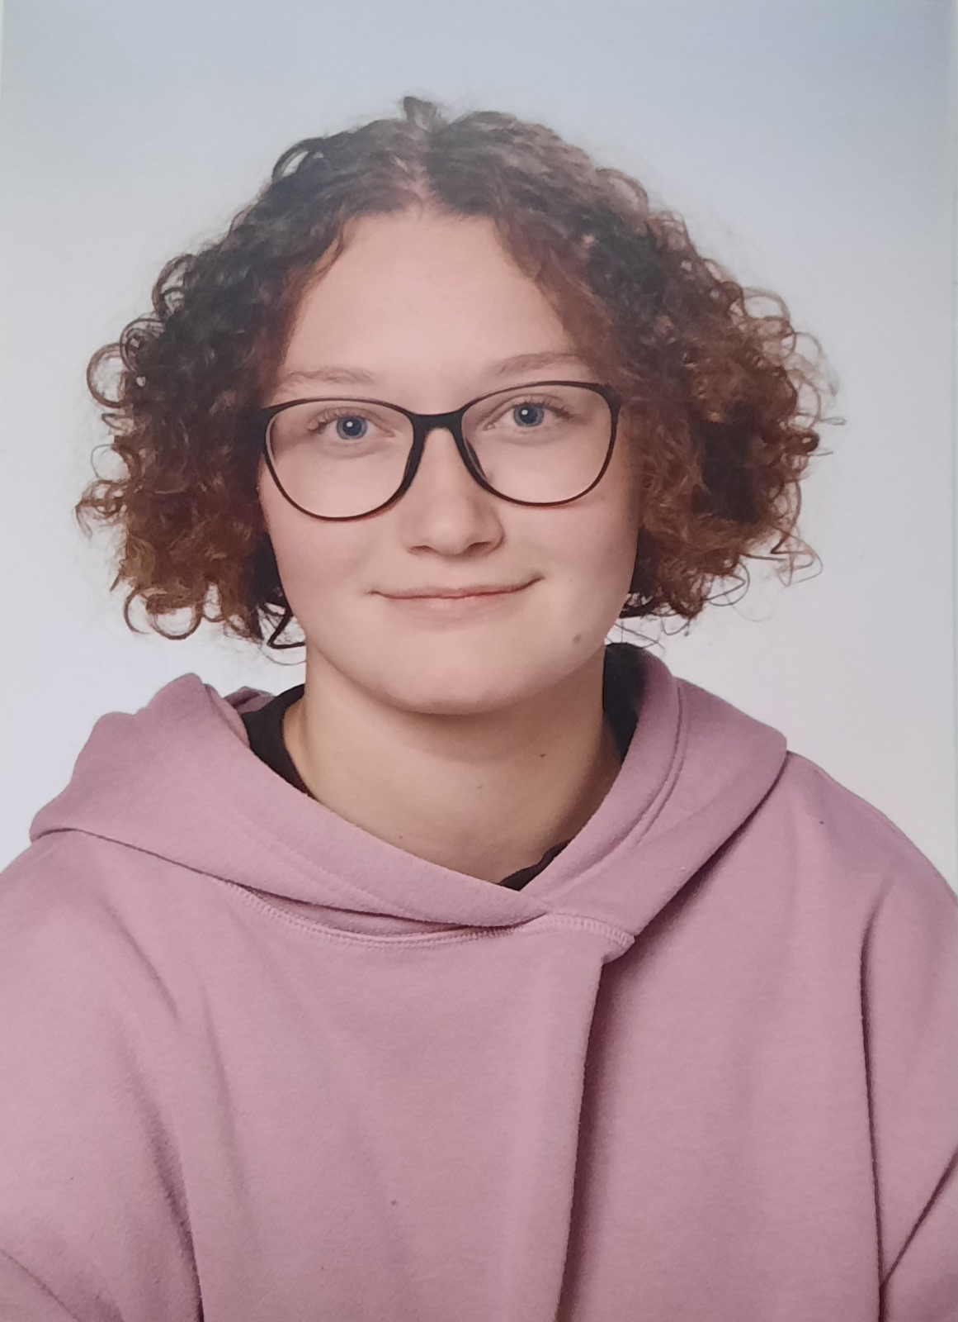
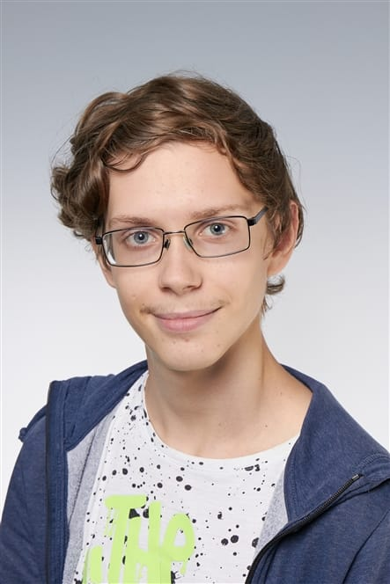
Unser Team
Isabella Baumann – Lien Hochbichler – Stefanie Steinmair – Thomas Gossenreiter

Slide 5

02
Ziel

Slide 6

Nervt es denn nicht… …, wenn man üben möchte und keine Übungen findet. …, wenn man krank war und niemand einem die Sachen zum Nachschreiben bringen will. …, wenn man beim Lernen für die Matura realisiert, dass man nicht alle Unterlagen hat.

Slide 7
Ziel
SchülerInnen helfen SchülerInnen
SchülerInnen helfen sich gegenseitig um einen gemeinsamen Erfolg zu erzielen.
Seite kann zum Üben genutzt werden || Matura
Schularbeitenbeispiele, MAK-Beispiele, Hausaufgabenbeispiele, …
Wenn man krank war, zum Nachschreiben
weniger Aufwand für MitschülerInnen + Sicherheit, dass man up-to-date ist.

Slide 8

03
Idee

Slide 9
Idee
Web-App
Filtern nach Jahrgang und Fächern
Mitschriften, Zusammenfassungen hochladen bei verschiedenen Themenbereichen
Übungen
Schularbeiten-, MAK-, Hausaufgabenbeispiele
Prüfmodus / Lernmodus
Lernquizze

Slide 10

Was ist mit Prüf-/Lernmodus gemeint?
Lernmodus:
So eine Art Moodlequiz
1. Lösung eingeben
2. auf weiter klicken
3. Lösungsweg angezeigt
Prüfmodus:
So eine Art Moodlequiz
1. Lösung eingeben
2. Zeitläuft ab (50min)
3. wenn Zeit vorbei => richtig oder falsch + Lösungsweg angezeigt

Slide 11
04
Momentaner Zwischenstand

Slide 12
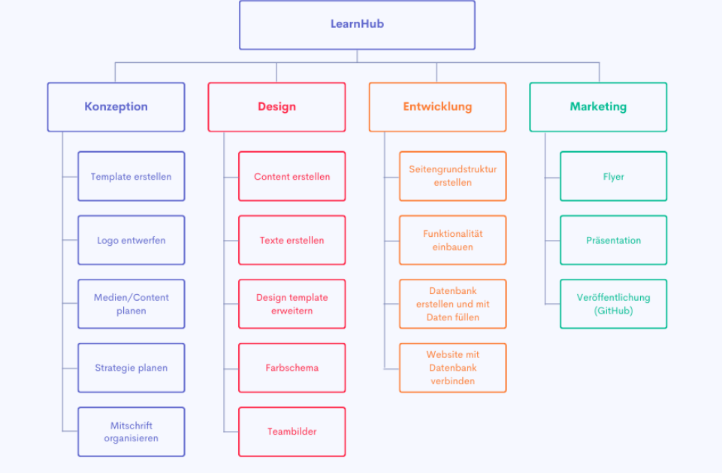

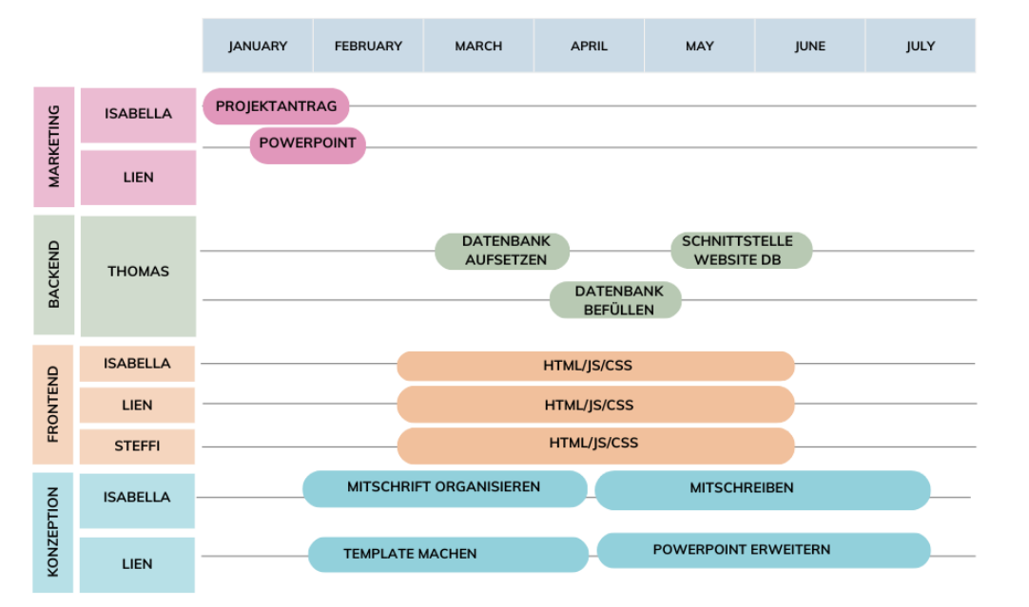
Zwischenstand:
Projektantrag mk | pdf erstellen
Projektstrukturplan erstellen
Webseitentemplate erstellen

Slide 13
BootStrap?
Was ist BootStrap?
Open-Source-Framework
Für Frontend-Entwicklung
Sammlung von Vorlagen
Erleichtert responsive Designs
Enthält vorgefertigte Komponenten
Grid-Systeme, Navigationsleisten, Formulare, Buttons, Tabs, etc.
Optimiert für verschiedene Bildschirmgrößen
Zeitersparnis für Entwickler

Slide 14

Startseite

Slide 15
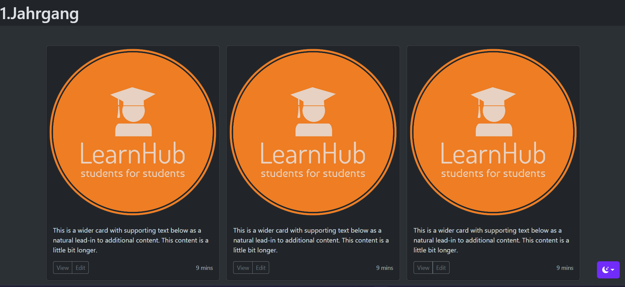
Content

Slide 16
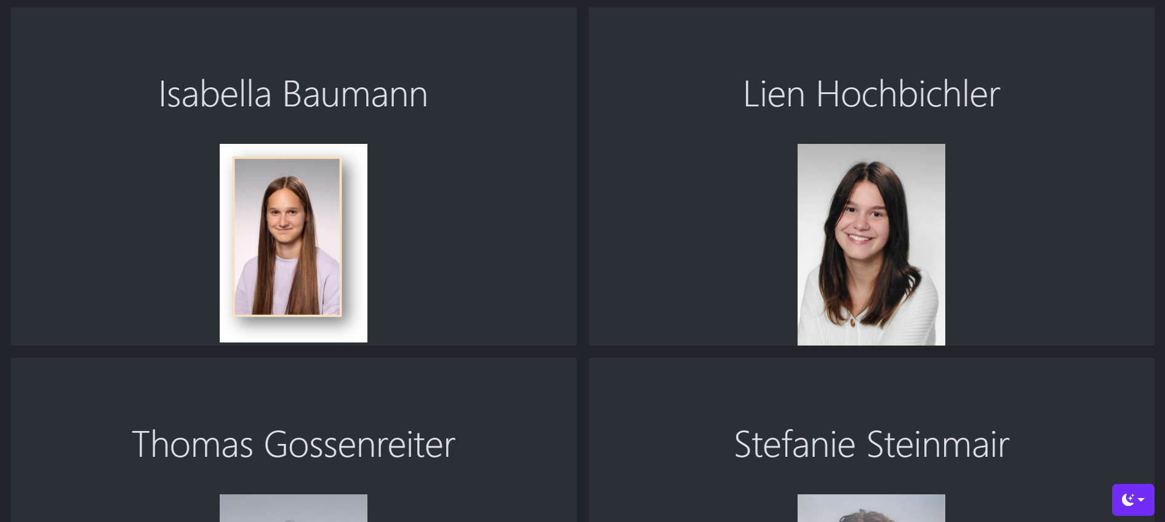
Team

Slide 17
Ideen
Correct tense
Pronoun usage
Adjective order
Let’s learn about the right tense for each sentence!
It’s important to use the correct pronoun depending on the noun it's replacing
There is often a specific order in which adjectives must appear in sentences
Use of prepositions
Sentence structure
Punctuation
They show the relationship of a noun or pronoun to another word in a sentence
What’s the correct sentence structure in this language? Stay tuned to find out!
Punctuation marks clarify the meaning of sentences. Let’s master them all!

Slide 18
Where is this language spoken?
Country A
This language was originated in this country
Country B
This country has the largest number of speakers
Country C
This country was influenced by this language in the past

Slide 19
Here are some steps to proficiency!
Start with simple vocabulary words and basic grammar
Learn more complex sentence structures and grammar rules
Introduction
Intermediate
Basic
Advanced
Continue expanding your vocabulary and practicing speaking and listening skills
Start participating in conversations and discussions in the new language

Slide 20
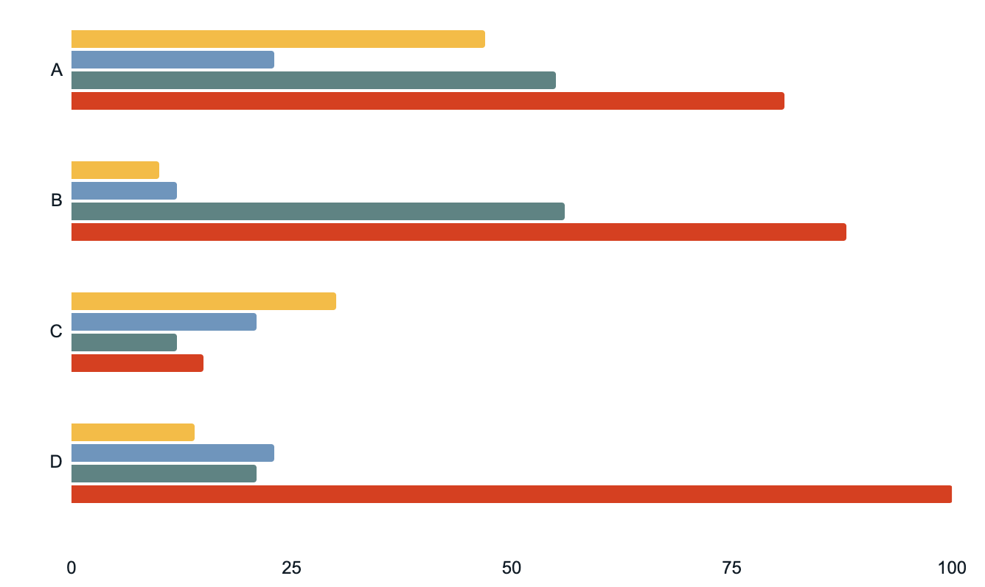
Skills acquired at each level
Listening
Speaking
Writing
Reading
Follow the link in the graph to modify its data and then paste the new one here. For more info, click here

Slide 21
Rubric
Criteria | Exceptional (4) | Proficient (3) | Basic (2) | Limited (1)
Content Mastery | Deep understanding, advanced vocabulary, minimal errors | Solid understanding, effective use of vocabulary | Basic understanding, limited vocabulary, noticeable errors | Limited understanding, very basic vocabulary, frequent errors
Communication Skills | Clear and fluent expression, wide range of vocabulary | Effective communication, varied vocabulary | Limited fluency, basic vocabulary | Struggles to communicate, frequent errors
Language Use & Conventions | Consistent use of correct grammar, pronunciation | Generally correct grammar and pronunciation | Basic language skills, noticeable errors | Significant errors, hindering understanding
Engagement & Participation | Active involvement, consistent contribution | Active participation, enthusiastic contribution | Limited engagement, minimal contribution | Little to no engagement, minimal participation

Slide 22
Short answer questions
What is a memorable experience or event in your life, and why was it significant?
What is a skill or hobby that has positively impacted your life?
What is a movie that has left an impression on your and why did it resonate with you?
The students should read the following questions and answer them in their paper in the target language. They should use two words from the word list for each answer
Word list
Word 1
Word 2
Word 3
Word 4
Word 5
Word 6
Word 7
Word 8
1
2
3

Slide 23
Group discussion
Divide the class into small groups of 3-5 students. Assign each group a discussion topic or question. In their groups, they should discuss the topic in the target language
Communication styles
Adaptability in the face of change
Innovation and its impact
Topics
Intersection of art and technology
Cultural exchange and understanding
Evolution of education

Slide 24
Vielen Dank für Eure Aufmerksamkeit
Credits: SlidesGo

