Slide 1
SEMESTER 5 · GROUP PROJECT · GROUP 08
LearnMateAI
An E-Learning Platform for Self-Learning Using Large Language Models
Dinura N. Ginige · Tharumini Gamage · Thevindu Fernando
Every model runs locally. No uploaded document ever leaves the machine.

Slide 2
A PDF cannot be asked a question
Why the material a student already has is hard to actually study from.
01
Lecture material is static
02
General chatbots answer from the internet
It can be read start to finish, but not interrogated, quizzed against, or summarised on demand.
Not from your lecture notes — and with no page you can turn to and check.
03
Generated study material is unverified
04
Course material is sensitive
An MCQ with the wrong option marked correct teaches the wrong thing, confidently.
Uploading a department's notes to a cloud model is a privacy question most institutions cannot answer.
05
The requirement: material has to be traceable to its source and checked before delivery. Without both, a generated summary and a confident guess look identical from the outside.
Sri Lankan legal education
Very little digitised, subject-aligned material exists to study from in the first place.
LearnMateAI
2

Slide 3
What LearnMateAI does
Upload a PDF. Ask it questions and get answers that cite the pages they came from, or generate study material from it — and everything the system produces is graded by a second model before it reaches you.
01
02
03
04
Upload
Ask
Generate
Judge
Validate, extract, clean, chunk and embed a PDF. Page numbers survive the whole pipeline — they are what citations point at.
Answers built from retrieved passages, carrying the pages they came from. A question the document does not cover is answered separately, without citations.
Summary, key points, MCQs and short-answer practice questions — from one passage or pooled across the whole document.
Structural validators first, then a second model from a different family grades the output and can send it back for one more attempt.
2 × 3B
11
4
70 / 100
local models
Mongo collections + GridFS
resource types
judge pass threshold
LearnMateAI
3

Slide 4
One machine, four moving parts
React talks to FastAPI over JSON and a bearer token. The backend is split into a web layer and an engine that knows nothing about HTTP.
CLIENT
SERVER
BEHIND IT
integrated-frontend
integrated-backend · FastAPI
data & identity
React 19 · Vite 8 · Tailwind 4
React Router 7
axios with two interceptors
useJob polls 202 → done
app/ — routers, services, auth
jobs, ownership checks
learnmate/ — the engine
ingestion · agents · evaluator
MongoDB 8 :27018 (+ GridFS)
Qdrant 1.18 :6335 (HNSW)
2 × Q4 GGUF via llama.cpp
Keycloak 26 :8081
→
→
Everything slow is a job. Local inference on a 3B model takes tens of seconds, so no slow endpoint holds a connection open. Upload, generation and chat each answer 202 with a job id, and the client polls /api/jobs/{id} through queued → running → done. The queue lives in MongoDB, not in memory, so reloading the page does not lose your place. One worker thread — because llama_cpp.Llama holds a single mutable context, and two threads generating at once corrupt both replies.
LearnMateAI
4

Slide 5
Three tracks, merged on main
Each member built their part as a standalone component first. Work landed on feature branches and pull requests into main, then the pieces were integrated into one application.
Dinura N. Ginige
Chat and resource agents as LangGraph state machines · evaluator (validators + LLM judge) · retrieval, embeddings, reranking · auth, jobs and ownership · integration of all components · frontend shell and design system
Engine & integration
Tharumini Gamage
PDF document-processing pipeline · resource generator service · backend API and database work · frontend pages and layouts
Documents & resources
Thevindu Fernando
Sri Lankan legal corpus → instruction pairs · LoRA / QLoRA fine-tune of Qwen 2.5 · evaluation gate and version registry · MLOps promote / rollback workflow
Offline ML track
The standalone components — components-Dinura/, backend/, frontend/ — are kept frozen as references. The live application is integrated-backend/ + integrated-frontend/; model-Thevindu/ stays out of the request path by design.
LearnMateAI
5

Slide 6
Overall progress
The application is complete end to end and running locally. What remains is verification and deployment, not features.
Working now
Next
Ingestion pipeline — validate, extract, clean, chunk, embed
Grounded chat agent with page citations and one retry
Four resource types, each with its own structural gate
LLM judge, rubrics per task, every verdict logged
Auth, ownership, background job queue
Full frontend: dashboard, documents, resources, chat, analytics, dark mode
Offline fine-tune — first candidate failed its gate, not promoted
Unit tests over the engine, pytest suite in CI
Judge-score regression tracking across prompt changes
GPU offload and warm model loading
Keycloak from start-dev to start, with TLS
Containerise the API, back up the named volumes
Status: every user-facing feature in this deck is running against local models on a single machine — the screenshots that follow are of the working system.
LearnMateAI
6

Slide 7
High-level architecture
A document is indexed once. Every question then runs the RAG path inside a LangGraph agent, and nothing is stored before the judge has seen it.
React 19 SPA · Documents · Chat · Resources · Analytics
axios + Bearer JWT · useJob polls /api/jobs/{id}
FastAPI · routers · auth · ownership · job queue
INGESTION · RUNS ONCE PER DOCUMENT, IN THE BACKGROUND
PDF upload
Validate
Extract
Clean
Chunk
Embed
≤ 10 MB · ≤ 300 pages
encrypted · corrupt · page count
PyMuPDF, page by page
heads · ligatures · hyphens
900 chars / 150 overlap
all-MiniLM-L6-v2 → Qdrant
LANGGRAPH AGENT · ONE PASS PER CHAT TURN OR RESOURCE REQUEST
rewrite
retrieve — RAG
generate
evaluate
decide
persist
resolve
pronouns
from 6 turns
all-MiniLM-L6-v2 · question → 384-d vector
LangChain BaseChatModel
structural validators
accept,
or retry
once
chat_turns
resources
evaluations
Qdrant ANN search · top 20 candidates
Qwen2.5-3B · llama.cpp Q4
Llama-3.2-3B judge · rubric
ms-marco cross-encoder rerank · top 3
grammar-constrained JSON
score ≥ 70 to pass
regenerate once with the judge's instruction · MAX_ATTEMPTS = 2
MongoDB 8 · :27018
Qdrant 1.18 · :6335
llama.cpp runtime
Keycloak 26 · :8081
11 collections + GridFS · job queue
chunk vectors · HNSW index
2 × Q4 GGUF, in the API process
realm · JWKS · themed login
LearnMateAI
7

Slide 8
From a PDF to something a model can search
Five stages between the file a student drops and the index a question is answered from.
Validate
Extract
Clean
Chunk
Embed
PDF · ≤10 MB · ≤300 pp
PyMuPDF, page by page
heads · ligatures · hyphens
900 chars / 150 overlap
MiniLM → Qdrant
What cleaning removes
How a document is represented
Running heads and footers repeated on every page
Ligatures rejoined into plain letters
Hyphenation reconnected across line breaks
Chunks under 80 characters dropped as noise
pages — cleaned page text, what the models read
chunks — 900-char overlapping windows on sentence boundaries
Qdrant — one 384-dimension vector per chunk, HNSW index
GridFS — the original file, so text and PDF stay together
Stored once. Documents are keyed by the SHA-256 of their bytes, so a file ten students upload is extracted and embedded a single time. That is also why ownership cannot be a field on the document and lives in user_documents instead.
LearnMateAI
8

Slide 9

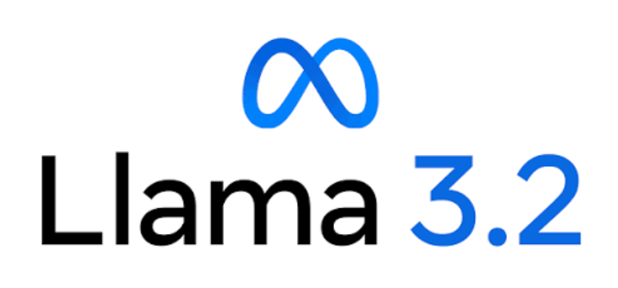
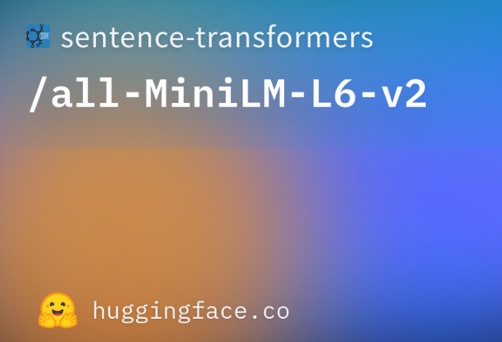
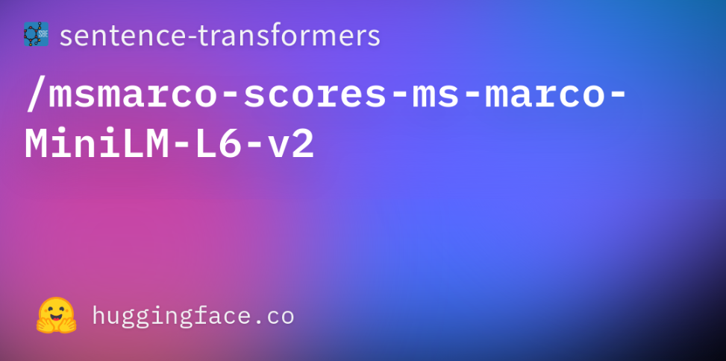
Four models, all running locally
Two 3B generators and two small retrieval models — no API key, no network call in the request path.
GENERATOR
JUDGE
BI-ENCODER
CROSS-ENCODER
Qwen2.5-3B-Instruct
Llama-3.2-3B-Instruct
all-MiniLM-L6-v2
ms-marco-MiniLM-L-6-v2
Q4 GGUF ≈ 2 GB · llama.cpp
Writes every reply and resource
Q4 GGUF ≈ 2 GB · llama.cpp
Grades output against its source
≈ 90 MB · 384-dim vectors
Searches every chunk in ms
≈ 90 MB · reranks 20 → 3
Reads question and chunk together
Why a different family for the judge. A model grading its own writing rates its own style highly, and the quality check quietly stops catching anything. Different weights means a genuine second opinion rather than a rubber stamp — and the two retrieval models split the job because searching everything and scoring one pair are not the same task.
LearnMateAI
9

Slide 10



Three stores, three jobs
Each has its own container and its own named volume, on a non-default host port.
MongoDB 8
Qdrant 1.18
Keycloak 26
:27018
:6335
:8081
Everything that is not a vector. An MCQ, a summary and a chat turn genuinely differ in shape, so a document database stores them without inventing a table for each.
One collection of chunk vectors. Answers "which passages are closest in meaning to this question" in milliseconds using an HNSW index.
The identity store: the learnmate realm, its public client and its users, imported from JSON the first time the volume is empty.
Ten collections, plus the file bucket
users
user_documents
documents
pages
chunks
sessions
chat_turns
resources
evaluations
jobs
pdfs (GridFS)
Why the unusual ports. This machine already answers on 27017, 6333 and 8080 for other projects — and sharing a database server means sharing a failure: another project's docker compose down -v would take this one's PDFs, sessions and generated resources with it.
LearnMateAI
10

Slide 11
Two ML stories, kept apart
The live path runs on every request. The offline fine-tune has never been in the request path, and will not be until it passes its gate.
First candidate — qwen25-lora-20260815-090709
Offline track — model-Thevindu/
Metric | chapter | strict | Gate
Accuracy (LLM judge) | 0.557 | 0.621 | ≥ 0.70 fail
Groundedness | 0.877 | 0.921 | ≥ 0.85 pass
Hallucination | 0.123 | 0.079 | ≤ 0.15 pass
Latency p95 | 16.4 s | 14.9 s | ≤ 8 s fail
Accuracy (token-F1) | 0.717 | 0.836 | proxy only
1
Parse, clean and section-aware chunking of Sri Lankan legal PDFs
2
Instruction pairs: Q&A, summary, MCQ
3
Splits by (doc_id, chapter), plus a whole-document holdout
4
LoRA / QLoRA on Qwen2.5-1.5B-Instruct, Colab T4
5
Evaluated against acceptance_thresholds.yaml
6
Staging → teammate sign-off → promote a pointer, rollback kept
The gate did its job. Token-F1 of 0.717 looked like a pass; the LLM judge — the metric that matches how the live app defines correctness — did not agree. The candidate was not promoted and the local GGUF generator stays. Two dataset defects were caught the same way: ungrounded section citations (≈38% of pairs on a spot check, 1.0% after the fix) and a split that left six subjects with no training pairs at all.
LearnMateAI
11

Slide 12
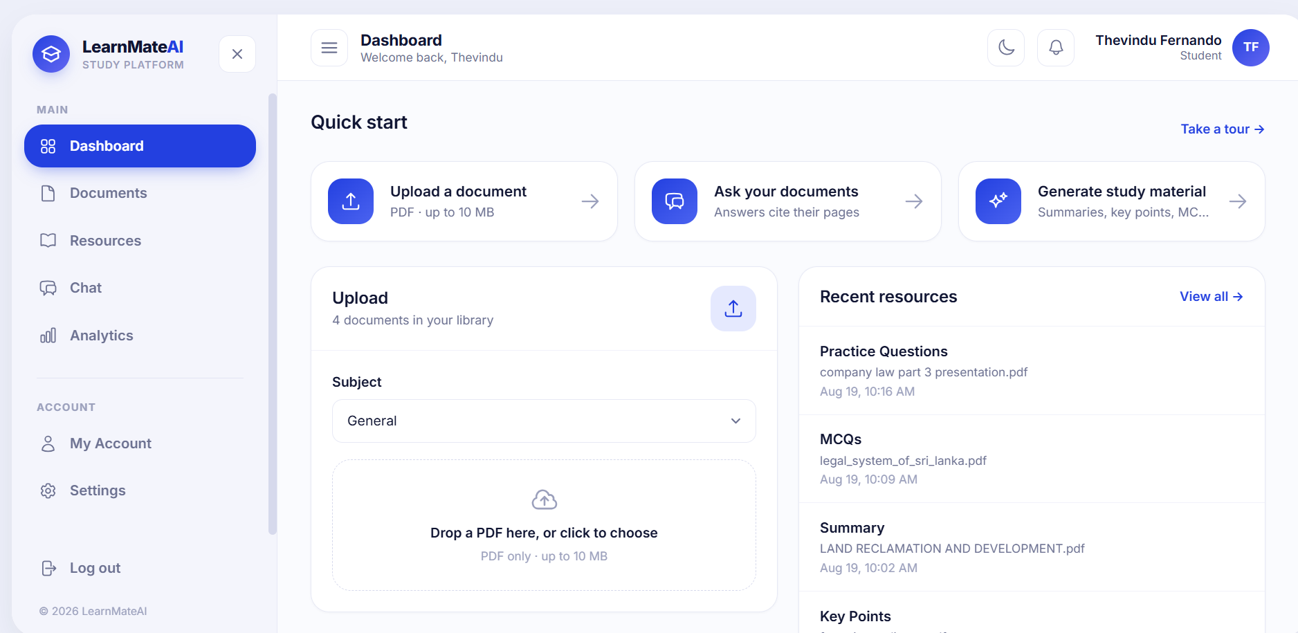
The first screen after signing in
What to do next, and what you were last working on — in that order.
Quick start — the three things there are to do, as links
Recent resources — the latest generated material, with anything still running shown above what has finished
Your documents — recent uploads with their Processing or Ready state
A returning student's first action is one click from sign-in
Recent first. The dashboard reads from the same job queue as every other page, so a resource still generating appears here before it is finished.
LearnMateAI
12

Slide 13
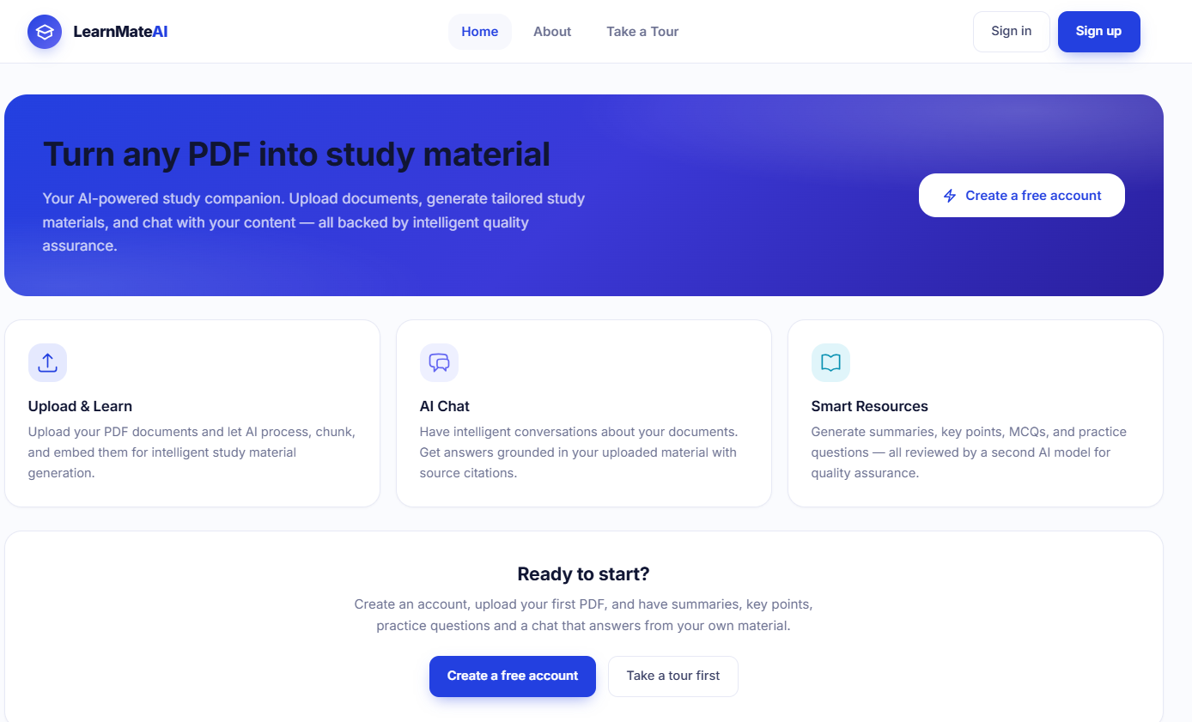
What a student can do
Five functions, reachable from one rail, all working against the same document library.
1
Upload
PDFs up to 10 MB, processed in the background
2
Chat
Ask a document, get answers that cite their pages
3
Generate
Summary, key points, MCQs, practice questions
4
Review
Take a quiz, check answers, see the judge's verdict
5
Track
Activity and quality statistics per task type
Home — public, readable before signing up
LearnMateAI
13

Slide 14
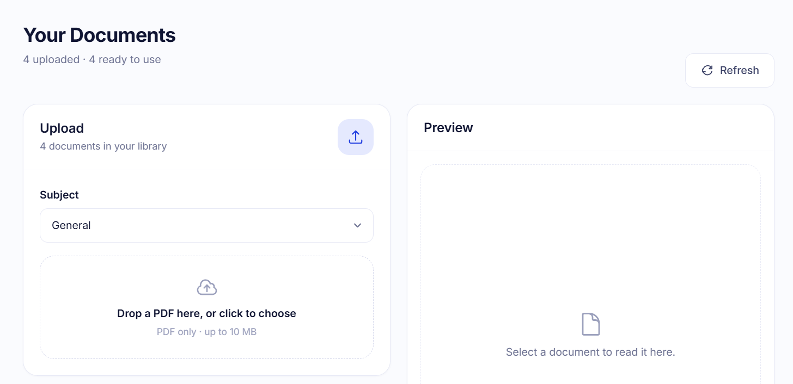
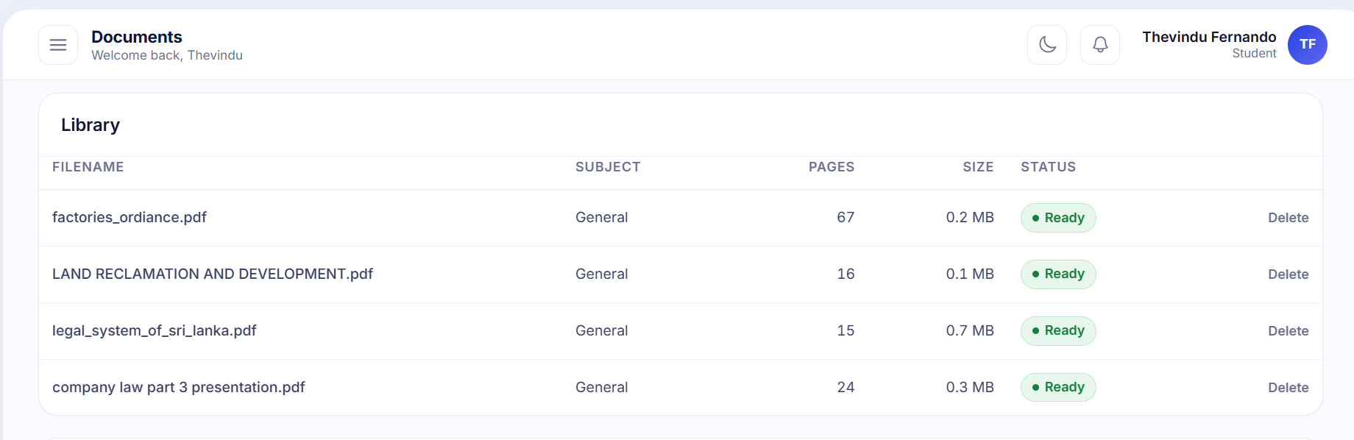
Drop a file and keep working
The row appears immediately and turns Ready on its own — nothing to refresh, nothing to wait on.
PDF only, up to 10 MB and 300 pages
Encrypted or corrupt files are caught at validation and explained
A subject label is chosen at upload and travels with the document
The worker extracts, cleans, chunks and embeds, reporting progress per stage
The original file goes to GridFS, the cleaned text to MongoDB
Repeat uploads are instant. Documents are keyed by the SHA-256 of their bytes — if that exact file is already stored, extraction and embedding are skipped entirely and only the ownership link is new.
LearnMateAI
14

Slide 15
How the models are used
One generator, one judge, and a decoding strategy that makes a 3B model dependable.
Generation
Evaluation — two gates
Grammar-constrained decoding forces valid JSON — asked politely, a 3B model returns prose about half the time
≤ 6 000 characters of retrieved passage per call; 6 turns of chat history carried
2 attempts: one regeneration on a rejection, and the better attempt wins
Gate 1 — structural validators, plain Python in microseconds: four options and exactly one answer, a summary that exists and is long enough
Gate 2 — the judge, one rubric per task, plus two for grounded and general chat replies
Below 70 the judge returns an instruction, not just a number
Three interchangeable backends
llama.cpp
Served endpoint
Cloud API
default · fully local, in-process
an HTTP model server on the network
availability fallback only
The wrapper implements LangChain's BaseChatModel interface, so swapping the generator is two lines of .env and no code change. The cloud path is an availability fallback — process down, timeout, missing pointer — never a per-answer quality router.
LearnMateAI
15

Slide 16
One chat turn is one graph pass
A LangGraph state machine rather than one long function — because the interesting part is the edge that loops back.
rewrite
retrieve
generate
evaluate
decide
persist
resolve "it", "that case"
embed → ANN → rerank
answer from the chunks
validators, then the judge
accept, or send it back
store the turn
regenerate once with the judge's instruction · MAX_ATTEMPTS = 2
Two milestones in one turn
Grounded, or honestly not
Tokens stream onto progress.partial as they arrive, then reply_ready hands over a finished, readable answer while the judge runs off-screen. A regeneration is deliberately not streamed over it — replacing a finished paragraph with a half-written one reads as the assistant having second thoughts in public.
An answer built from retrieved chunks carries the pages it came from. A question the document does not cover is answered from general knowledge instead — a different kind of answer, graded on a different rubric, carrying no citations, so the difference is visible rather than hidden.
LearnMateAI
16

Slide 17
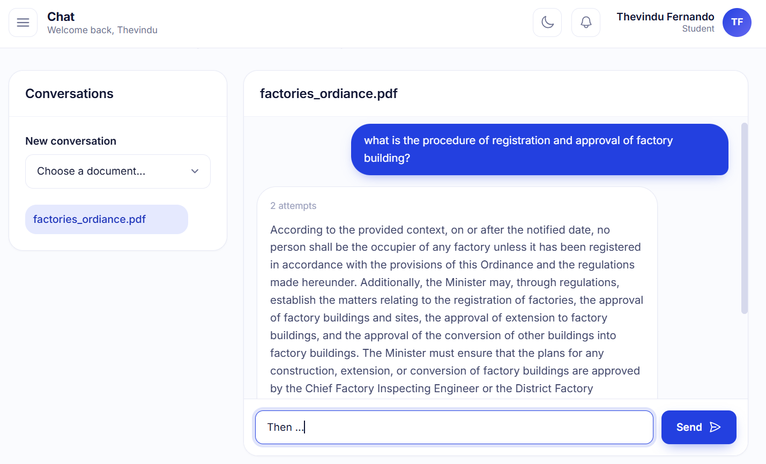
Chat
Pick a document, ask in plain language, and read an answer built from its pages.
One conversation per document — context stays where it belongs
Six turns of history carried, so follow-ups like "then?" resolve
The attempt count is shown: an answer regenerated once says so
Answers cite the pages they were built from
Leaving the page does not lose the answer — the turn is stored
Two rubrics. A grounded reply is graded against the passages it used; a general-knowledge reply is graded on its own rubric and carries no citations.
LearnMateAI
17

Slide 18
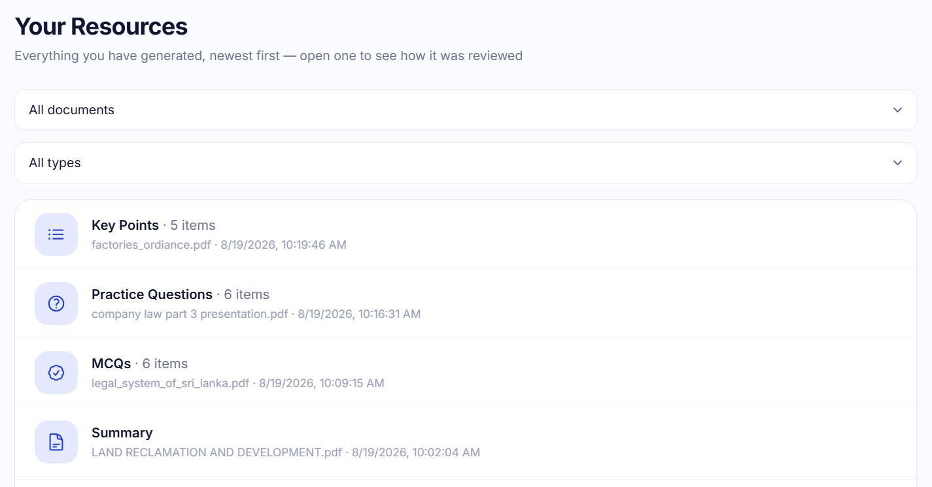
Nothing reaches the student ungraded
Generate → validate → judge → accept or retry once. The verdict is stored with the resource.
Generate
Gate 1
Gate 2
Decide
Store
grammar-constrained JSON
structural validators
LLM judge, per-task rubric
≥ 70 accept · else retry once
resource + evaluation
Gate 1 costs microseconds and keeps the ≈25-second judge call for well-formed content only
A chat reply skips gate 1 — there is nothing mechanical to check in free prose
Every verdict is logged, passes as well as failures, into the evaluations collection
That log is what turns "how good is this material" into a question with an answer
Resources — everything generated, newest first
Four types, one contract. Adding a fifth means one module beside the existing four, one line in the task registry, one structural validator and one rubric.
LearnMateAI
18

Slide 19
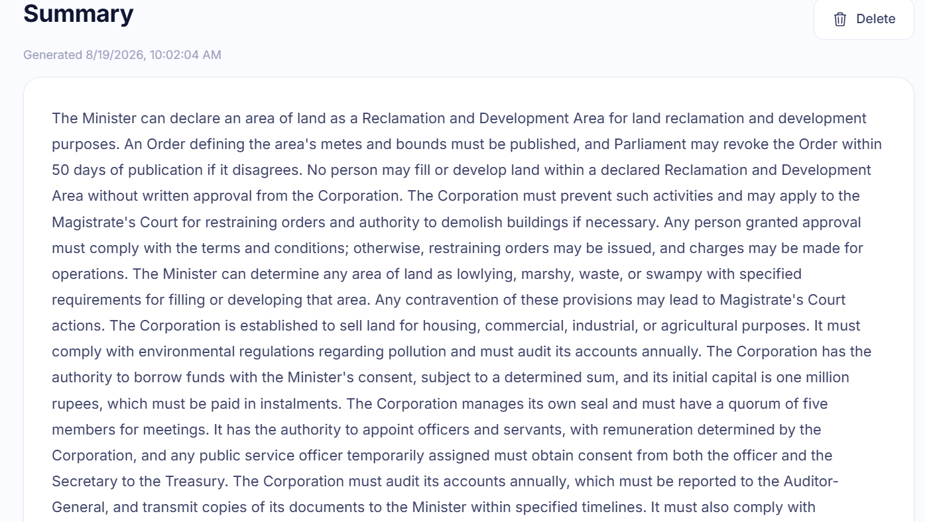
Resource 1 — Summary
One block of connected prose that says what the passage says.
Connected prose, not a summary chopped into bullets
Built only from the retrieved source text
Scoped to one passage, or pooled across the whole document
Gate 1 rejects an empty or too-thin summary without spending a judge call
Gate 2 grades it against the source on the summary rubric
Two scopes. Passage — one extract, optionally the pages that best match a topic you name. Whole document — read in groups and pooled, so the result covers the file rather than its first few pages.
LearnMateAI
19

Slide 20
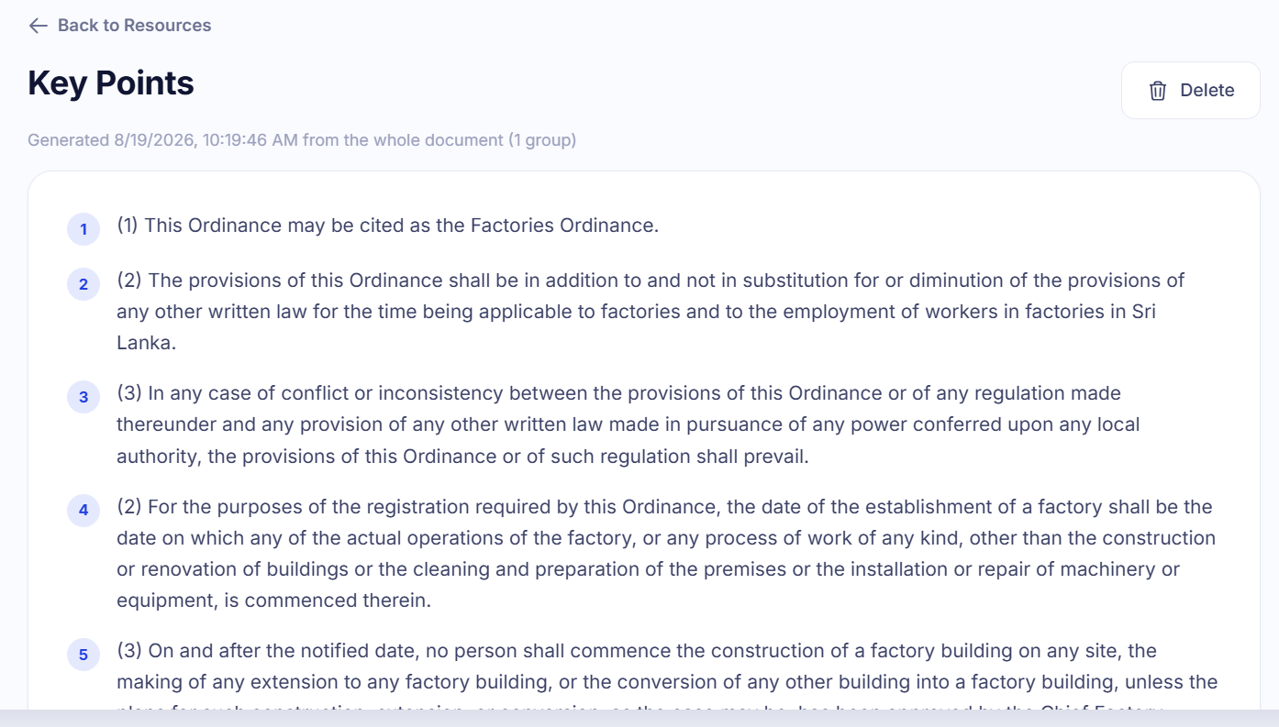
Resource 2 — Key points
The points the passage itself treats as important — not a summary in bullet form.
Each point a complete statement that stands on its own
Ordered as the passage presents them
Sized to the passage, not padded to a round number
Gate 1 checks count, emptiness and duplication
Gate 2 asks what a validator cannot: is each point actually in the source
A summary compresses; key points select. Generating one from the other produces material that reads well and teaches badly — which is why they are separate tasks with separate rubrics.
LearnMateAI
20

Slide 21
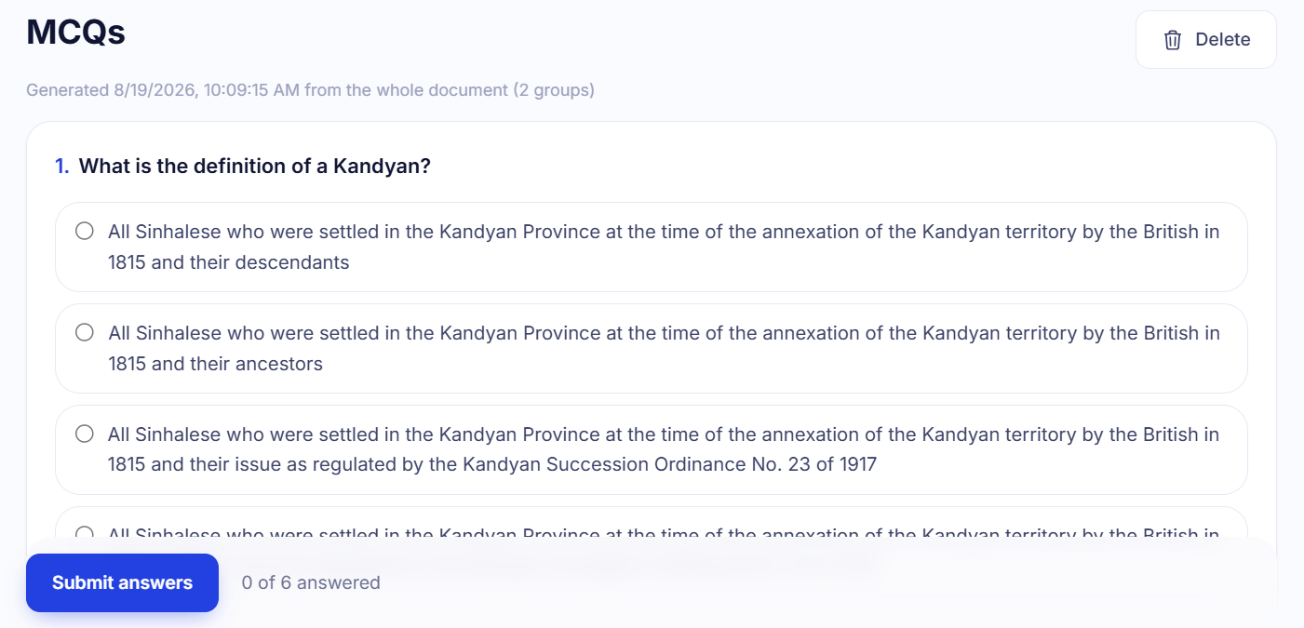
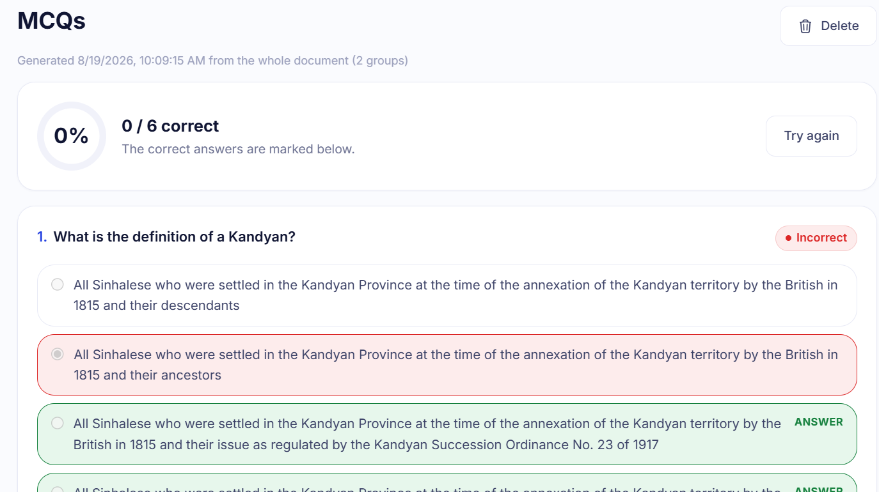
Resource 3 — Multiple-choice questions
Four options, one right, three plausible — and the set as a whole has to be unguessable.
Gate 1 — per question
Four options, none blank, none duplicated
The marked answer must be one of them
No "all of the above" giveaway
Gate 1 — per set
Take the quiz
Submit — correct answers marked
The answer is not always in the same slot
The correct option is not always the longest
The same question is not asked twice
The set-level rules are the interesting ones. Every question can be individually perfect while the set as a whole is still guessable without reading the passage, and no single-item check can see that. The bias rules only apply from four questions upward — below that, the answer landing in the same slot each time is coincidence, not a signal.
LearnMateAI
21

Slide 22
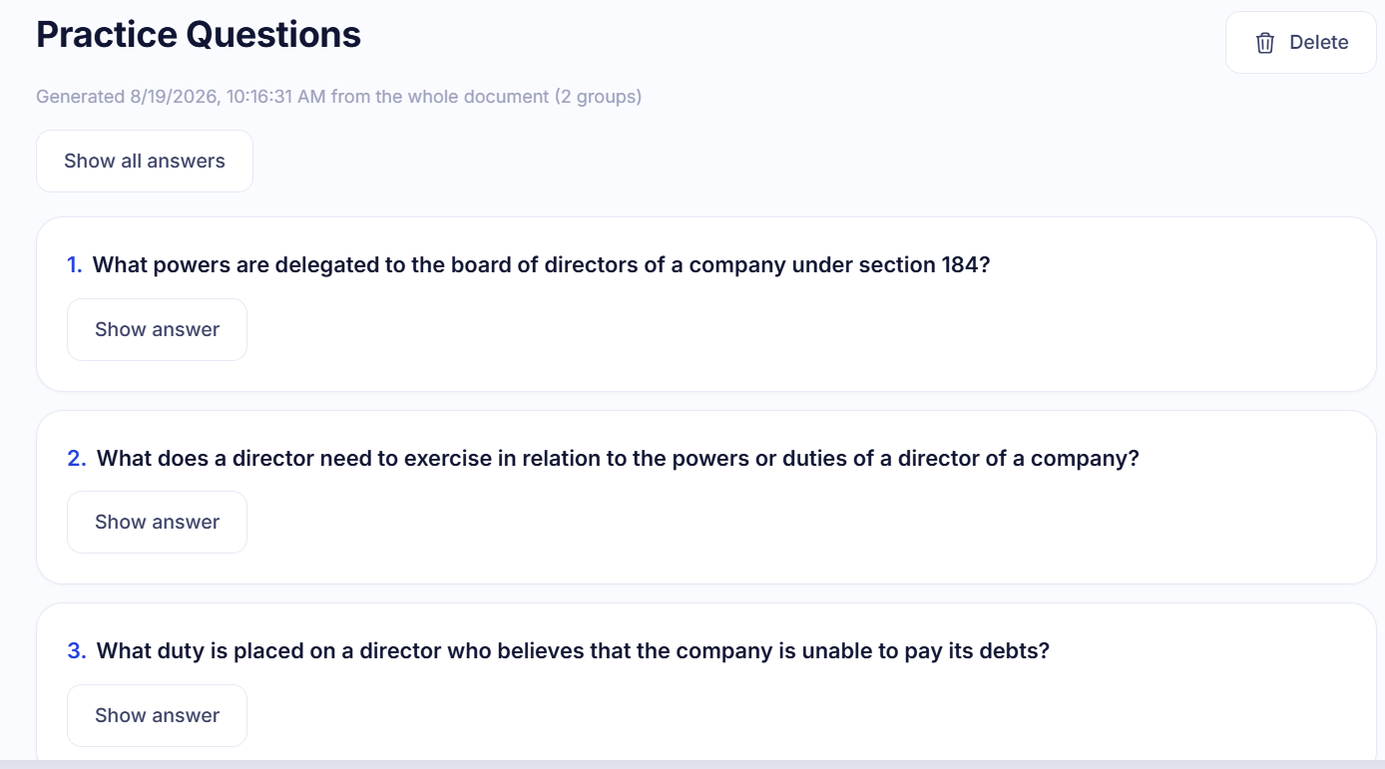
Resource 4 — Practice questions
Short-answer questions with reference answers — the format that makes you produce the idea instead of recognising it.
Answerable from the passage alone
A reference answer supplied with every question
Revealed one at a time, or all at once
Gate 1 rejects an answer that merely restates its question
Gate 2 grades the pair against the source
MCQs test recognition; short answers test recall. Keeping both is the reason there are four resource types rather than two.
LearnMateAI
22

Slide 23
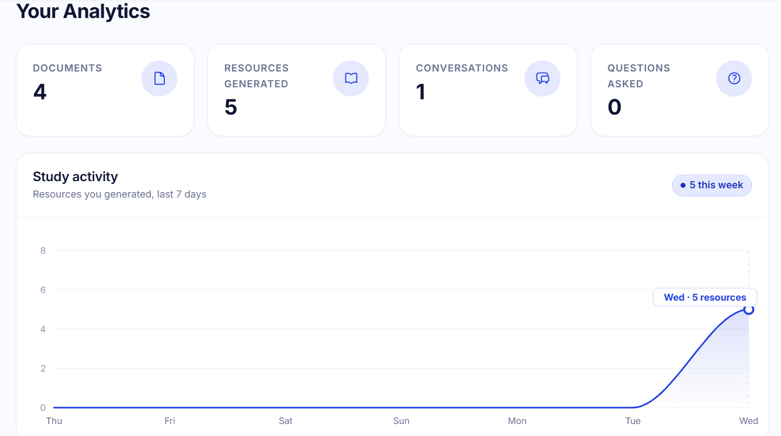
What you did, and how well it scored
Two halves, and the second is the one worth reading.
Activity
Documents, conversations and questions asked
Study activity over the last seven days
Resources generated, broken down by type
Quality, from the evaluation log
Per task: n, min, median, max, mean, distinct, pass rate
Acceptance rate against the judge threshold of 70
distinct says whether the judge separates good from bad at all
Null is not zero. Acceptance rate is null rather than 0 when nothing has been generated — "no data" and "nothing passed" are different things.
parse
validator
judge
skipped
not readable as JSON
rejected before the judge ran
the model scored it
evaluation switched off
LearnMateAI
23

Slide 24
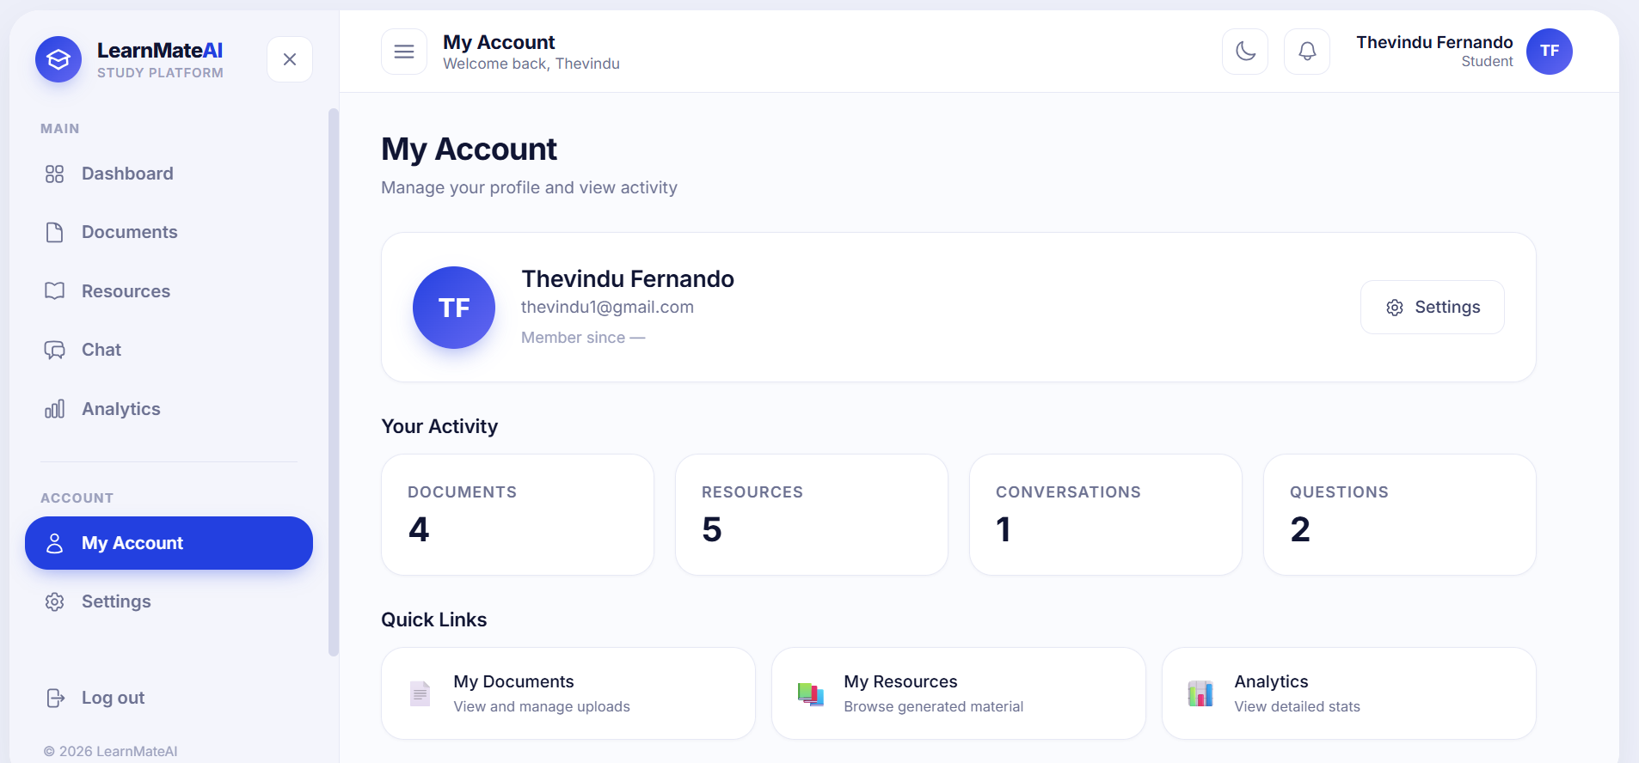
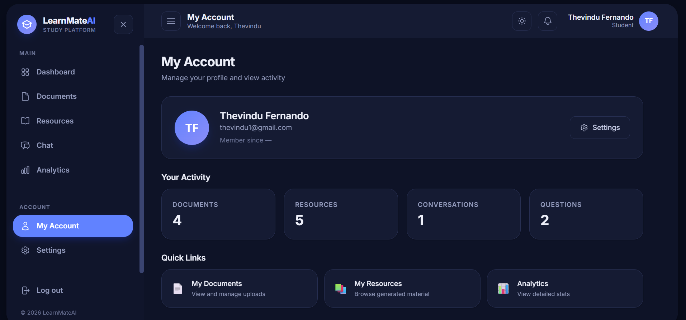
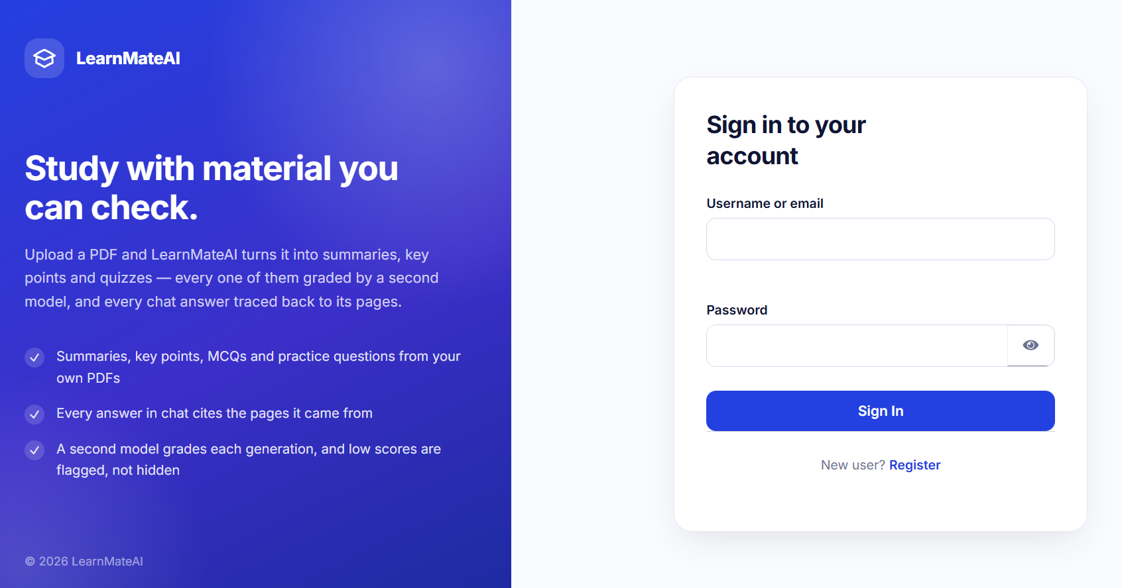
One blue, used sparingly
A royal-blue LMS: a pale lavender rail against near-white content, and generously rounded white cards with hairline borders instead of heavy shadows.
#2340E0
#E5E9FE
#101533
#3B4166
#6C7191
#E7E9F5
primary
primary-light
heading
body
muted
border
One saturated colour — #2340E0 marks the active nav pill, the primary button and the data marks. Nothing else gets it.
Status colours are reserved: green, amber and red mean success, warning and danger — never decoration.
Radii from 8 to 24 px — most of the difference between this and a bootstrap page.
Dark mode is a token swap: not one component is theme-aware, so a new screen costs nothing to support.
Navy-tinted greys in the dark theme — neutral grey reads as a different product wearing the same logo.
Light
Dark — same components, swapped tokens
Three kinds of route. Open (/login, /register) · explore (/, /about, /tour) · protected (everything else). The root is Home, not a redirect to a login form.
LearnMateAI
24

Slide 25
Nothing blocks, and nothing pretends
Six decisions that shape what using the app actually feels like.
01
Slow work never blocks
02
Status is visible
03
Answers arrive when readable
Upload, generation and chat return immediately and report progress. Leave the page, come back tomorrow — the job lives in the database, not in a browser tab.
A document row says Processing and becomes Ready on its own. The page watches it, so there is nothing to refresh and nothing to guess at.
A reply is handed over the moment it is finished, not when the judge is done — and a retry never overwrites a finished paragraph on screen.
04
One place for a dead session
05
Explore before committing
06
Failures are locatable
A single axios interceptor catches a 401, clears the session and redirects to login — instead of forty call sites each getting it slightly wrong.
Home, About and Take a Tour are readable without an account, so a visitor can find out what the product does before signing up.
/api/health reports both databases and both model files separately, so a problem is found in seconds rather than guessed at.
LearnMateAI
25

Slide 26
Keycloak issues the tokens; this backend only verifies them
Authentication and authorisation are separate questions, and each is asked in exactly one place.
Sign in
Keycloak 26
RS256 token
JWKS verify
get_current_user
LearnMate login theme
learnmate realm · :8081
signed with Keycloak's key
public keys, cached
on every protected route
Two kinds of token, one dependency — a token this server issued is HS256; a Keycloak token is RS256. One pair of except clauses catches both, and being unable to reach Keycloak is handled as a different thing from a bad token.
Ownership is checked before work is queued. services/ownership.py is the only place that decision is made, so posting into somebody else's session is a 403 immediately rather than a background job that fails a minute later.
JWT_SECRET_KEY has no default, deliberately — a fallback secret works in development, ships unnoticed, and makes every token it ever signed forgeable.
Local passwords are bcrypt-hashed, never stored or logged in readable form.
Custom LearnMate login theme, served by Keycloak
One caveat: Keycloak runs start-dev here — the right trade for a development identity provider and the wrong one for anything reachable from outside this machine.
LearnMateAI
26

Slide 27
LIVE
Demo
1
Upload a PDF and watch the row turn Ready
2
Ask it a question — answer with its page citations
3
Generate an MCQ set and take the quiz
4
Open the evaluation verdict behind a resource
5
Analytics: scores per task, and what each gate rejected

Slide 28
Testing, deployment, closure
None of this requires rewriting the application — the seams it was built around are the same seams every one of these steps uses.
Testing — running today
Testing — what it needs
Deployment, in order of effect
scripts/smoke_test.py drives the whole system end to end, with a pass or fail line per step
/api/health checks both databases and both model files separately
Every generation is validated, judged and logged — a continuous quality record
Unit tests over the engine: cleaning, chunking, the MCQ set-level rules
A pytest suite in CI on every pull request
Judge-score regression tracking, so a prompt change that lowers quality is visible before it ships
A load test on the job queue with concurrent students
GPU offload first — LEARNMATE_N_GPU_LAYERS=-1 with API_WARM_MODELS=1. This is the line that turns tens of seconds into seconds
Keycloak from start-dev to start, with TLS and a real database
Containerise the API alongside Mongo and Qdrant, with backups on the named volumes
Promote a fine-tune when it earns it — two lines of .env
Project closure: freeze the integrated application, hand over the smoke test and the version registry, and keep the standalone components as the record of how each part was built.
LearnMateAI
28

Slide 29
Thank you
Questions?
Grounded chat that cites its pages
Four resource types, each with its own structural gate
A judge that can say no — and one retry when it does
Entirely local: two 3B models, no network in the request path
Group 08 · Dinura N. Ginige · Tharumini Gamage · Thevindu Fernando

