Slide 1
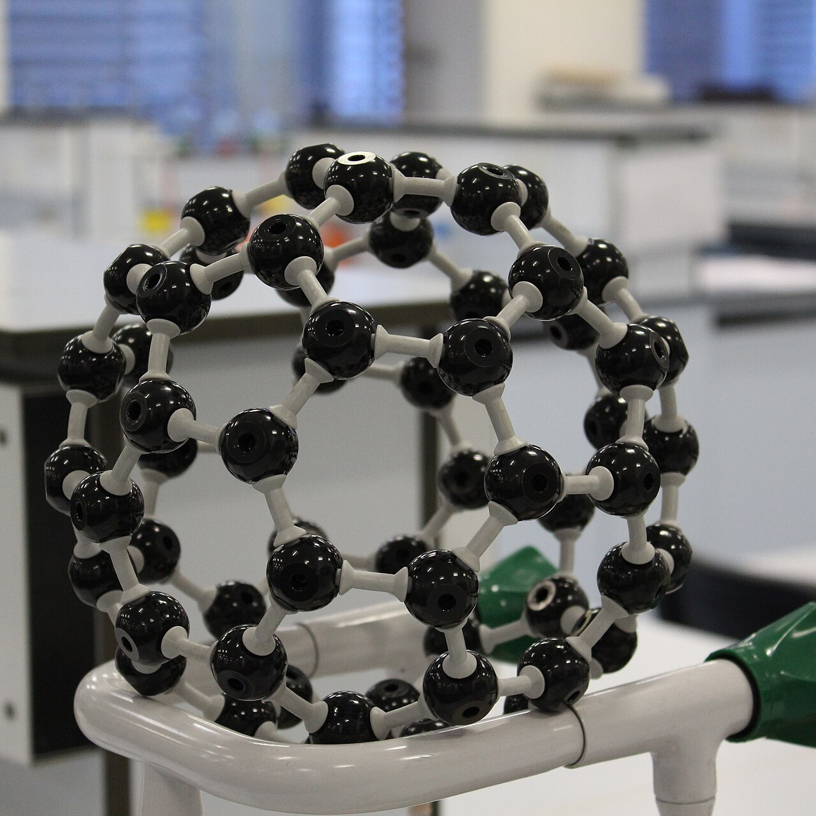
C₆₀ FULLERENE
A carbon allotrope in molecular form
C60 FULLERENE | 1
Notes:
Image: UCL Mathematical and Physical Sciences, “Molecular Model of C60, Buckminsterfullerene,” Wikimedia Commons, CC BY 2.0. https://commons.wikimedia.org/wiki/File:Molecular_Model_of_C60,_Buckminsterfullerene_-_UCL_Chemistry.jpg. Image shows a physical molecular model, not a photograph of a single molecule.

Slide 2
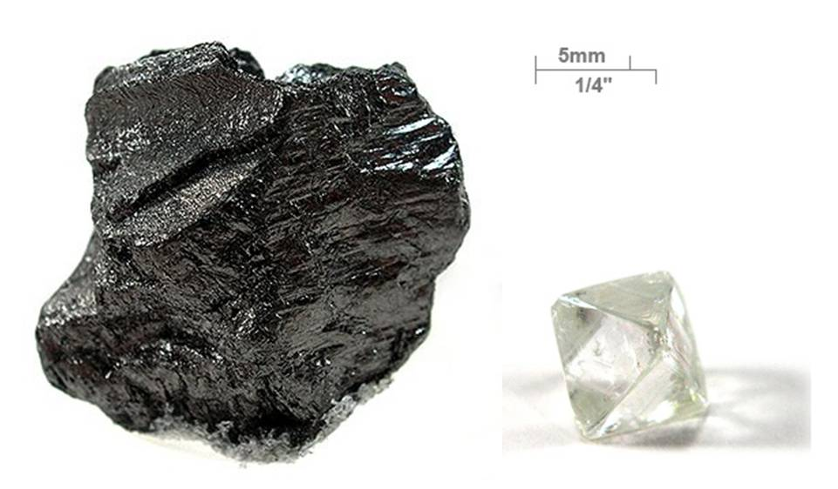
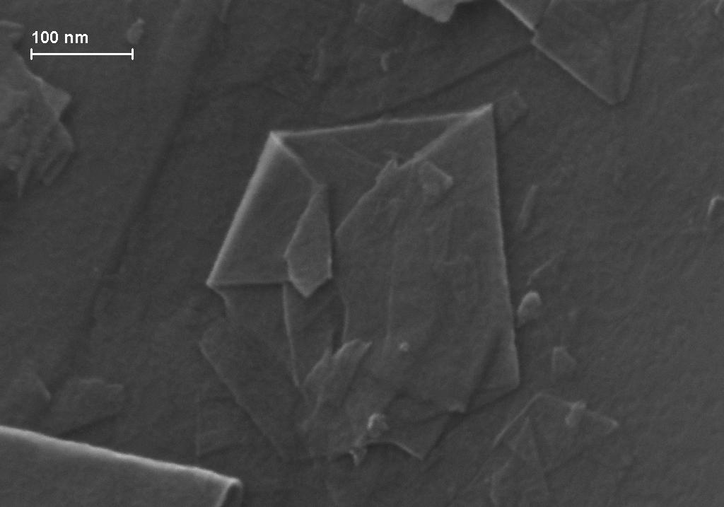
Carbon allotropes
Graphite and diamond specimens
Graphene flakes, scanning electron micrograph
• An allotrope is a structural form of an element, with the same atoms arranged differently.
• Diamond forms a rigid three-dimensional network; graphite forms layers; graphene is a single carbon sheet.
• C₆₀ is different again: a separate molecule with a closed carbon cage.
• Different bonding arrangements give carbon forms different properties.
C60 FULLERENE | 2
Notes:
Images: R. M. Lavinsky, “Graphite-and-diamond-with-scale.jpg,” Wikimedia Commons, CC BY-SA 3.0, https://commons.wikimedia.org/wiki/File:Graphite-and-diamond-with-scale.jpg; Capkuckokos, “Graphene flakes.JPG,” Wikimedia Commons, CC BY-SA 4.0, https://commons.wikimedia.org/wiki/File:Graphene_flakes.JPG. Allotrope background: Royal Society of Chemistry, “Symmetry of buckminsterfullerene,” https://edu.rsc.org/; Nobel Prize in Chemistry 1996, https://www.nobelprize.org/prizes/chemistry/1996/press/.

Slide 3
Meet C₆₀
• C₆₀ is one molecule made from exactly 60 carbon atoms. Its formula names the number of atoms in that molecule.
• The molecule is a hollow cage that is nearly spherical. Its diameter is about 0.7 nanometres.
• C₆₀ is the best-known member of the fullerene family, a group of closed-cage carbon molecules. C₇₀ is another example.
• Chemists call it buckminsterfullerene. The shorter name “buckyball” describes its round shape.
C60 FULLERENE | 3
Notes:
C₆₀ formula, synonyms and molecular weight: PubChem, https://pubchem.ncbi.nlm.nih.gov/compound/Buckminsterfullerene. Fullerene family background: Nobel Prize in Chemistry 1996, https://www.nobelprize.org/prizes/chemistry/1996/press/.

Slide 4
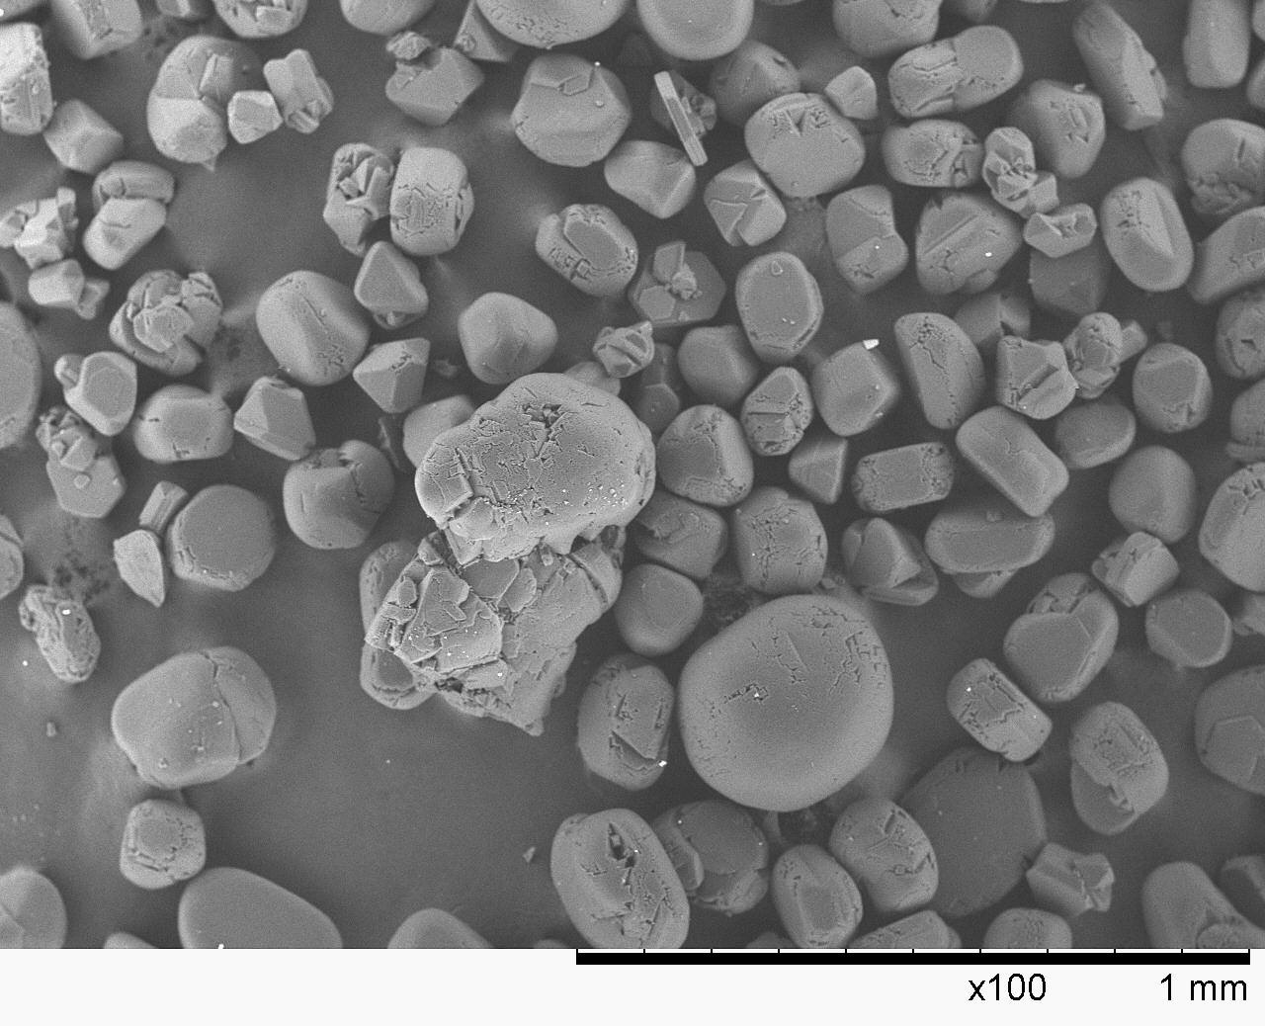
The C₆₀ cage
• The cage is a truncated icosahedron: 12 pentagons and 20 hexagons form a closed surface.
• Each of the 60 carbon atoms sits at a vertex and bonds to three neighbouring atoms, making 90 carbon–carbon bonds.
• Of the 90 bonds, 30 join two hexagons and 60 join a pentagon to a hexagon.
• No two pentagons share an edge. This isolated-pentagon arrangement helps explain the cage’s stability.
• The image at left is a scanning electron micrograph of fullerite crystals. Each crystal contains many C₆₀ molecules.
C60 FULLERENE | 4
Notes:
Image: Ludvig14, “C60 SEM.jpg,” fullerite crystals under scanning electron microscopy, Wikimedia Commons, CC BY-SA 3.0, https://commons.wikimedia.org/wiki/File:C60_SEM.jpg. Cage geometry and isolated-pentagon arrangement: Nobel Prize in Chemistry 1996, https://www.nobelprize.org/prizes/chemistry/1996/press/; RSC, “Symmetry of buckminsterfullerene,” https://edu.rsc.org/.

Slide 5
Bonding and curvature
• Each carbon is approximately sp²-hybridised and forms three sigma bonds with its neighbours.
• One p orbital remains on each atom. Their overlap forms a delocalised π-electron system around the cage.
• The cage bends the carbon network. This curvature strains the bonds and makes C₆₀ more chemically reactive than flat graphene.
• The two bond types are unequal: 6–6 bonds are shorter than 5–6 bonds.
• The delocalised electrons also help C₆₀ accept electrons from other materials, a useful feature in electronic research.
C60 FULLERENE | 5
Notes:
Bonding and fullerene functionalisation: H. Lin and Y. Matsuo, “Functionalization of [60]fullerene through fullerene cation intermediates,” Chemical Communications (2018), https://doi.org/10.1039/C8CC05965A; Chang, Xu and von Delius, “Recent advances in supramolecular fullerene chemistry,” Chemical Society Reviews (2024), https://doi.org/10.1039/D2CS00937D.

Slide 6
Physical and electrical properties
• Pure C₆₀ has a molecular mass of about 720.66 g mol⁻¹. A single molecule is about 0.7 nanometres across.
• Bulk samples appear dark brown to black. In a crystal, separate C₆₀ cages are held together mainly by weak intermolecular attractions.
• C₆₀ dissolves poorly in water but dissolves in some non-polar organic solvents. Its solutions are often purple or magenta.
• Pure solid C₆₀ is a semiconductor. Adding metal atoms between the cages can change its electrical behaviour.
• The observed properties depend on whether C₆₀ is isolated, crystallised, chemically modified or combined with another material.
C60 FULLERENE | 6
Notes:
Molecular mass and solvent properties: PubChem, https://pubchem.ncbi.nlm.nih.gov/compound/Buckminsterfullerene. Solid-state orientational transition: W. I. F. David et al., “Structural Phase Transitions in the Fullerene C₆₀,” Europhysics Letters 18 (1992), 219, https://doi.org/10.1209/0295-5075/18/3/006.

Slide 7
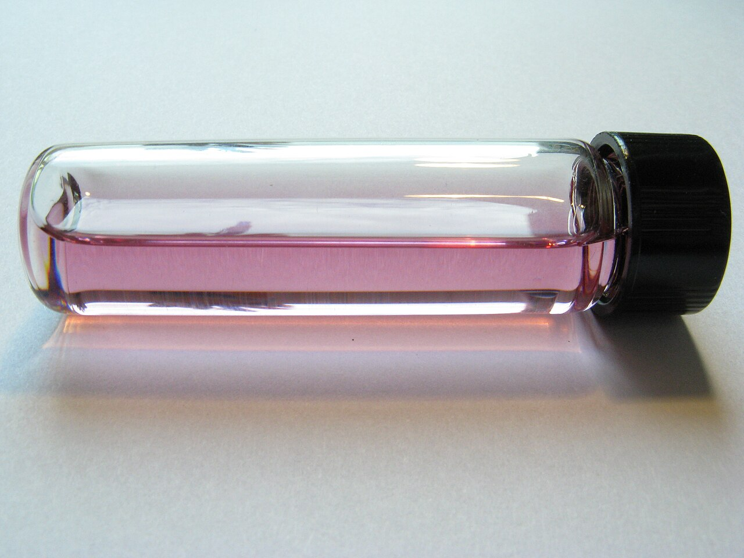
From fullerite to solution
• When C₆₀ molecules pack into a crystal, the solid is called fullerite.
• The carbon atoms remain bonded within each cage. Neighbouring cages interact through weaker intermolecular forces.
• Above about 260 K, the molecules reorient within the crystal. Cooling through this transition makes their orientations more ordered.
• C₆₀ is poorly soluble in water, but some organic solvents dissolve it and produce a purple solution.
• Dissolving C₆₀ separates the molecules in the liquid but leaves each covalent cage intact.
C₆₀ dissolved in an organic solvent
Photo: Alpha six / Wikimedia Commons
C60 FULLERENE | 7
Notes:
Image: Alpha six, “C60 Fullerene solution.jpg,” Wikimedia Commons, CC BY-SA 2.0, https://commons.wikimedia.org/wiki/File:C60_Fullerene_solution.jpg. Solution and solid-state properties: PubChem, https://pubchem.ncbi.nlm.nih.gov/compound/Buckminsterfullerene; David et al., “Structural Phase Transitions in the Fullerene C₆₀,” https://doi.org/10.1209/0295-5075/18/3/006.

Slide 8
How C₆₀ was discovered
• In 1985, Harold Kroto, Robert Curl, Richard Smalley and their students studied carbon clusters made by vaporising graphite with a laser.
• Mass spectrometry revealed a particularly abundant, stable cluster containing 60 carbon atoms.
• The researchers proposed a closed cage made from pentagons and hexagons. Its geometry resembled the geodesic domes associated with architect Buckminster Fuller.
• The team named the molecule buckminsterfullerene. The discovery established a new family of carbon structures, later called fullerenes.
• Kroto, Curl and Smalley shared the 1996 Nobel Prize in Chemistry for the discovery of fullerenes.
C60 FULLERENE | 8
Notes:
Discovery and Nobel recognition: Nobel Prize in Chemistry 1996, “The discovery of carbon atoms bound in the form of a ball,” https://www.nobelprize.org/prizes/chemistry/1996/press/.

Slide 9
Producing and isolating C₆₀
• The 1985 laser experiment made tiny amounts of C₆₀, enough to detect clusters but not to study bulk material.
• In 1990, Krätschmer, Lamb, Fostiropoulos and Huffman reported a practical route to larger quantities using an electric arc between graphite electrodes.
• The carbon vapour cools in an inert gas and forms soot containing C₆₀, C₇₀ and other carbon clusters.
• Researchers extract the fullerenes from the soot with an organic solvent, then separate C₆₀ from other fullerenes.
• Mass spectrometry and spectroscopy help identify the products and check their purity.
C60 FULLERENE | 9
Notes:
Bulk synthesis: W. Krätschmer et al., “Solid C₆₀: a new form of carbon,” Nature 347 (1990), 354–358, https://www.nature.com/articles/347354a0; Nobel Prize in Chemistry 1996, https://www.nobelprize.org/prizes/chemistry/1996/press/.

Slide 10
Chemical modification
• C₆₀ accepts electrons readily, so it can be reduced to negatively charged fulleride ions under suitable conditions.
• Chemists can add atoms or chemical groups across bonds in the cage. These addition reactions produce fullerene derivatives.
• A derivative can be easier to dissolve or mix with another material than unmodified C₆₀.
• The number and position of added groups affect a derivative’s shape, solubility and electronic behaviour.
• Functionalisation lets researchers tune C₆₀ for a particular experiment or material, but each new derivative must be tested on its own.
C60 FULLERENE | 10
Notes:
Functionalisation and fullerene chemistry: H. Lin and Y. Matsuo, Chemical Communications (2018), https://doi.org/10.1039/C8CC05965A; X. Chang, Y. Xu and M. von Delius, Chemical Society Reviews (2024), https://doi.org/10.1039/D2CS00937D.

Slide 11
C₆₀ in materials research
• Organic solar cells: C₆₀ derivatives such as PCBM have served as electron acceptors in polymer-based cells.
• In these devices, light creates excited charges in a donor material. A fullerene acceptor can help separate and transport electrons.
• Fullerene acceptors were widely used in earlier organic photovoltaics. Newer non-fullerene acceptors offer more control over light absorption and molecular design.
• C₆₀ and its derivatives remain useful in research on thin films, transistors, charge transfer and composite materials.
• These are material-specific uses. The performance of a device depends on the derivative, mixture, processing and device structure.
C60 FULLERENE | 11
Notes:
Fullerene acceptors in organic photovoltaics: RSC, “Critical review of the molecular design progress in non-fullerene electron acceptors towards commercially viable organic solar cells,” https://pubs.rsc.org/en/content/articlehtml/2019/cs/c7cs00892a. Current fullerene functionalisation and applications: Chang, Xu and von Delius, Chemical Society Reviews (2024), https://doi.org/10.1039/D2CS00937D.

Slide 12
Biomedical research and safety
• Researchers have studied water-compatible fullerene derivatives for drug delivery, imaging and interactions with reactive oxygen species.
• Unmodified C₆₀ is hydrophobic and poorly soluble in water. Scientists therefore change its surface chemistry or carry it in a host material.
• A modification can change how a fullerene behaves in light, in water and in biological systems. Results for one derivative do not automatically apply to another.
• Safety findings depend on dose, particle size, purity, aggregation, surface groups and route of exposure.
• These topics remain research areas. Ordinary C₆₀ powder is not an approved medicine.
C60 FULLERENE | 12
Notes:
Biomedical fullerene research: “Biological applications of hydrophilic C60 derivatives,” PubMed, https://pubmed.ncbi.nlm.nih.gov/27049677/; “Biomedical applications of functionalized fullerene-based nanomaterials,” PubMed, https://pubmed.ncbi.nlm.nih.gov/20011243/.

Slide 13
Comparing carbon allotropes
Allotrope | Carbon arrangement | Typical property
Diamond | 3D tetrahedral network; each carbon bonds to four others | Very hard; electrical insulator
Graphite | Stacked hexagonal sheets; each carbon bonds to three others | Conducts along sheets; layers slide
Graphene | One atom-thick sheet of hexagonal carbon rings | Strong, light and electrically conductive
C₆₀ fullerene | Separate 60-atom cages; three bonds per carbon | Molecular solid; accepts electrons
C60 FULLERENE | 13
Notes:
Carbon allotrope comparison: Royal Society of Chemistry, “Symmetry of buckminsterfullerene,” https://edu.rsc.org/; Nobel Prize in Chemistry 1996, https://www.nobelprize.org/prizes/chemistry/1996/press/.

Slide 14
What makes C₆₀ distinctive?
• C₆₀ is a carbon allotrope built as a molecule, rather than an extended sheet or three-dimensional network.
• Its 12 pentagons close the cage; its 20 hexagons complete the football-like surface.
• Covalent bonds hold each cage together, while weaker forces hold neighbouring cages in fullerite crystals.
• Its curved electron system makes C₆₀ a useful electron acceptor and a versatile starting point for chemical modification.
• The clearest applications so far are in materials research. Biomedical uses depend on modified compounds and remain under study.
C60 FULLERENE | 14

Slide 15
Sources and image credits
• Royal Society of Chemistry, “Symmetry of buckminsterfullerene,” edu.rsc.org
• PubChem, “Buckminsterfullerene (C₆₀),” pubchem.ncbi.nlm.nih.gov/compound/Buckminsterfullerene
• Nobel Prize in Chemistry 1996, “The discovery of carbon atoms bound in the form of a ball,” nobelprize.org
• Krätschmer et al., “Solid C₆₀: a new form of carbon,” Nature 347 (1990), 354–358
• David et al., “Structural Phase Transitions in the Fullerene C₆₀,” Europhysics Letters 18 (1992), 219
• Chang, Xu and von Delius, “Recent advances in supramolecular fullerene chemistry,” Chemical Society Reviews (2024)
• UCL Mathematical and Physical Sciences, C₆₀ model photo, Wikimedia Commons, CC BY 2.0
• R. M. Lavinsky, graphite and diamond specimens, Wikimedia Commons, CC BY-SA 3.0
• Capkuckokos, graphene flakes SEM, Wikimedia Commons, CC BY-SA 4.0
• Ludvig14, fullerite C₆₀ SEM, Wikimedia Commons, CC BY-SA 3.0
• Alpha six, C₆₀ solution photo, Wikimedia Commons, CC BY-SA 2.0
C60 FULLERENE | 15
Notes:
Primary and review sources are linked on this slide. Photo credits and licenses are recorded in the notes of their corresponding slides.

