Slide 1
Marketing Intelligence
DECISION THESIS
Scale what is measurable.
Experiment where it is uncertain.
Govern every model decision.
From media spend to defensible growth decisions
ABC Retail Sales Analysis | Team Lead, Data Intelligence case study
Prepared by Abinash Sahu
13 August 2026
Notes:
[Sources] - ABC Retail Sales Analysis - Case Study.docx (user-supplied case brief) - Retail Sales Case Study.xlsx (user-supplied dataset; 36 monthly observations and quarterly GDP) [/Sources] [Sources] - Job Description - Team Lead - Data Intelligence.pdf (user-supplied) [/Sources]

Slide 2
Executive answer
The evidence points to a focused, test-and-learn media strategy, not an across-the-board increase.
SCALE
VALIDATE
HOLD
MONITOR
DIGITAL
RADIO
TV
GDP / COVID
Strongest driver
Positive association
No detected lift
No independent signal
β = 0.82
β = 0.57
β = -0.04
p > 0.56
Leadership recommendation
Protect and optimize Digital investment.
Use a controlled experiment to confirm Radio incrementality.
Do not add TV budget until tracking, units and lift are validated.
Treat the model as a decision aid; 36 observations are not causal proof.
Model: Adj. R² 0.85 | LOOCV R² 0.73 | MAE $33.7M
Notes:
[Sources] - ABC Retail Sales Analysis - Case Study.docx (user-supplied case brief) - Retail Sales Case Study.xlsx (user-supplied dataset; 36 monthly observations and quarterly GDP) [/Sources]

Slide 3
A senior-lead approach: decision first, model second
The workflow explicitly separates data quality, inference, prediction and business action.
1
2
3
4
5
6
FRAME
AUDIT
ENGINEER
ESTIMATE
CHALLENGE
ACT
What decision changes?
Units, grain, missingness
GDP, COVID phases, trend
OLS + HC3 inference
LOOCV Ridge sanity check
Scale, test, hold
Why this is credible
HC3 robust errors reduce sensitivity to unequal variance. Standardized coefficients compare channels on a common scale. Leave-one-out validation tests whether fit survives when each month is unseen. Recommendations retain an explicit causal caveat.
Python stack: pandas, statsmodels, scikit-learn and matplotlib. Reproducible source code included.
Notes:
[Sources] - ABC Retail Sales Analysis - Case Study.docx (user-supplied case brief) - Retail Sales Case Study.xlsx (user-supplied dataset; 36 monthly observations and quarterly GDP) [/Sources]

Slide 4
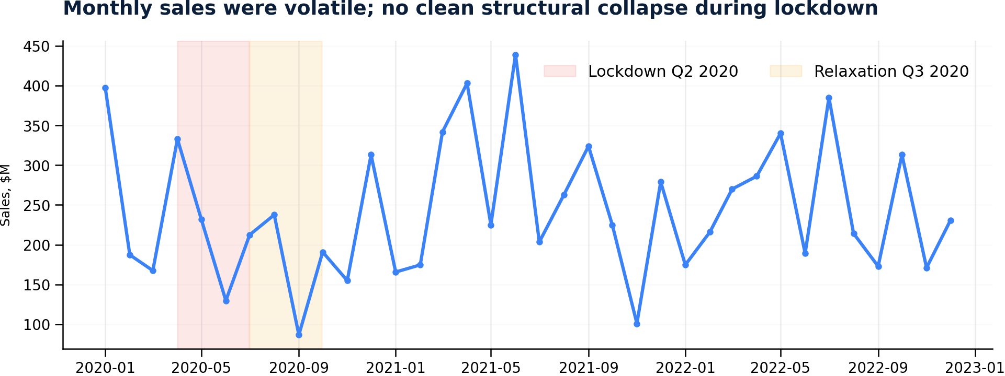
Sales are volatile, with no simple COVID break
Q3 2020 was weaker than lockdown Q2, but media spend also fell sharply.
Observed phase averages
Lockdown Q2-20
$231.6M
avg/month
Relaxation Q3-20
$178.8M
avg/month
Other months
$250.6M
avg/month
Interpretation
The timing alone cannot isolate a COVID effect. Marketing mix and omitted retail drivers changed simultaneously.
Notes:
[Sources] - ABC Retail Sales Analysis - Case Study.docx (user-supplied case brief) - Retail Sales Case Study.xlsx (user-supplied dataset; 36 monthly observations and quarterly GDP) [/Sources]

Slide 5
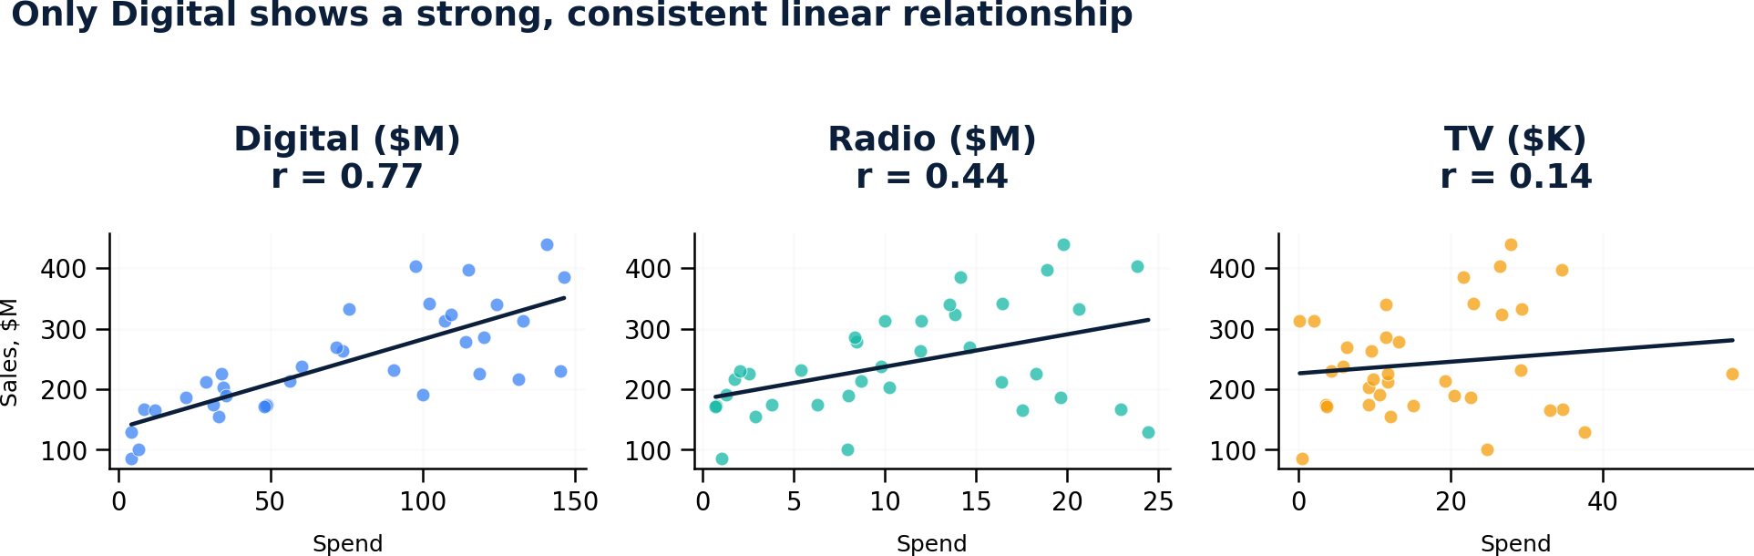
Digital is the clearest channel signal
Raw relationships show Digital is strong, Radio is moderate and TV is weak.
Business read: prioritize Digital optimization, validate Radio with experiments, and diagnose TV measurement before further investment.
Notes:
[Sources] - ABC Retail Sales Analysis - Case Study.docx (user-supplied case brief) - Retail Sales Case Study.xlsx (user-supplied dataset; 36 monthly observations and quarterly GDP) [/Sources]

Slide 6
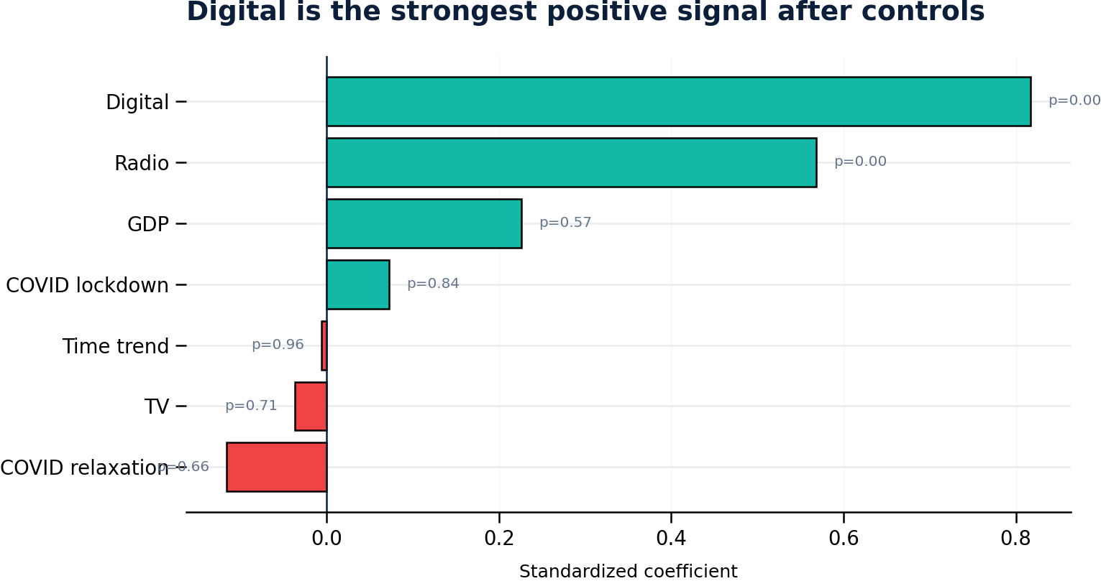
The controlled model confirms the ranking
Standardized effects include GDP, COVID phases and trend; p-values use HC3 robust errors.
Interpretation by channel
DIGITAL
Largest stable positive effect; coefficient remains highly significant after controls.
RADIO
Positive and significant, but causal lift still requires a holdout design.
TV
Near-zero standardized effect with wide uncertainty. “No evidence” is not proof of no effect.
Robustness
Adj. R² 0.85; leave-one-out R² 0.73. Predictive signal survives out-of-sample testing.
Notes:
[Sources] - ABC Retail Sales Analysis - Case Study.docx (user-supplied case brief) - Retail Sales Case Study.xlsx (user-supplied dataset; 36 monthly observations and quarterly GDP) [/Sources]

Slide 7
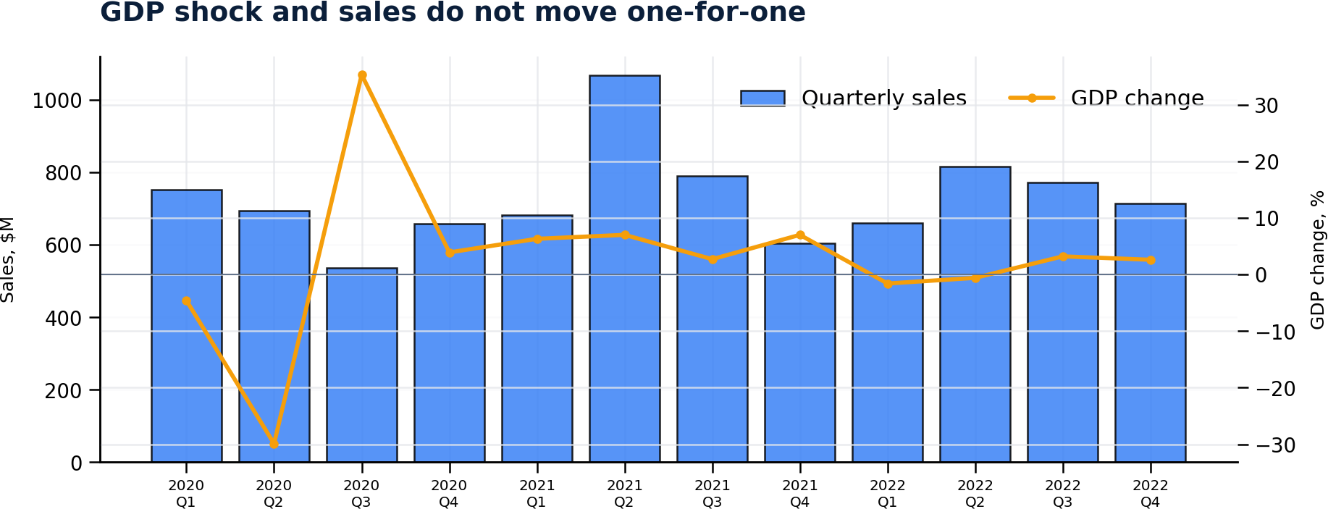
GDP and COVID do not add reliable explanatory power
The extreme Q2/Q3 2020 GDP swing does not map consistently to quarterly sales.
Controlled estimates
GDP
p = 0.57
Not significant
Lockdown
p = 0.84
Not significant
Relaxation
p = 0.66
Not significant
What leaders should conclude
Macro conditions matter conceptually, but this small sample cannot identify an independent effect. Add inflation, unemployment, mobility and consumer sentiment only after increasing history and controlling seasonality.
Notes:
[Sources] - ABC Retail Sales Analysis - Case Study.docx (user-supplied case brief) - Retail Sales Case Study.xlsx (user-supplied dataset; 36 monthly observations and quarterly GDP) [/Sources]

Slide 8
Convert evidence into a governed budget decision
The recommendation is staged to protect growth while creating causal learning.
NOW
TEST
HOLD
Protect Digital
Validate Radio
Diagnose TV
Maintain core spend; optimize audience, creative and conversion.
Run geo or audience holdouts; predefine incremental revenue KPI.
Pause incremental budget; verify the “thousands” unit and tracking.
Decision guardrail
Do not present regression coefficients as guaranteed ROI. Approve budget changes only with confidence ranges, test design, owner, expected benefit and rollback trigger.
Notes:
[Sources] - ABC Retail Sales Analysis - Case Study.docx (user-supplied case brief) - Retail Sales Case Study.xlsx (user-supplied dataset; 36 monthly observations and quarterly GDP) [/Sources]

Slide 9
Productize the analysis as an AI decision agent
A SaaS-style prototype connects governed data, models, explanations and leadership actions.
DATA CONTRACT
FEATURE LAYER
MODEL FACTORY
AI ANALYST
DECISION UI
Spend, sales, price, promo
Lag, carryover, saturation
MMM, forecasts, experiments
Explain, challenge, simulate
Approve, monitor, learn
Explainability
Governance
Monitoring
Reuse
Coefficient ranges, driver lineage
Human approval and audit trail
Drift, data quality and SLA alerts
One semantic model for BI and AI
The included HTML prototype demonstrates the executive cockpit and scenario sandbox.
Notes:
[Sources] - Job Description - Team Lead - Data Intelligence.pdf (user-supplied) [/Sources] [Sources] - ABC Retail Sales Analysis - Case Study.docx (user-supplied case brief) - Retail Sales Case Study.xlsx (user-supplied dataset; 36 monthly observations and quarterly GDP) [/Sources]

Slide 10
MLOps and operating model make the solution scalable
This directly addresses production reliability, team leadership and stakeholder adoption.
BUSINESS
Category / Marketing
Define decision, KPI and test
Monthly value review
DATA
Engineering / IT
Trusted pipeline and contracts
Data quality SLA
SCIENCE
Analysts / DS
Model, validate, explain
Model card + peer review
PLATFORM
Fabric / MLOps
Deploy, monitor, retrain
Drift + retraining trigger
Team Lead cadence
Weekly delivery stand-up | Fortnightly model review | Monthly stakeholder value review | Quarterly roadmap and capability plan
Notes:
[Sources] - Job Description - Team Lead - Data Intelligence.pdf (user-supplied) [/Sources]

Slide 11
What I would improve before production
The current model is useful for prioritization; the next data layer enables causality and optimization.
Required data backlog
Production model design
HISTORY
24–36 more months
Adstock for delayed media impact.
Saturation curves for diminishing returns.
Hierarchical model by region or category.
Experiment calibration for causal lift.
Prediction intervals and scenario constraints.
Automated drift, retraining and approval workflow.
COMMERCIAL
Price, promotion, inventory, distribution
MEDIA
Impressions, reach, creative, audience, campaign
MARKET
Holiday, weather, competitors, inflation, mobility
EXPERIMENT
Geo-cell or customer holdout outcomes
Critical leadership behavior: make uncertainty visible instead of hiding it behind a single ROI number.
Notes:
[Sources] - ABC Retail Sales Analysis - Case Study.docx (user-supplied case brief) - Retail Sales Case Study.xlsx (user-supplied dataset; 36 monthly observations and quarterly GDP) [/Sources] [Sources] - Job Description - Team Lead - Data Intelligence.pdf (user-supplied) [/Sources]

Slide 12
90-day execution plan
Deliver immediate decision value while building the foundation for a reusable capability.
0–30 DAYS
31–60 DAYS
61–90 DAYS
Stabilize
Prove
Scale
Validate units and definitions
Create KPI dictionary
Automate monthly ingestion
Design Digital / Radio tests
Add price and promotion
Launch prototype cockpit
Production MMM proof of value
Set model monitoring
Train analysts and stakeholders
Success measures: faster insight cycle | test-backed budget decisions | reusable semantic model | monitored production adoption
Notes:
[Sources] - Job Description - Team Lead - Data Intelligence.pdf (user-supplied) [/Sources] [Sources] - ABC Retail Sales Analysis - Case Study.docx (user-supplied case brief) - Retail Sales Case Study.xlsx (user-supplied dataset; 36 monthly observations and quarterly GDP) [/Sources]

Slide 13
The answer is not “spend more.”
It is to scale the strongest evidence, test uncertainty, and institutionalize learning.
DIGITAL
RADIO
TV
Scale
Validate
Hold
Thank you
Abinash Sahu
Notes:
[Sources] - ABC Retail Sales Analysis - Case Study.docx (user-supplied case brief) - Retail Sales Case Study.xlsx (user-supplied dataset; 36 monthly observations and quarterly GDP) [/Sources]

