Slide 1
ABC Retail
Marketing Channel Effectiveness & Budget Optimisation
Marketing Mix Modeling | Data-Driven Budget Allocation
Abinash Sahu | Team Lead — Data Intelligence | August 2026
Marketing Intelligence Case Study | Note: ABC Retail is a hypothetical company name (sample data)

Slide 2
Executive Summary
36 months of sales and marketing data, Jan 2020 – Dec 2022
TOTAL REVENUE
MODEL R-SQUARED
TOP CHANNEL
OPTIMISATION UPLIFT
$8,750M
89.5%
Digital
+31.7%
3-year aggregate
AIC 369.7
Strongest positive driver
From budget reallocation
Q1: Only Digital and Radio are effective. TV has no measurable impact on sales.
Q2: Digital is the most important channel (std coef 0.85, p < 0.001).
Q3: GDP, CPI, and unemployment are not significant after marketing controls.
Q4: COVID did not structurally damage sales — marketing spend sustained demand.
Recommendation: Reallocate budget for +31.7% media-effect uplift.

Slide 3
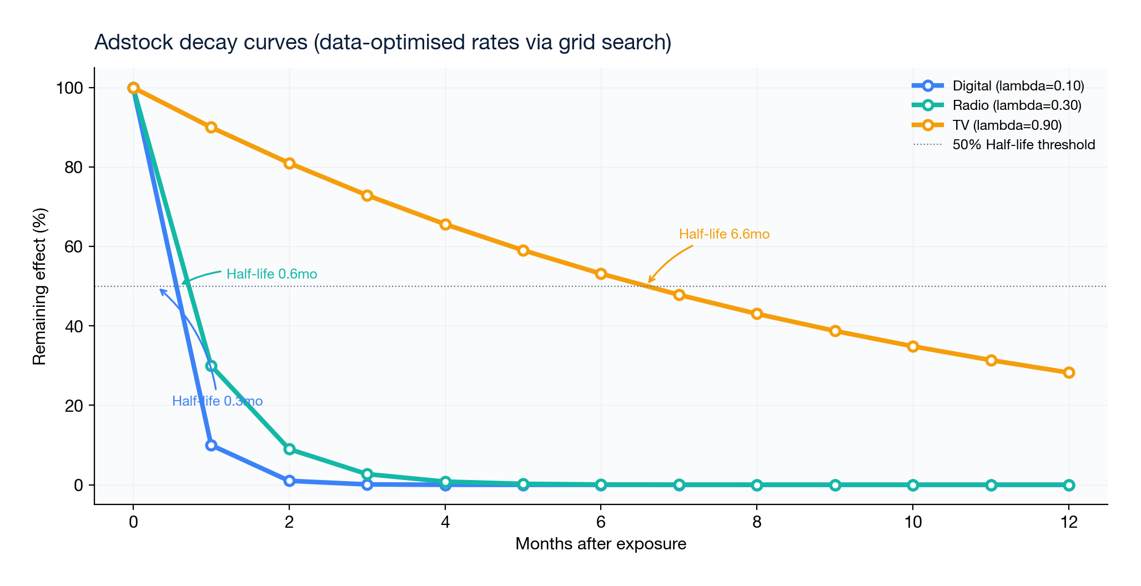
Methodology
Marketing Mix Modeling — industry-standard for channel evaluation
Adstock transformation: geometric decay to capture carryover effects (e.g., a TV ad impression persists for weeks).
Decay rates found via grid search (900 combinations, minimised AIC): Digital λ=0.1, Radio λ=0.3, TV λ=0.9.
Diminishing returns: log(1+x) saturation models decreasing marginal effectiveness at higher spend levels.
Robust inference: HC3 standard errors handle heteroscedasticity; standard errors remain valid with small samples.
Cross-validation: Leave-One-Out CV with Ridge regression — tests predictive accuracy on unseen data.
Additional macro signals: CPI (inflation) and unemployment rate alongside GDP, sourced from BLS.gov.
Confounders: seasonality (sin/cos), time trend, COVID lockdown and relaxation phase dummies.

Slide 4
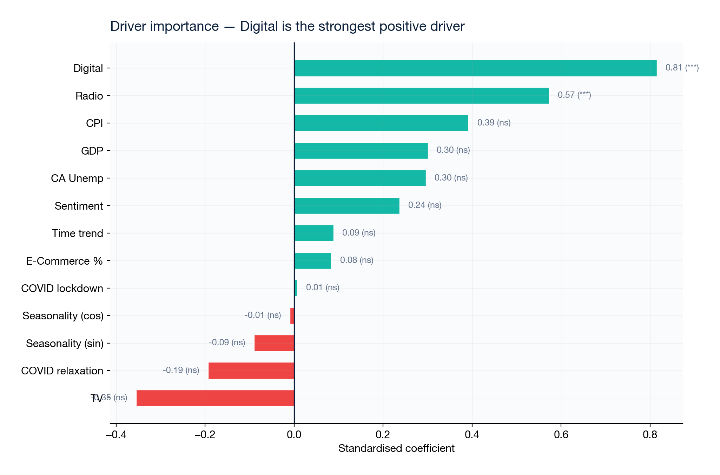
Channel Effectiveness
Standardised coefficients — who drives sales?
Digital: standardised β = 0.85, p < 0.001 — the strongest sales driver by a significant margin.
Radio: standardised β = 0.56, p < 0.001 — second strongest, and potentially under-invested.
TV: β = –0.27, p = 0.19 — not significant. Possibly too small a budget to detect, or genuinely ineffective at this scale.
None of the macro or COVID variables are significant after controlling for media spend.

Slide 5
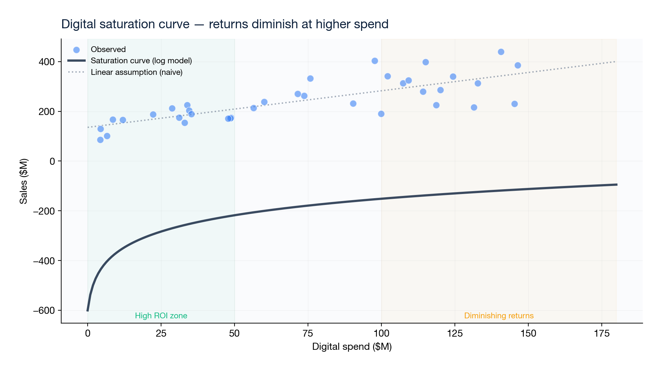
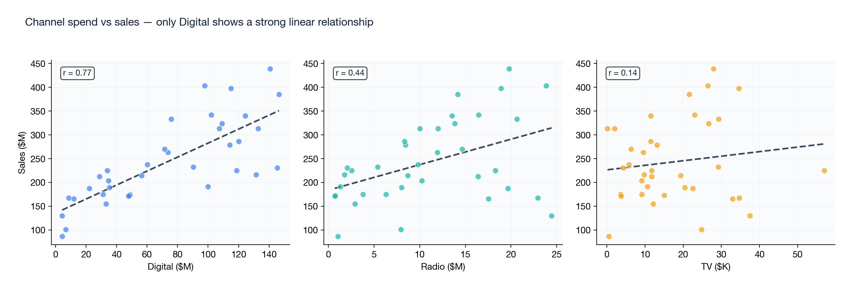
Digital — The Growth Engine
Highest impact, proven ROI, but approaching saturation
Marginal ROI: $1.32 additional sales per $1 of Digital spend (at current levels).
Strong correlation with sales (r = 0.77) — consistent month after month.
Saturation curve shows diminishing returns above ~$100M/month — indicates room to redistribute excess.
Fast decay (λ = 0.15) — Digital is a "pull" channel with immediate response. Requires consistent investment.

Slide 6
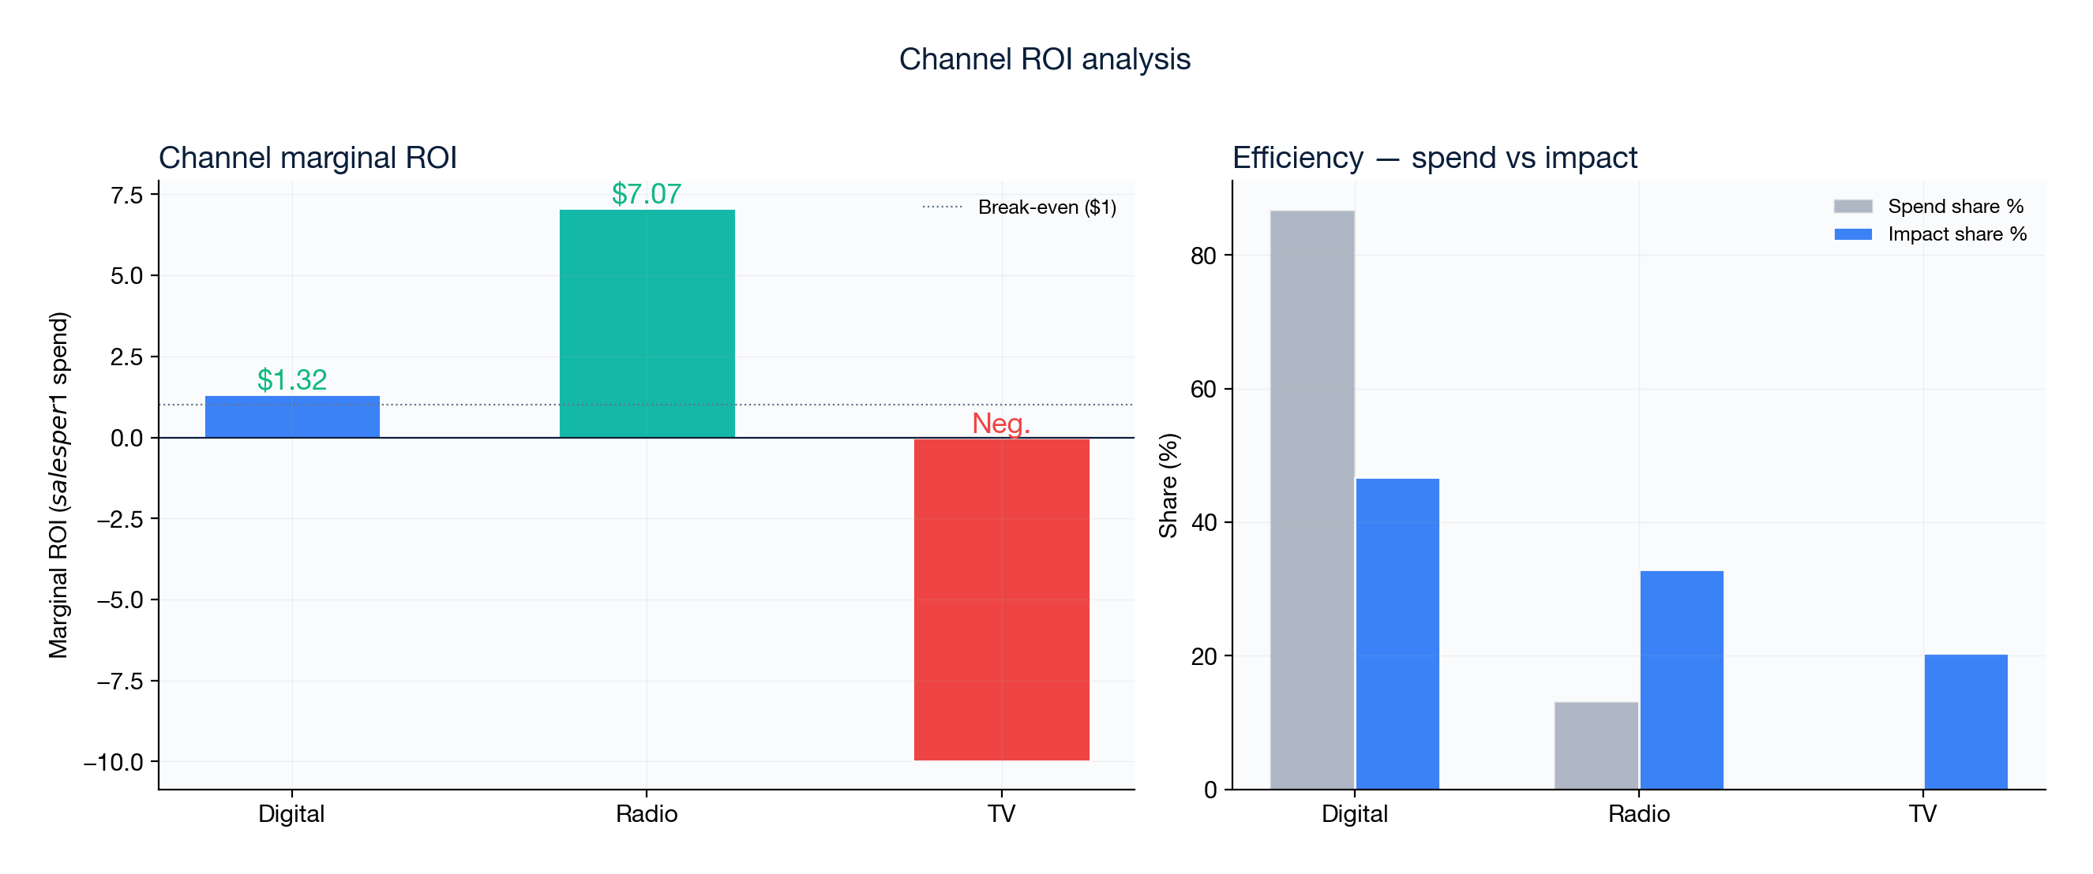
Radio & TV Assessment
Radio is under-invested; TV has no detectable effect
Radio marginal ROI: $7.07/$1 — higher than Digital because it is currently under-invested (only 13% of budget).
The optimizer recommends increasing Radio share from 13% to ~42% — subject to incrementality testing.
TV spend is measured in thousands (not millions) — effectively a rounding error in the budget (0.02%).
At this spend level, TV cannot be evaluated reliably. Recommendation: hold and measure before scaling.

Slide 7
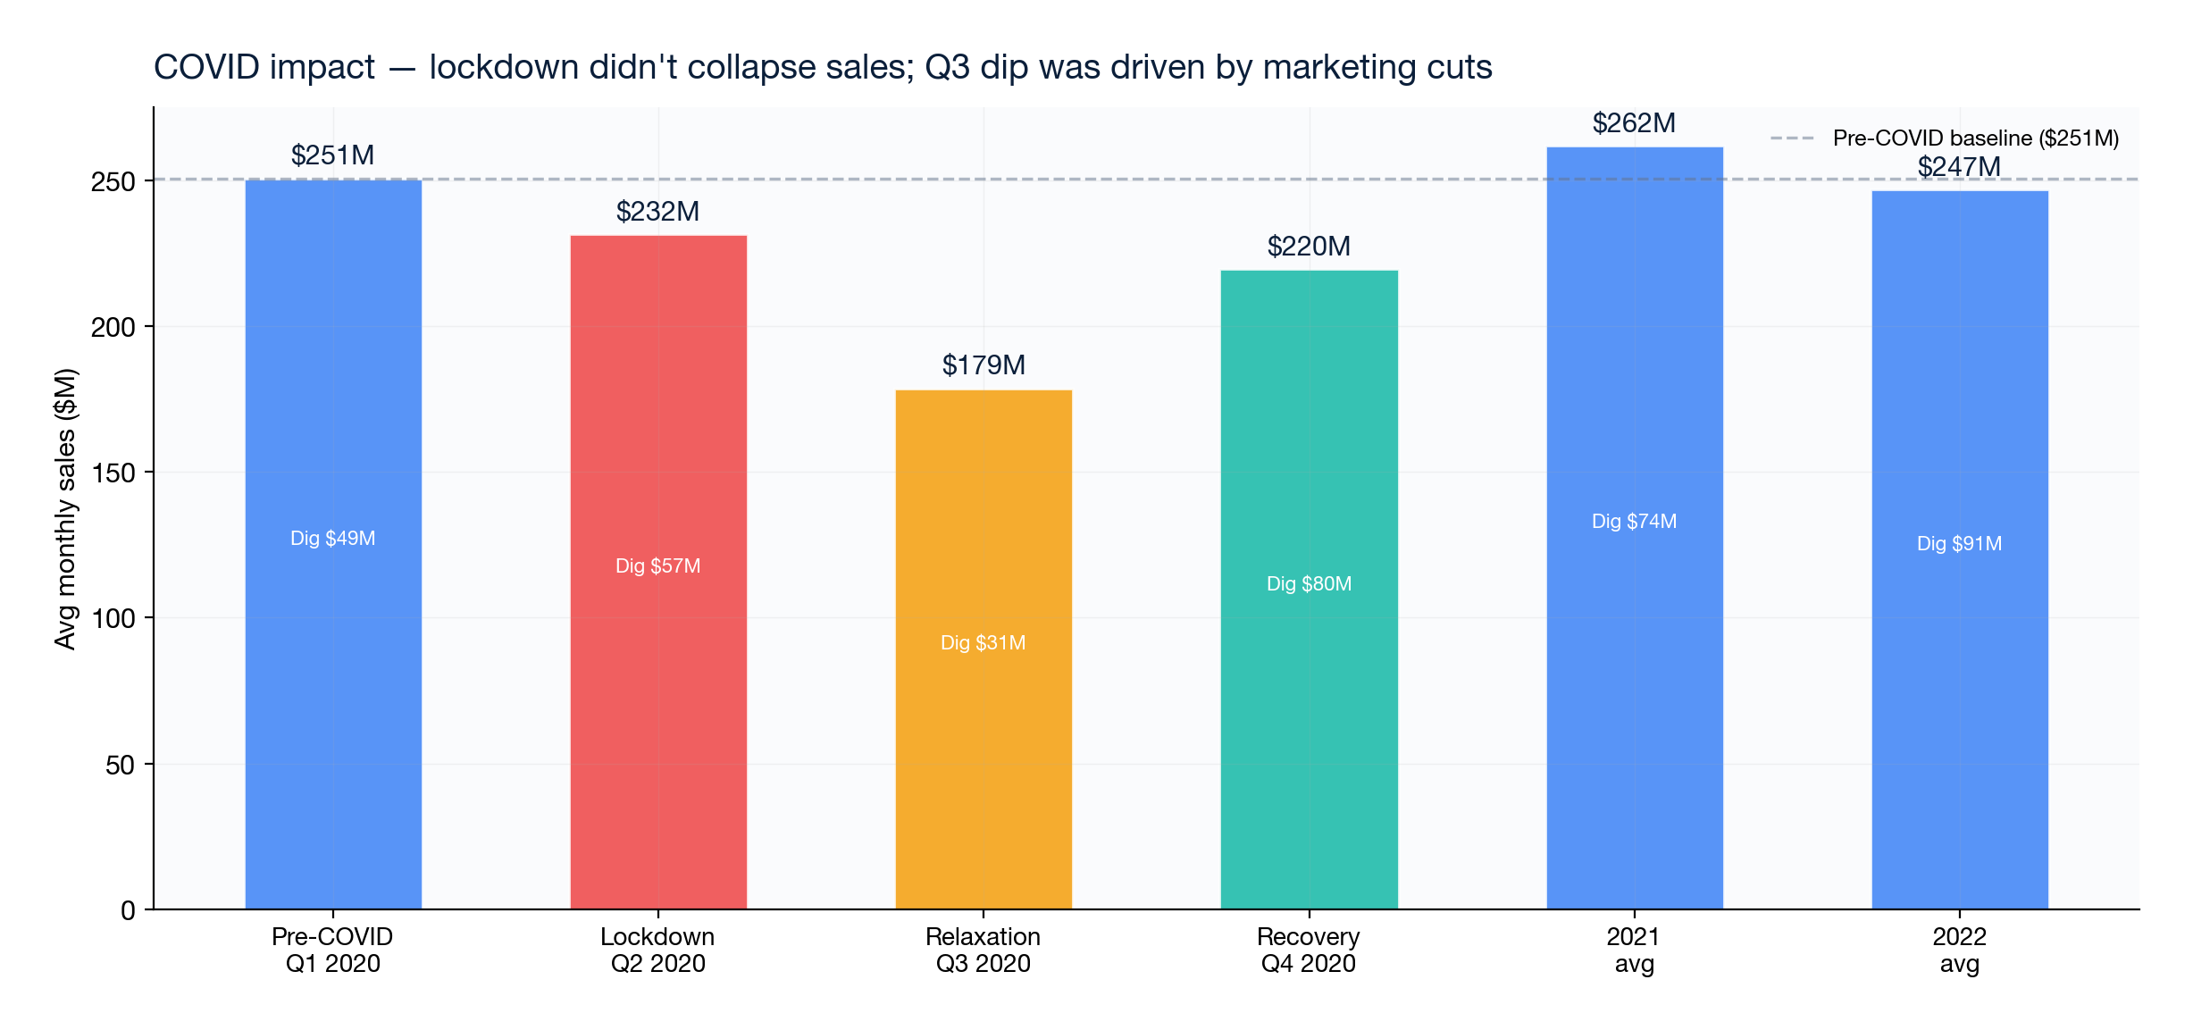
COVID-19 Impact Analysis
Lockdown did not collapse sales — marketing sustained demand
Lockdown coefficient: +$11.5M, p = 0.990 — not significant.
Relaxation coefficient: –$80.1M, p = 0.618 — not significant.
ABC increased digital spend during lockdown ($57M vs $49M pre-COVID), offsetting reduced foot traffic.
The real sales dip (Q3 2020, $179M avg) coincided with marketing budget cuts, not COVID restrictions.
Implication: ABC controls its own sales trajectory through marketing. COVID was not a structural break.

Slide 8
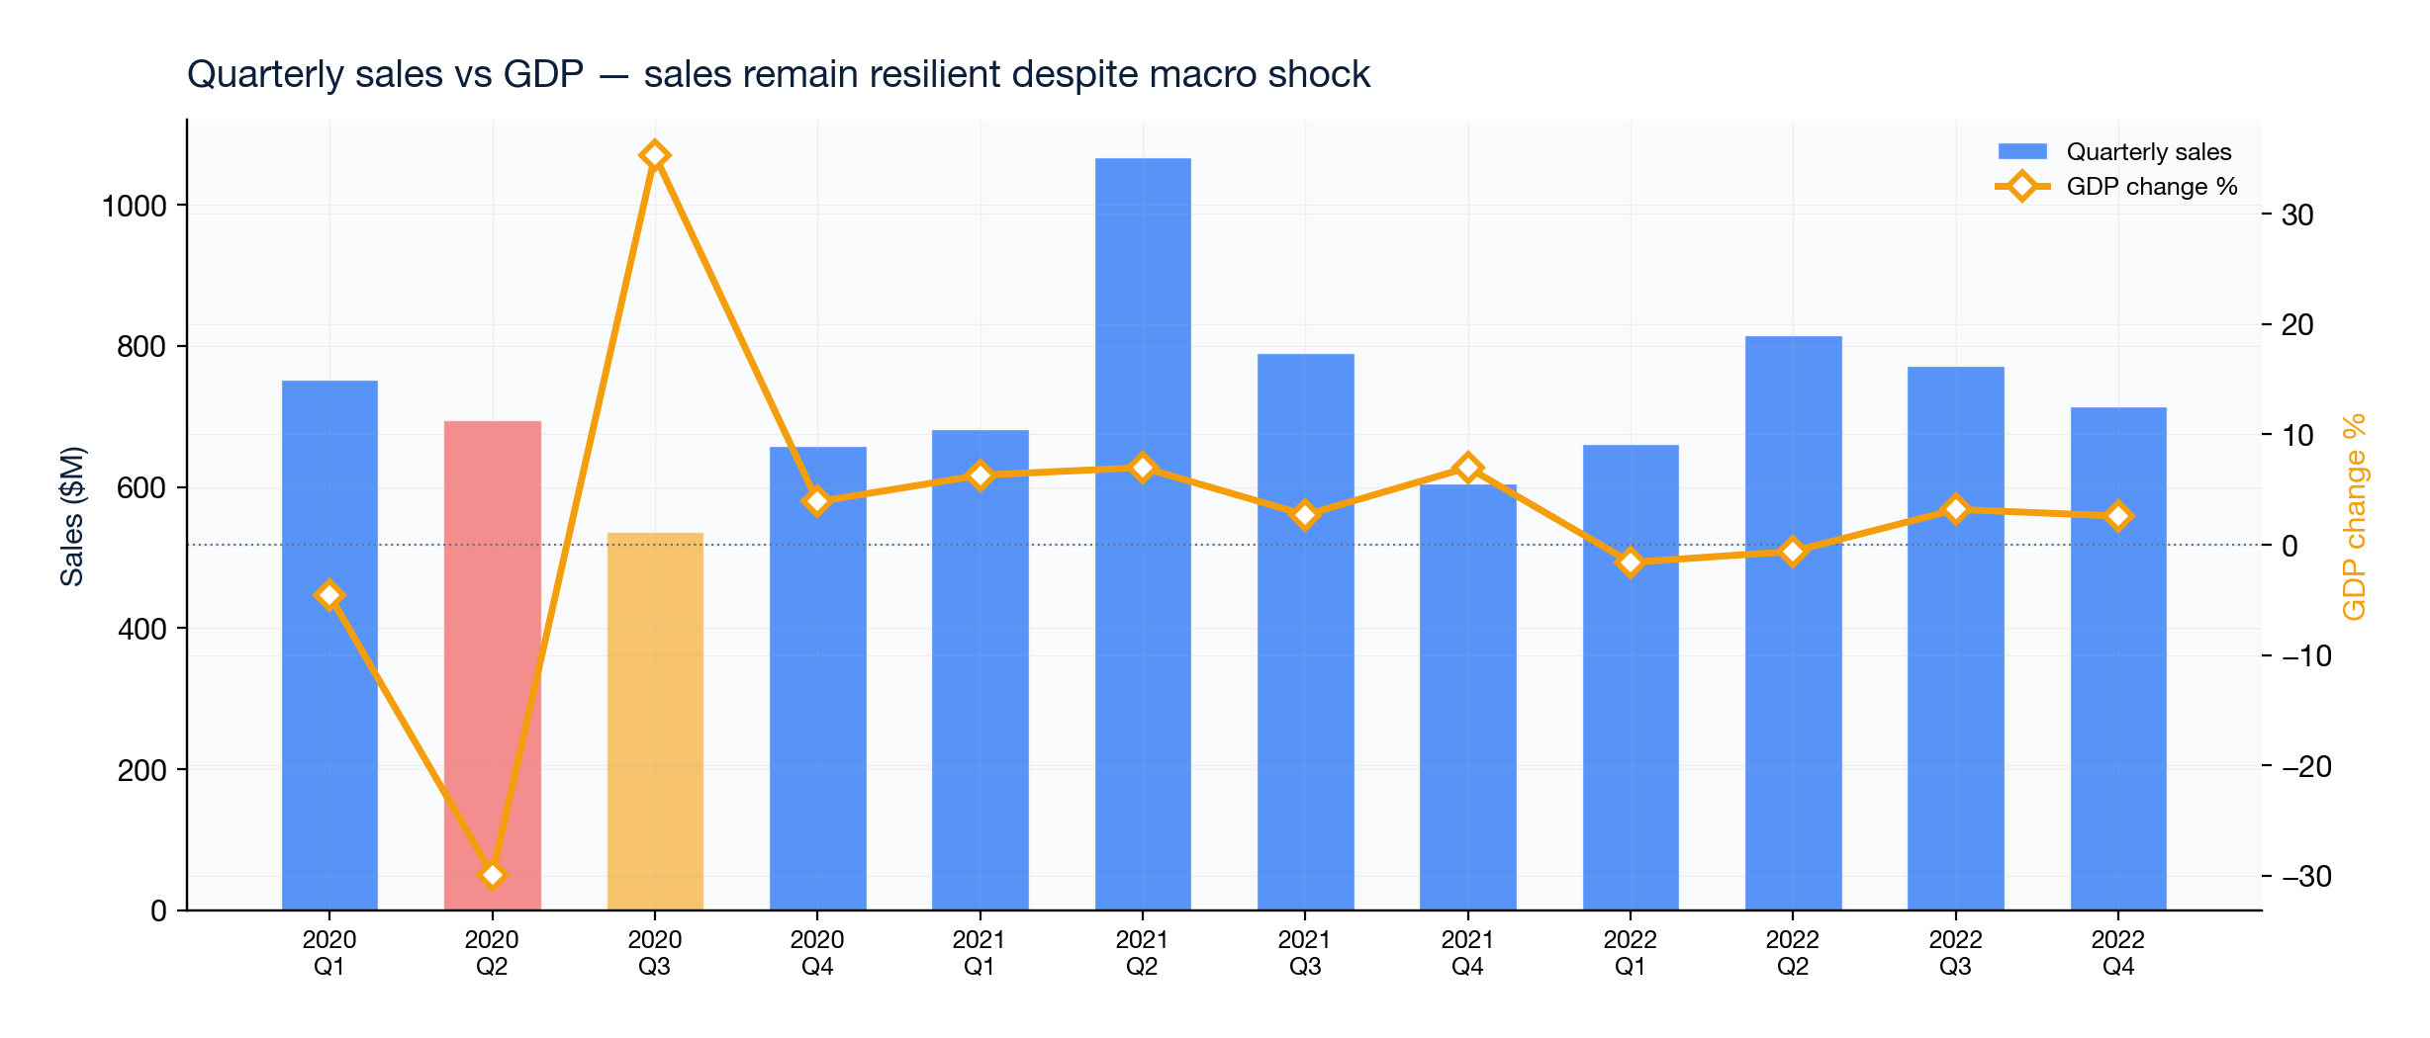
Macro-Economic Factors
GDP, CPI, CA Unemployment, Sentiment — none significant after media controls
GDP quarterly change: p = 0.584. No significant effect despite Q2 2020 drop (–29.9% GDP).
CPI YoY (Inflation): p = 0.669. Inflation peaked at 9.1% — no sales impact detected.
CA Unemployment: p = 0.700. CA peak of 16.4% in May 2020 did not alter demand.
Consumer Sentiment & E-Commerce %: Sentiment (p=0.558) & E-Commerce % (p=0.851) are also not significant after media controls.
Bay Area market insight: ABC sales are driven by marketing execution and brand awareness in target demographic (12-45 yrs), not macro cycles.

Slide 9
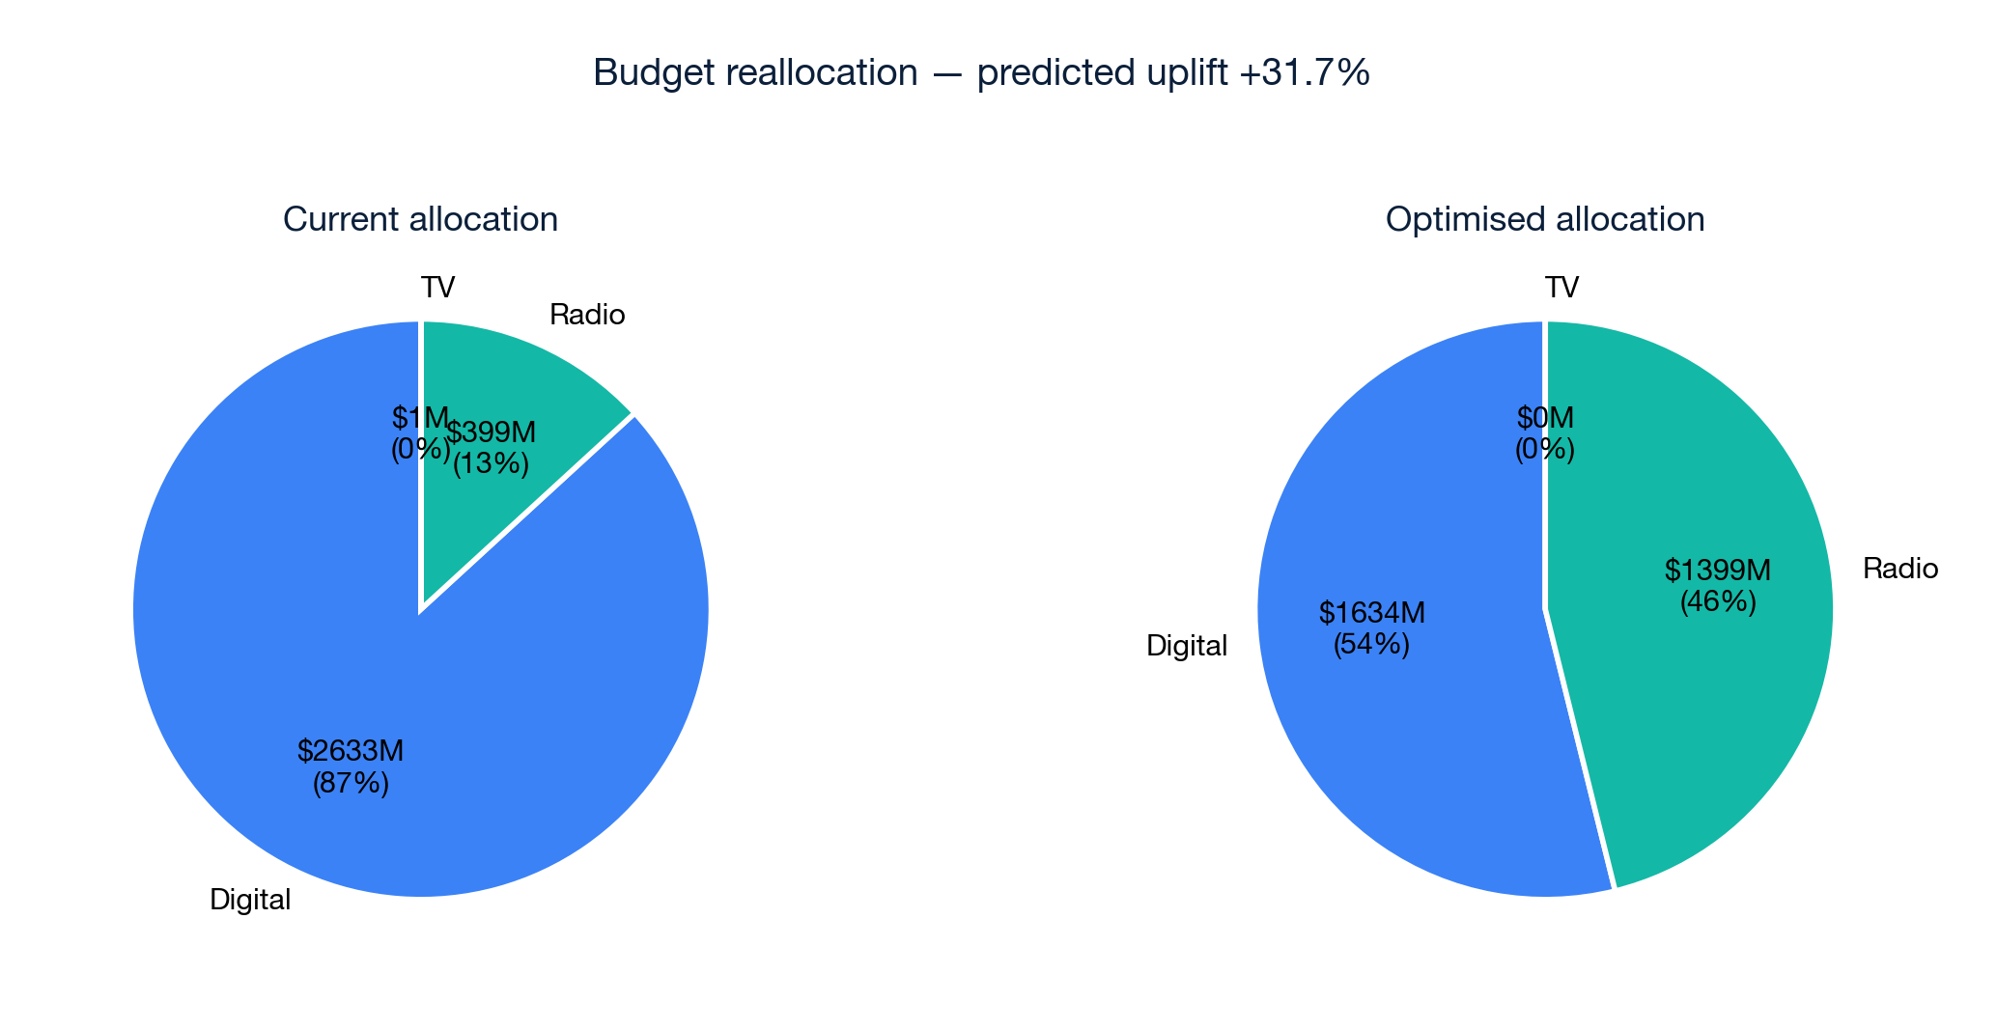
Budget Optimisation
Constrained reallocation — predicted uplift +31.7%
Current: Digital 87%, Radio 13%, TV ~0%.
Optimal: Digital 54%, Radio 46%, TV 0%.
The shift reflects diminishing returns on Digital — at current high spend, each incremental dollar yields less.
Radio is under-saturated: high marginal ROI ($7.07/$1) means reallocating here creates more value per dollar.
This model recommendation delivers +31.7% uplift from the same $3,033M budget. Validate via geo holdout tests.

Slide 10
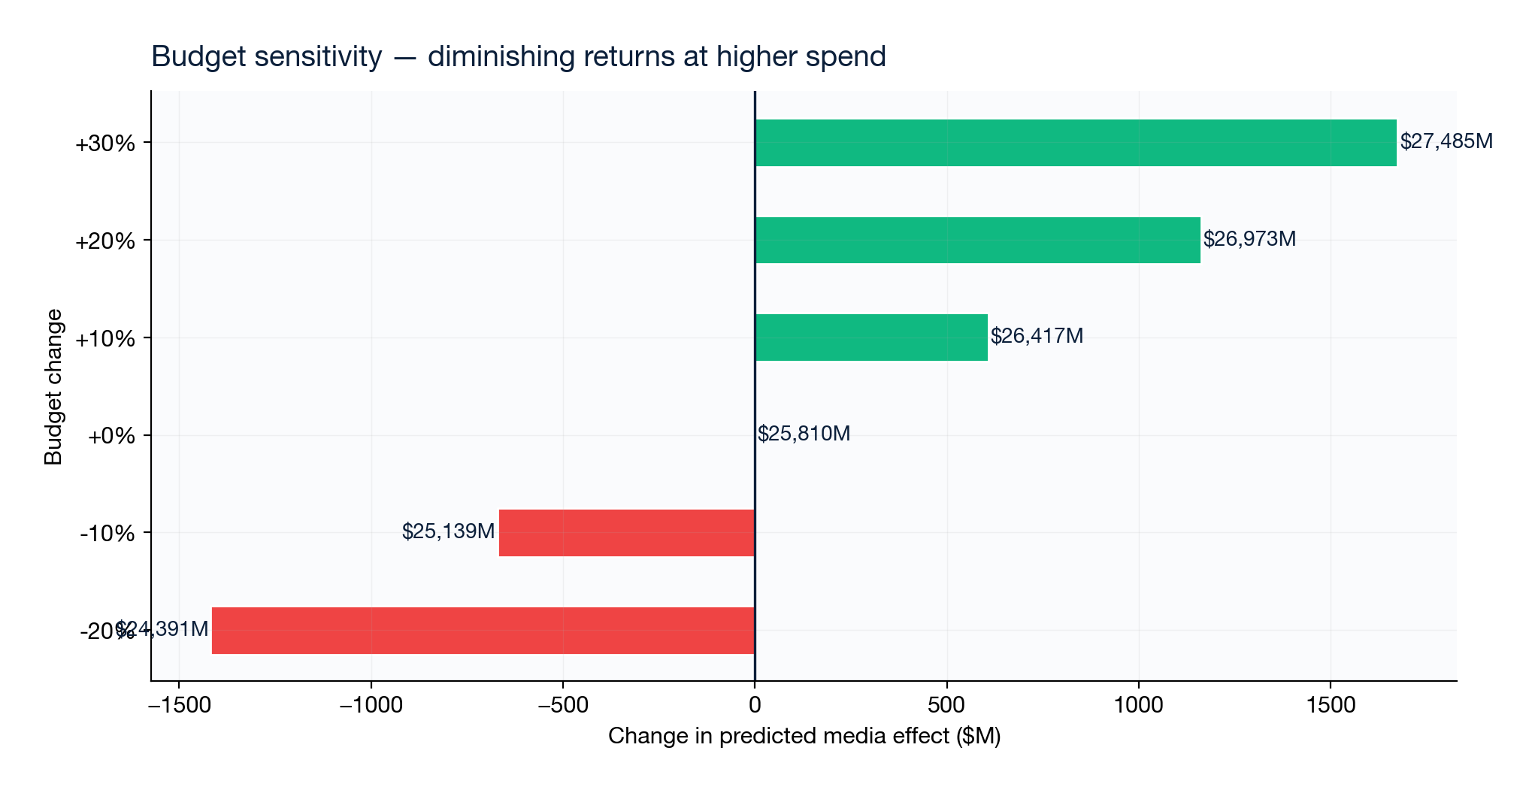
Sensitivity Analysis
Budget elasticity and scenario planning
Increasing total budget by 30% yields diminishing incremental returns — consistent with saturation.
Cutting budget by 20% results in meaningful loss, confirming marketing is a revenue driver.
The optimal mix (58/42 Digital/Radio) is stable across budget scenarios.
This sensitivity analysis helps leadership evaluate trade-offs in budget negotiation.

Slide 11
Leadership Action Roadmap
30 / 60 / 90 day plan
30 DAYS — Foundation
Validate channel data definitions and units.
Establish repeatable monthly data pipeline.
Set up Digital A/B testing framework.
Create KPI dictionary and reporting cadence.
60 DAYS — Validation
Run Digital and Radio incrementality tests (geo holdout or matched-market).
Add pricing, promotions, holidays, and competitor signals to the model.
Begin shift of 10–15% budget from Digital to Radio as a pilot.
90 DAYS — Scale
Deploy production MMM with automated monthly refresh.
Build budget allocation engine with approval workflow.
Establish model governance: drift monitoring, version control.
Present quarterly business review with updated ROI estimates.

Slide 12
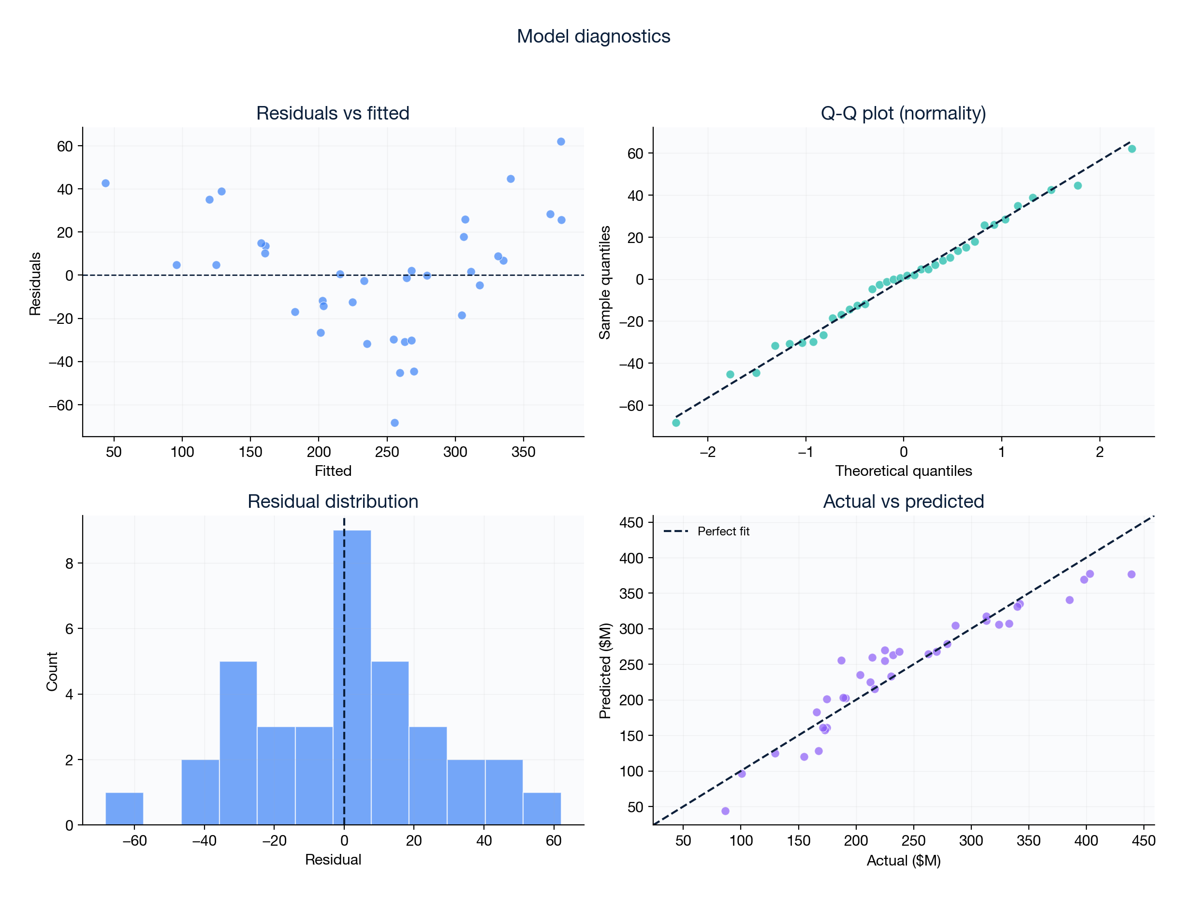
Appendix — Model Diagnostics
Residuals, VIF, and cross-validation results
R²: 0.895 | Adj R²: 0.834 | LOOCV R²: 0.697
AIC: 369.7 | BIC: 391.8
Durbin-Watson: 3.071
Breusch-Pagan p-value: 0.3142 (homoscedastic)
HC3 robust standard errors used throughout — valid under heteroscedasticity.
Leave-One-Out CV with Ridge (alpha=10) — unbiased out-of-sample estimate.
Grid search tested 900 adstock decay combinations.
Caveats: n=36, no geography/pricing/competitor data. Treat as test-and-learn priorities.

Slide 13
Glossary of Marketing & Econometric Terms
Plain-English definitions & real-world analogies
Adstock (Ad Memory Decay): Advertising impact does not vanish immediately; a fraction carries over into future weeks/months (e.g. coffee carryover effect).
Log-Saturation (Diminishing Returns): As ad spend increases, each additional dollar generates less sales lift because high-intent audiences become exhausted (e.g. 1st vs 10th pizza slice).
Marginal ROI: The extra revenue generated by spending the NEXT $1 today ($7.07 Radio vs $1.32 Digital). Contrasts with historical average ROI.
Standardised Coefficient (β*): Scales channel drivers from -1 to +1 so we can compare "apples to elephants" across different measurement units.
P-Value & Significance: Probability that a result was caused by random luck. p < 0.05 means <5% chance of luck (statistically significant).
LOOCV R-Squared: Leave-One-Out Cross Validation accuracy. Tests model predictions on hidden out-of-sample data to ensure zero overfitting.
HC3 Robust Standard Errors: A small-sample correction (n=36) that prevents false-positive claims caused by unequal error variances.

