Slide 1
AI in Legacy Code
Small Steps, Deterministic Tools, Reusable Context

Slide 2
Types of knowledge
PROFICIENCY
FLUENCY
AWARENESS

Slide 3
The idea
We are going to
clean up some code.

Slide 4
Which repo?
01
CsvHelper
C# · CSV reading and writing
02
FluentValidation
C# · Validation rules
03
Serilog
C# · Structured logging
04
Apache Commons Text
Java · String utilities

Slide 5
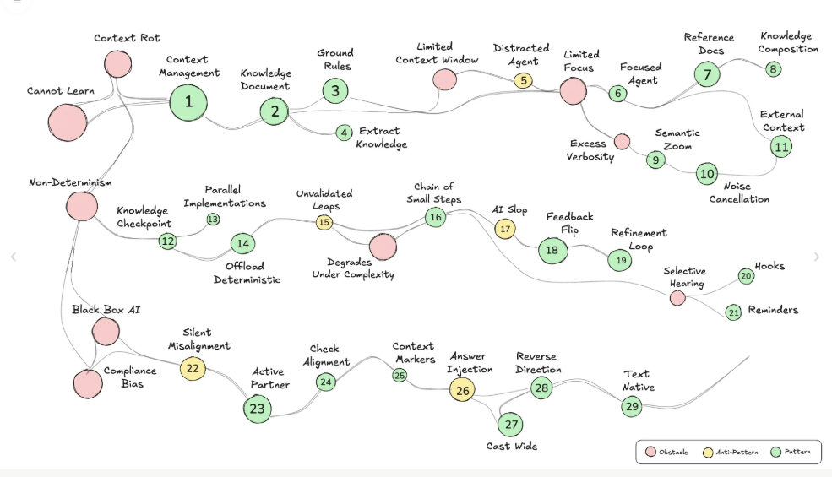

Lada Kesseler

Slide 7
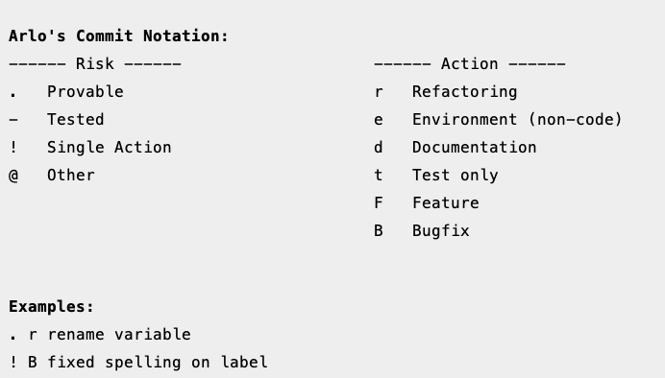
Arlo’s Commit Notation

Slide 10
./tools/

Slide 11
#!/bin/bash
# Create a commit message: <risk char> <intention char> <message>
#
# Usage: create-commit-message.sh RISK INTENTION MESSAGE
# See InternalDocuments/commit_notation.md for the names.
set -e
name=$(basename "$0")
fail() {
echo "$name: error: $1" >&2
exit 1
}
if [ $# -ne 3 ]; then
echo "$name: usage: $name risk intention message" >&2
exit 2
fi
risk=$1
intention=$2
message=$3
case "$risk" in
completely_safe) risk_char=. ;;
proven) risk_char=- ;;
single_item) risk_char=! ;;
other) risk_char=@ ;;
*) fail "unrecognized risk '$risk' (expected one of: completely_safe, proven, single_item, other)" ;;
esac
case "$intention" in
environment) intention_char=e ;;
test) intention_char=t ;;
refactor) intention_char=r ;;
feature) intention_char=F ;;
bug) intention_char=B ;;
documentation) intention_char=d ;;
*) fail "unrecognized intention '$intention' (expected one of: environment, test, refactor, feature, bug, documentation)" ;;
esac
# Development environment changes can't break production, whatever the testing.
if [ "$intention" = environment ] && [ "$risk" != completely_safe ]; then
fail "intention '$intention' can't break production, so risk must be completely_safe"
fi18
# Trim leading and trailing whitespace.
message="${message#"${message%%[![:space:]]*}"}"
message="${message%"${message##*[![:space:]]}"}"
[ -n "$message" ] || fail "message is required"
echo "$risk_char $intention_char $message"
create-commit-message.sh

Slide 14
Extract deterministic
01 Committers
02 BuildAndTest
03 Analyzers
04 Refactoring tools
05 Detectors

Slide 15
Extract deterministic · 01
Committers
Committers
BuildAndTest
Analyzers
Refactoring tools
Detectors

Slide 16
Extract deterministic · 02
BuildAndTest
Committers
BuildAndTest
Analyzers
Refactoring tools
Detectors

Slide 17
Extract deterministic · 03
Analyzers
Committers
BuildAndTest
Analyzers
Refactoring tools
Detectors

Slide 18
Extract deterministic · 04
Refactoring tools
Committers
BuildAndTest
Analyzers
Refactoring tools
Detectors

Slide 19
Extract deterministic · 05
Detectors
Committers
BuildAndTest
Analyzers
Refactoring tools
Detectors

Slide 20
Fast feedback
The quick check

Slide 21
Sensors for code smells
Tool
Habit Hooks
Runs your linters, then turns each violation into a coaching guide the agent can act on
github.com/habit-hooks/habit-hooks

Slide 22
Internal documents
Extract knowledge

Slide 23
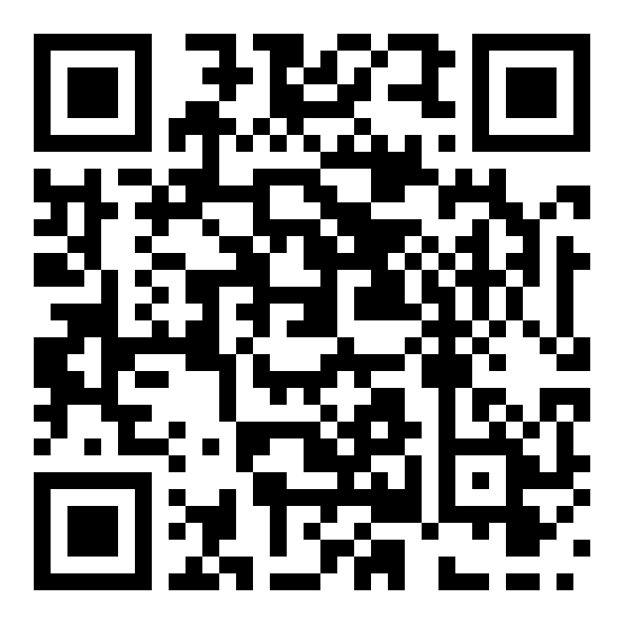

Thank you
Llewellyn Falco
github.com/isidore/Talks/blob/master/AiInLegacyCode.md

Slide 24
Style Guide
Color Palette
#1F3A5F
#415A77
#5A7D5A
#A14B4B
#6B7280
#DCE3EC
Navy
Primary
Slate
Secondary
Green
Accent
Rust
Alert
Gray
Neutral
Light
Text/BG
Typography
Components
Title — 32pt Bold
Card Title
Supporting body text with an accent highlight
Step
Card Header — 18pt Bold
Body Text — 14pt Regular

Slide 25
Design Philosophy
Every choice in this system serves one goal: making complex ideas clear, easy to visualize, and easy to follow
01
Clarity over decoration
Structure carries the meaning.
Color and shape signal hierarchy and state
Never ornament for its own sake.
02
Calm, confident palette
Navy and slate set a steady tone.
Green and rust appear sparingly.
Color marks safe and risk — nothing more.
03
Consistent components
Rounded cards and arrows repeat.
One visual grammar across slides.
Every new slide fits the system.
04
Scannable by design
Lead with the takeaway.
Short lines over dense paragraphs.
Limited attention is a constraint, not an afterthought.

