Slide 1

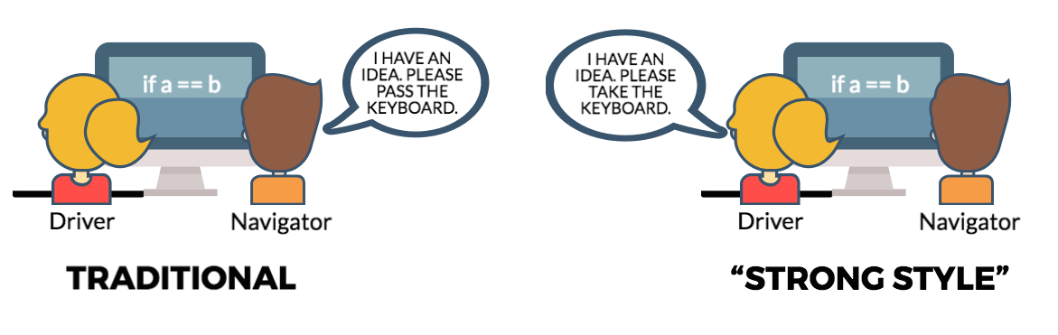
I HAVE AN IDEA PLEASE PASS THE
KEYBOARD
I HAVE AN IDEA PLEASE TAKE THE
KEYBOARD
Typer
(Driver)
Talker
(Navigator)
Typer
(Driver)
Talker
(Navigator)
Pair Programming

Slide 2
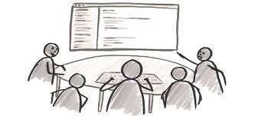
" Mob Programming is all the brilliant people working on the same thing, at the same time, in the same space, on the same computer."
-- Woody Zuill

Slide 3
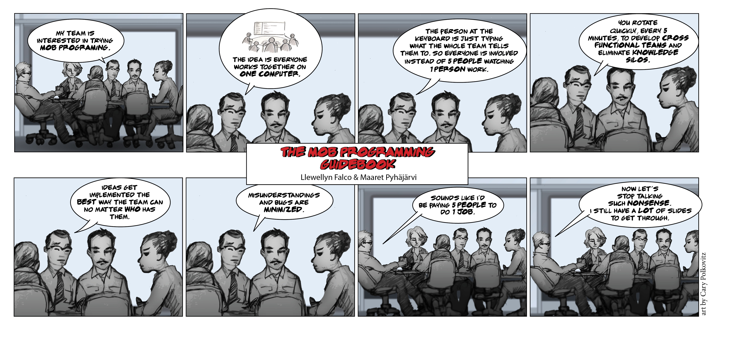

Slide 4

“For an idea to go from your head to the computer it must go through someone else’s hands”
1. Idea
2. speak
3. Type
Strong Style
Pair Programming

Slide 5
Speak at the highest level of abstraction
go down as needed
Intention
Location
Details
- “write a for loop”
- “at line 34 and ½ ”
- “for(int i = 0; ….”

Slide 6
The 5 Whys
Define the Problem
The client refused to pay the progress payment
Why is it Happening?
we completed the activity late
Why is it Happening?
It took longer than we estimated
Why is that?
We couldn’t precure enough material
Why is that?
We didn’t purchase on time
Why is that?
We didn’t analyze the work schedule
Root Cause

Slide 7

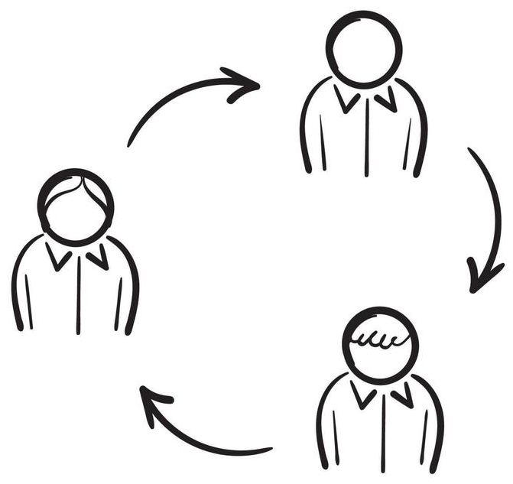
When is the last time you rotated ?
Typer
Rotate
Frequently!
Talker
Observer

Slide 8


Rotation Styles
Let’s try…
Test Complete
On Task
On Time
On Idea

Slide 9

Kindness
Consideration
and
Respect
Working Agreements
Make for better pairs & mobs

Slide 10
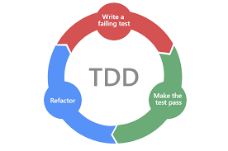
Write a
failing test
Make the
test pass
Refactor

Slide 11
Start Here!
with drawing
and natural language
// Create side (0,0) – (3,4)
// Verify length
Whiteboard
English
Testing Circle
Result
Code
Side (0,0) – (3,4) length = 5
Side s = new Side(0,0,3,4);
Approvals.Verify(s + “ length = “ +s.Length);

Slide 12

When was the last time you ran your tests?
1 minute?
3 minutes?
more?

Slide 13
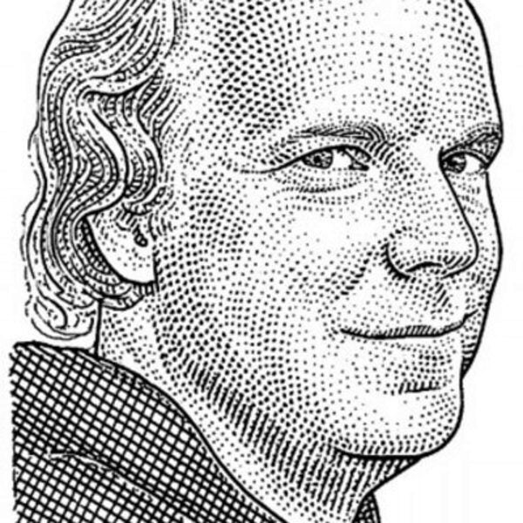
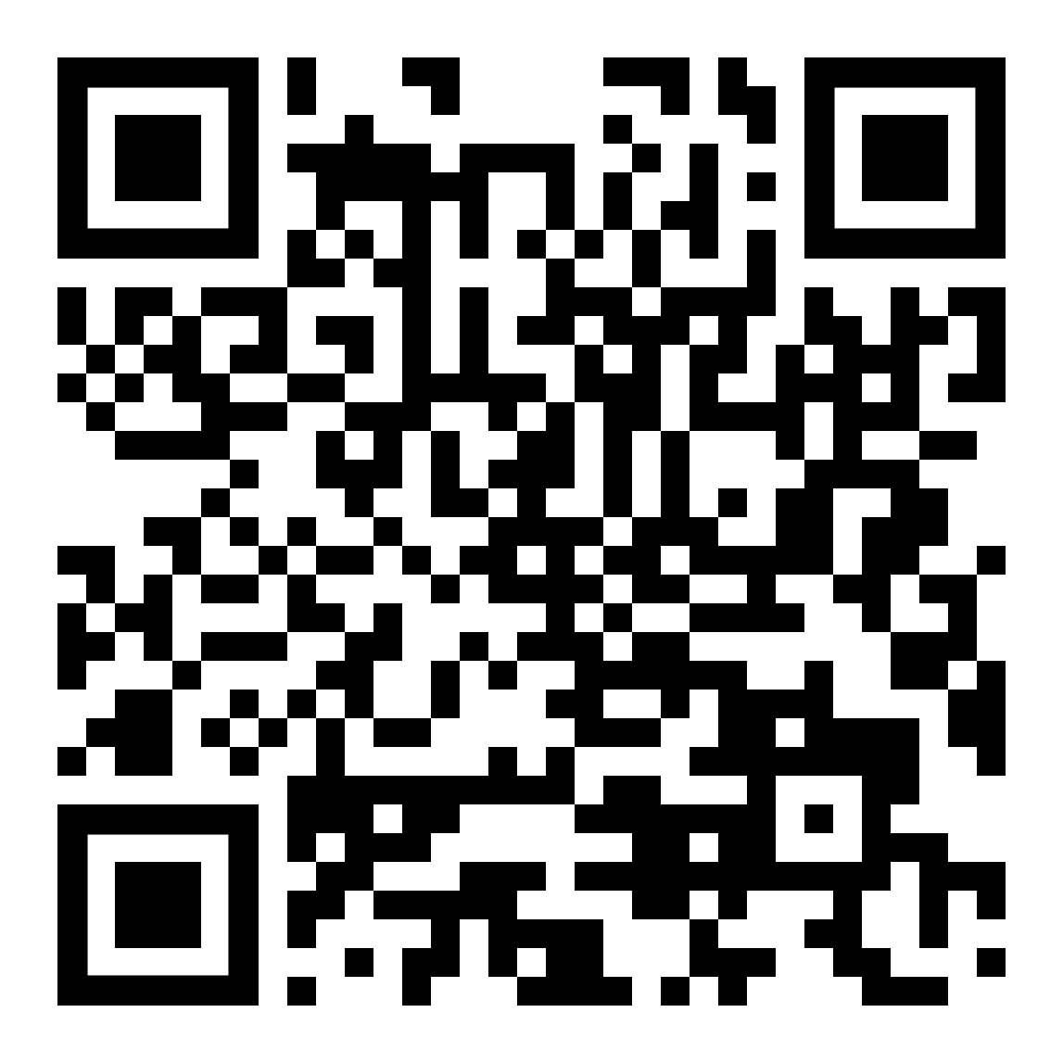
Test && Commit || Revert
(TCR)
Advanced
Technique
What it is
Every time you run your tests, you will either:
Commit everything, because all tests passed
Revert everything (or everything except the test) because it failed
Smaller steps
Faster Feedback
Better safety net
Java starter project
Kent Beck Creator of TCR
& Extreme Programming
github.com/LarsEckart/tcr-extension.starterproject
1

Slide 14
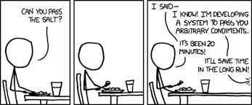
Y A G N I
ou
in’t
xkcd.com
onna
eed
Write the simplest thing
that could possibly work
t

Slide 15
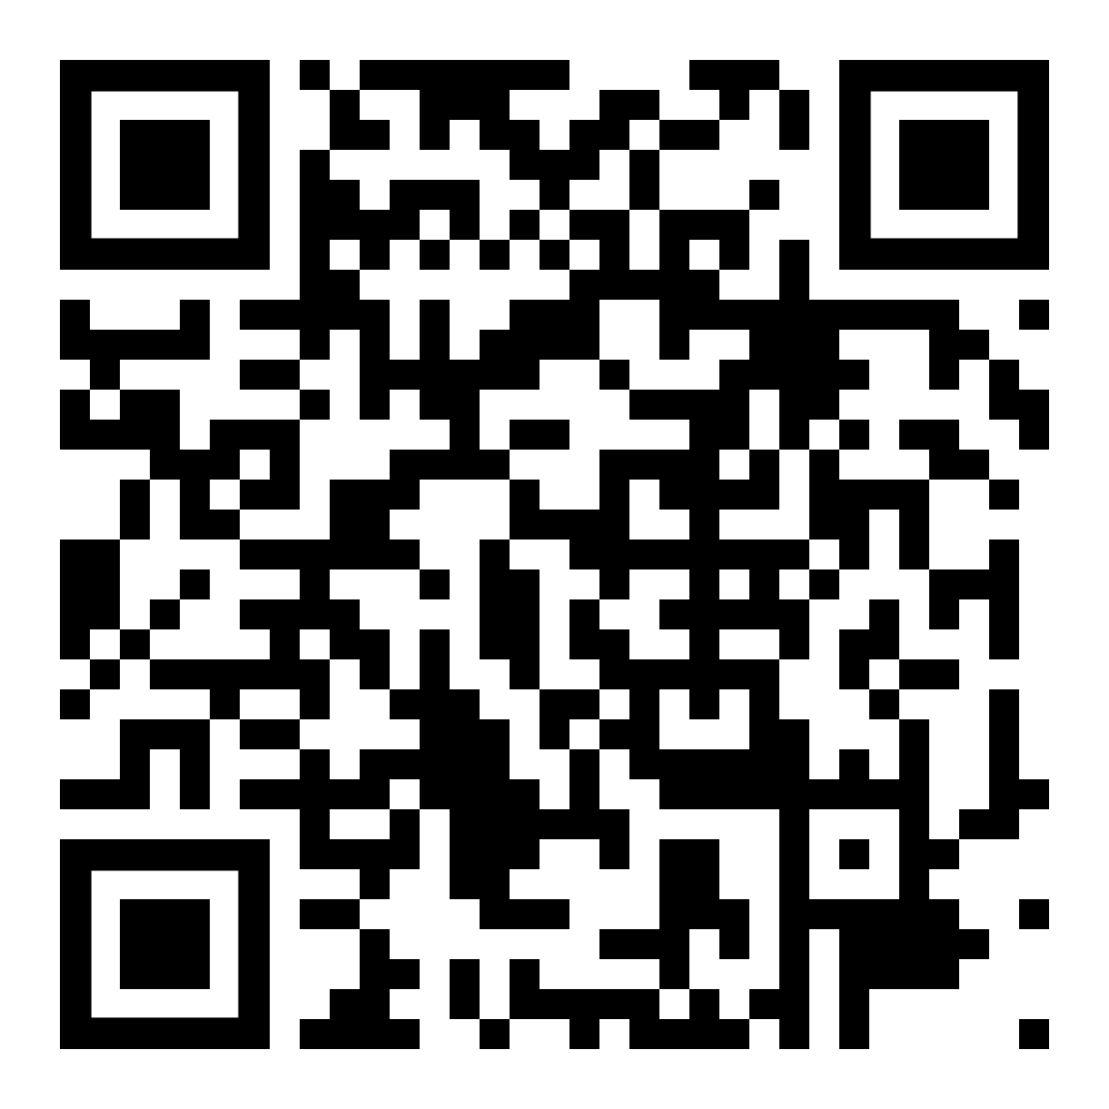
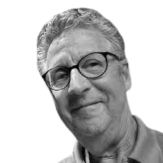
Z
O
M
B
I
E
S
ero
Guide your tests by
looking at these 7 cases
ne
any
oundaries
nterfaces
Blog
xceptions
blog.wingman-sw.com/tdd-guided-by-zombies
Pattern by
James Grenning
cenarios

Slide 16
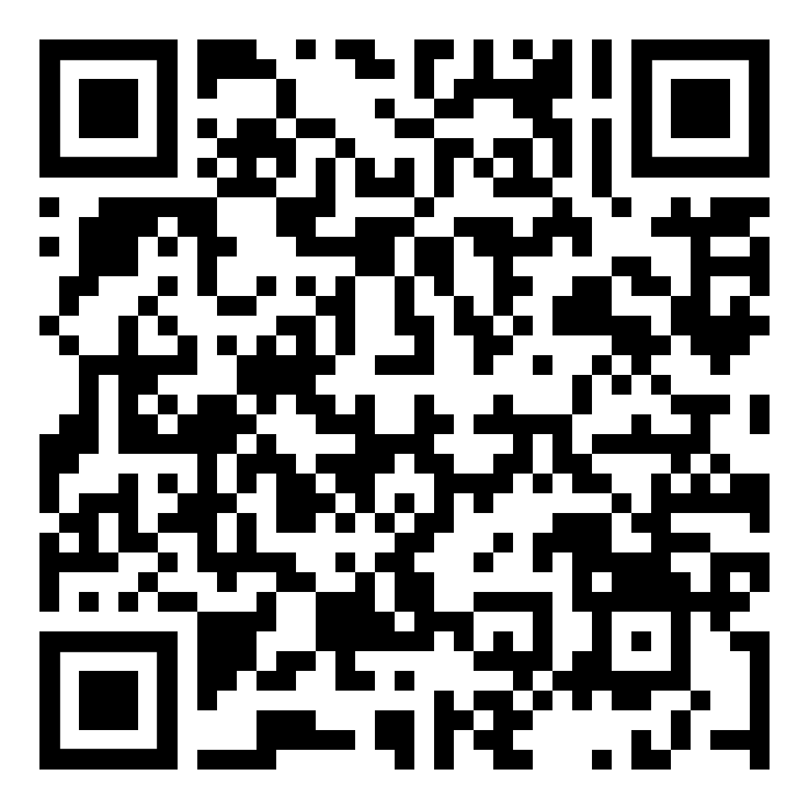
1. Specification
2. Feedback
3. Regression
4. Granularity
- what am I going to write?
- did it work?
- does it still work?
- why did it stop working?
Blog
The 4 Benefits of Tests

Slide 17
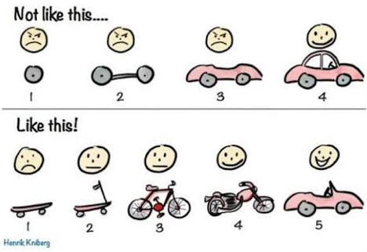
Building an MVP
(minimal viable product)

Slide 18
The 4 principles of
simple design:
(in order of importance)
Passes all tests
Expresses the intent of programmer
Contains no duplication
Minimizes the number of classes and methods
duplication

Slide 19
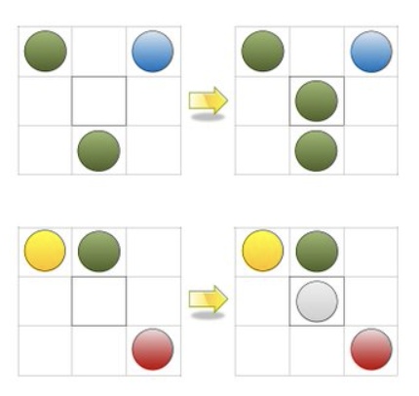
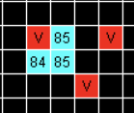
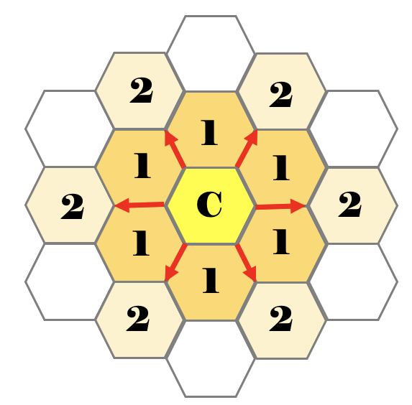
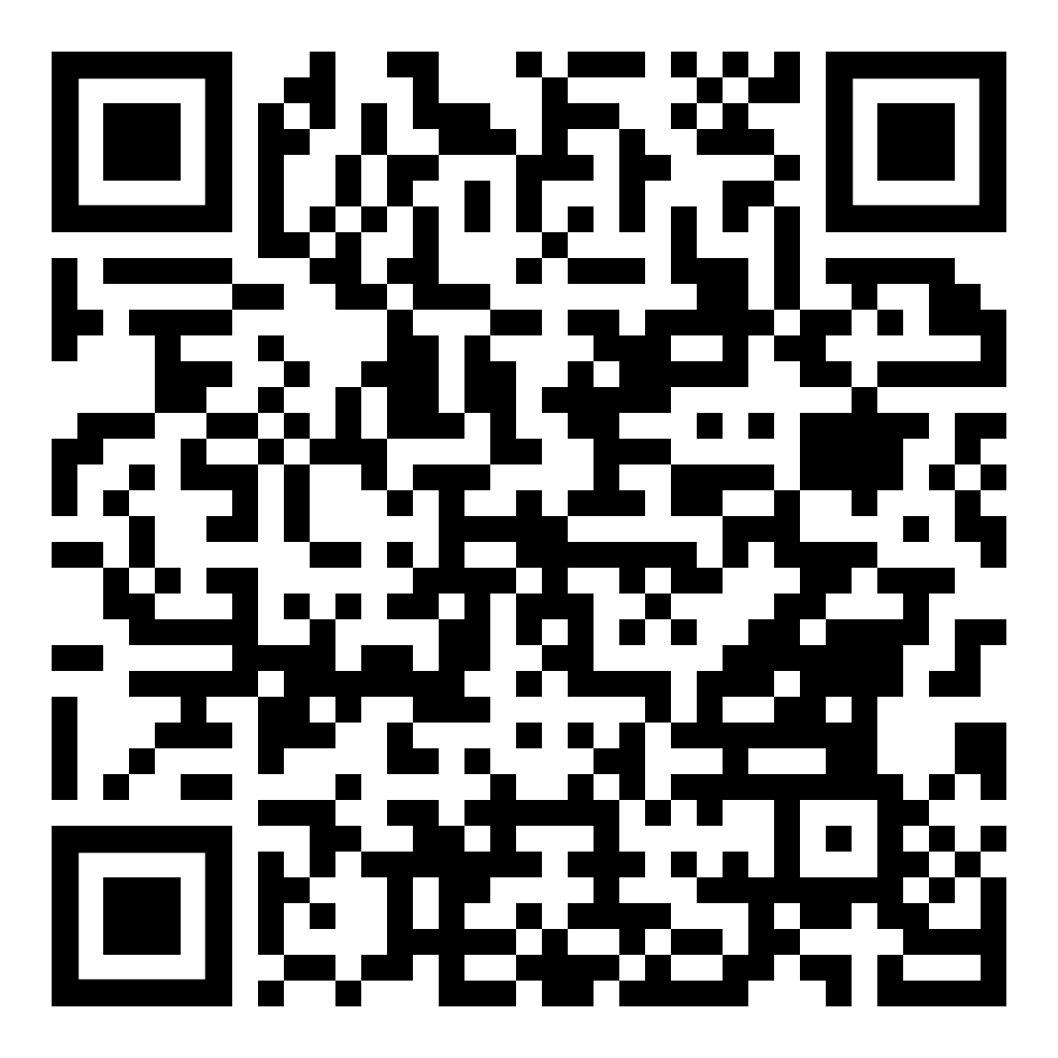
Variations to Game of Life:
Vampires
Hex
Cells with Friends
Cells age,
turn into undying vampires,
that kill each other
The board isn’t square
Cells have color which is passed onto their children
More info at:
1

Slide 20



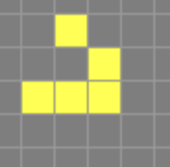



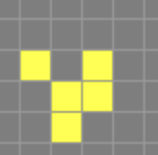



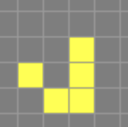
Interesting Game of Life Structures
Unchanging
Oscillating
Traveling
https://playgameoflife.com

Slide 21
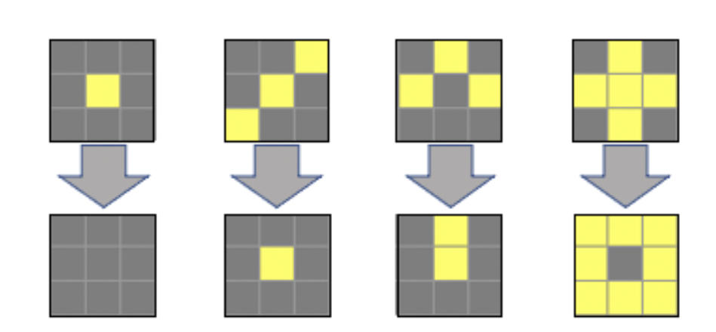
1 neighbor or less
2-3 neighbors
3 neighbors
4 or more neighbors
Middle square
dies
from Starvation
Middle square survives
from Subsistence
Middle square
is born
Middle square
dies
from Overpopulation
Game of Life
Rules

Slide 22
Need an environment?
CyberDojo
Starter Projects
cyber-dojo.org
github.com/LearnWithLlew/StarterProjects
Online coding and testing in many languages
Clone and go
exercism
Gitpod.io
exercism.org
gitpod.io/#<http://your_github_url>
64 languages with setup instructions
VS Code online with linux Can install and run via the terminal

Slide 23
















Elm
Haskell
REASON ML
Rust
TypeScript
Swift
Perl
Go
Kotlin
clojure
Prolog

Slide 24
Schedule

Slide 25
What Surprised you today?

Slide 26
What would you like to try today?

Slide 27
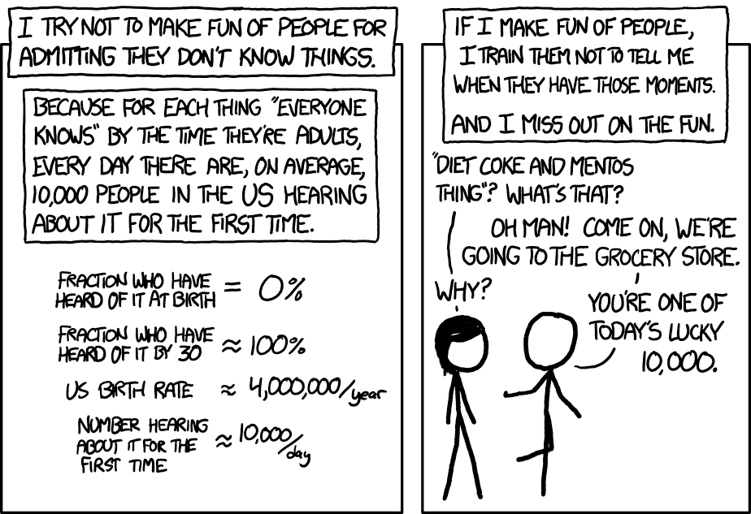
What did you learn today?
xkcd.com

Slide 28
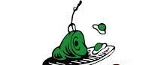
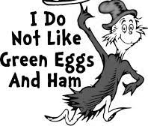
Many people have strong opinions
about things they have not experienced
Hate it with data
Don't make up your mind
about something without trying it.

Slide 29
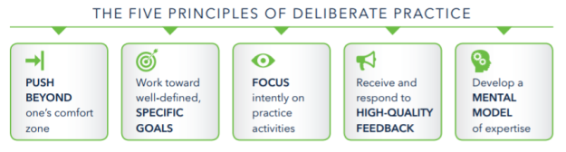
Deliberate Practice

