Slide 1
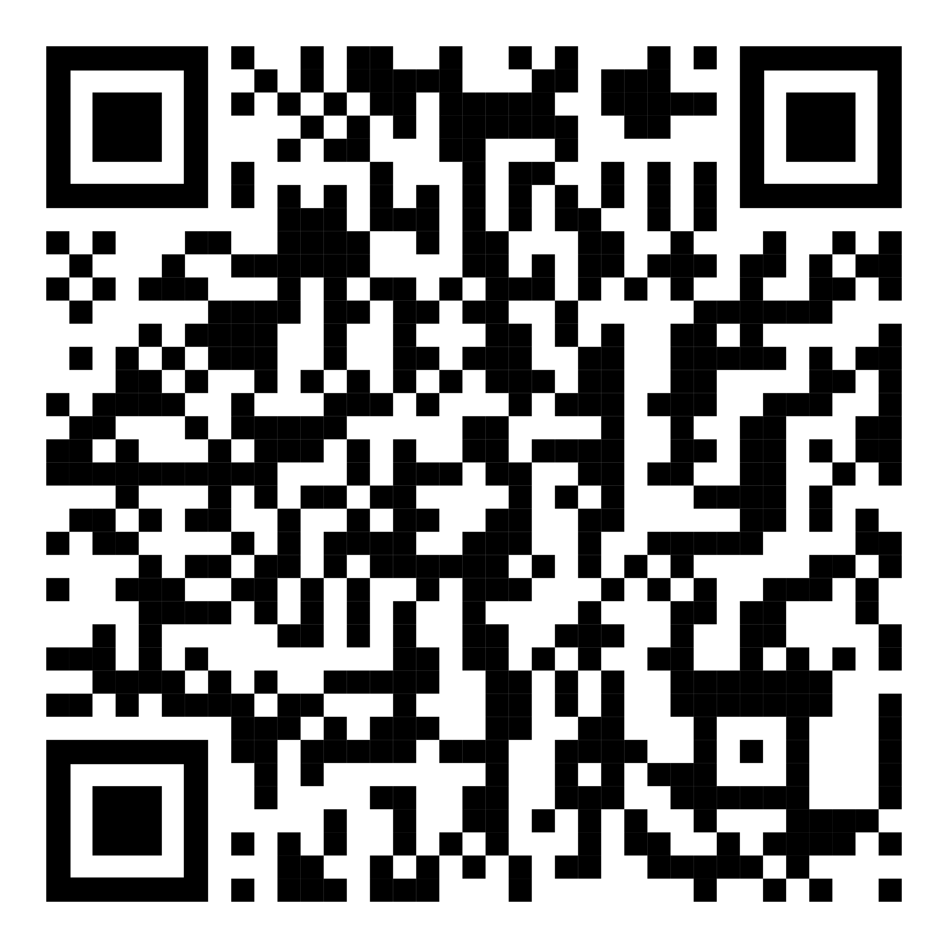
Deepen your coderetreat experience with a
Virtual Follow Up Week*
90 minutes a day
Monday – Friday Nov 6th - 10th
18:00-19:30 UTC
(11:00-12:30 PST)
Sign up Here:
Monday
Tuesday
Wednesday
Thursday
Friday
CODE!!!
CODE!!!
CODE!!!
CODE!!!
CODE!!!
* Prior coderetreat attendance is required as this event will have minimal facilitation
https://www.eventbrite.com/e/coderetreat-virtual-follow-up-week-tickets-742854105627

Slide 2

