Slide 1
Refactoring to Cleaner Code
with @JayBazuzi
& @LlewellynFalco

Slide 2
Better Games
We work at an online game company that wants to improve the yatzy experience.
Our product owner ‘has a few ideas’ and we want to make the code flexible to try things out

Slide 3
Why we Refactor?
Insights
Gain an insight
Record an insight
Change
Change how you use code
Change what the code does

Slide 4
Quotations are commonly printed as a means of inspiration and to invoke philosophical thoughts from the reader.

Slide 6
Home work
Draw 6 test scenarios

Slide 7
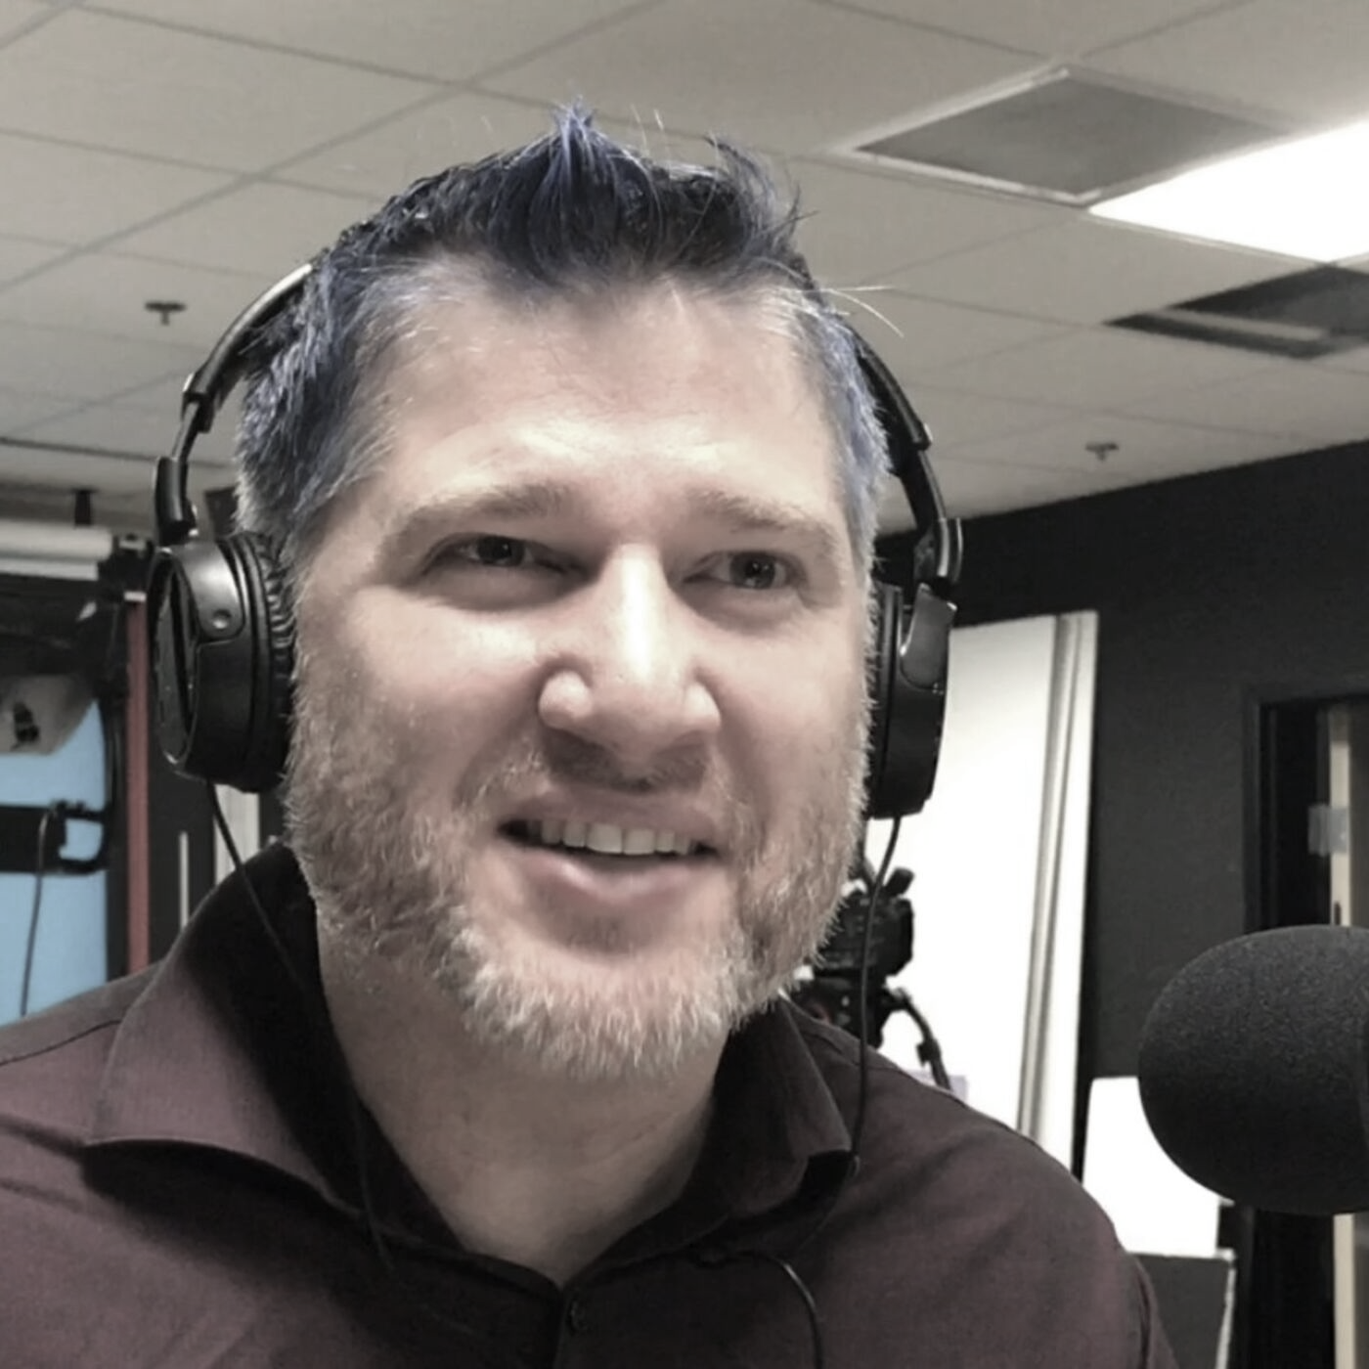
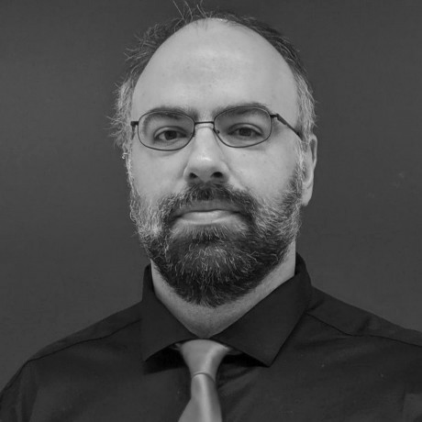
thanks!
Any questions?
Please connect through LinkedIn & Twitter
@LlewellynFalco
Llewellyn.Falco@gmail.com
@JayBazuzi
jay@bauzi.com
Presentation template by SlidesCarnival

