Slide 1
Refactoring to Cleaner Code
with @JayBazuzi
& @LlewellynFalco

Slide 2
Home work
Draw 6 test scenarios

Slide 3
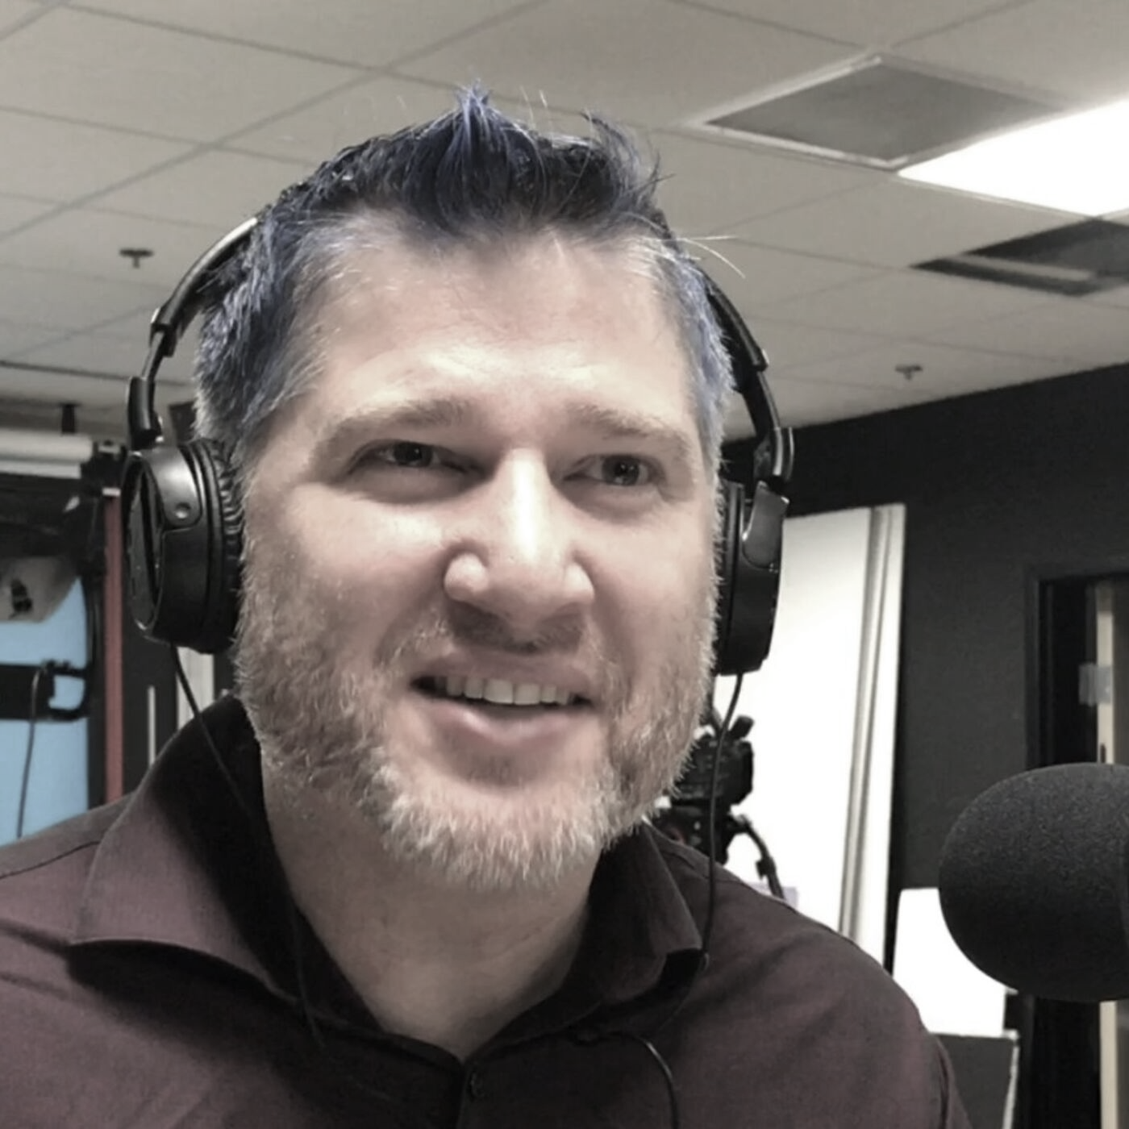
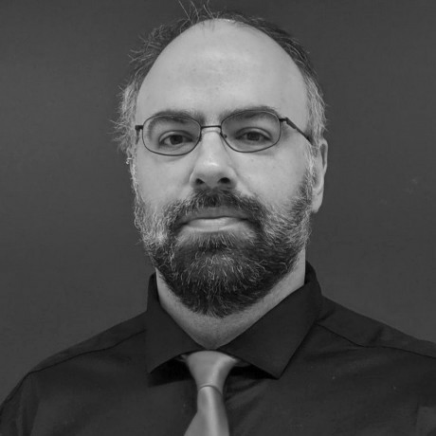
thanks!
Any questions?
Please connect through LinkedIn & Twitter
@LlewellynFalco
Llewellyn.Falco@gmail.com
@JayBazuzi
jay@bauzi.com
Presentation template by SlidesCarnival

