Slide 1
Refactoring to Cleaner Code
with @JayBazuzi
& @LlewellynFalco

Slide 2
AnyDesk

Slide 3
Zoom
Camera On = I am present
Camera Off = I’ve stepped out of the room

Slide 4
Mob Programming

Slide 5
Why we Refactor?
Change
Change what the code does
Change how you use code
Insights
Gain an insight
Record an insight

Slide 6
Better Games
We work at an online game company that wants to improve the BigDiceGame experience.
Our product owner ‘has a few ideas’ and we want to make the code flexible to try things out

Slide 7
Some possible ideas…
Simpler
Maybe there are too many different options already
New Scores
Add scoring for Straight and 3 of a kind. Maybe some others
Different Levels
Easy, Normal, Expert versions with subsets of the rules

Slide 8
Let’s Refactor!

Slide 9
Instead of extending the system to add your feature,
extend it to add extendibility
and then plug in your feature

Slide 10
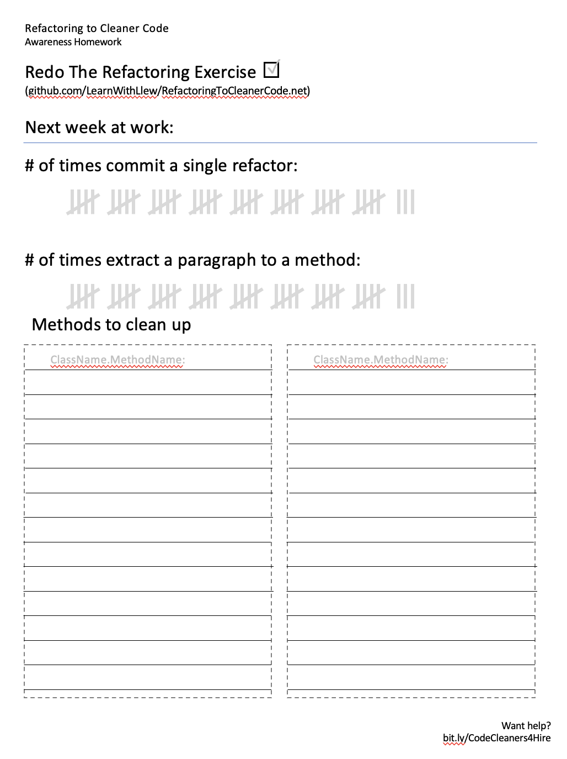
Home work
Draw 6 test scenarios

Slide 11
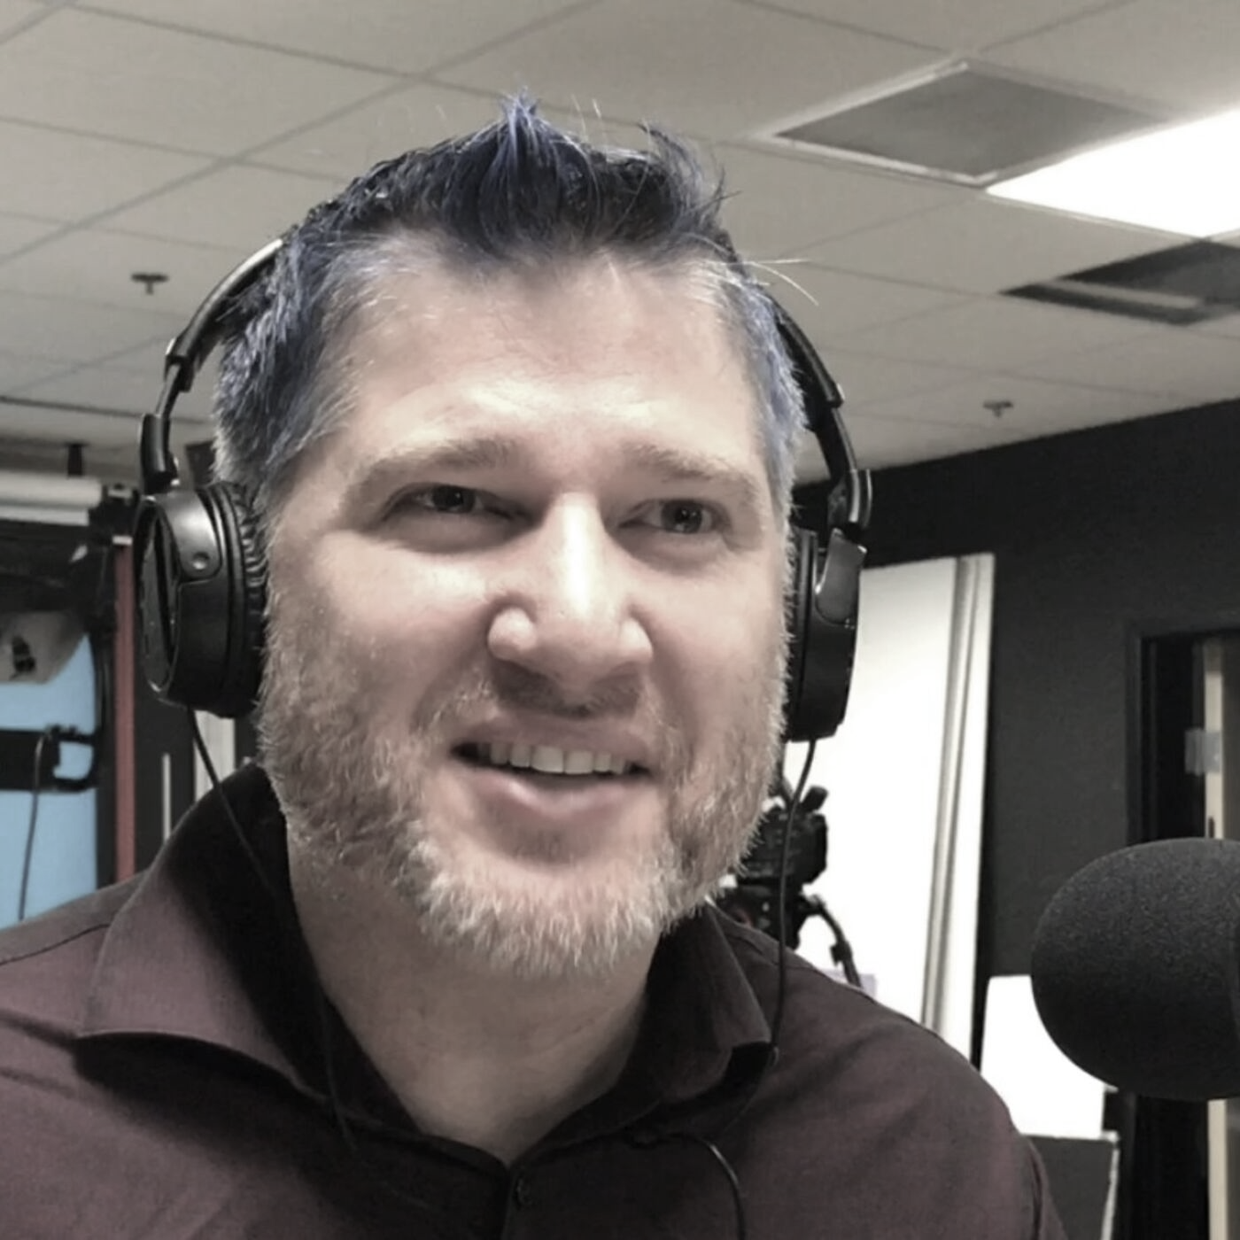
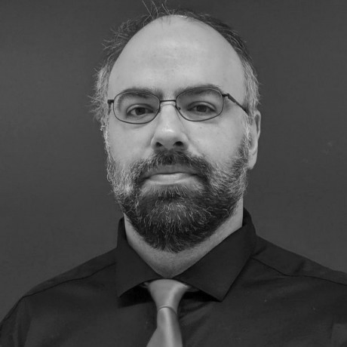
thanks!
Any questions?
Please connect through LinkedIn & Twitter
@LlewellynFalco
Llewellyn.Falco@gmail.com
@JayBazuzi
jay@bazuzi.com
Presentation template by SlidesCarnival

