Slide 1
Export to animated gif (4 seconds per slide) large
Multiple slides for Extended time

Slide 2
Got a large method you’ve been
meaning to clean up…

Slide 3

Refactoring to Cleaner Code
2 ½ Hours Free Workshop
Jan 09 Jan 23 Feb 06
Feb 20
Mar 06
Mar 20
13:00 PST
07:00 PST
16:00 PST
09:00 PST
13:00 PST
07:00 PST

Slide 4
Refactoring to Cleaner Code
2 ½ Hours Free Workshop
Jan 09 Jan 23 Feb 06
Feb 20
Mar 06
Mar 20
13:00 PST
07:00 PST
16:00 PST
09:00 PST
13:00 PST
07:00 PST

Slide 5
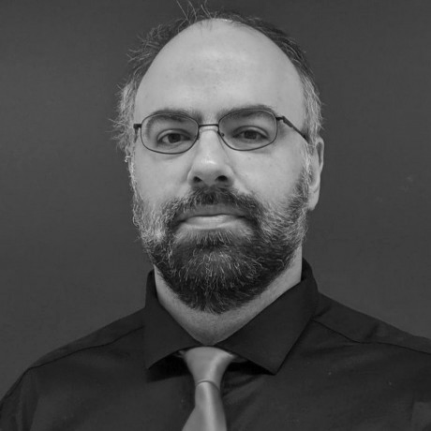
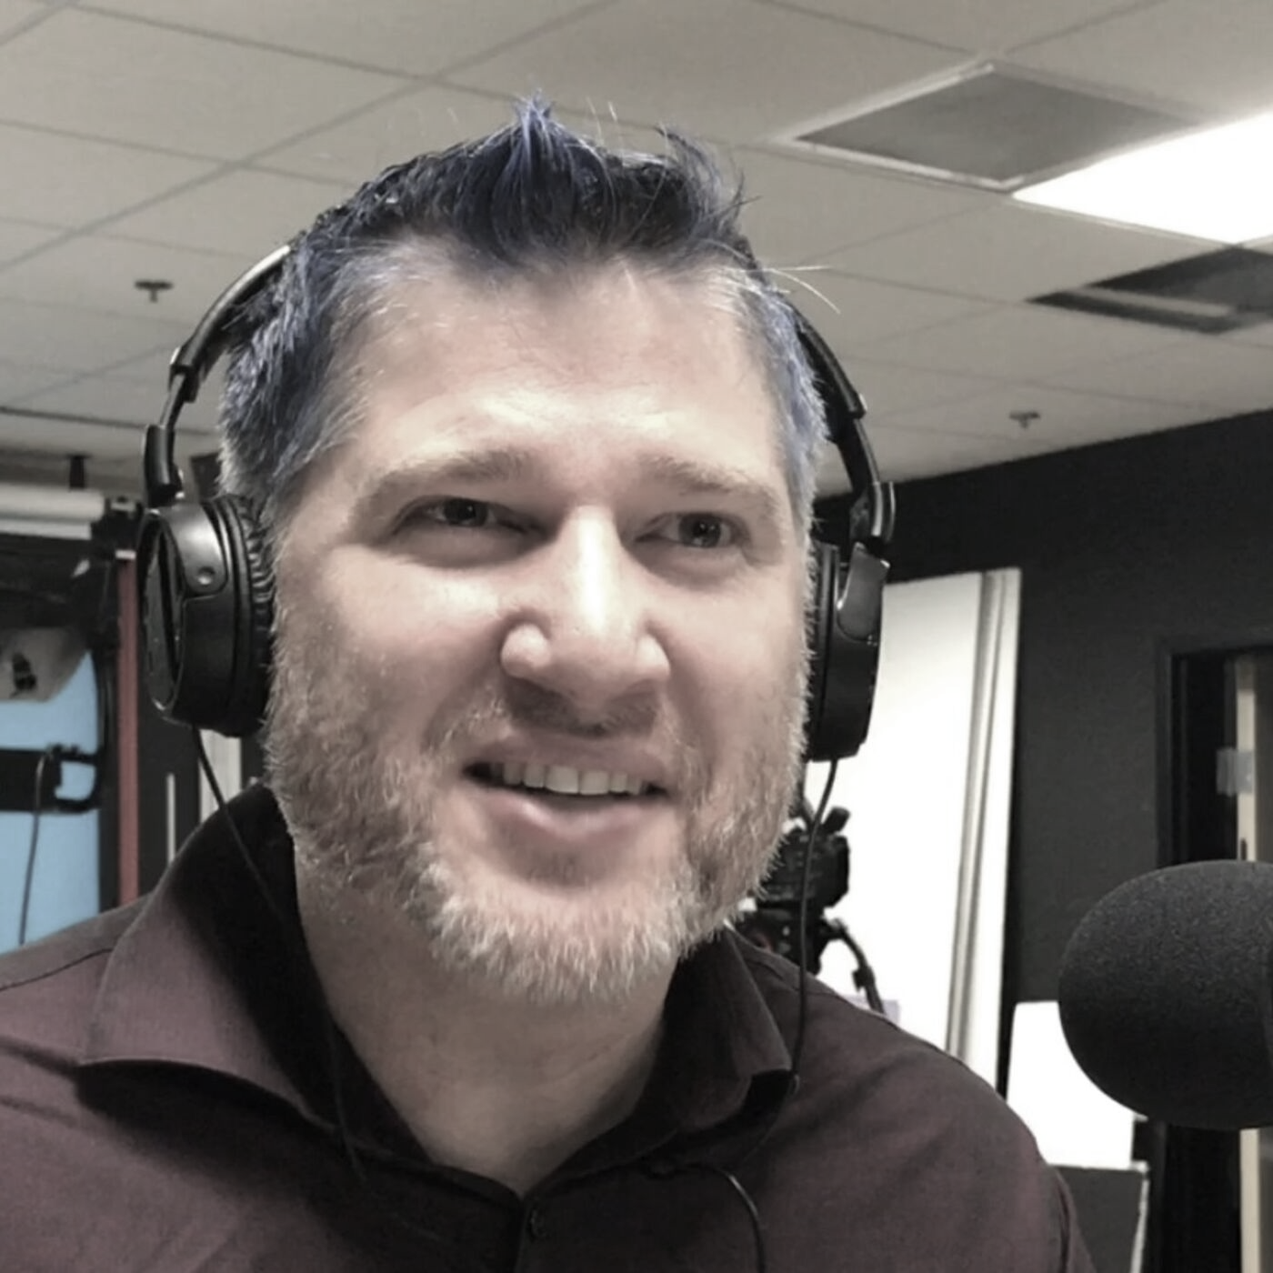
Refactoring to Cleaner Code
with @JayBazuzi
& @LlewellynFalco
Register today at bit.ly/cleaner_code_2021

