Slide 1
Tell me and I forget,
teach me and I may remember,
involve me and I learn.
- Xun Kuang (312-230 BC)

Slide 2
Tell me and I forget,
teach me and I may remember,
involve me and I learn.
- Xun Kuang (312-230 BC)

Slide 3
Online instructor lead workshops
Hands on, small group, small batch learning
Practical skill building you can use immediately
75% workshop followed by 25% theory

Slide 4
Online instructor lead workshops
Hands on, small group, small batch learning
Practical skill building you can use immediately
75% workshop followed by 25% theory

Slide 5
Learn to quickly and easily get existing C++ code under unit tests

Slide 6
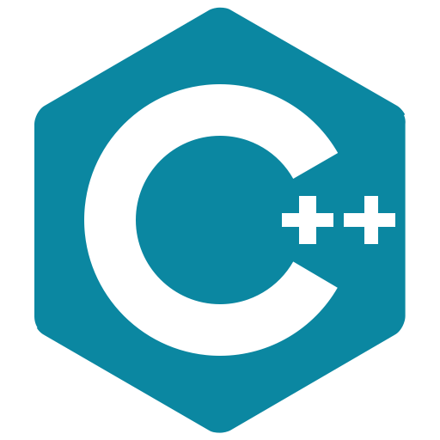
+ (optional) 1–on-1 consults with the instructors on your code
2 Hours a week for 4 weeks: Tuesdays 8-10am pst
Testing Legacy Code Effectively with Approval Tests
Online Workshop
£350 / $450
Sept 08 Sept 15 Sept 22
Sept 29
Testing existing code Testing w/ApprovalTests Testing Globals & Services Testing inconsistent dates and hard to invoke code

Slide 7
+ (optional) 1–on-1 consults with the instructors on your code
2 Hours a week for 4 weeks: Tuesdays 8-10am pst
Testing Legacy Code Effectively with Approval Tests
Online Workshop
£350 / $450
Sept 08 Sept 15 Sept 22
Sept 29
Testing existing code Testing w/ApprovalTests Testing Globals & Services Testing inconsistent dates and hard to invoke code

Slide 8
+ (optional) 1–on-1 consults with the instructors on your code
2 Hours a week for 4 weeks: Tuesdays 8-10am pst
Testing Legacy Code Effectively with Approval Tests
Online Workshop
£350 / $450
Sept 08 Sept 15 Sept 22
Sept 29
Testing existing code Testing w/ApprovalTests Testing Globals & Services Testing inconsistent dates and hard to invoke code

Slide 9
Interested in learning the skills necessary to master legacy code?

Slide 10
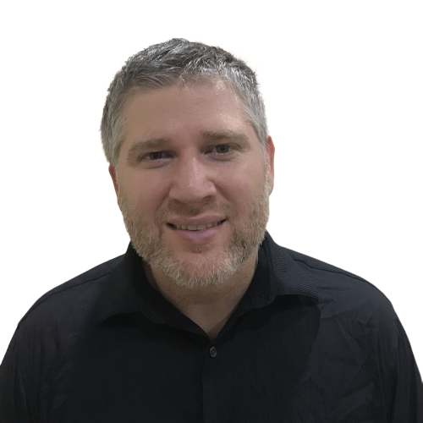
Testing Legacy Code Effectively with Approval Tests
Online Workshop
@LlewellynFalco
Legacy code expert
Invertor of Approvaltests
@ClareMacraeUK
Co-author
Approvaltests.cpp
Register today!
bit.ly / Legacy Cpp Sept 2020

Slide 11
Testing Legacy Code Effectively with Approval Tests
Online Workshop
@LlewellynFalco
Legacy code expert
Invertor of Approvaltests
@ClareMacraeUK
Co-author
Approvaltests.cpp
Register today!
bit.ly / Legacy Cpp Sept 2020

