Slide 1
Export to animated gif (4 seconds per slide)
Multiple slides for Extended time

Slide 2
Tell me and I forget,
teach me and I may remember,
involve me and I learn.
- Xun Kuang (312-230 BC)

Slide 3
Tell me and I forget,
teach me and I may remember,
involve me and I learn.
- Xun Kuang (312-230 BC)

Slide 4
Online instructor lead workshops
Hands on, small group, small batch learning
Practical skill building you can use immediately
75% workshop followed by 25% theory

Slide 5
Online instructor lead workshops
Hands on, small group, small batch learning
Practical skill building you can use immediately
75% workshop followed by 25% theory

Slide 6
Learn to quickly and easily get existing C++ code under unit tests

Slide 7
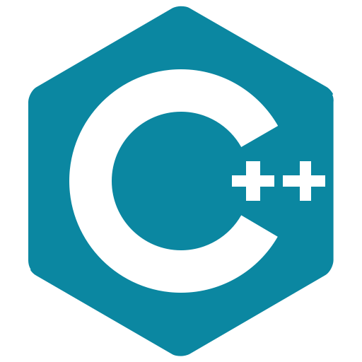
+ (optional) 1–on-1 consults with the instructors on your code
2 Hours a week for 4 weeks: Tuesdays 8-10am pst
Testing Legacy Code Effectively with Approval Tests
Online Workshop
£350 / $450
Sept 08 Sept 15 Sept 22
Sept 29
Testing existing code Testing w/ApprovalTests Testing Globals & Services Testing inconsistent dates and hard to invoke code

Slide 8
+ (optional) 1–on-1 consults with the instructors on your code
2 Hours a week for 4 weeks: Tuesdays 8-10am pst
Testing Legacy Code Effectively with Approval Tests
Online Workshop
£350 / $450
Sept 08 Sept 15 Sept 22
Sept 29
Testing existing code Testing w/ApprovalTests Testing Globals & Services Testing inconsistent dates and hard to invoke code

Slide 9
+ (optional) 1–on-1 consults with the instructors on your code
2 Hours a week for 4 weeks: Tuesdays 8-10am pst
Testing Legacy Code Effectively with Approval Tests
Online Workshop
£350 / $450
Sept 08 Sept 15 Sept 22
Sept 29
Testing existing code Testing w/ApprovalTests Testing Globals & Services Testing inconsistent dates and hard to invoke code

Slide 10
Interested in learning the skills necessary to master legacy code?

Slide 11
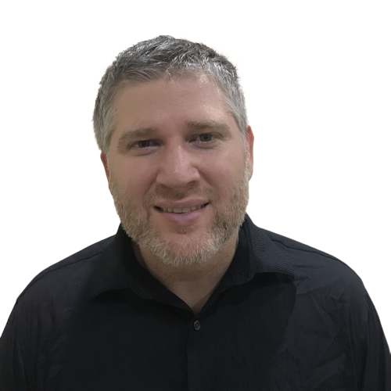
Testing Legacy Code Effectively with Approval Tests
Online Workshop
@LlewellynFalco
Legacy code expert
Invertor of Approvaltests
@ClareMacraeUK
Co-author
Approvaltests.cpp
Register today!
bit.ly / Legacy Cpp Sept 2020

Slide 12
Testing Legacy Code Effectively with Approval Tests
Online Workshop
@LlewellynFalco
Legacy code expert
Invertor of Approvaltests
@ClareMacraeUK
Co-author
Approvaltests.cpp
Register today!
bit.ly / Legacy Cpp Sept 2020

