Slide 1
Export to animated gif (4 seconds per slide)
Multiple slides for Extended time

Slide 2
Interested in learning the skills necessary to master legacy code?

Slide 3
Tell me and I forget,
teach me and I may remember,
involve me and I learn.
- Xun Kuang (312-230 BC)

Slide 4
Tell me and I forget,
teach me and I may remember,
involve me and I learn.
- Xun Kuang (312-230 BC)

Slide 5
Online instructor led workshops
Hands on, small group, small batch learning
Practical skill building you can use immediately
75% workshop followed by 25% theory

Slide 6
Online instructor led workshops
Hands on, small group, small batch learning
Practical skill building you can use immediately
75% workshop followed by 25% theory

Slide 7
Learn to quickly and easily get existing C++ code under unit tests

Slide 8

+ (optional) 1–on-1 consults with the instructors on your code
2 Hours a week for 4 weeks: Tuesdays 8-10am pst
Testing Legacy Code Effectively with Approval Tests
Online Workshop
£350 / $450
Nov 03 Nov 10 Nov 17
Nov 24
Testing existing code Testing w/ApprovalTests Testing Globals & Services Testing inconsistent dates and hard to invoke code

Slide 9
+ (optional) 1–on-1 consults with the instructors on your code
2 Hours a week for 4 weeks: Tuesdays 8-10am pst
Testing Legacy Code Effectively with Approval Tests
Online Workshop
£350 / $450
Nov 03 Nov 10 Nov 17
Nov 24
Testing existing code Testing w/ApprovalTests Testing Globals & Services Testing inconsistent dates and hard to invoke code

Slide 10
+ (optional) 1–on-1 consults with the instructors on your code
2 Hours a week for 4 weeks: Tuesdays 8-10am pst
Testing Legacy Code Effectively with Approval Tests
Online Workshop
£350 / $450
Nov 03 Nov 10 Nov 17
Nov 24
Testing existing code Testing w/ApprovalTests Testing Globals & Services Testing inconsistent dates and hard to invoke code

Slide 11
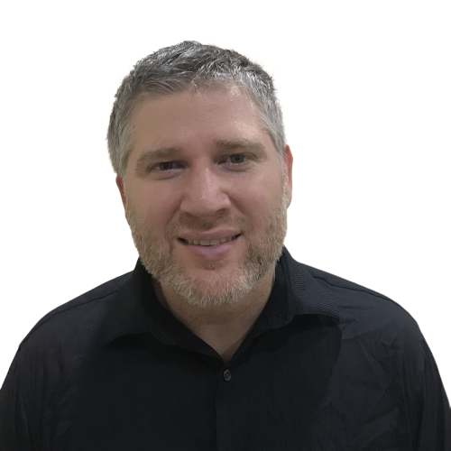
Testing Legacy Code Effectively with Approval Tests
Online Workshop
@LlewellynFalco
Legacy code expert
Inventor of Approvaltests
@ClareMacraeUK
Co-author
Approvaltests.cpp
Register today!
bit.ly / Legacy Cpp Nov 2020

Slide 12
Testing Legacy Code Effectively with Approval Tests
Online Workshop
@LlewellynFalco
Legacy code expert
Inventor of Approvaltests
@ClareMacraeUK
Co-author
Approvaltests.cpp
Register today!
bit.ly / Legacy Cpp Nov 2020

