Slide 1
Arlo Git Notation github.com/RefactoringCombos/ArlosCommitNotation

Slide 2
Risk Prefix | meaning
. | Impossible to affect production
- | Completely Tested
! | Single Action
@ | Risky

Slide 3
Risk Prefix | meaning
. | Impossible to affect production
- | Unit Tested
! | Single Action
@ | Risky
Intent Prefix | meaning
e | Environment
r | refactoring
d | documentation
t | Test only
B | Bug Fix
F | New Feature

Slide 4
Example | meaning
! F | Feature
- B | Bug
. t | Test only
. r | Provable Refactor
! r | Refactoring

Slide 5
* 7eb8bac ! F Conjured items (20 hours ago) <Llewellyn Falco>
* 102edc6 . r public static (20 hours ago) <Llewellyn Falco>
* b70fffc . r Inline (20 hours ago) <Llewellyn Falco>
* 7a4d940 . r Extract Method (20 hours ago) <Llewellyn Falco>
* 8b70b9c . r Extract Variable (20 hours ago) <Llewellyn Falco>
* 70a73ac . r looped (20 hours ago) <Llewellyn Falco>
* 64e736c . r looping (20 hours ago) <Llewellyn Falco>
* 7659cc8 . r to many of 1 (20 hours ago) <Llewellyn Falco>
* e68d810 . r implementing item updater (20 hours ago) <Llewellyn Falco>
* 2f43d6c . r implementing item updater (20 hours ago) <Llewellyn Falco>
* b42cbcf . r added item (20 hours ago) <Llewellyn Falco>
* f9a9ffa . r interface (20 hours ago) <Llewellyn Falco>
* 89a406a . r public (20 hours ago) <Llewellyn Falco>
* 342e2c1 . r Rename (20 hours ago) <Llewellyn Falco>
* c271979 . r Rename (20 hours ago) <Llewellyn Falco>
* 58ef751 . r Rename (20 hours ago) <Llewellyn Falco>
* 09a5ce0 . r Rename (20 hours ago) <Llewellyn Falco>
* 721a412 . r seperate (20 hours ago) <Llewellyn Falco>
* 60418e8 . r seperate (20 hours ago) <Llewellyn Falco>
* 08917e4 . r dead code (20 hours ago) <Llewellyn Falco>
* 7eb3018 . r seperate (20 hours ago) <Llewellyn Falco>
* a1c5b36 . r seperate (20 hours ago) <Llewellyn Falco>
* 96ad3f1 . r Rename (20 hours ago) <Llewellyn Falco>
* 30244ee . r dead code (20 hours ago) <Llewellyn Falco>
* 5335fa6 . r seperate (20 hours ago) <Llewellyn Falco>
* 9f4ad5c . r seperate (20 hours ago) <Llewellyn Falco>
* 37c416c . r added dead code (20 hours ago) <Llewellyn Falco>
* 58f7f97 . r seperated class (20 hours ago) <Llewellyn Falco>
* 6d8f385 . r aged brie (21 hours ago) <Llewellyn Falco>
* ca0c832 . r Extract Variable (21 hours ago) <Llewellyn Falco>
* f466a84 . r extract superclass (21 hours ago) <Llewellyn Falco>
* 64c2738 . r extract superclass (21 hours ago) <Llewellyn Falco>
* 2501cd3 . r extract superclass (21 hours ago) <Llewellyn Falco>
* c76b23f . r extracted Brie (21 hours ago) <Llewellyn Falco>
* 7165da3 . r Delete Clutter (21 hours ago) <Llewellyn Falco>
* 09b4675 . r Extract Method (21 hours ago) <Llewellyn Falco>
* 11fcb91 . r Extract Method (21 hours ago) <Llewellyn Falco>
* c1def3d . r Extract Method (21 hours ago) <Llewellyn Falco>

Slide 6
* 7eb8bac ! F Conjured items (20 hours ago) <Llewellyn Falco>
* 102edc6 . r public static (20 hours ago) <Llewellyn Falco>
* b70fffc . r Inline (20 hours ago) <Llewellyn Falco>
* 7a4d940 . r Extract Method (20 hours ago) <Llewellyn Falco>
* 8b70b9c . r Extract Variable (20 hours ago) <Llewellyn Falco>
* 70a73ac . r looped (20 hours ago) <Llewellyn Falco>
* 64e736c . r looping (20 hours ago) <Llewellyn Falco>
* 7659cc8 . r to many of 1 (20 hours ago) <Llewellyn Falco>
* e68d810 . r implementing item updater (20 hours ago) <Llewellyn Falco>
* 2f43d6c . r implementing item updater (20 hours ago) <Llewellyn Falco>
* b42cbcf . r added item (20 hours ago) <Llewellyn Falco>
* f9a9ffa . r interface (20 hours ago) <Llewellyn Falco>
* 89a406a . r public (20 hours ago) <Llewellyn Falco>
* 342e2c1 . r Rename (20 hours ago) <Llewellyn Falco>
* c271979 . r Rename (20 hours ago) <Llewellyn Falco>
* 58ef751 . r Rename (20 hours ago) <Llewellyn Falco>
* 09a5ce0 . r Rename (20 hours ago) <Llewellyn Falco>
* 721a412 . r seperate (20 hours ago) <Llewellyn Falco>
* 60418e8 . r seperate (20 hours ago) <Llewellyn Falco>
* 08917e4 . r dead code (20 hours ago) <Llewellyn Falco>
* 7eb3018 . r seperate (20 hours ago) <Llewellyn Falco>
* a1c5b36 . r seperate (20 hours ago) <Llewellyn Falco>
* 96ad3f1 . r Rename (20 hours ago) <Llewellyn Falco>
* 30244ee . r dead code (20 hours ago) <Llewellyn Falco>
* 5335fa6 . r seperate (20 hours ago) <Llewellyn Falco>
* 9f4ad5c . r seperate (20 hours ago) <Llewellyn Falco>
* 37c416c . r added dead code (20 hours ago) <Llewellyn Falco>
* 58f7f97 . r seperated class (20 hours ago) <Llewellyn Falco>
* 6d8f385 . r aged brie (21 hours ago) <Llewellyn Falco>
* ca0c832 . r Extract Variable (21 hours ago) <Llewellyn Falco>
* f466a84 . r extract superclass (21 hours ago) <Llewellyn Falco>
* 64c2738 . r extract superclass (21 hours ago) <Llewellyn Falco>
* 2501cd3 . r extract superclass (21 hours ago) <Llewellyn Falco>
* c76b23f . r extracted Brie (21 hours ago) <Llewellyn Falco>
* 7165da3 . r Delete Clutter (21 hours ago) <Llewellyn Falco>
* 09b4675 . r Extract Method (21 hours ago) <Llewellyn Falco>
* 11fcb91 . r Extract Method (21 hours ago) <Llewellyn Falco>
* c1def3d . r Extract Method (21 hours ago) <Llewellyn Falco>

Slide 7
* 7eb8bac ! F Conjured items (20 hours ago) <Llewellyn Falco>
* 102edc6 . r public static (20 hours ago) <Llewellyn Falco>
* b70fffc . r Inline (20 hours ago) <Llewellyn Falco>
* 7a4d940 . r Extract Method (20 hours ago) <Llewellyn Falco>
* 8b70b9c . r Extract Variable (20 hours ago) <Llewellyn Falco>
* 70a73ac . r looped (20 hours ago) <Llewellyn Falco>
* 64e736c . r looping (20 hours ago) <Llewellyn Falco>
* 7659cc8 . r to many of 1 (20 hours ago) <Llewellyn Falco>
* e68d810 . r implementing item updater (20 hours ago) <Llewellyn Falco>
* 2f43d6c . r implementing item updater (20 hours ago) <Llewellyn Falco>
* b42cbcf . r added item (20 hours ago) <Llewellyn Falco>
* f9a9ffa . r interface (20 hours ago) <Llewellyn Falco>
* 89a406a . r public (20 hours ago) <Llewellyn Falco>
* 342e2c1 . r Rename (20 hours ago) <Llewellyn Falco>
* c271979 . r Rename (20 hours ago) <Llewellyn Falco>
* 58ef751 . r Rename (20 hours ago) <Llewellyn Falco>
* 09a5ce0 . r Rename (20 hours ago) <Llewellyn Falco>
* 721a412 . r seperate (20 hours ago) <Llewellyn Falco>
* 60418e8 . r seperate (20 hours ago) <Llewellyn Falco>
* 08917e4 . r dead code (20 hours ago) <Llewellyn Falco>
* 7eb3018 . r seperate (20 hours ago) <Llewellyn Falco>
* a1c5b36 . r seperate (20 hours ago) <Llewellyn Falco>
* 96ad3f1 . r Rename (20 hours ago) <Llewellyn Falco>
* 30244ee . r dead code (20 hours ago) <Llewellyn Falco>
* 5335fa6 . r seperate (20 hours ago) <Llewellyn Falco>
* 9f4ad5c . r seperate (20 hours ago) <Llewellyn Falco>
* 37c416c . r added dead code (20 hours ago) <Llewellyn Falco>
* 58f7f97 . r seperated class (20 hours ago) <Llewellyn Falco>
* 6d8f385 . r aged brie (21 hours ago) <Llewellyn Falco>
* ca0c832 . r Extract Variable (21 hours ago) <Llewellyn Falco>
* f466a84 . r extract superclass (21 hours ago) <Llewellyn Falco>
* 64c2738 . r extract superclass (21 hours ago) <Llewellyn Falco>
* 2501cd3 . r extract superclass (21 hours ago) <Llewellyn Falco>
* c76b23f . r extracted Brie (21 hours ago) <Llewellyn Falco>
* 7165da3 . r Delete Clutter (21 hours ago) <Llewellyn Falco>
* 09b4675 . r Extract Method (21 hours ago) <Llewellyn Falco>
* 11fcb91 . r Extract Method (21 hours ago) <Llewellyn Falco>
* c1def3d . r Extract Method (21 hours ago) <Llewellyn Falco>

Slide 8
* 7eb8bac ! F Conjured items (20 hours ago) <Llewellyn Falco>
* 102edc6 . r public static (20 hours ago) <Llewellyn Falco>
* b70fffc . r Inline (20 hours ago) <Llewellyn Falco>
* 7a4d940 . r Extract Method (20 hours ago) <Llewellyn Falco>
* 8b70b9c . r Extract Variable (20 hours ago) <Llewellyn Falco>
* 70a73ac . r looped (20 hours ago) <Llewellyn Falco>
* 64e736c . r looping (20 hours ago) <Llewellyn Falco>
* 7659cc8 . r to many of 1 (20 hours ago) <Llewellyn Falco>
* e68d810 . r implementing item updater (20 hours ago) <Llewellyn Falco>
* 2f43d6c . r implementing item updater (20 hours ago) <Llewellyn Falco>
* b42cbcf . r added item (20 hours ago) <Llewellyn Falco>
* f9a9ffa . r interface (20 hours ago) <Llewellyn Falco>
* 89a406a . r public (20 hours ago) <Llewellyn Falco>
* 342e2c1 . r Rename (20 hours ago) <Llewellyn Falco>
* c271979 . r Rename (20 hours ago) <Llewellyn Falco>
* 58ef751 . r Rename (20 hours ago) <Llewellyn Falco>
* 09a5ce0 . r Rename (20 hours ago) <Llewellyn Falco>
* 721a412 . r seperate (20 hours ago) <Llewellyn Falco>
* 60418e8 . r seperate (20 hours ago) <Llewellyn Falco>
* 08917e4 . r dead code (20 hours ago) <Llewellyn Falco>
* 7eb3018 . r seperate (20 hours ago) <Llewellyn Falco>
* a1c5b36 . r seperate (20 hours ago) <Llewellyn Falco>
* 96ad3f1 . r Rename (20 hours ago) <Llewellyn Falco>
* 30244ee . r dead code (20 hours ago) <Llewellyn Falco>
* 5335fa6 . r seperate (20 hours ago) <Llewellyn Falco>
* 9f4ad5c . r seperate (20 hours ago) <Llewellyn Falco>
* 37c416c . r added dead code (20 hours ago) <Llewellyn Falco>
* 58f7f97 . r seperated class (20 hours ago) <Llewellyn Falco>
* 6d8f385 . r aged brie (21 hours ago) <Llewellyn Falco>
* ca0c832 . r Extract Variable (21 hours ago) <Llewellyn Falco>
* f466a84 . r extract superclass (21 hours ago) <Llewellyn Falco>
* 64c2738 . r extract superclass (21 hours ago) <Llewellyn Falco>
* 2501cd3 . r extract superclass (21 hours ago) <Llewellyn Falco>
* c76b23f . r extracted Brie (21 hours ago) <Llewellyn Falco>
* 7165da3 . r Delete Clutter (21 hours ago) <Llewellyn Falco>
* 09b4675 . r Extract Method (21 hours ago) <Llewellyn Falco>
* 11fcb91 . r Extract Method (21 hours ago) <Llewellyn Falco>
* c1def3d . r Extract Method (21 hours ago) <Llewellyn Falco>

Slide 9
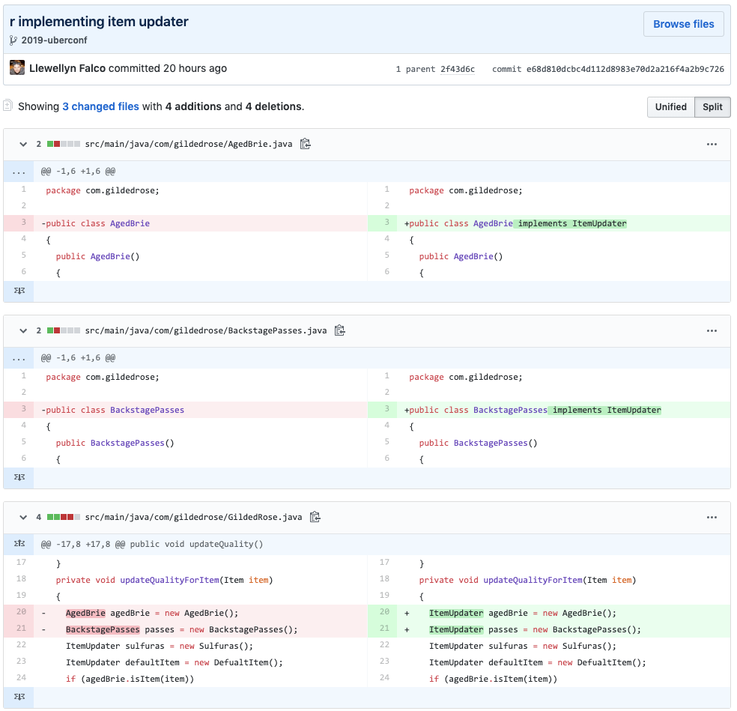

Slide 10
* b70fffc . r Inline
* 7a4d940 . r Extract Method
* 8b70b9c . r Extract Variable
* 70a73ac . r Deleted dead code
* 2f43d6c ! r Simpler formula
* 89a406a . r Rename
* c271979 . r Rename
* 58ef751 . r Rename
* 09a5ce0 . r Rename
* 721a412 ! r Extract Method
* 60418e8 . r Inline
* 08917e4 . r Joined Initiations
* 9f4ad5c . r Extract

Slide 11
* b70fffc . r Inline
* 7a4d940 . r Extract Method
* 8b70b9c . r Extract Variable
* 70a73ac . r Deleted dead code
* 2f43d6c ! r Simpler formula
* 89a406a . r Rename
* c271979 . r Rename
* 58ef751 . r Rename
* 09a5ce0 . r Rename
* 721a412 ! r Extract Method
* 60418e8 . r Inline
* 08917e4 . r Joined Initiations
* 9f4ad5c . r Extract

Slide 12
* b70fffc . r Inline
* 7a4d940 . r Extract Method
* 8b70b9c . r Extract Variable
* 70a73ac . r Deleted dead code
* 2f43d6c ! r Simpler formula
* 89a406a . r Rename
* c271979 . r Rename
* 58ef751 . r Rename
* 09a5ce0 . r Rename
* 721a412 ! r Extract Method
* 60418e8 . r Inline
* 08917e4 . r Joined Initiations
* 9f4ad5c . r Extract

Slide 13
* b70fffc . r Inline
* 7a4d940 . r Extract Method
* 8b70b9c . r Extract Variable
* 70a73ac . r Deleted dead code
* 2f43d6c ! r Simpler formula
* 89a406a . r Rename
* c271979 . r Rename
* 58ef751 . r Rename
* 09a5ce0 . r Rename
* 721a412 ! r Extract Method
* 60418e8 . r Inline
* 08917e4 . r Joined Initiations
* 9f4ad5c . r Extract

Slide 14
voltage = (incoming * normalizer) / normalizer;
voltage = incoming;

Slide 15
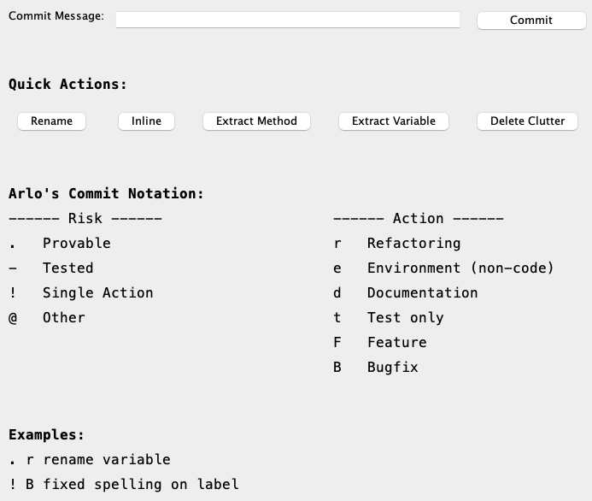

Slide 16
Resources
github.com/RefactoringCombos/ArlosCommitNotation

Slide 17

Thank YOU (please connect via LinkedIn and Twitter)
@LlewellynFalco
youtube.com/isidoreus
LlewellynFalco.Blogspot.com approvaltests.com

