Slide 1
10 X

Slide 2
What does 10X look like?

Slide 3
$1 @ 10% interest For 1 Year
Total: $1.10
$1 @ 100% interest For 1 Year
Total: $2.00

Slide 4
$1 @ 10% interest For 20 Years
Total: $6.73
$1 @ 100% interest For 20 Years
Total: $1,048,576.00

Slide 5
Gross: $100,000 Gross: $145,000
Overhead: $95,000
($5K Profit)
($50K Profit)

Slide 6
Loan: $100,000 @ 10% interest $839 $2124
(50 years)
(5 years)

Slide 7
Interest: $100,000 @ 100% interest $8,333
(50 years)
$8,402
(5 years)

Slide 8
Person 1: $100 a Month for 17 Years
Person 2: $100 a Month for 17 Years

Slide 9
Person 1: $100 a Month for 17 Years
Person 2: $100 a Month for 17 Years

Slide 10
Person 1: $100 a Month for 17 Years
$530k
$53k
Person 2: $100 a Month for 17 Years

Slide 11
Test First
Test After

Slide 12
Unsurprisingly, the team did not achieve 10x productivity. In fact, we found our productivity to be almost the same as it was before…Your mileage may vary, but as far as we’re concerned it’s a resounding NO.
My Experience With MobProgramming
Is the product higher quality? Is there better test coverage? Is the code idiomatic and does it follow best practices? Are the chances of a bug crawling into the product minimized? From our experience this is the most emphatic YES of all the concerns listed above. Not only does having everyone together increase accountability and awareness, but mistakes that may be made by more junior developers are more likely to be caught. Furthermore, when our QA engineer was in the mob, he gained a much better sense of how to go about testing the feature as thoroughly as possible.
http://engineering.appfolio.com/appfolio-engineering/2014/03/17/my-experience-with-mob-programming

Slide 13
Infinite TASKS

Slide 14
1
2
3
4
5
6

Slide 15
SUPER TASKS

Slide 16
1
½
¼
1/8
1/16
1/32

Slide 17
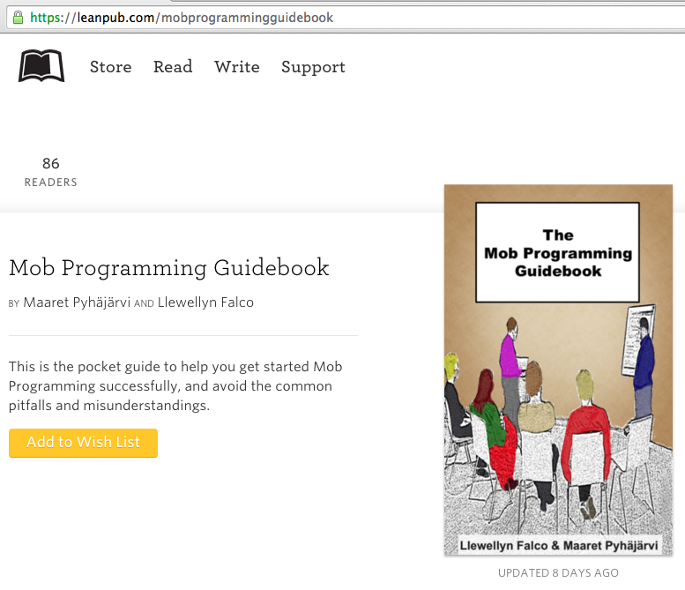
#MobProgrammingGuidebook

Slide 18
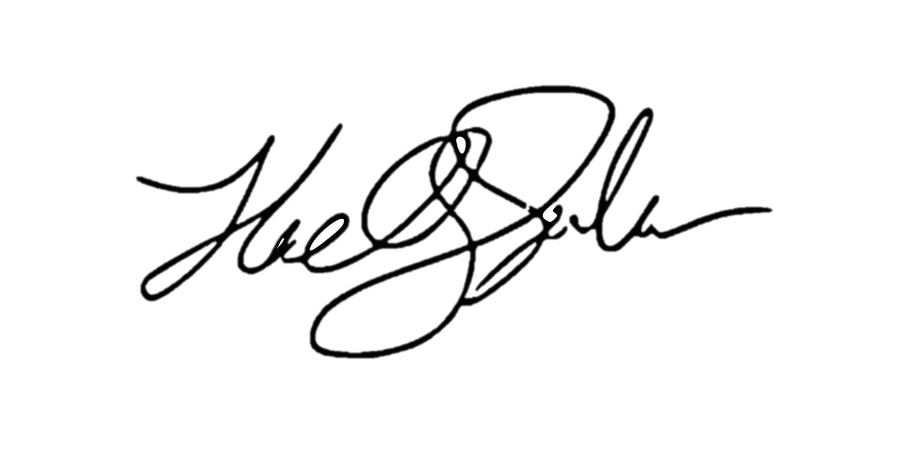
ROI of investing1 hour a day
for a 1% increase ( 5 minutes )
5x (1 year)
4x (10 months)
Output
2x (6 months)
3x (8.5 months)
28 days
Llewellyn Falco

Slide 19
1.00 ^ 365 = 1
1.01 ^ 365 = 37.78

Slide 20
“The best time to plant a tree is 20 years ago.
The second best time is now.”

Slide 21





Special offer! Free corporate refactoring session
Next week only
Part 1
Lecture (45 mins)
Part 2
Workshop (90 mins)
Exploring the effect and reasons for refactoring & why it is often neglected
We will Refactor
your own code
In a Mob Programming session
(Java or C#)
Inquire by emailing
info@spunlabs.com
Llewellyn Falco

Slide 22
Thank YOU (please connect via LinkedIn and Twitter)
@LlewellynFalco
youtube.com/isidoreus
LlewellynFalco.Blogspot.com approvaltests.com

