Slide 1
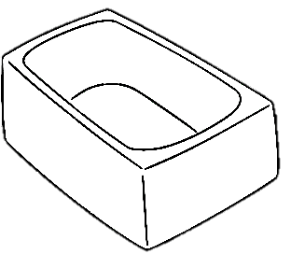
A swimming pool is not just a bigger bathtub
@LlewellynFalco

Slide 2
Bathtub
a tank or artificial basin filled with water

Slide 3
Swimming Pool
a large tank or artificial basin filled with water
larger

Slide 4
Swimming Pool
a tank or large artificial basin filled with water

Slide 5
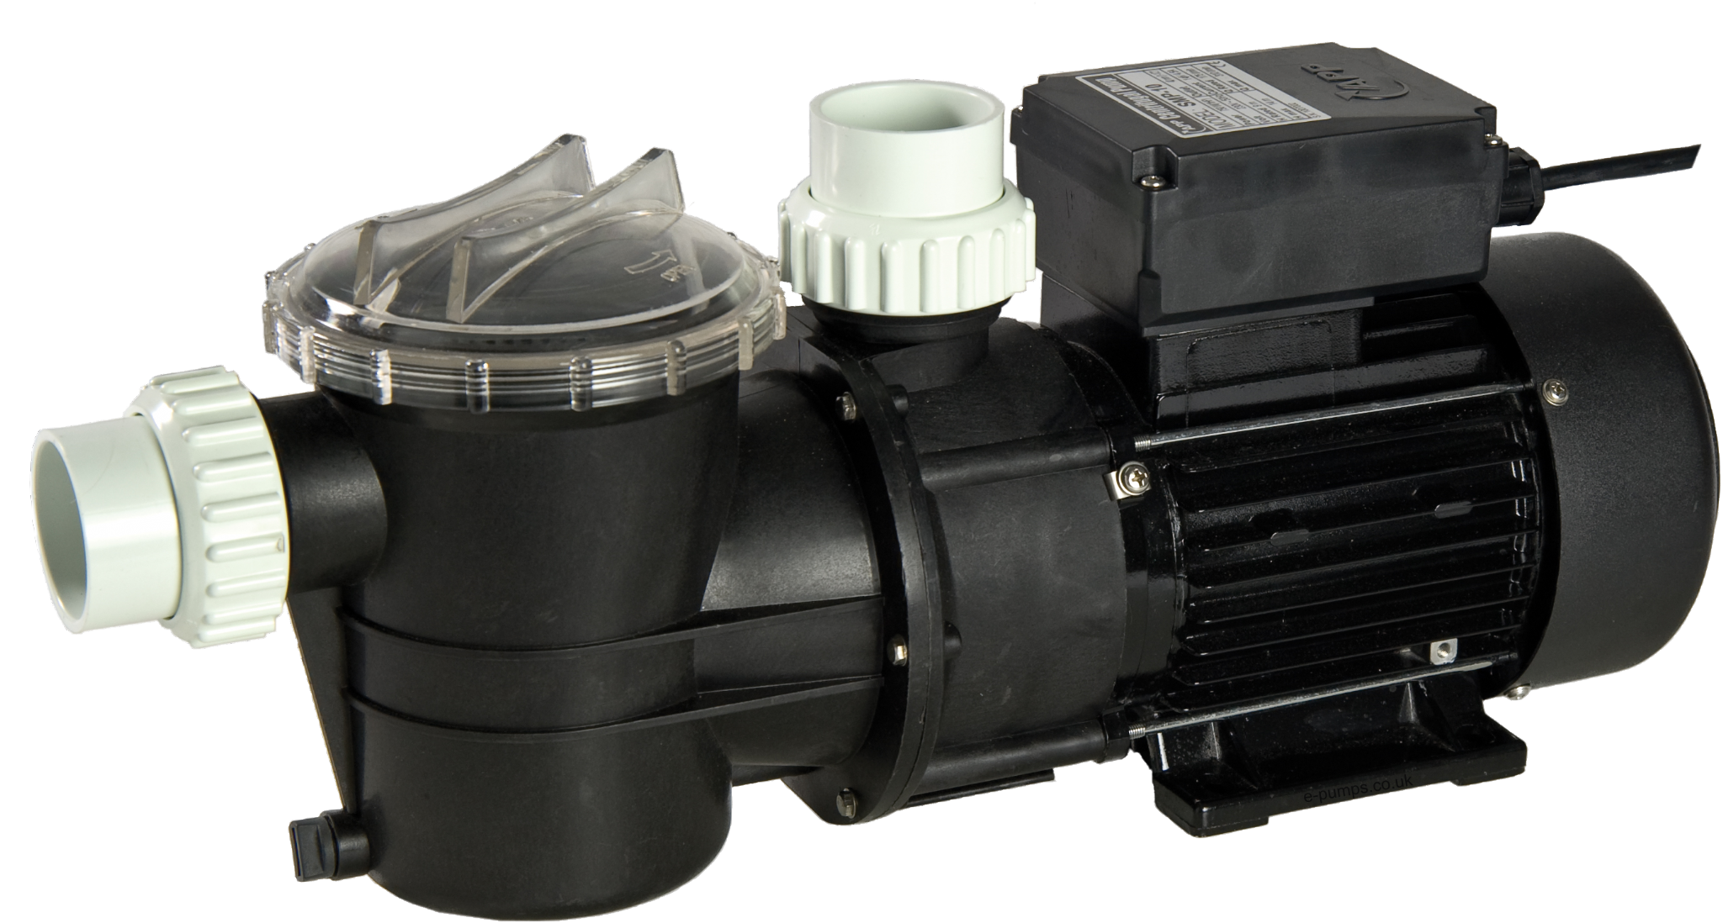
PoolPump

Slide 6

Swimming

Slide 7

Pool Party

Slide 8

Diving Board

Slide 9
Good Point!
Who Cares?

Slide 10
Virtual machine vs. Docker

Slide 11
Sprints Releases vs. Continuous Deployment

Slide 12
Test First vs. Test After

Slide 13

Thank YOU (please connect via LinkedIn and Twitter)
@LlewellynFalco
youtube.com/isidoreus
LlewellynFalco.Blogspot.com approvaltests.com

