Slide 1
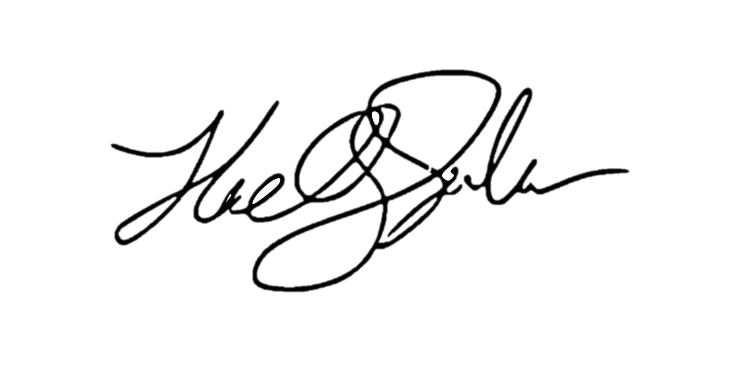
The Lift If Refactoring
- a way to separate threads of logic
&
Llewellyn Falco

Slide 2
The Lift If Refactoring
- a way to separate threads of logic
Step 1
- get 100% code coverage
Llewellyn Falco

Slide 3
The Lift If Refactoring
- a way to separate threads of logic
Step 2
- clone into both sides of an if/else
if ( true )
{
}
else
{
}
Llewellyn Falco

Slide 4
The Lift If Refactoring
- a way to separate threads of logic
Step 3
- set the condition to the thread you want to isolate
if ( true )
{
}
else
{
}
if ( )
{
}
else
{
}
Llewellyn Falco

Slide 5
{
The Lift If Refactoring
- a way to separate threads of logic
Step 4
- Run w/code coverage
if ( ) )
{
}
else
{
}
The uncovered lines are not needed to complete the yellow path.
if ( )
{
}
else
{
}
Llewellyn Falco

Slide 6
The Lift If Refactoring
- a way to separate threads of logic
Step 5
- delete the red
if ( )
{
}
else
{
}
if ( )
{
}
else
{
}
Delete the uncovered lines The remaining is the yellow path.
Llewellyn Falco

Slide 7

The Lift If Refactoring
- a way to separate threads of logic
&
See in in action: lfal.co/liftif
Llewellyn Falco

