Slide 1
A newspaper is better than a magazine

Slide 2
A seashore is a better place than the street.

Slide 3
At first it is better to run than to walk

Slide 4
You may have to try several times. It takes some skill, but it is easy to learn. Even young children can enjoy it.

Slide 5
Once successful, complications are minimal. Birds seldom get too close

Slide 6
Rain, however, soaks in very fast

Slide 7
Too many people doing the same thing can also cause problems. One needs lots of room.

Slide 8
If there are no complications, it can be very peaceful.

Slide 9
A rock will serve as an anchor.

Slide 10
If things break loose from it, however, you will not get a second chance.
* On Being Certain by Robert A Burton, M.C.

Slide 11
“the curse of knowledge”
or
The importance of context

Slide 12
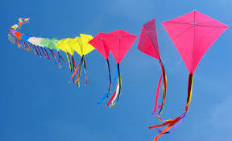

Slide 13
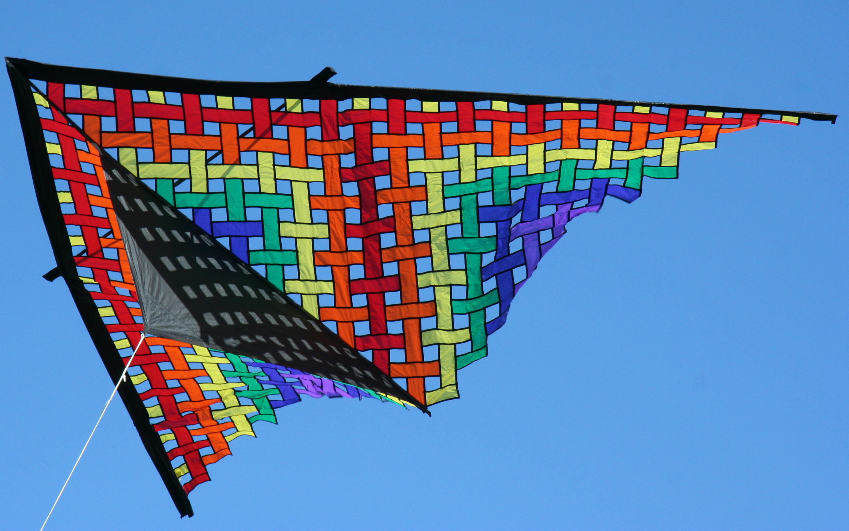

Slide 14
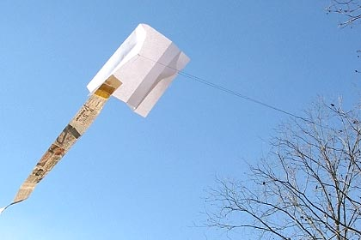

Slide 15
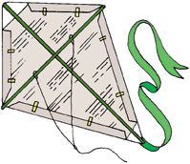
A newspaper is better than a magazine

Slide 16
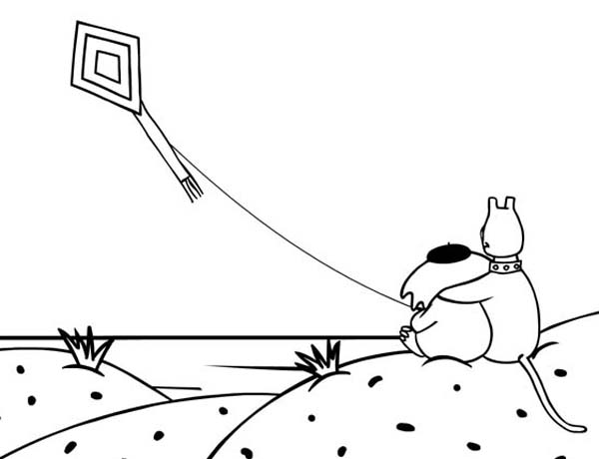
A seashore is a better place than the street.

Slide 17

At first it is better to run than to walk

Slide 18
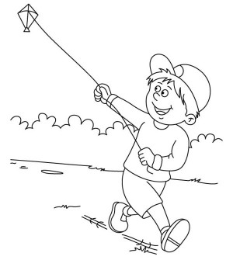

You may have to try several times. It takes some skill, but it is easy to learn. Even young children can enjoy it.

Slide 19

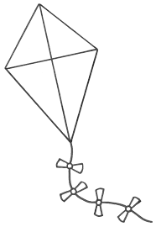
Once successful, complications are minimal. Birds seldom get too close

Slide 20
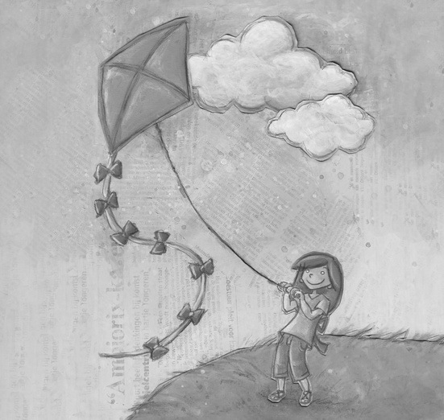
Rain, however, soaks in very fast

Slide 21
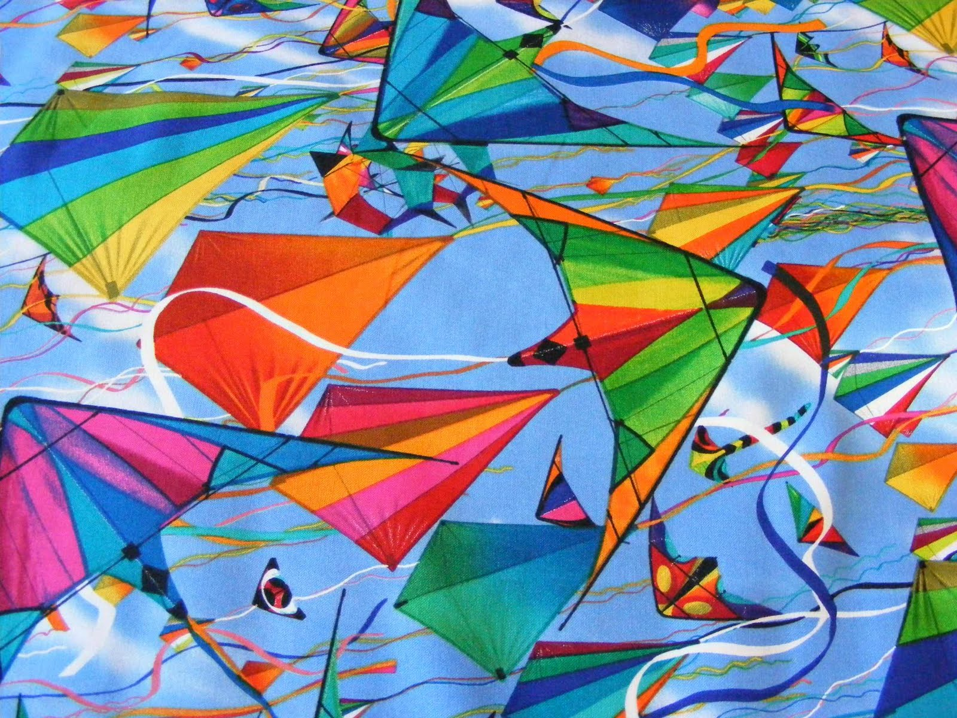
Too many people doing the same thing can also cause problems. One needs lots of room.

Slide 22
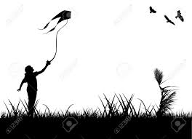
If there are no complications, it can be very peaceful.

Slide 23
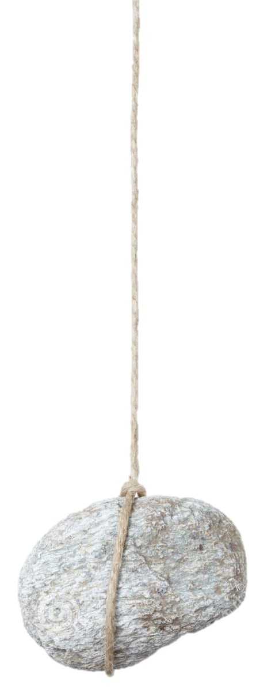
A rock will serve as an anchor.

Slide 24
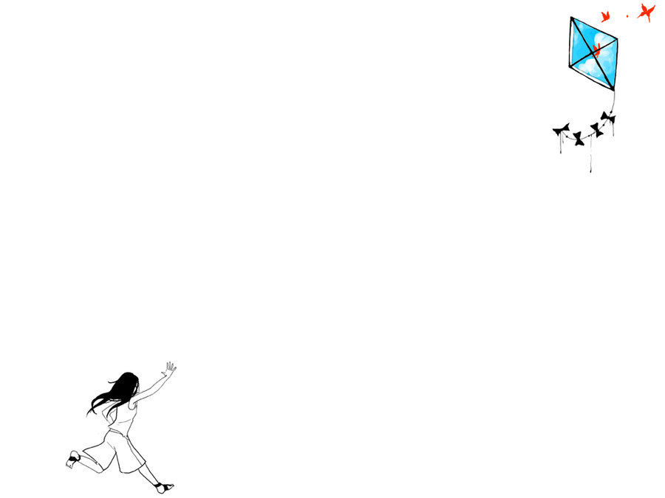
If things break loose from it, however, you will not get a second chance.

Slide 25
I hope that makes sense (now)
@LlewellynFalco

