Slide 1


Slide 2
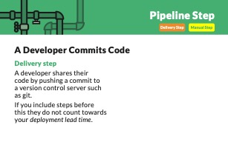

Slide 4
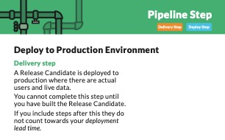

Slide 6
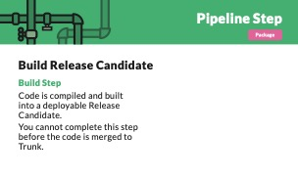

Slide 8
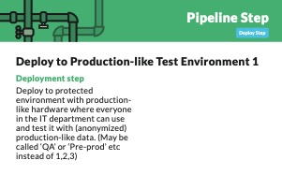

Slide 10


Slide 13

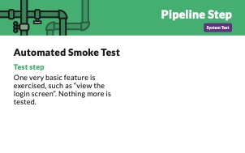
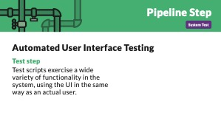
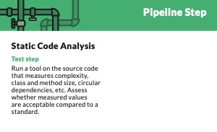
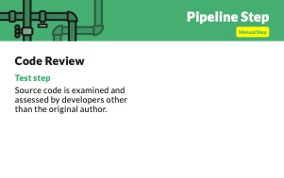
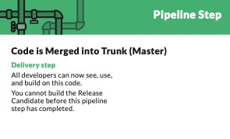
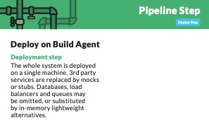
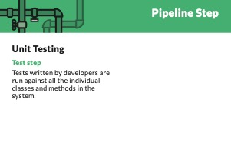
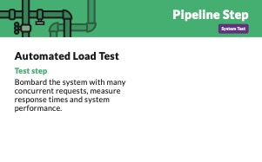
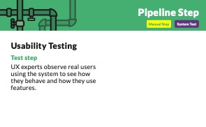

Slide 14
1 < 2 Minutes 2 < 15 Minutes 3 < 1 hour 4 < 6 Hours 5 < ∞

Slide 15
1 < 2 Minutes 2 < 15 Minutes 3 < 1 hour 4 < 6 Hours 5 < ∞
1

Slide 16
1 < 2 Minutes 2 < 15 Minutes 3 < 1 hour 4 < 6 Hours 5 < ∞
1

Slide 17
www.praqma.com/stories/pipeline-card-game/

Slide 18

Thanks!
Please connect on
LinkedIn & Twitter
@LlewellynFalco
llewellynfalco.blogspot.com
Presentation template by SlidesCarnival

Slide 19
SlidesCarnival icons are editable shapes.
This means that you can:
Resize them without losing quality.
Change line color, width and style.
Isn’t that nice? :)
Examples:

