Slide 1
Provable Refactoring by Inverse R(R⁻¹(code))

Slide 2
Provable Undos

Slide 3
Ctrl + Z is a valid refactoring

Slide 4
Safety First

Slide 5
The identity refactoring

Slide 6
public void updateQuality() {
for (int i = 0; i < items.length; i++) {
Item item = items[i];
updateQuality(item);
}
}
private void updateQuality(Item item)
{
updateAgain(item);
}
private void updateAgain(Item item)
{
if (!item.name.equals("Aged Brie")
&& !item.name.equals("Backstage passes to a TAFKAL80ETC concert")) {
if (item.quality > 0) {
if (!item.name.equals("Sulfuras, Hand of Ragnaros")) {
item.quality = item.quality - 1;
}
}

Slide 7
Do nothing

Slide 8
public void updateQuality() {
for (int i = 0; i < items.length; i++) {
Item item = items[i];
updateQuality(item);
}
}
private void updateQuality(Item item)
{
updateAgain(item);
}
private void updateAgain(Item item)
{
if (!item.name.equals("Aged Brie")
&& !item.name.equals("Backstage passes to a TAFKAL80ETC concert")) {
if (item.quality > 0) {
if (!item.name.equals("Sulfuras, Hand of Ragnaros")) {
item.quality = item.quality - 1;
}
}

Slide 9


Slide 10
Provable
A
≈
A’

Slide 11
A
A

Slide 12
Provable Refactoring
via
Tooling

Slide 13
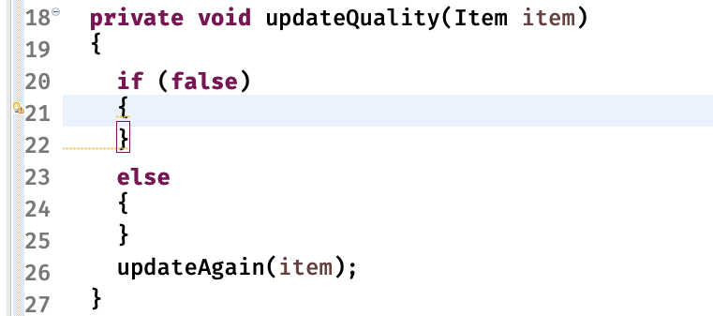

Slide 14
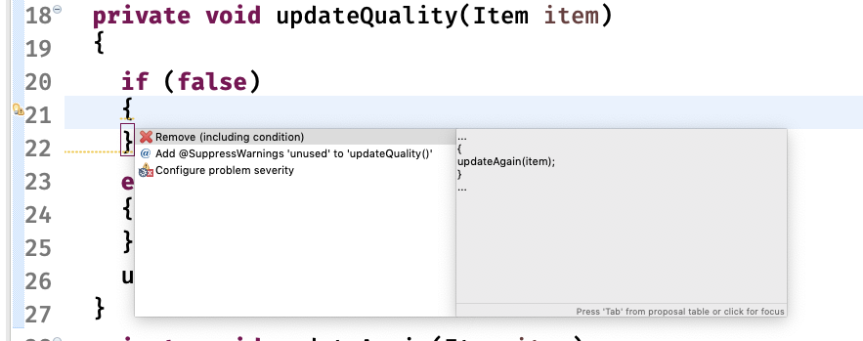

Slide 15
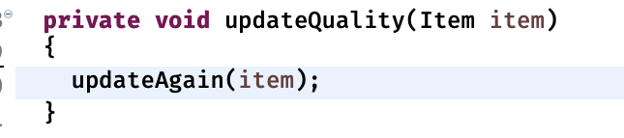

Slide 16
Provable
A
≈
A’

Slide 17
Provable Inverse Refactoring

Slide 18
private void updateQuality(Item item)
{
updateAgain(item);
}

Slide 19
private void updateQuality(Item item)
{
if (false)
{
}
else
{
}
updateAgain(item);
}

Slide 20
?!?!
A
A’

Slide 24
A
A’
≈
A’’
Provable

Slide 26
Provable
A
A’
≈
A’’
Provable

Slide 27
Provable
A
≈
A’
Provable

Slide 29
Create Check Point
Do unprovable refactoring
Undo Via provable refactoring
Verify identical to check point
Undo

Slide 30
THANKS!
Any questions?
You can find me at
@LlewellynFalco
LlewellynFalco.BlogSpot.com
Presentation template by SlidesCarnival

Slide 31
SlidesCarnival icons are editable shapes.
This means that you can:
Resize them without losing quality.
Change line color, width and style.
Isn’t that nice? :)
Examples:

