Slide 1
Learnathon 3.0
Pitch Deck

Slide 2
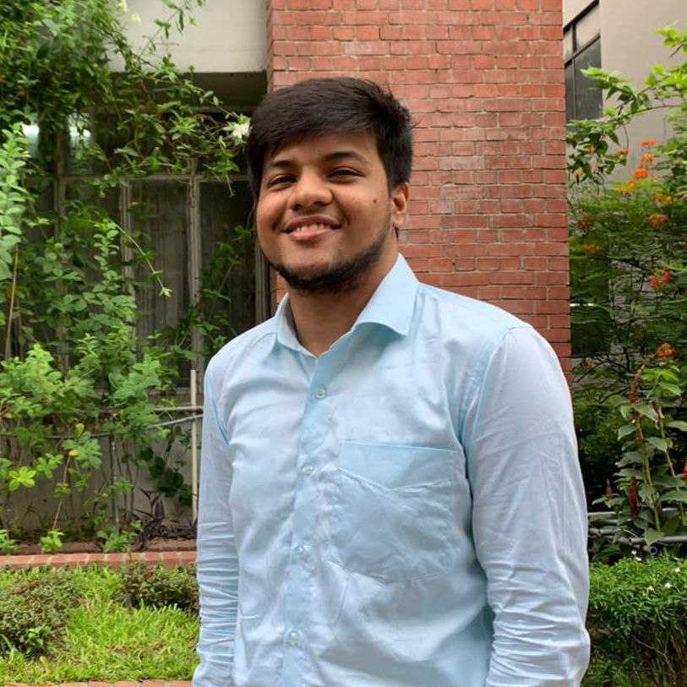
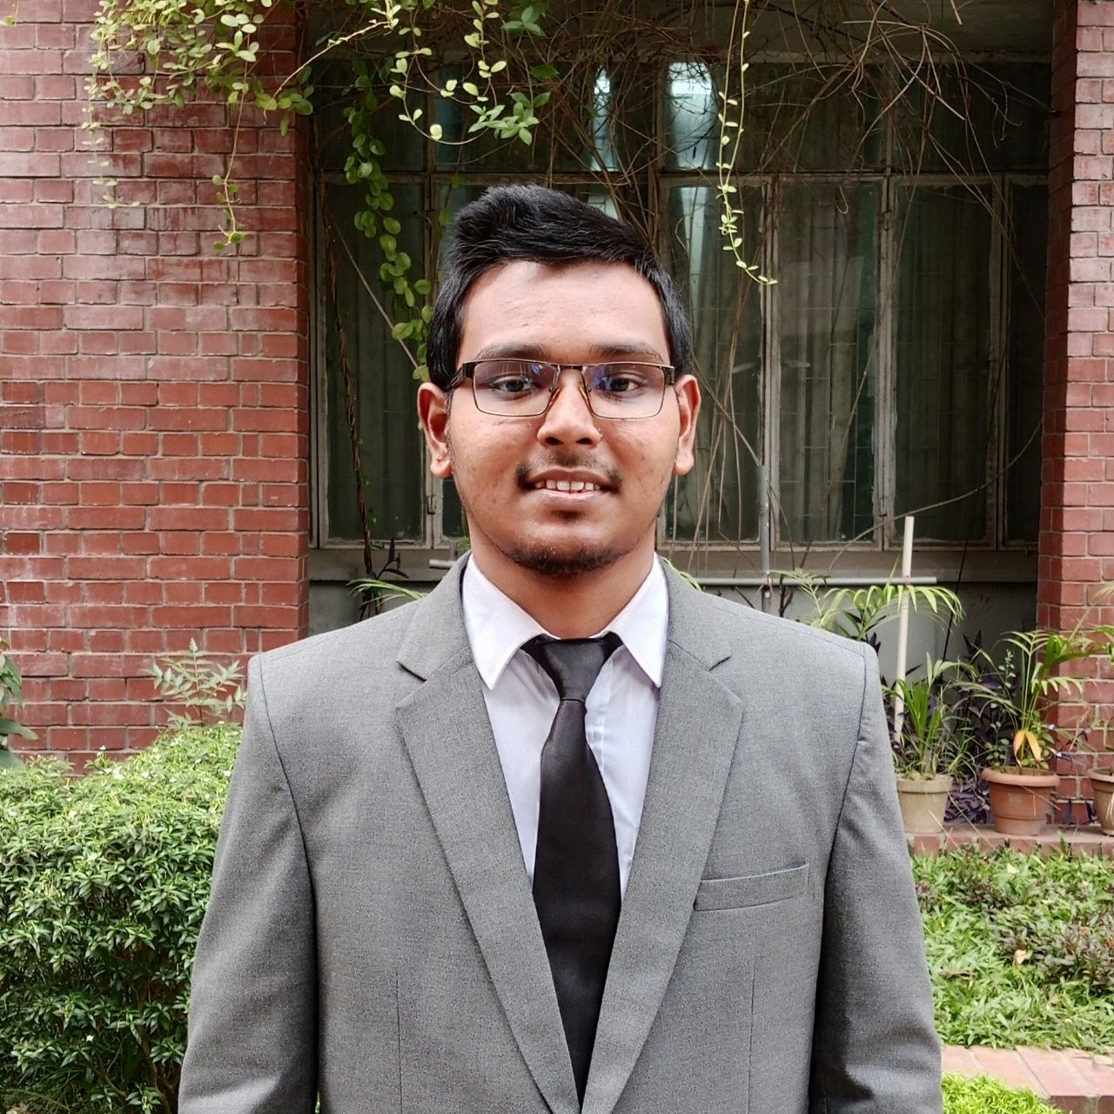
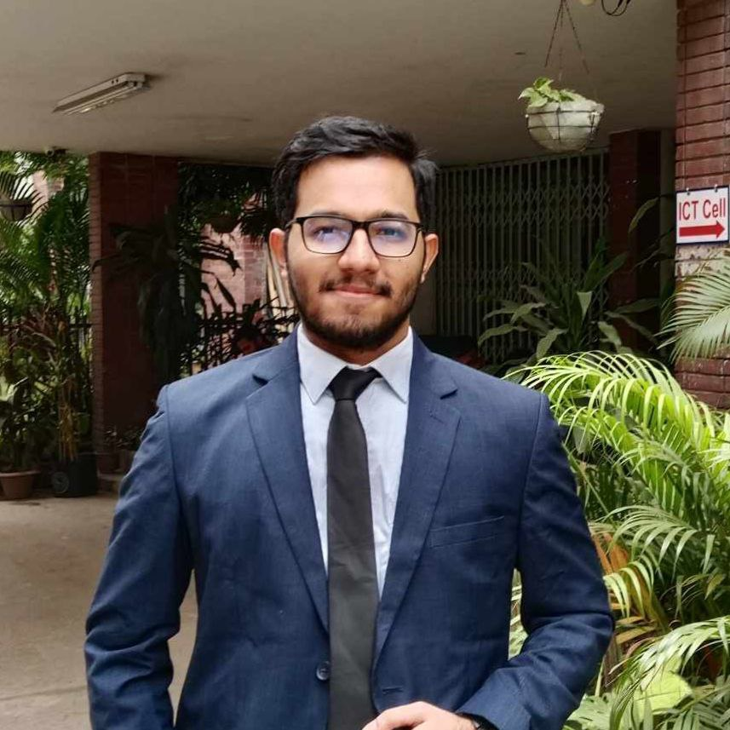
Team React_ive
Team Leader
Team member 1
Team member 2
Shahid-E-Kaiser Md. Tashrif
tashrifpro@gmail.com
3rd Year, 5th Semester
Software Engineering, DU
Mohammad Ismail Hossain
bsse1433@iit.du.ac.bd
3rd Year, 5th Semester
Software Engineering, DU
Nandan Bhowmick
nandanbhow123@gmail.com
3rd Year, 5th Semester
Software Engineering, DU

Slide 3
Project Name:
DU Tutors - Connecting DU Students with Guardians for Tuition Opportunities
Project overview:
DU Tutors is an online platform that connects Dhaka University students with guardians seeking tuition. Students can create profiles to showcase their teaching skills, while guardians can post tuition needs. Features include real-time messaging, personalized search filters, and a rating system. Built with the MERN stack, it ensures smooth user authentication, post management, and easy navigation for finding the perfect tutor.

Slide 4
Core Features
User Authentication
Student Registration
Guardian Registration
Profile Management
Student Profiles
Guardian Profiles
Search and Filter System
For Students
For Guardians
Post Management
Student Posts
Guardian Posts

Slide 5
Additional Features
Real-time Chat System
Application and Approval System
Rating and Review System
Notification System
Favorite/Bookmark Feature

Slide 6
Optional Advanced Features
Location-Based Search
Admin Panel
AI-based Matching
Favorite/Bookmark Feature

Slide 7
Development Technology & Tools
Frontend: React
Backend: Node.js + Express
Database: MongoDB

Slide 8
Questions
Which collaborative tools will be good for us?
Is our project feasible for a short time period of 3-4 months?
How can we reach this event’s ending with a good impression?
How can we effectively differentiate ourselves from other competitors?
What will be our communication medium?

Slide 9
Thank You

