Slide 1
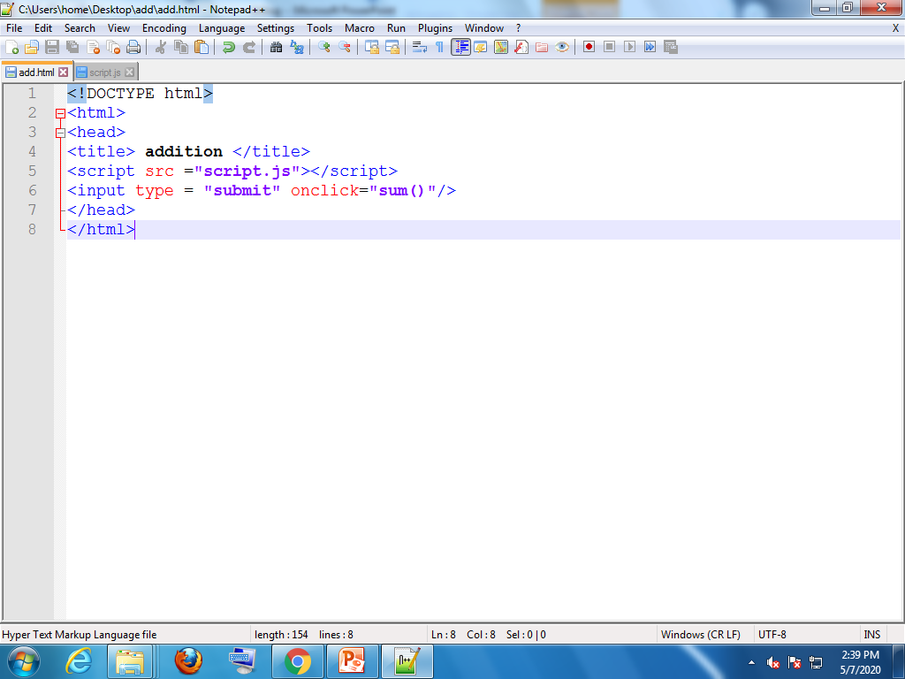
DATE : 07-05-2020
DEBUGGING
It is the process of detecting and removing errors in a program.
Here in javascript, we can debug using different browsers like chrome, Firefox, Safari etc.
Now lets see debugging in Chrome browser.
We use developer tools to debug the code. There are two ways to open the developer tools. They are (i) by clicking the F12 key on the keyboard. (ii) by clicking on “customize and control chrome” which is on the top right corner of the window and then go to “more tools” and then select “developer tools”.

Slide 2
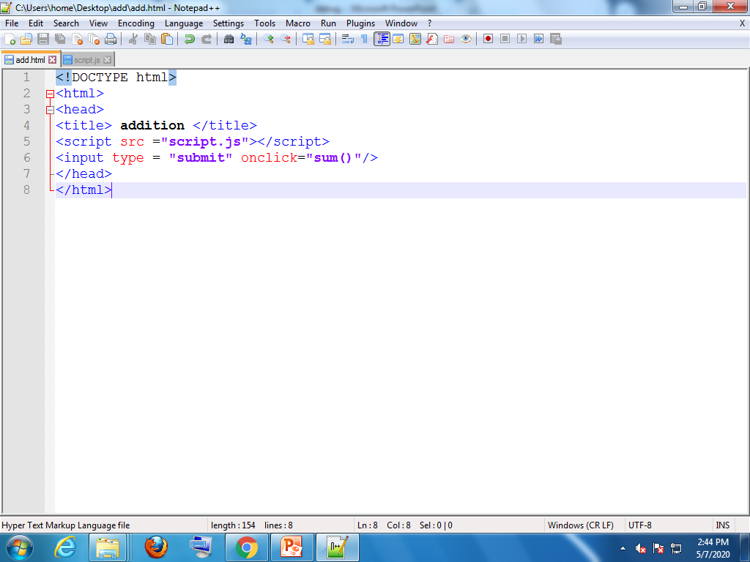
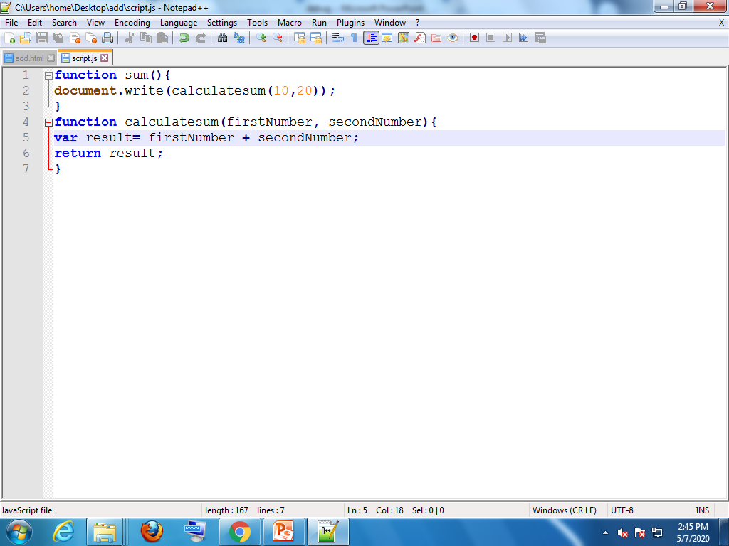
Here are the two files of a addition program with no errors and shows the output on clicking submit
HTML file
.JS file

Slide 3
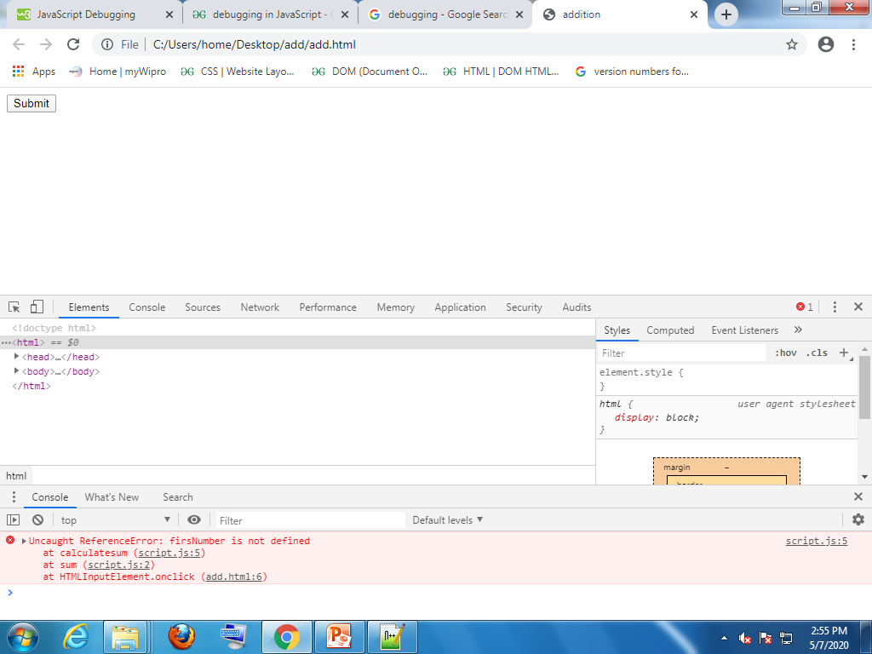
Now, make any error in the program it will not show output on clicking submit also, then go for debugging. Press F12 on keyboard.
Show no.of errors
Shows in which file the error is, then click on that

Slide 4
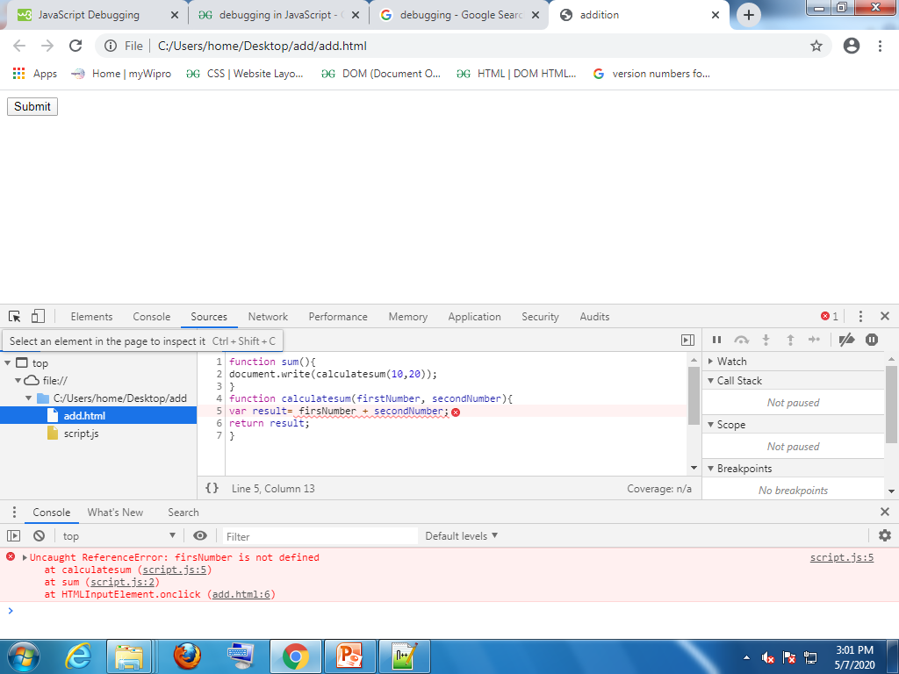
Shows the error in CONSOLE tab and the code is displayed in the SOURCES tab. And the error is “firsNumber is not defined” as shown.. Go to code ad fix the error

Slide 5
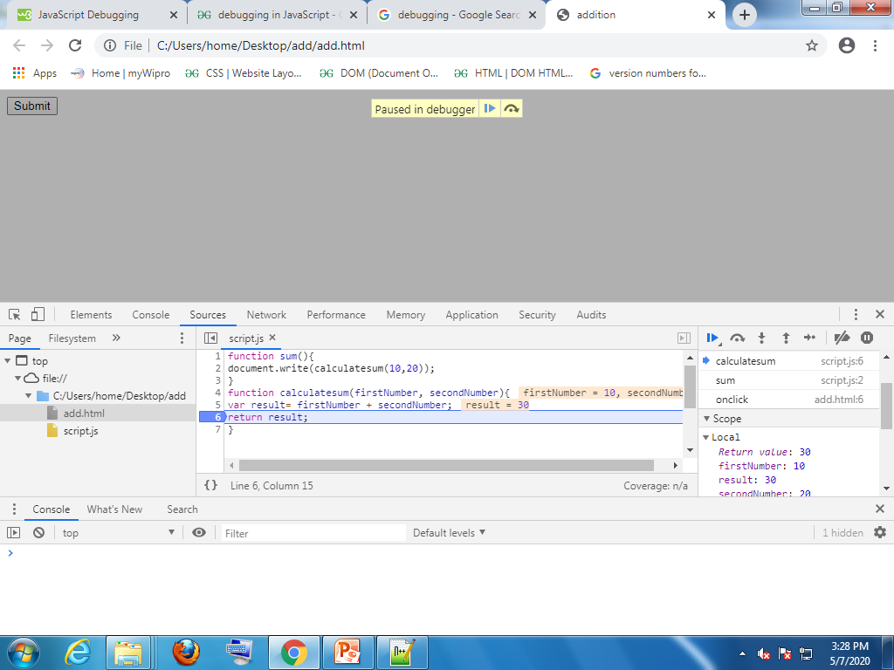
We can put “breakpoint” simply by clicking on the line numbers as shown below. When we keep breakpoint and when we run the code it will run up to the breakpoint and will be pause there.
Breakpoint at line:6

Slide 6
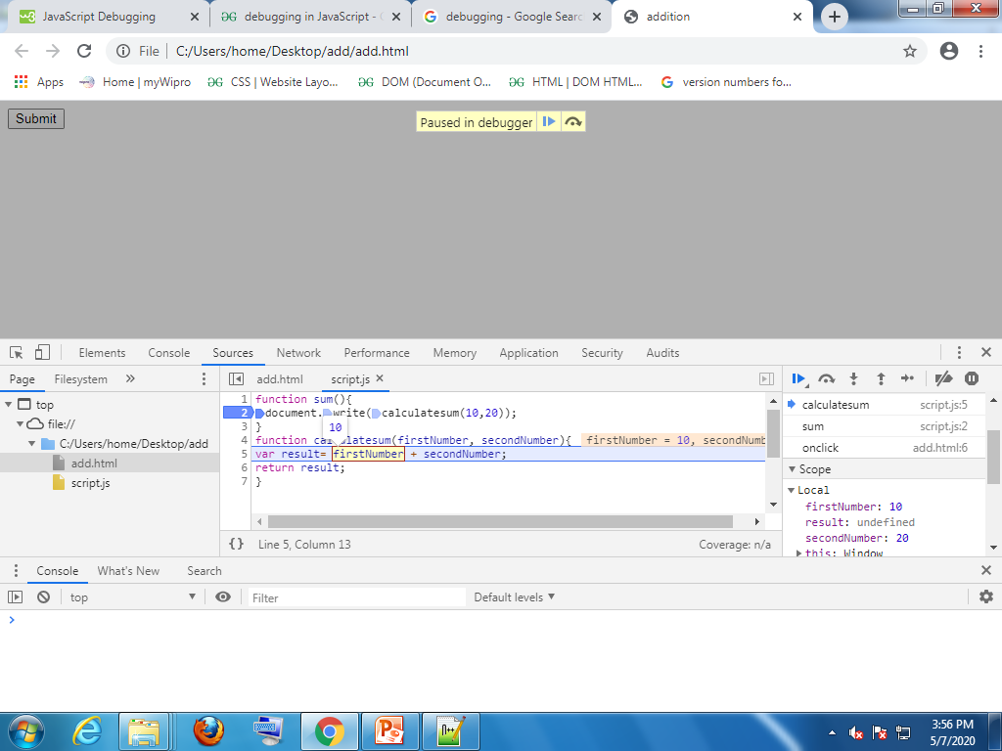
Along with putting breakpoint, there are also other functions, they are
F10--- Step over the next function call
F11---Step into the next function call
Shift+F11---Step out of the current function
F8---continue the execution
By preesing F11 key at line 2, it steps into the next function as shown above

